Slide 1
The adventures of Wimiky
Kyle Hodge
Michael Hawk
William Holley

Slide 2
Problem Statement
For our project we have been tasked to create an Interactive game in HTML/CSS.

Slide 3
Solution
We have decided to create an interactive Adventure Game using html. To style our game we will primarily use css and its corresponding elements, e.g. blink.

Slide 4
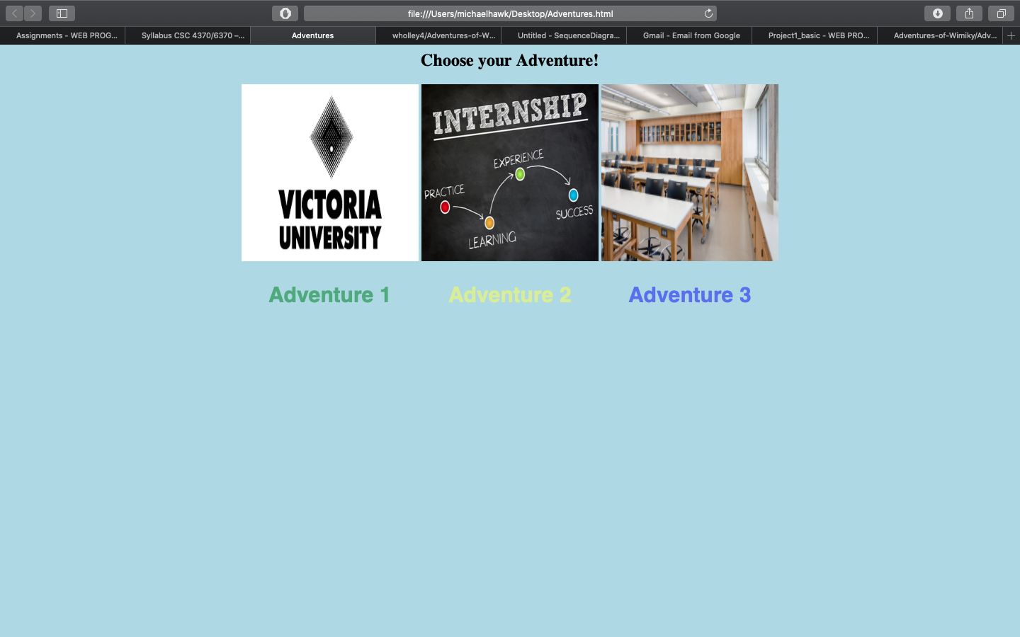
UI Example

Slide 5
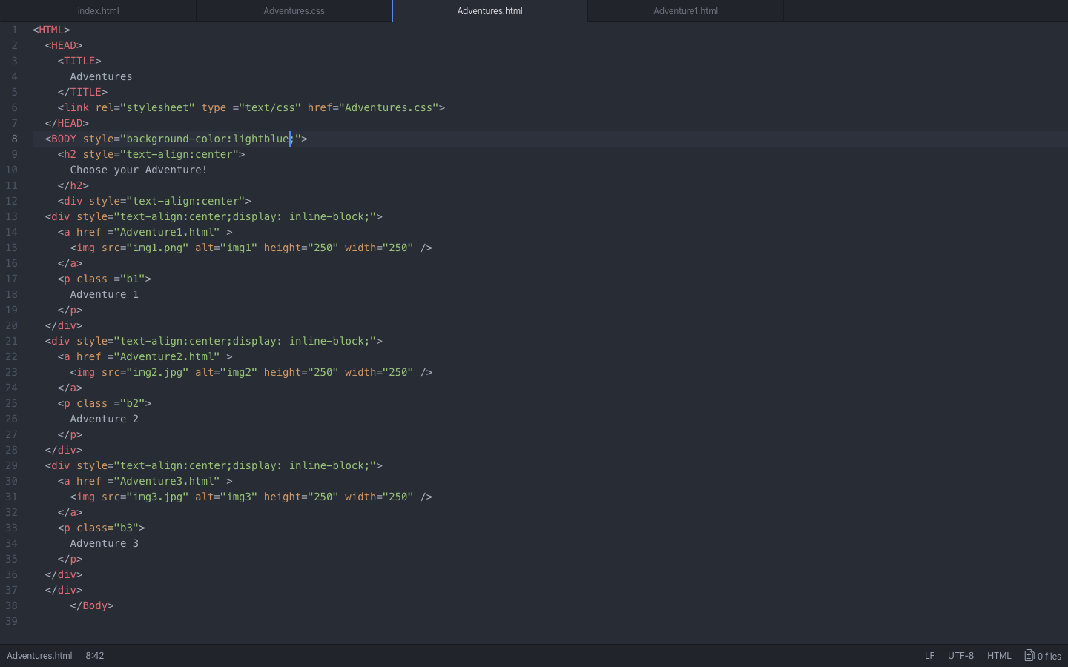
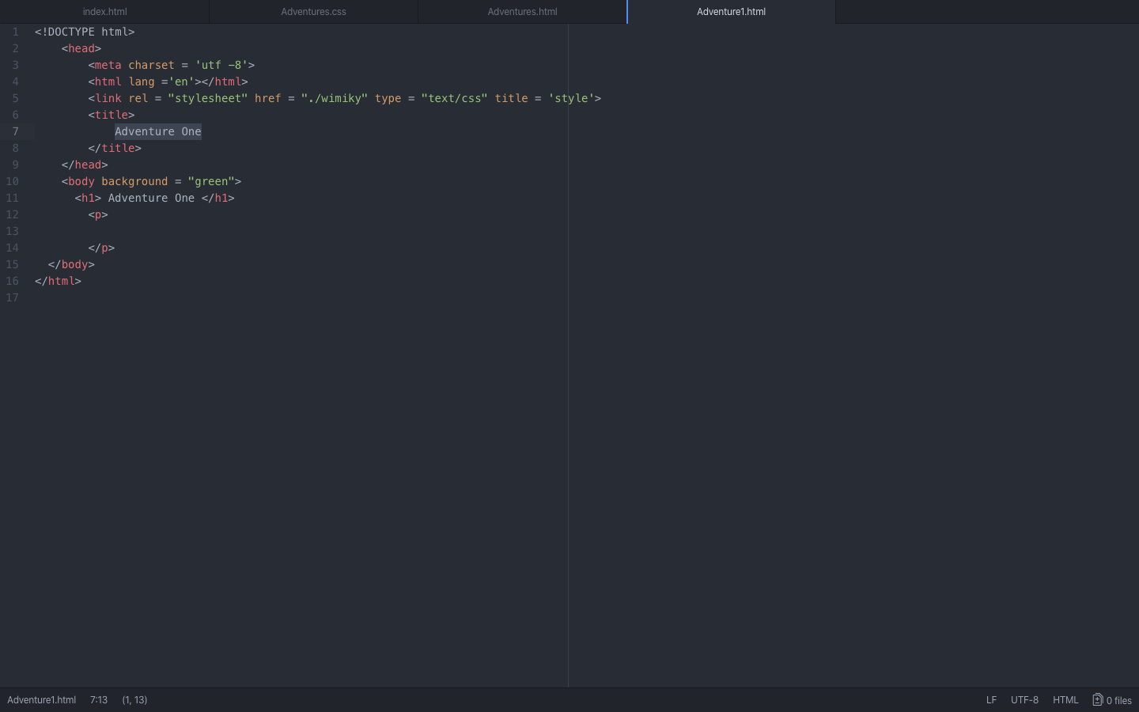
Example Code

Slide 6
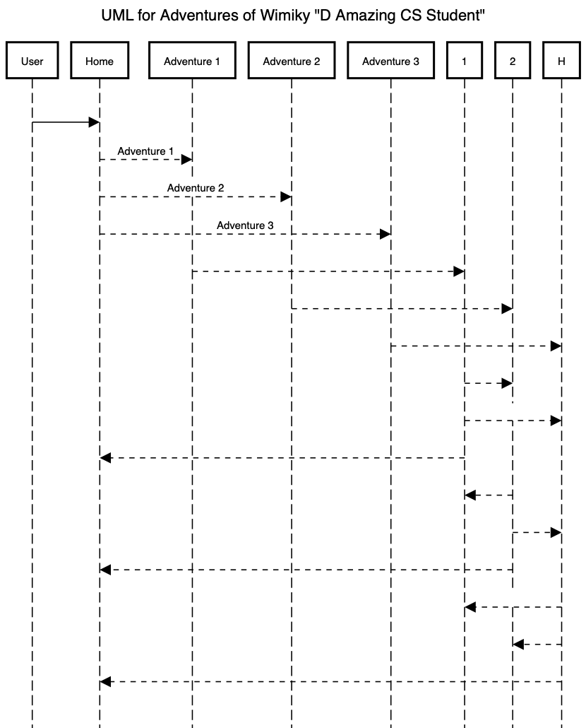
UML DIagram

Slide 7
Video Demonstration
https://www.youtube.com/channel/UCDPpSSpiZfgiDDXTWYx3KiA/

Slide 8
Q & A ?

