Slide 1
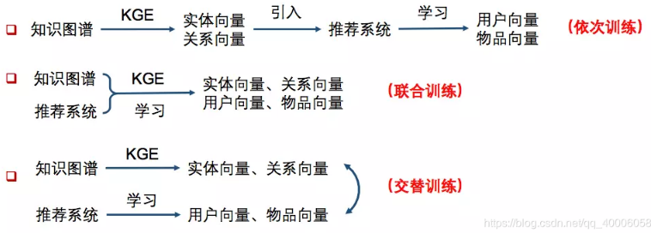
基于知识图谱特征表示的推荐系统

Slide 2
基于知识图谱特征表示的推荐系统
依次训练的方法主要有：Deep Knowledge-aware Network(DKN)
联合训练的方法主要有：Ripple Network
交替训练主要采用multi-task的思路，主要方法有：Multi-task Learning for KG enhanced Recommendation (MKR)

Slide 3
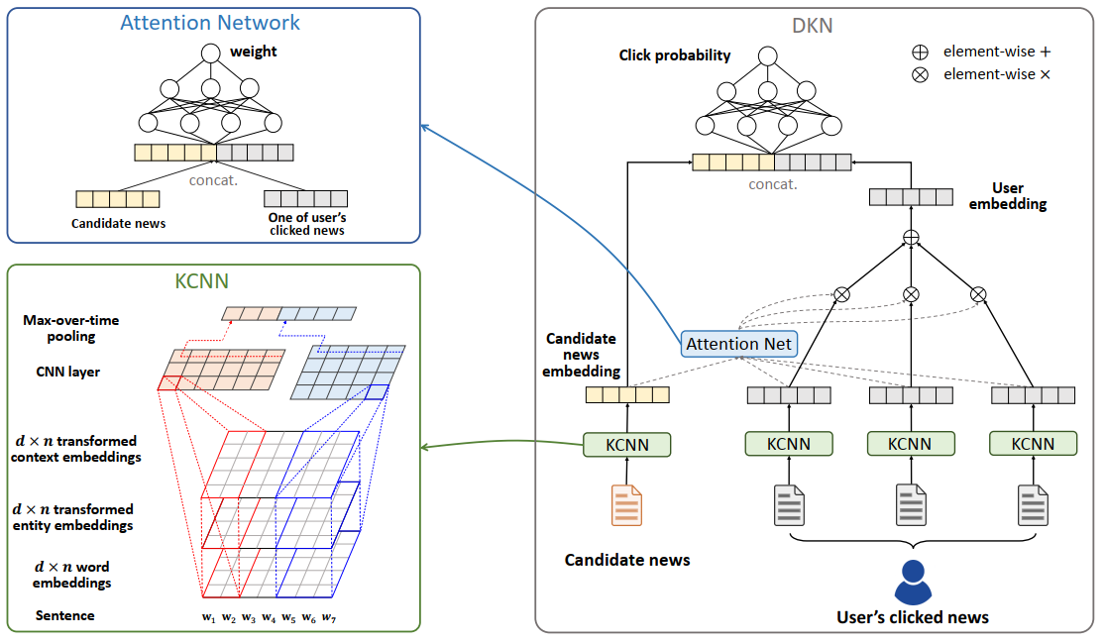
Deep Knowledge-aware Network(DKN)

Slide 4
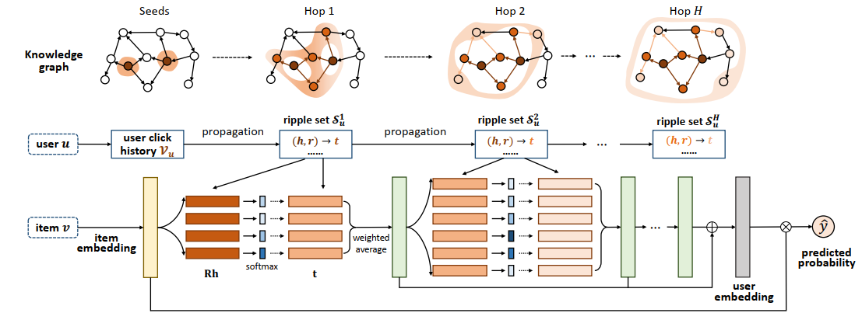

RippleNet: Propagating User Preferences on the Knowledge Graph for Recommender Systems

Slide 5
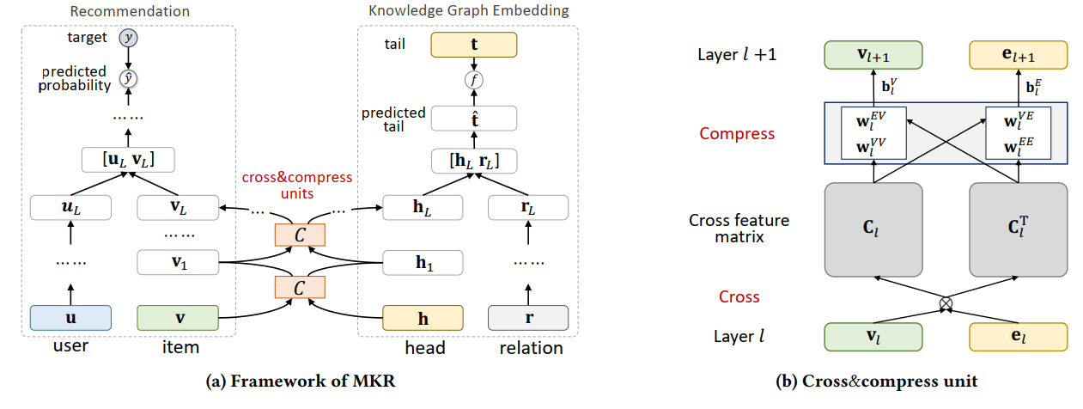
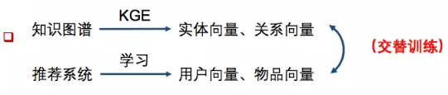
Multi-Task Feature Learning for Knowledge Graph Enhanced Recommendation

