Slide 1
Connect Four
Majid Aghayev 211ADB088
Eltaj Abbasov 211ADB072

Slide 2
About Connect Four
Objective : The main goal is to line up four discs of the same color in a row—horizontally, vertically, or diagonally—to win the game.
Players : Two players alternate turns to drop colored discs into a 7-column, 6-row grid.
Game: Discs will occupy the lowest available space in the chosen column.
Game result: The winner is the first player to connect four discs in a row, or if the grid is completely filled and no player has aligned four discs, the game ends in a draw.

Slide 3
Connect Four Implementation Requirements
Game Interface:
Allow players to drop discs into columns.
Provide a real-time view of the game state.
Implement the rules of Connect Four.
Ensure the design is responsive and adapts to different screen sizes.
Game State Management:
Manage and update the game state continuously.
Store the positions of the discs on the grid.
Handle turns between players.
Additional Features:
Option to restart the game.
Disk color selection for players.

Slide 4
Used Technologies
Languages:
Python (with Tkinter for the GUI)
Testing Frameworks:
unittest
pytest

Slide 5
Testing
Conducted Black Box Testing.
Performed Visual Testing.
Performed Unit Testing in Python
Tested program functionalities through manual and automated methods.

Slide 6
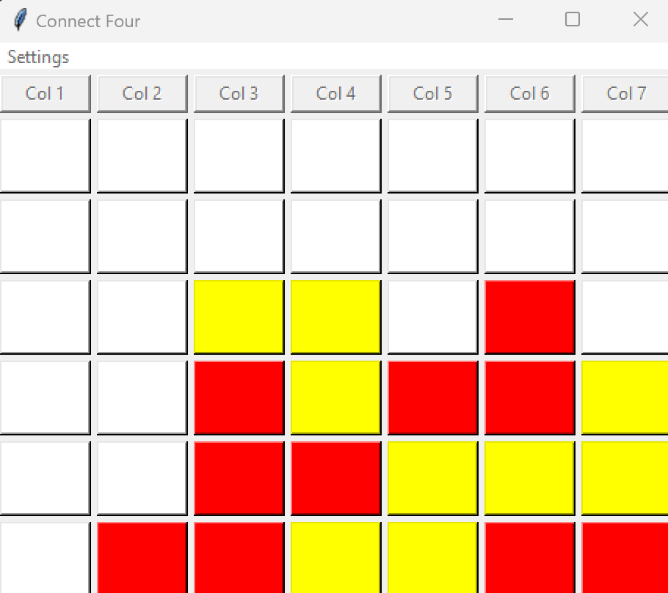
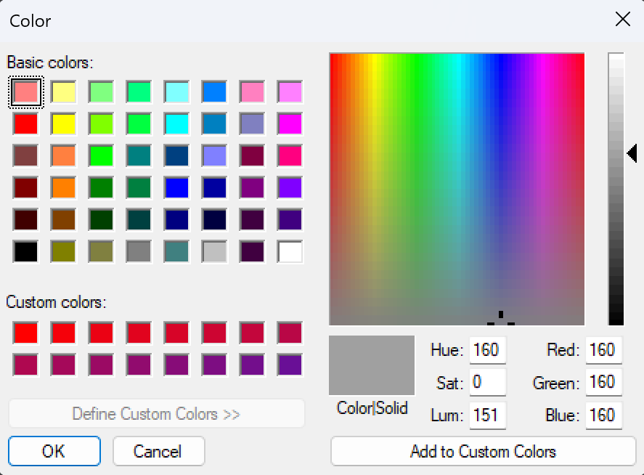
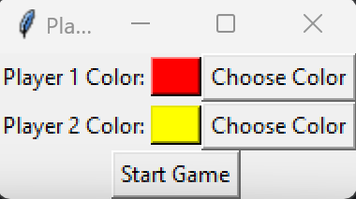
Graphic User Interface

Slide 7

GitHub Link with application code and report
GitHub Link : https://github.com/whoseltaj/DIP392-LogBaiters

Slide 8

Thanks for sticking with us till the end.

