Slide 1
DSA PROJECT text editor
BY :- SHUBHAM KUMAR

Slide 2
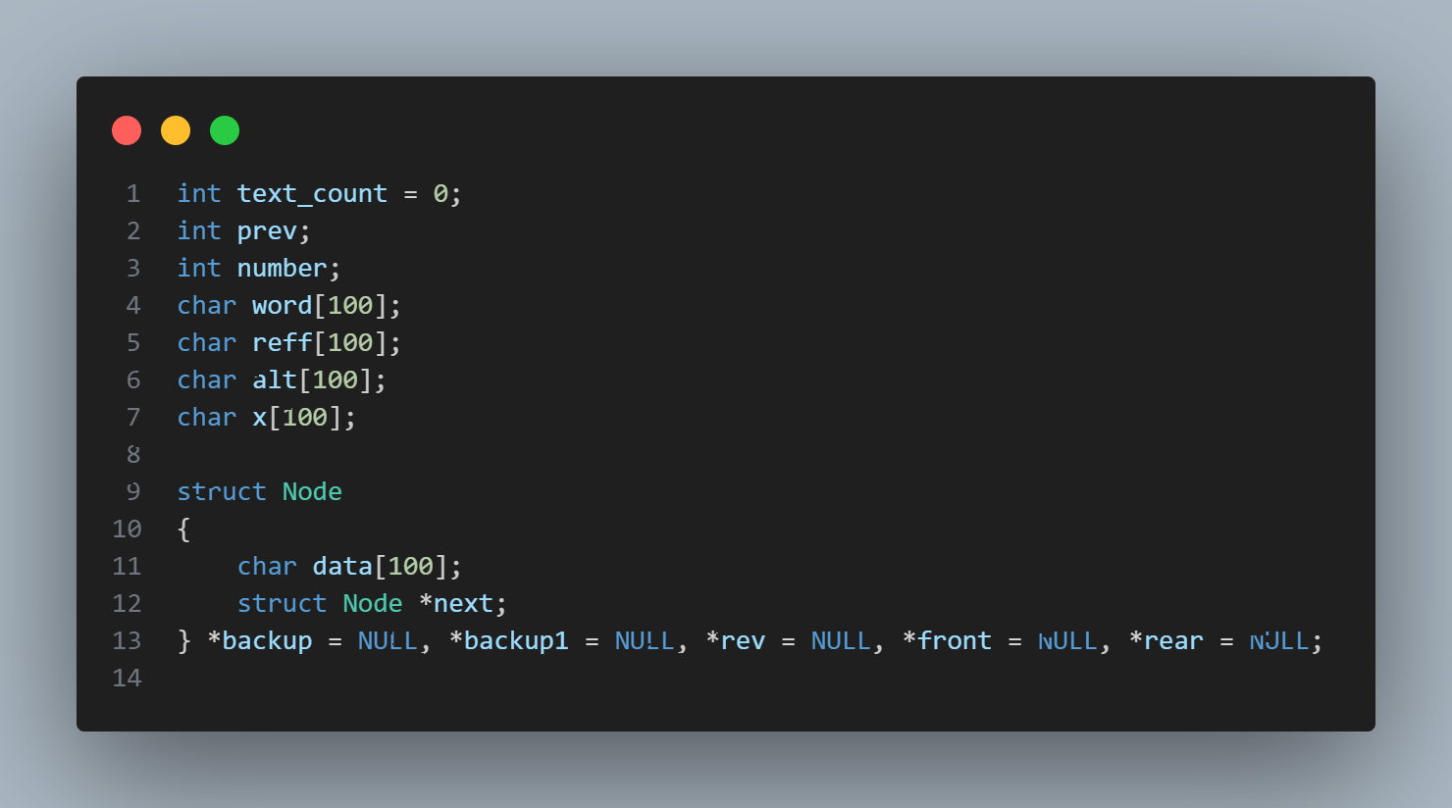
Structure and Global Variables
text_count is stores number of words in text
prev stores last operation performed
prev = 1 for delete operation
prev = 2 for replace operation
number stores the place of the word replaced
word, reff, x and alt stores tempory string
Backup, backup1 and rev are stack
Front and rear are used for queue which stores main text

Slide 4
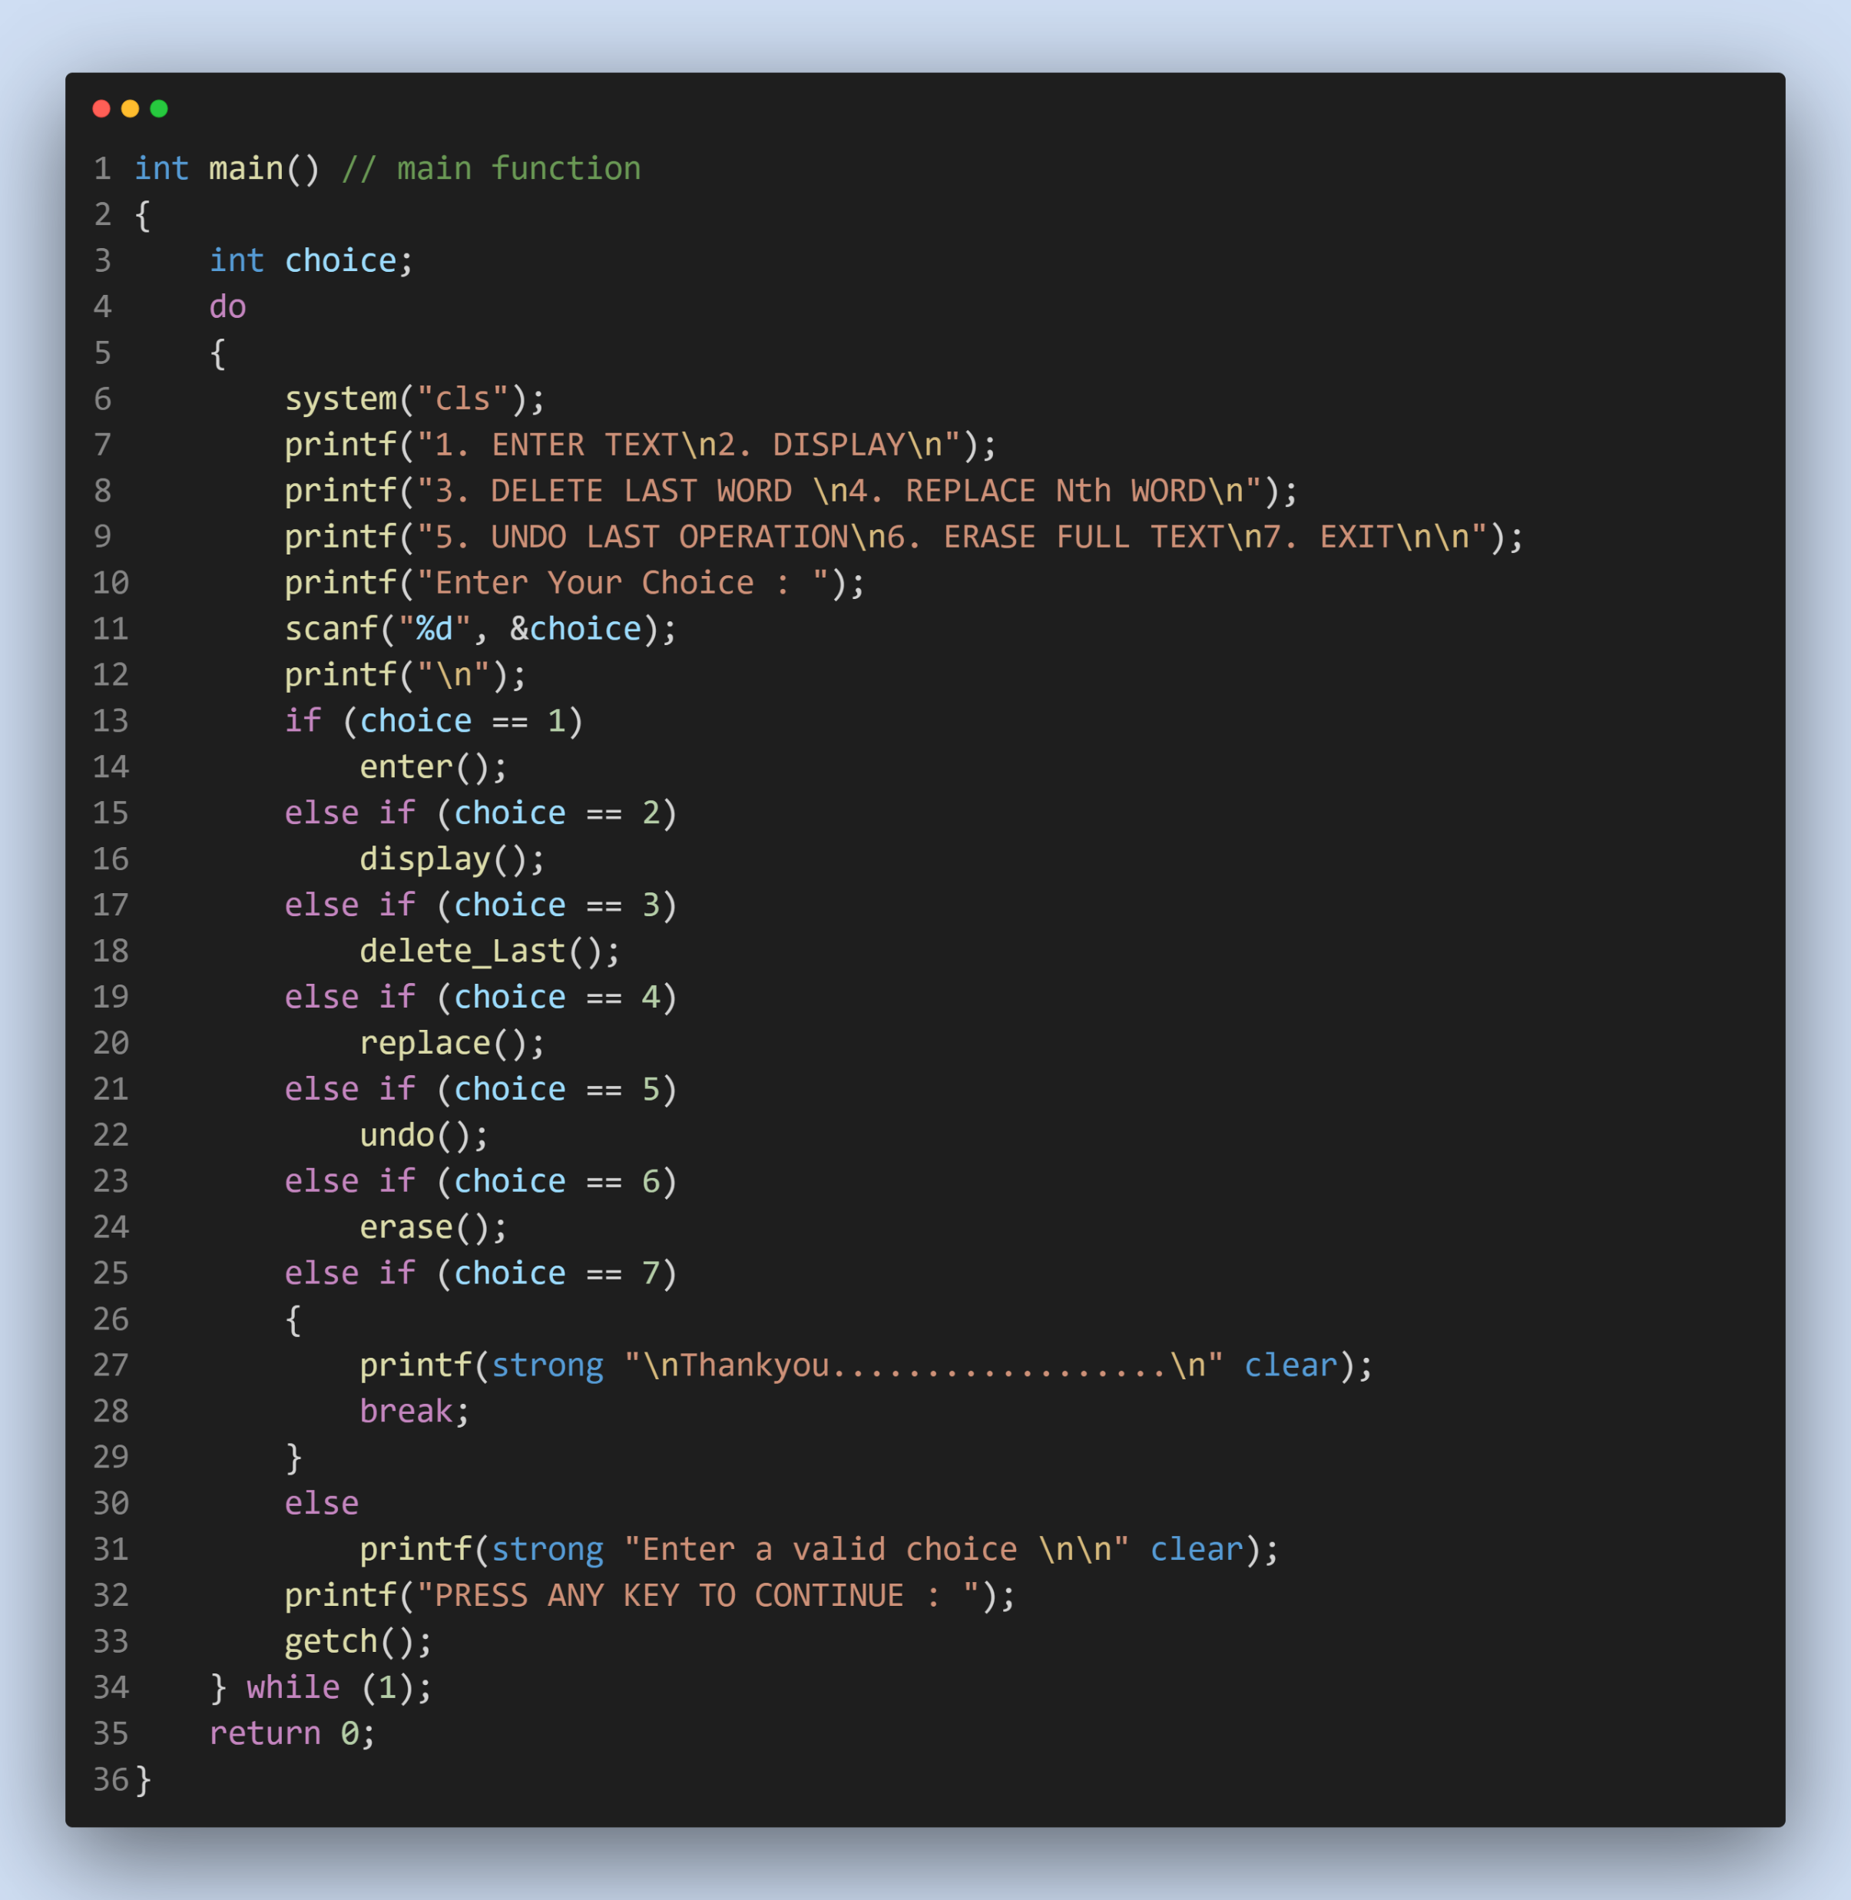
Main Function
The Main function provides the choices for running the different
operations programmed in code
It uses the switch case statement for this purpose.
Do while loop is used to run program repeatedly, also system(“cls”)
is used to clear previous output.
Main Function comprises of 7 functions :
Enter
Display in bold / italic / underlined form
Delete last word
Replace Nth word
Undo last operation
Erase all text
Exit

Slide 5
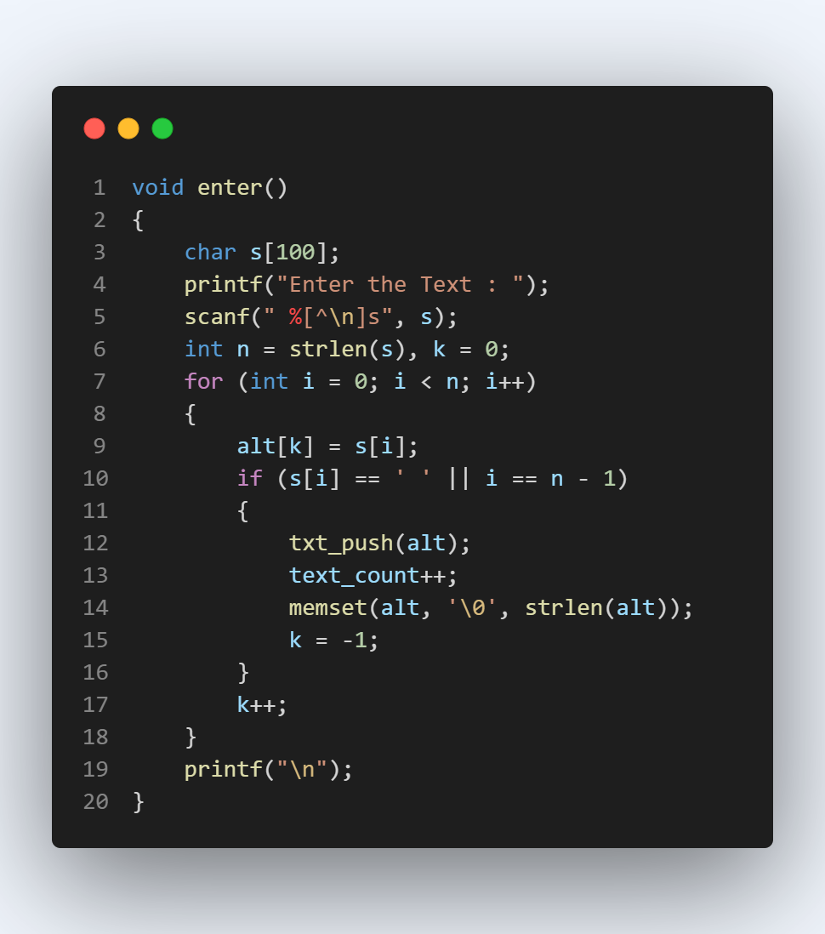
Structure and Global Variables

Slide 6
Enter Function
In enter function we are taking text input and storing it in Queue
In this function we are using txt_push() function which
enqueues your entered text word by word in the node.
memset() sets value of every index of alt string to ‘\0’.
text_count will be incremented by 1 for each word entered.

Slide 8
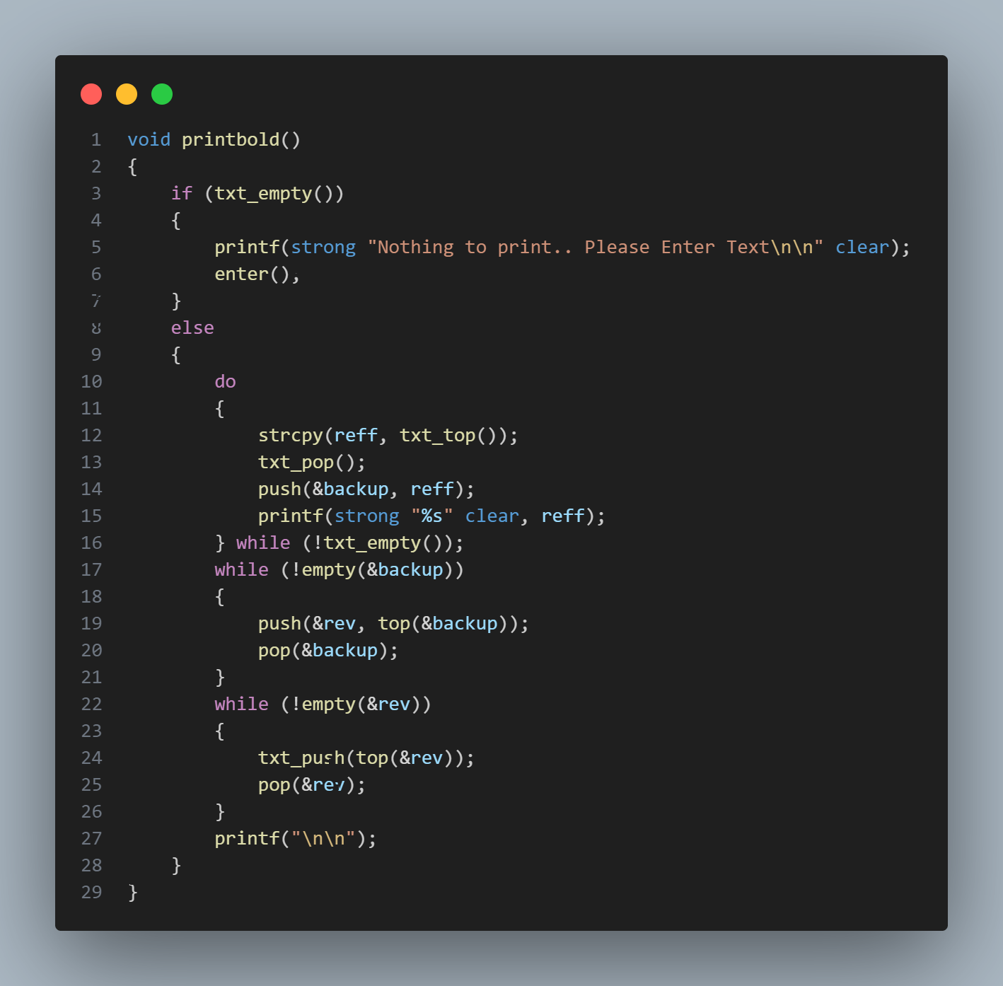
PRint Bold Function
Print Bold function uses strong (“\e[1m”) and clear (“\e[0m”) macros
The string printing after the ‘strong’ macro will be bold.
Once our string is printed we use ‘clear’ to reset text to normal weight
reff( string ) is used to store return value of txt_top() and reff is being printed one by one (data of front of queue)
Now this reff is getting pushed in backup stack this operation is performed with help of push function.
Now the all data in backup is stored in reverse order in ‘rev’ stack. After this all data in rev is popped out and enqueued using text_push function in queue
Now we have our queue as it was before the print operation

Slide 10
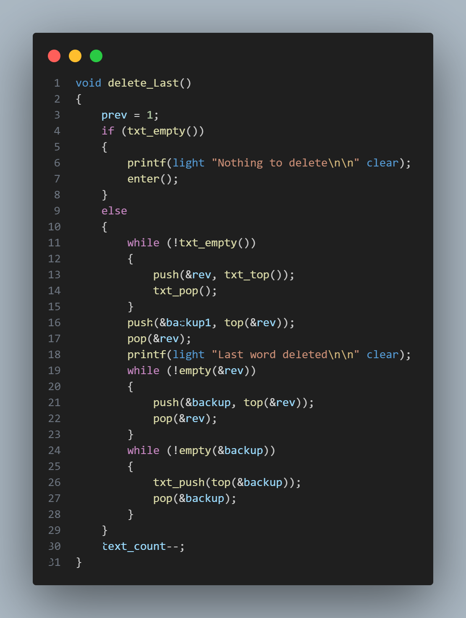
Delete LAST function
We store the all data of queue in rev stack using txt_top(), txt_pop()
function
Delete Last function uses the backup1 stack to store the deleted word
(top of rev stack)
This operation is performed using push() function which pushes the
return value of top() function in backup1 stack.
Now member in rev stack are stored in backup stack in reverse order
and this backup stack is used to push all words in queueusing txt_push()
function.
We set prev = 1 here which indicates last operation performed was
delete operation
Here text count decreases by 1 as we are deleting a word

Slide 12
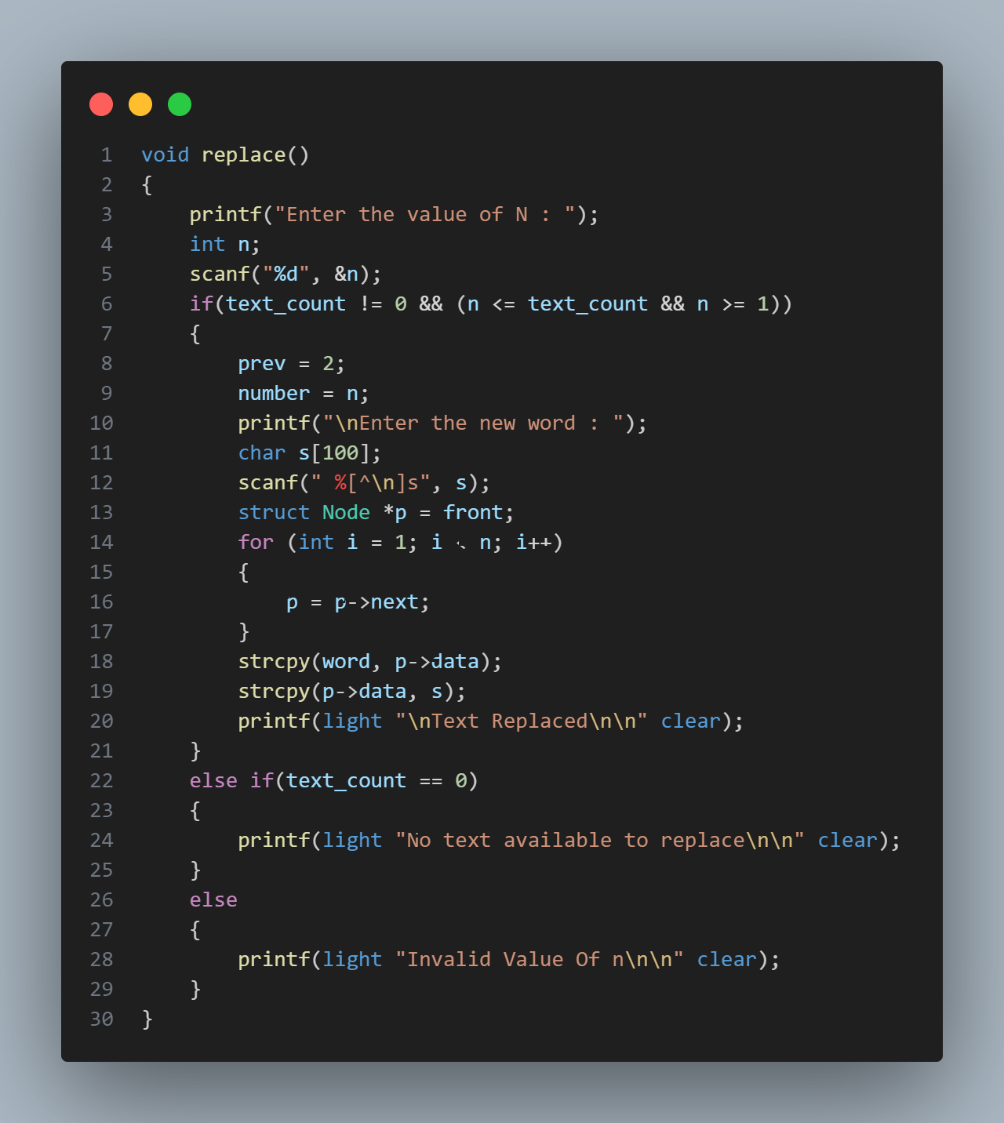
Replace Function
Replace function take input of n which denote position of word
to be replaced
Valid n value will be 1 to no. of total words in sentence.
We iterate our p pointer through queue upto the nth position
and replace the data in node with s string(input by user).
We store the previous value of data in word string.
We set our prev global variable value 2 here which indicates last operation performed was replace operation.
We store value of n in number(global variable) for further undo operation

Slide 14
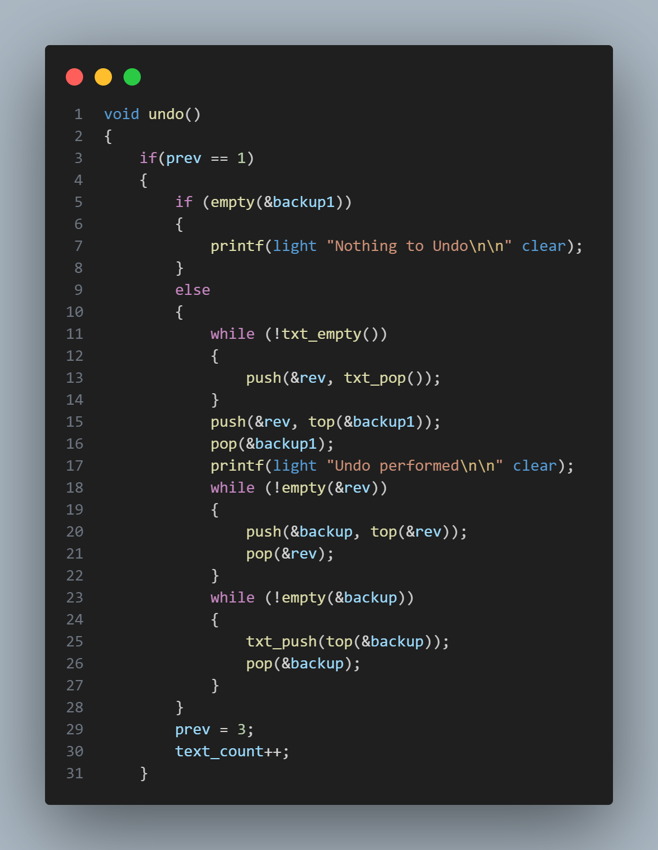
Undo Function
Case 1 : When prev = 1
When our last operation performed was delete then we proceed via this case first we use rev stack to store all data of queue
Then we push the top of backup1 stack into our rev stack after this we push top of rev stack in backup stack one by one simultaneously popping the rev stack
Now top of backup stack is enqueued one by one using txt_push() function in queue, simultaneously top is popped out from backup stack.
Here text_count will be incremented by 1 because we have added the deleted word in our text

Slide 16
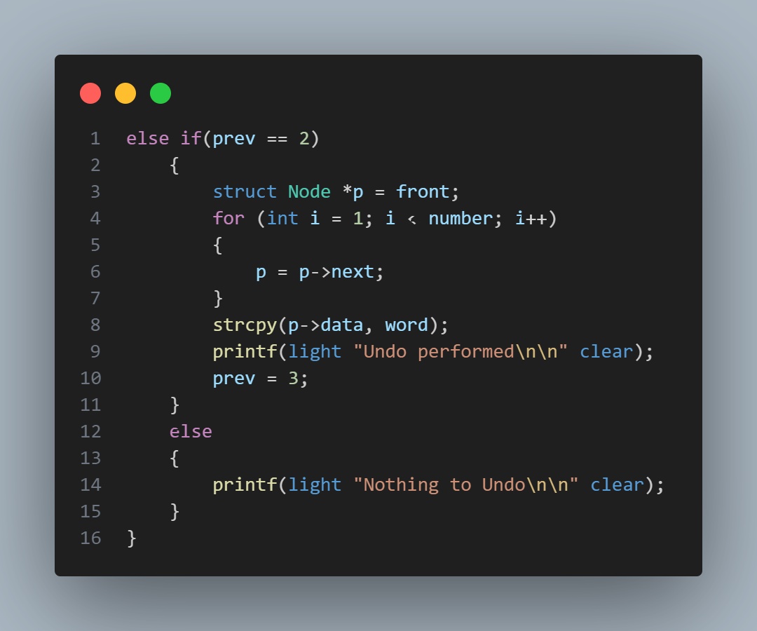
Undo Function
Case 2 : When prev = 2
When our last operation performed was replace then we proceed via this case
First we iterate our queue to reach to the position of replaced node’s data.
We replace the data in node with word string(storing previous word)
Finally we set our prev value to 3.

Slide 18
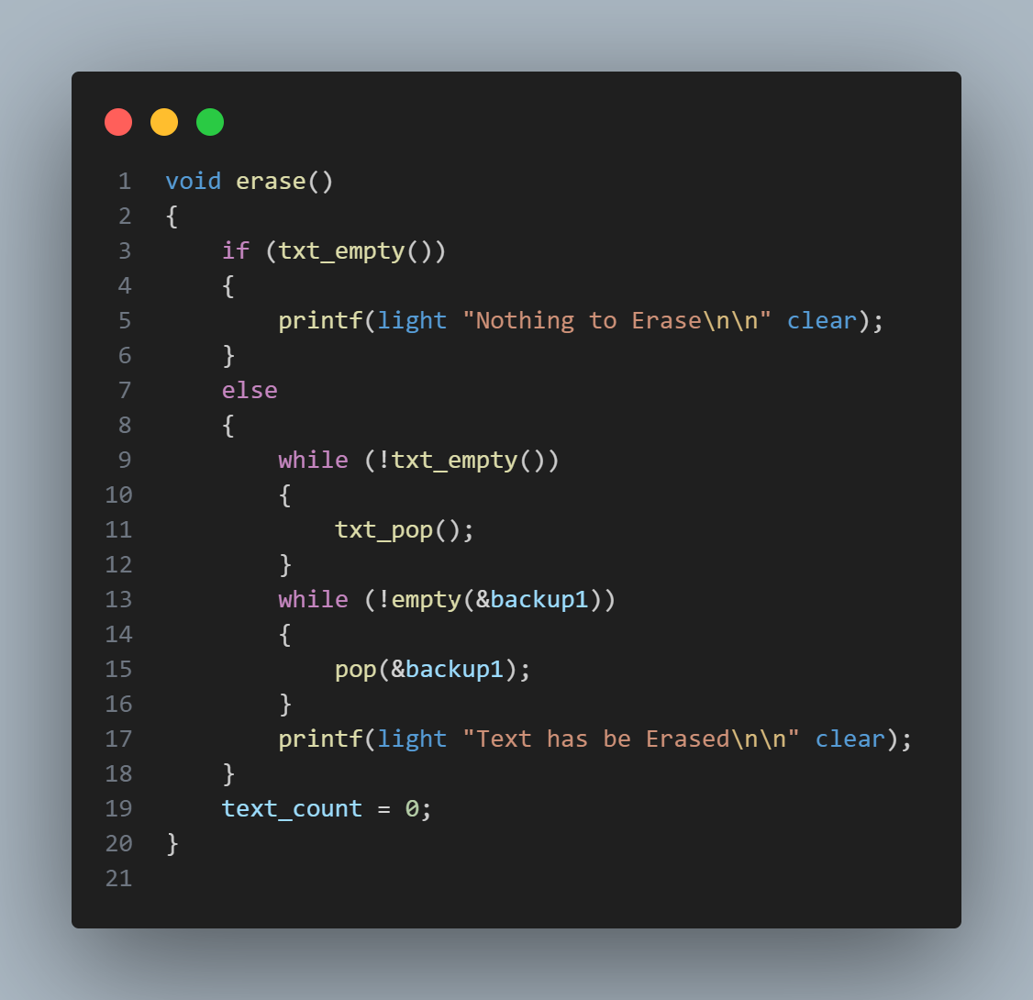
Erase Function
First we will check whether there is data available to erase
using text_empty() function
If above condition is true we simply pop out our data from queue
Along with it we also pop out our backup1 stack members
and set our text_count variable as zero

Slide 19
Erase Function
THANK YOU!

Slide 20
THANK YOU!

