Slide 1

Credence Services
CS
CREDENCE SERVICES
CHANGE YOUR FUTURE

Slide 2

TEAM
16MIS0352 – SUMANTH VARMA
16MIS0257 – SAI NIKHIL
16MIS0480 – ADITYA KENGUVA
16MIS0316 – BHARGAVA
16MIS0453 – ABHISHEK

Slide 3
Review – 1&2
CS

Slide 4

TABLE OF CONTENT
CS
PROBLEM STATEMENT
PAIN POINT
PURPOSE
SOLUTION

Slide 5
Problem Statement :
CS
Poverty and Unemployment.
Unable to find a job.
Not aware of what to do.

Slide 6
Pain Point
CS
No jobs for un educated and educated people.
Unable to find right job which suits their skills.
No aware of jobs available.
How to reach them.

Slide 7
Purpose
CS
To reduce Unemployment.
To provide jobs opportunities to needy people.
To eradicate the unemployment in India.
To build reduce poverty rate.

Slide 8
Solution :
CS
Create a website initially.
Perform survey in different places who are in need of employers (it includes all fields from companies, industries to small shops)and collect the required skills to be needed, contact details etc.
Perform survey with different people in locals who are in need of jobs and what are skills they have to do a work, contact details etc.
Collect all the companies details and job seekers details and provide them In the website.
Let the companies choose the people who they needed and contact them.
Let the people choose the company they want to work according the skills they pose and their comfort.

Slide 9
Review - 3
CS

Slide 10
TABLE OF CONTENT
CS
DESCRIPTION OF BUSINESS
DESCRIPTION OF INDUSTRY
TECHNOLOGY PLAN
MARKETING PLAN
FINANCIAL PLAN
PRODUCTION PLAN
ORGANIZATION PLAN
OPERATIONAL PLAN

Slide 11
Description of Business
CS
Provide required jobs to the customers.
Two way income from both customers of job seekers and job givers.
Helps in increasing the rate of job opportunities.
Increase in number of connections with the different companies.
Provide various types of jobs available from different regions.
Increase in number of customers.

Slide 12
Description of Industry
CS
Marketing platform.
Provide opportunities to job seekers.
Help companies to find the right employee.
Various Job opportunities.
Easy to find a job.
Help people to find jobs in both educational and non – educational platforms.

Slide 13
Technology Plan
CS
Web platform is the mediating platform to get the required information for both job seekers and givers.
In initial take a survey of both job seekers and different companies and different business related shops.
Later make collection of data from website.
Maintain the both job seekers and providers data base in website and provide the required details to the customers.
Provide the best results with good algorithms.

Slide 14
Marketing Plan
CS
Creating a killer marketing plan doesn't have to cost a lot of money. All that is required is time, effort and creativity.
Define your end goal.
Maintain a consistent brand and message.
Find the social channel for your startup.
Build a referral network.
Create ads that appeal to people's emotions.
Determine your target audience.
Marketing strategy – Online marketing strategy

Slide 15
Financial Plan
CS
Create and review a financial plan
Organize your financial records
Investment accounts
Bank statements
Tax returns and paying
Calculate your net worth
Establish a spending plan
Build an emergency fund
Risk management
Reduce or minimize consumer debt

Slide 16
Financial Plan
CS
Initially to start the service a small amount of capital will be needed that can be invested in part by the founders of the firm or even by the members of the firm
Once the service gets started with a stable growth in the market a small commission fee can be acquired from the company as well as the customers for the services they are offered
If the firm grows exponentially it can be pitched at various startup events to attract investors
Once the company is properly recognised by the DPIIT(Department for promotion of industry and internal trade) it will be eligible for applying loans through various government schemes and even will also be given a small allowance capital by the government
The company will also be exempted from paying taxes until its total profits and funds touch a total of 25 crore

Slide 17
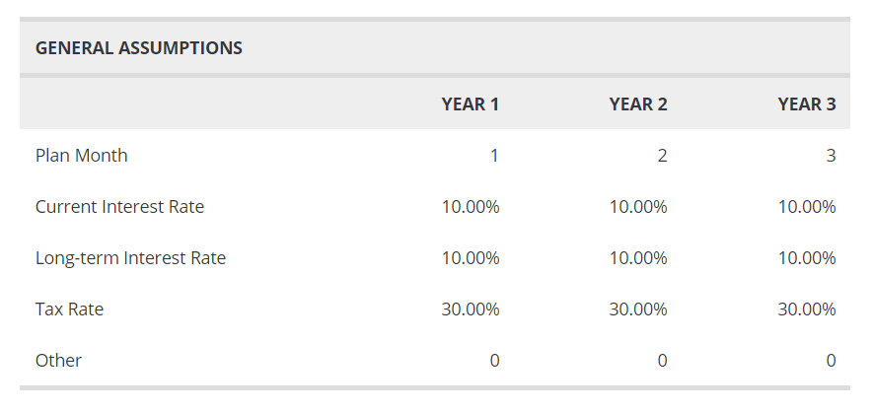
Financial Plan
CS

Slide 18
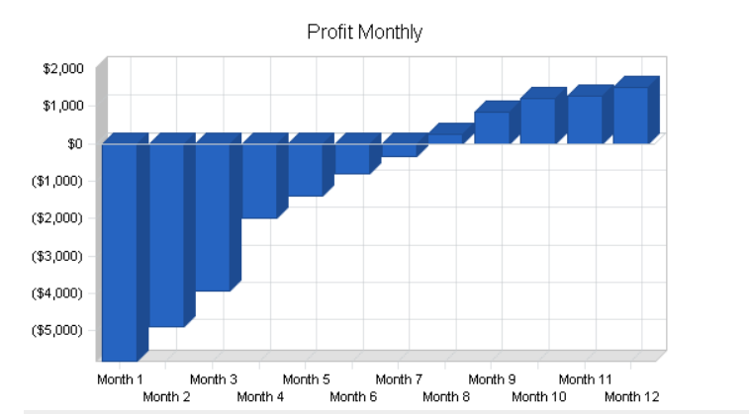
Financial Plan
CS

Slide 19
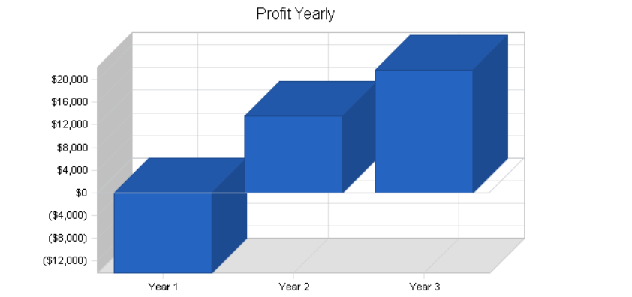
Financial Plan
CS

Slide 20
Production Plan
CS
Both the customer and the company registers with the firm for their job requirement and job vacancies respectively.
Customers are survey for their physical and technical skillsets.
Companies are surveyed for their vacancies and required skillsets for the vacancy.
Customers are screened based on their skillsets to see if or not they have what they say.
Companies are screened for their viability to check if they are genuine and are legal.

Slide 21
Production Plan
CS
Once all this pre-processing is done one or more number of customers skillsets are mapped to the companies requirement.
The company can also have their own screening if required and selects the most viable employee or employees based on its requirement.

Slide 22
Organization Plan
CS
SURVEY TEAM – They prepare a survey for the unemployed people who are jobless.
MANAGEMENT TEAM – They categorise into many different ways and they provide to the technical team.
TECHNICAL TEAM – So they will start designing the whole thing in such a way that the user will be easily able to identify his suitable job and also the design will be made neatly.
MARKETING TEAM – So after the product is ready the marketing team will approach the unemployed ones and explain the procedure he is suppose to do.
BUISINESS TEAM – Actually they are the ones who will manage the whole organisation.

Slide 23
Organization Plan
CS
For the whole organisation plan the survey will first start preparing a survey regarding what kinds of jobs are vacant and they will start noting it.
The survey will be given to the management team and the management team will categorise the jobs from small scale to large scale jobs.
After categorising the technical team will have to design the whole thing and should connect to the databases for that large servers have to be maintained in such a way they should not be anything wrong with the server even though there would be a problem the technical team should be able to fix it. So that when a user want to apply for a job he should not face any problem with it.
The marketing team has a job to let the people know that there shouldn’t be any unemployment and bringing out the unemployed ones and make them employed
Business teams job is most important they have to make sure that everything is going well because they are ones who started the job. Right from the survey to the marketing they will have to check.

Slide 24
Operational Plan
CS
Description of our objective and mission.
Users of our platform are the applicants who apply for the job.
For educated users they can login using their E-mail ID or Password.
For Uneducated users they can login using their aadhar card number /ration card number.
Personal details(Like password ,Email ID etc.) of the user are protected and safe.
Chatbot will be avaliable at the right end corner of the page .When the user logs in . Here,he/she can ask the queries they have.

Slide 25
Operational Plan
CS
User can fill in his/her resume and apply for jobs on the field he/she is interested in or the user can provide the skills in the resume and can show it in his/her profile so that companies can directly approach them.
User can go through the details of the company (History,Current acheivements and the company type).
User will be able to give his/her complaint in the feedback from .
User can also complaint through the chatbox hence,immediate action will be taken about the complaint given.
User can also interact with the company person who is hiring him. So they get to know what type of job the user is looking for .

Slide 26
Operational Plan
CS
Here, user can also search jobs on basis of his education qualification.
For uneducated users the portal will be in their mother tongue so they can access every service provided by the portal.
Provide call services to customers for uneducated to make the process easy for them to get the job.

Slide 27
Thank You.
CS
Team Credence
CREDENCE SERVICES
Phone Number
team@credenceservices.com
www.credenceservices.com

