Slide 1
Stock Price Prediction
Sai Nikhil – 16MIS0257

Slide 2
Welcome to our presentation!

Slide 3
Before starting
You might see a news headline that says the stock market has moved lower, or that the stock market closed up or down for the day. Most often, this means stock market indexes have moved up or down, meaning the stocks within the index have either gained or lost value as a whole. Investors who buy and sell stocks hope to turn a profit through this movement in stock prices..
The concept behind how the stock market works is pretty simple. Operating much like an auction house, the stock market enables buyers and sellers to negotiate prices and make trades.
Buyers offer a “bid,” or the highest amount they’re willing to pay, which is usually lower than the amount sellers “ask” for in exchange. This difference is called the bid-ask spread. For a trade to occur, a buyer needs to increase his price or a seller needs to decrease hers.

Slide 4
Contents
1
Abstract
4
Solutions
Before starting
Proposed solutions
2
Problem Statement
5
Architecture
What is wrong
3
Datasets
Past datas

Slide 5
Abstract

Slide 6
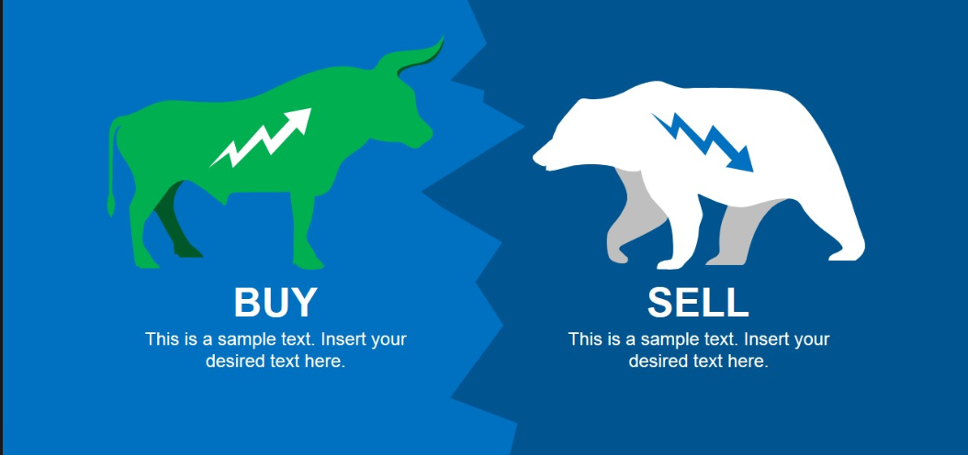
Abstract
In stock price prediction we are using NSE (National Stock Exchange) dataset for out project. Predicting a non-linear signal requires advanced algorithms of machine learning. The literature contains studies with machine learning algorithms such as ANN (Back Propagation algorithm). Using ANN we use the data from 2015-2018 to train the neural network and test the network using the present data from NSE.

Slide 7
Problem Statement

Slide 8
Our problem
In a financially volatile market, as the stock market, it is important to have a very precise prediction of a future trend. Because of the financial crisis and scoring profits, it is mandatory to have a secure prediction of the values of the stocks. Predicting a non-linear signal requires advanced algorithms of machine learning. The literature contains studies with different machine learning algorithms such as ANN

Slide 9
Dataset

Slide 10
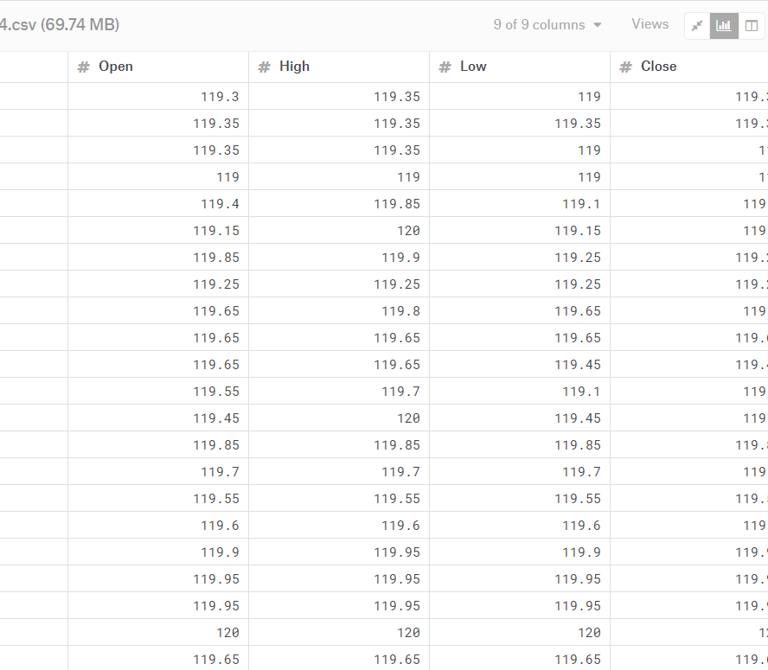
NSE-National Stock Exchange
The National Stock Exchange of India Limited (NSE) is the leading stock exchange of India, located in Mumbai. The NSE was established in 1992 as the first demutualized electronic exchange in the country.

Slide 11
Our Algorithm
ANN
We use Artificial neural network to train the network and test the same. We convert the data into inputs and train the network.
Then we test them with values and verify the efficiency

Slide 12
Our Plan
1st review
Abstract
The abstract of the project
2nd review
Half Implementation
Introduce data into Hadoop and write ANN code for training
3rd review
Full Implementation
Complete data in Hadoop and full training and testing of network

Slide 13
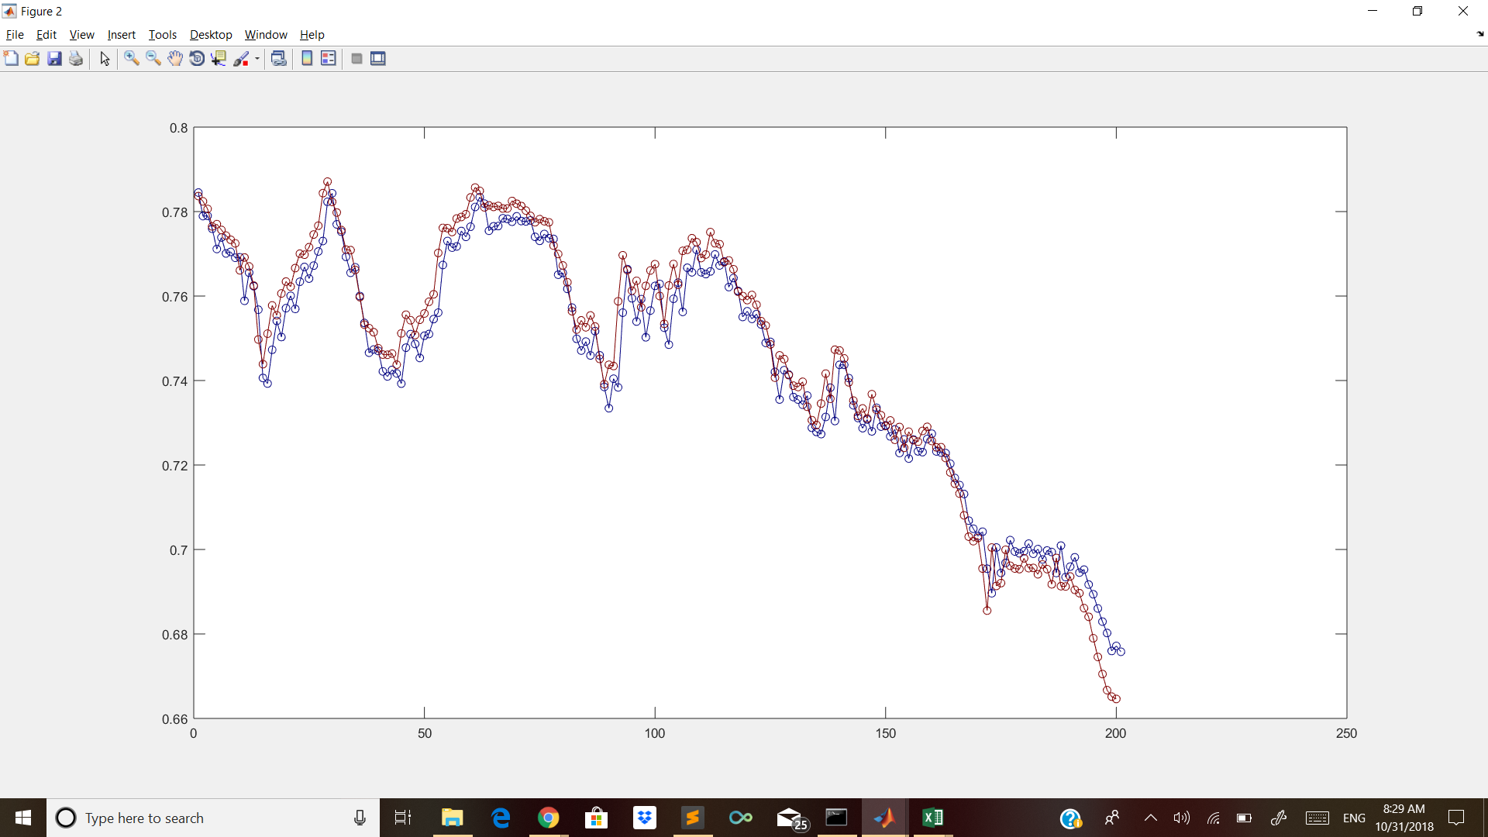
Laptop mockup

Slide 14
Solutions

Slide 15
Solution
Solution 1
We train our Artificial Neural Network for training and testing the network and verify the results and predict the stock value.
Solution 2
We use deep learning concept for most accurate prediction

Slide 16
Line graph
500
400
300
200
100
April
May
June
July
August
2015
2016

Slide 17
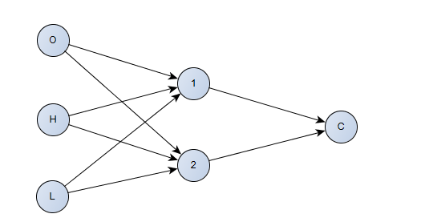
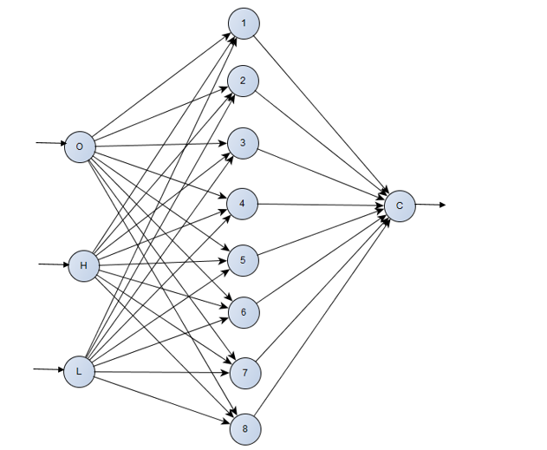
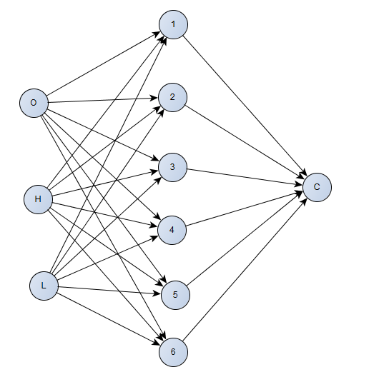
Architecture

Slide 18
Thank you!

