Slide 1
Trustworthy Recording of Media Files Using Blockchains Research Project
Hesham Hosney, 4th July 2019
ITIS TU Braunschweig
Supervisors: Prof. Dr. Rüdiger Kapitza & M.Sc. Signe Rüsch

Slide 2

Introduction
The main idea and the application work flow
Blockchain and Hyperledger Fabric Background
Discussing the prerequisite background knowledge
The Infrastructure
Discussing the application infrastructure, Docker Container nodes, and node.js SDK
Roadmap
The Application Development
The android application development in details
Issues, Future Work and Conclusion
Warp up all what have been discussed, Issues and Future work.
Demo
A live demonstration for the application capability.

Slide 3
1- Introduction
The main idea and the application work flow

Slide 4
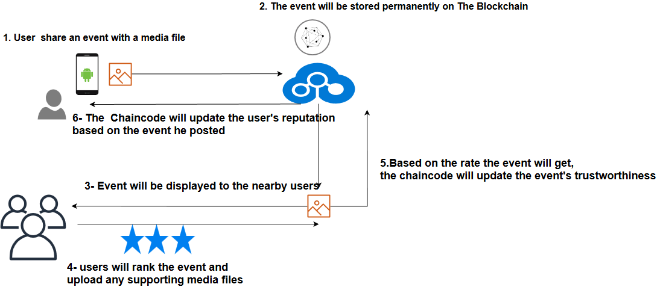
Fake News Detection a Use Case Scenario for Hyperledger Fabric
A real application use case scenario.
Using blockchain technology.
Using Hyperledger Fabric platform.
The chaincode is the only way to interact with the network.
Trustworthiness will be based on the location and the user rating.
Notes:
An Application that boosts our blockchain knowledge and gives us a profound understanding. of the technology
The best way is to learn by doing
Proposed a mobile application that allow users to share media events and upload them and other people in the area could view and interact.
Here comes the question

Slide 5
2- Blockchain and Hyperledger Fabric Background
Discussing the prerequisite background knowledge

Slide 6
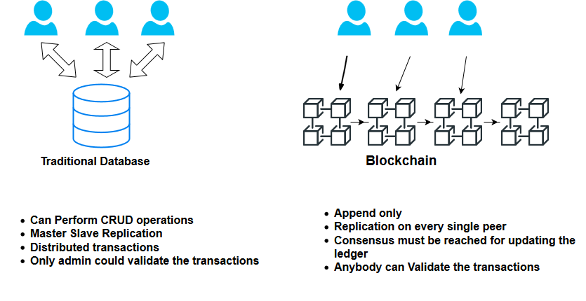
Blockchain
Blockchain is a distributed open ledger.
Once data is recorded, it becomes very difficult to be tampered.
Data stored in series of blocks; every block is dependent on the other previous one.
Decentralized, no central management authority.
Seeking trust and immutability.
Notes:
One of the most hyped technology trends
Someone has to have access to servers and and update the event change or delete the data if it’s stored in normal database.
All business record will be managed via blockchain to hack you have to attack all the peers one by one to change the data .

Slide 7

Hyperledger Fabric
Hyperledger Fabric is an open source collaborative effort governed by The Linux Foundation.
Permissioned blockchain.
The smart contracts("chaincode") in general-purpose programming languages such as Java, Go and Node.js.
More efficient by eliminating the mining concept.
Focusing on privacy and confidentiality.
Modular Design
Notes:
Permssioned blockchain unlike bitcoin not everyone could just simply join the network.
Hosted by the linux foundation. One the most well known and growing framework.
You have to have the right certificate to join the network.

Slide 8
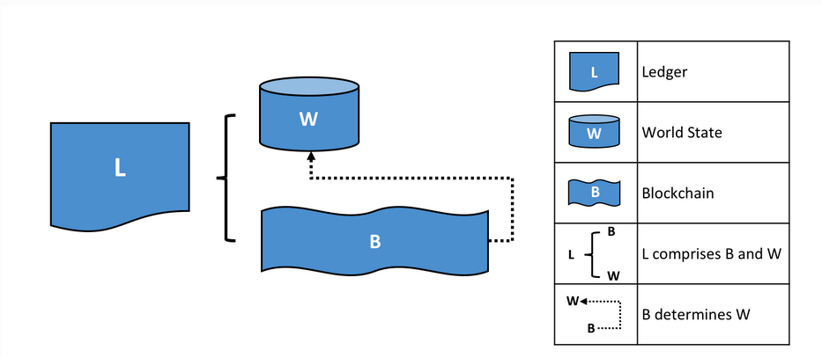
Hyperledger Fabric Terminology
The Ledger, The World State and the Blockchain.
Notes:
Blockchain a transaction log that records all

Slide 9

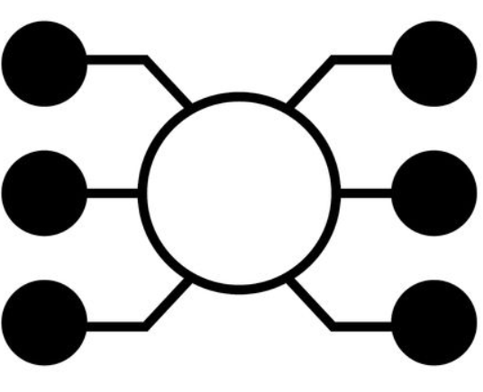

Hyperledger Fabric Terminology
Orderers: Order the transaction and create the blocks
Peers: Network nodes host the ledger
and the smart contract
Chaincode (Smart Contracts):
The only way to interact with the ledger and holds the business logic
Notes:
Blockchain a transaction log that records all
Order unique concept is a special node for ordering the transaction put them in order and create the block and sends it to the commiting peers to write it to the ledger.
By this they are eliminating the mining concept.

Slide 10
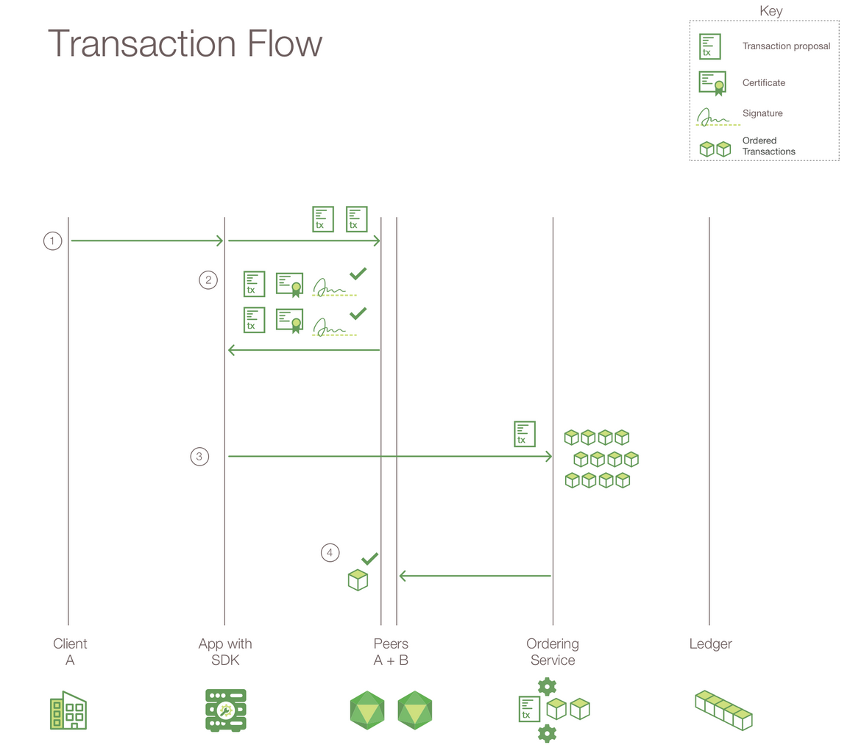
Putting It All Together
Photo Reference : https://www.ibm.com/support/knowledgecenter/bluemix_stage/services/blockchain/reference/v10_fabric.html
Notes:
Using APIs available in the SDK, sends a request.
SDK makes it a transaction proposal and sends it to the peers.
Peers simulate the transaction and sends back responses to the SDK.
SDK collects responses and sends them to the orderer.
Orderer sends the block to the committing peers.
SDK wants to make a transaction SDK makes a transaction proposal invoke a method on the chaincode and pass this parameters.
Then sending it to the peers and apply the endorsement policy to add a transaction two peers from two different org must sign the transaction or one from
Org 1 whatever you want it’s adaptable.
Peers receive the proposal they simulate the transaction execute the chaincode so read values and write new values nothing changed.
Once done they add read write sets and sign the response and send it back to sdk.
Sdk collects all responses from different peers must be the same.
Next step send it to the orderer will validate the transaction it will wait for a block is full or a timeout passed then send ti to peers and the peers will add It to the ledger and update the world state.
The peer broadcast the event which sdk listens to it that the transaction approved or rejected.

Slide 11
3- The Infrastructure
Discussing the application infrastructure, Docker Container nodes, and node.js SDK

Slide 12
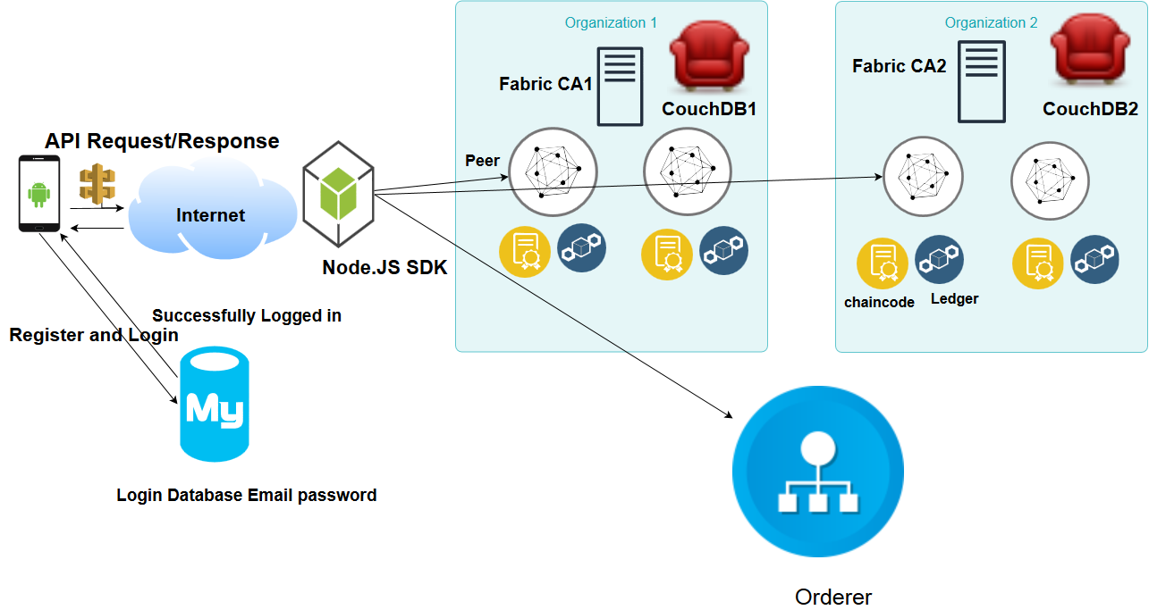
Inspired from Fabric Samples Balance Transfer Network
Notes:
Hyperledger fabric provides a sample network and shell scripts for using hyperledger fabric.
Fabric ca server will be responsible for enrolling users and generating certificate on the fly
Solo orderer not in production

Slide 13
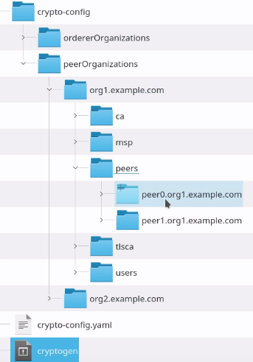
Building The Development Environment
Sample network and bash scripts in order to have an up-running network.
Defining network elements in a docker composer file such as organizations, peers, orderer and couch-database.
Generating the cryptographic material for network nodes.
Bringing up all docker container nodes.
Notes:
Using cryptogen tool certs and signing keys for different network entities.

Slide 14
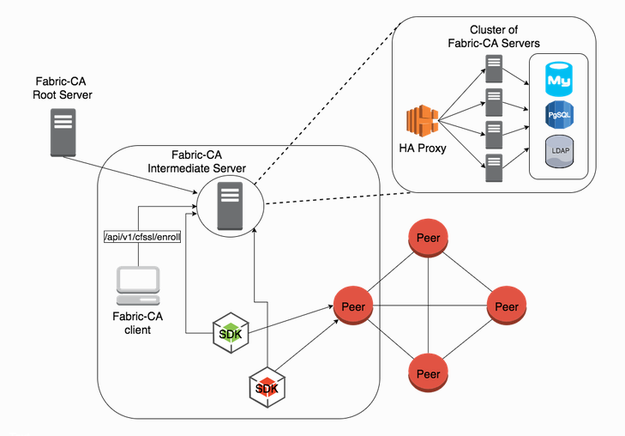
Fabric CA Server
Fabric CA Server Will be responsible for enrolling users.
Also, it will dynamically generate the ecerts, users private key and cacert chain PEM files.

Slide 15
Hyperledger Fabric Client SDK using Node.js
SDKs encapsulate all access to the ledger by allowing an application to communicate with smart contracts, run queries, or receive ledger updates.
Node.js process that exposes hyperledger fabric network as a REST API similar to Hyperledger Composer REST server.
Fabric-client encapsulates the APIs to interact with Peers and Orderers of the Fabric network to install and instantiate chaincodes, send transaction invocations and perform chaincode queries.
Fabric-ca-client to interact with the fabric-ca to manage user certificates.
Notes:
Using cryptogen tool certs and signing keys for different network entities.
SDKs encapsulate all access to the ledger

Slide 16
Balance transfer Node.js APP
is a sample Node.js app to demonstrate fabric-client, fabric-ca-client, and Node.js SDK APIs.
Allows the communication with the hyperledger fabric network by using fabric node.js Libraries.
Enables the interaction with the fabric network using REST APIs.
Allows different operations using GET/POST requests, such as channel’s creation, joining the channel, installing and instantiating the chaincode.
In addition, Registering and enrolling new users in the network.
Querying and Invoking transactions.
Notes:
Users will first authenticate with email and password using traditional database.
Then they will request to enroll and join the network every user has a unique email and password and the app will generate a JSON webtoken.
Using this JWT will enable the user to interact with the network query chaincode and invoke transactions.

Slide 17
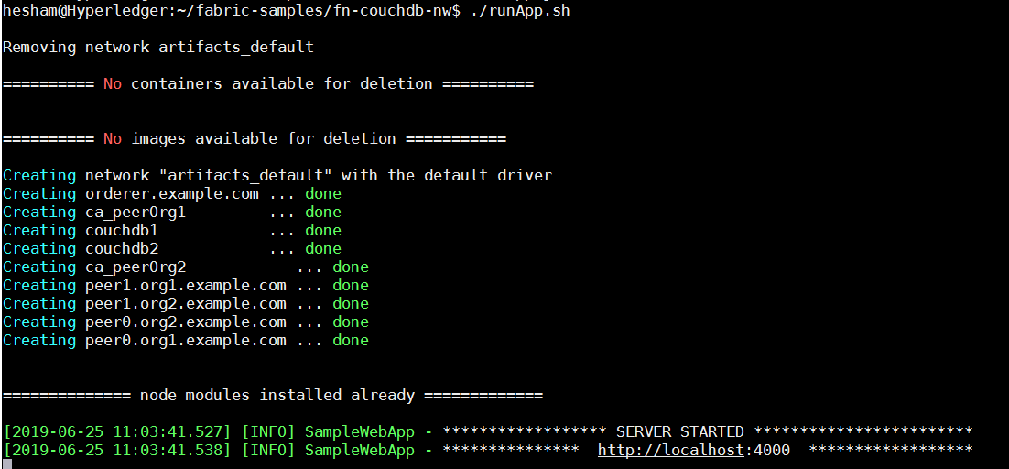
Node.Js SDK App
This launches the required network on the local machine.
Installs the fabric-client and fabric-ca-client node modules.
starts the node app on PORT 4000.
Running ./testAPI.sh to create the channel and install/instantiate the chaincode.

Slide 18
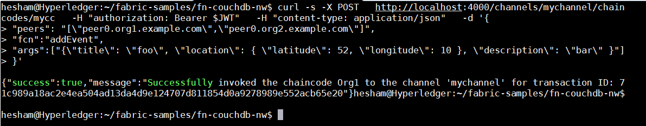
API Calls
In order to interact with the chaincode we are using API calls.
Making GET Request to query the chaincode and POST Request to invoke a transaction.
Calling the URL endpoint and passing the chaincode function name and the arguments.
We are passing JWT in the request header and the SDK validates the authorization.
We receive the responses as JSON objects and process them on the application side.

Slide 19
4- The Application Development
The android application development in details

Slide 20
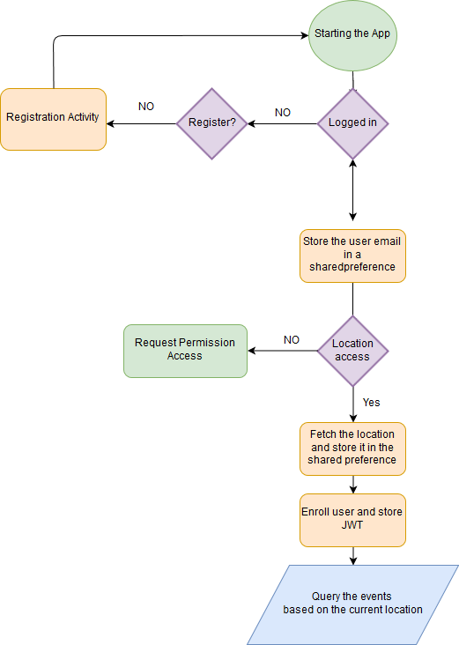
Mainactivity Walk-through
Starting the app and checking if the user logged-in.
If not directing to registration activity.
Check if the location access permission was guaranteed .
Enroll user and store the JWT.
Fetch the nearby events based on the user location by querying the blockchain.

Slide 21
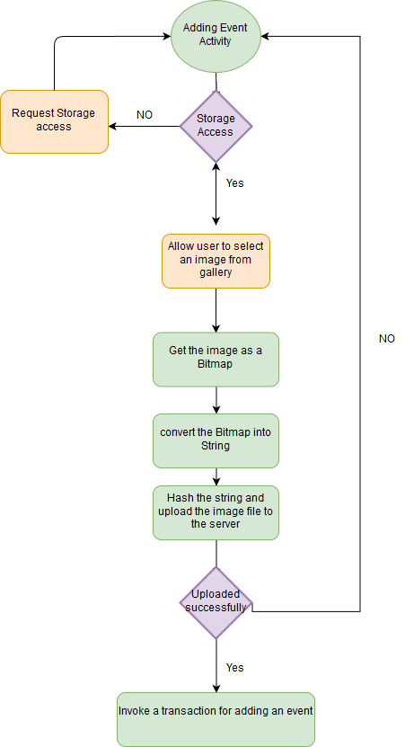
Adding an Event Walk-through

Slide 22
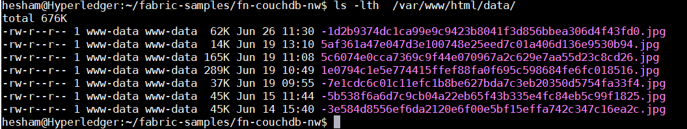
Hashing the Media File
For more efficient storage we store only the hash of the media file in the blockchain.
We are hashing the content using PBKDF2WithHmacSHA1
Serving the content from a CDN like amazon S3.

Slide 23
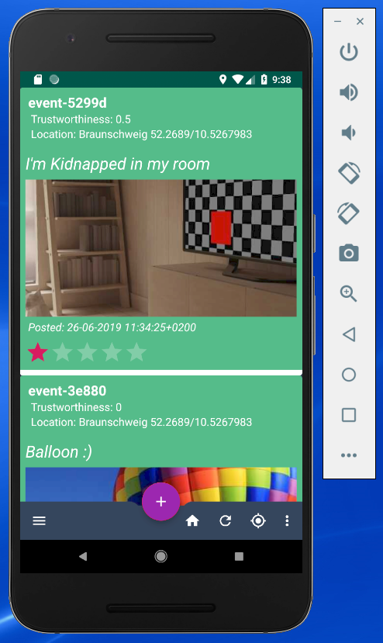
Home Feed
The main activity automatically fetches the events from the blockchain based on the location.
Data is fetched as JSON Object.
Displaying the events like Facebook or Instagram news feed.
This is done by using Recyclerview.Adapter and binding the data to the view holder.

Slide 24
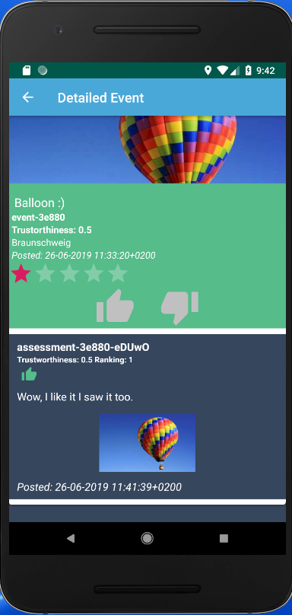
Ranking Events
The users could simply rank the events by voting them up/down.
In addition, they could also add photos and comments.

Slide 25
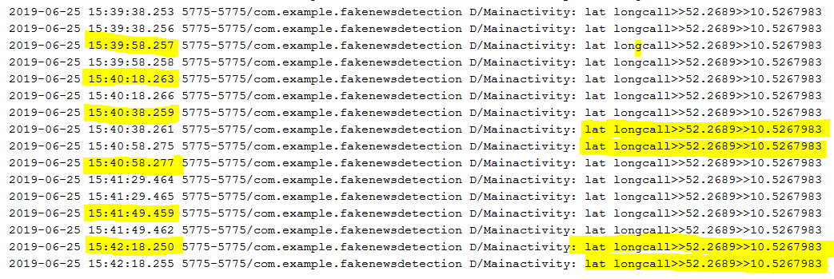
Location and Trustworthiness
The application automatically collects the users’ location.
The application should be integrated with another part that verifies the user’s location wasn’t faked or spoofed.
Assuming that the location wasn’t manipulated.
We are regularly capturing the location and sending it to the blockchain and this will increase the user’s trustworthiness.
Notes:
Enforcing the business logic using the chaincode.

Slide 26
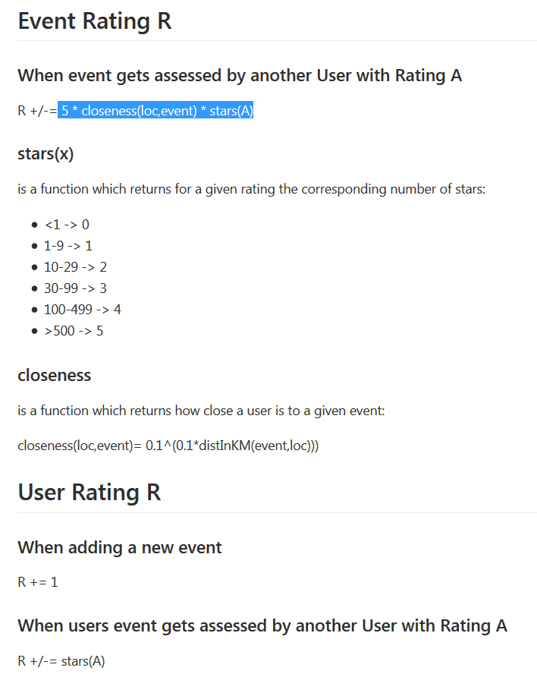
How Ranking Works
Every user starts with 0 reputation score.
This score increases the more the user interacts on the network.
Adding an event will increase his score by +1.
When other people rate his event this will directly reflect the user’s reputation score.
The algorithm considers the users rank and location trustworthiness(How Close).
What easily influences the user’s reputation. Is getting good/bad reviews from the highly ranked users.

Slide 27
5- Issues, Future Work and Conclusion
Warp up all what have been discussed, Issues and Future work.

Slide 28
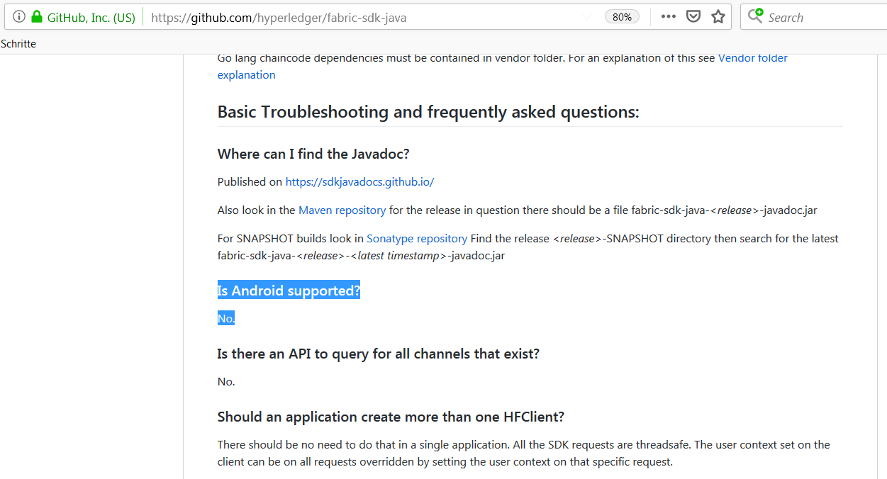
Issues and open question
1- Where should the SDK be installed from Architecture?
On the server side where the hyperledger fabric lives?
On the Client side (Android) no official support for an android SDK only GO, javascript and java.

Slide 29
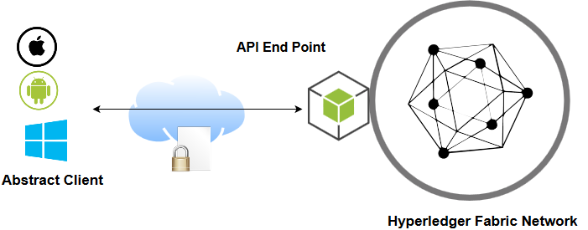
Abstracting The Network
No Officially supported SDK for Android.
Abstract the client the knowledge of hyperledger fabric.
Standardizing the communication using APIs.
Avoid the latency and restrict all the transaction flow on the internal network.
The communication will be encrypted using SSL certificate.
Avoid the unnecessary SDK Library size on the smartphone.

Slide 30
Future Work
As it’s permissioned we could make a community and adding roles to the users.
Such As Researchers, Verifiers and Administrators .
Making a community and based on the reputation we grant more privileges to the users, that they could delete posts or ban other users.
Preventing users with bad reputation from posting or voting.
Integrating machine learning once having more data and resources based on users behaviors.

Slide 31
Conclusion
A very promising Technology, However it requires more maturity.
A complex to solution and requires a concrete understanding of different technologies.
The application could be scaled.
Easily integrate a more complex business logic.

Slide 32
5- Demo
A live demonstration for the application capability.

