Slide 1
Trustworthy Recording of Media Files Using Blockchains Research Project
Hesham Hosney, 4th July 2019
ITIS TU Braunschweig
Supervisors: Prof. Dr. Rüdiger Kapitza & M.Sc. Signe Rüsch

Slide 2
Road Map
Introduction
Blockchain and Hyperledger Fabric Background
The Infrastructure
The Application Development
Results, Issues, and Future work
Demo
Conclusion and Discussion

Slide 3
1 Introduction
The main idea and the application work flow

Slide 4
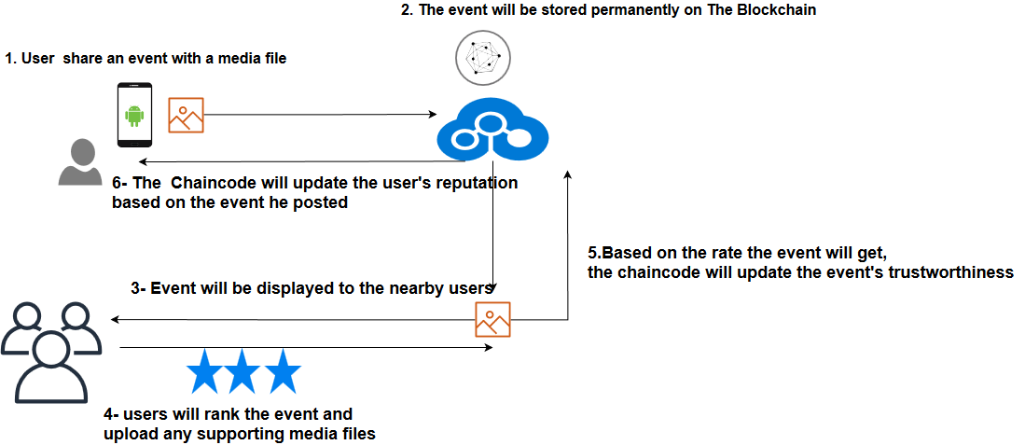
Fake News Detection a Use Case Scenario for Hyperledger Fabric
A real application use case scenario.
Using blockchain technology.
Using Hyperledger Fabric platform.
The Chaincode is the only way to interact with the network.
Trustworthiness will be based on the location and the user rating.

Slide 5
2 Blockchain and Hyperledger Fabric Background
Discussing the prerequisite background

Slide 6
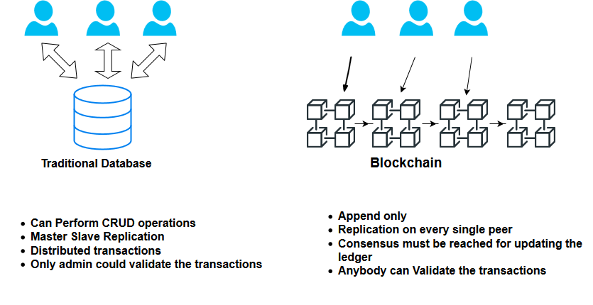
Blockchain
Blockchain is a distributed open ledger.
Once data is recorded, it becomes very difficult to tamper.
Data stored in series of blocks; every block is dependent on the other previous one.
No central authority.
Seeking trust and immutability.

Slide 7

Hyperledger Fabric
Hyperledger Fabric is an open source collaborative effort governed by The Linux Foundation.
Permissioned blockchain.
The smart contracts("chaincode") in general-purpose programming languages such as Java, Go and Node.js.
More efficient by eliminating the mining concept.
Focusing on privacy and confidentiality by introducing the channel concept.
Notes:
Permssioned blockchain unlike bitcoin not everyone could just simply join the network.
You have to have the right certificate to join the network.

Slide 8
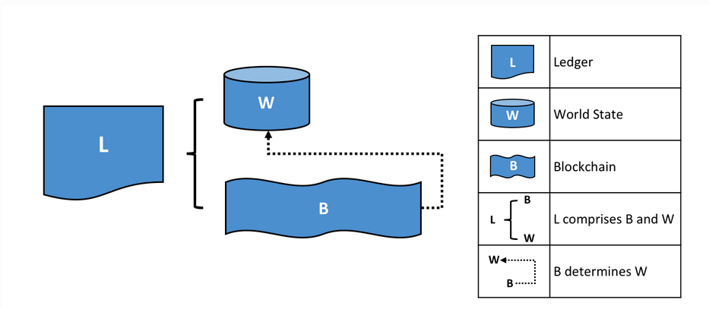
Hyperledger Fabric Terminology
The Ledger, The World State and the Blockchain.
Notes:
Blockchain a transaction log that records all

Slide 9

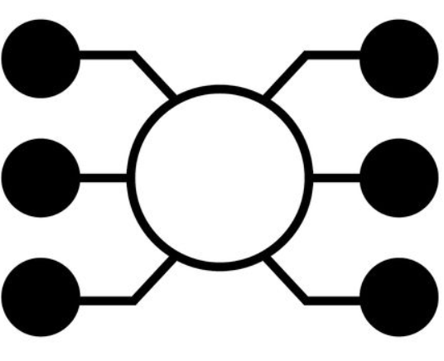

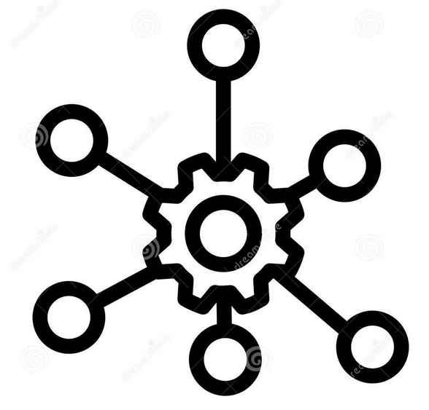
Hyperledger Fabric Terminology
Orderers: Order the transaction and create the blocks
Peers: Network nodes host the ledger
and the smart contract
Chaincode (Smart Contracts):
The only way to interact with the ledger and holds the business logic
Channel: Completely isolated instance of Hyperledger Fabric
Notes:
Blockchain a transaction log that records all
Order unique concept is a special node for ordering the transaction put them in order and create the block and sends it to the commiting peers to write it to the ledger.
By this they are eliminating the mining concept.

Slide 10
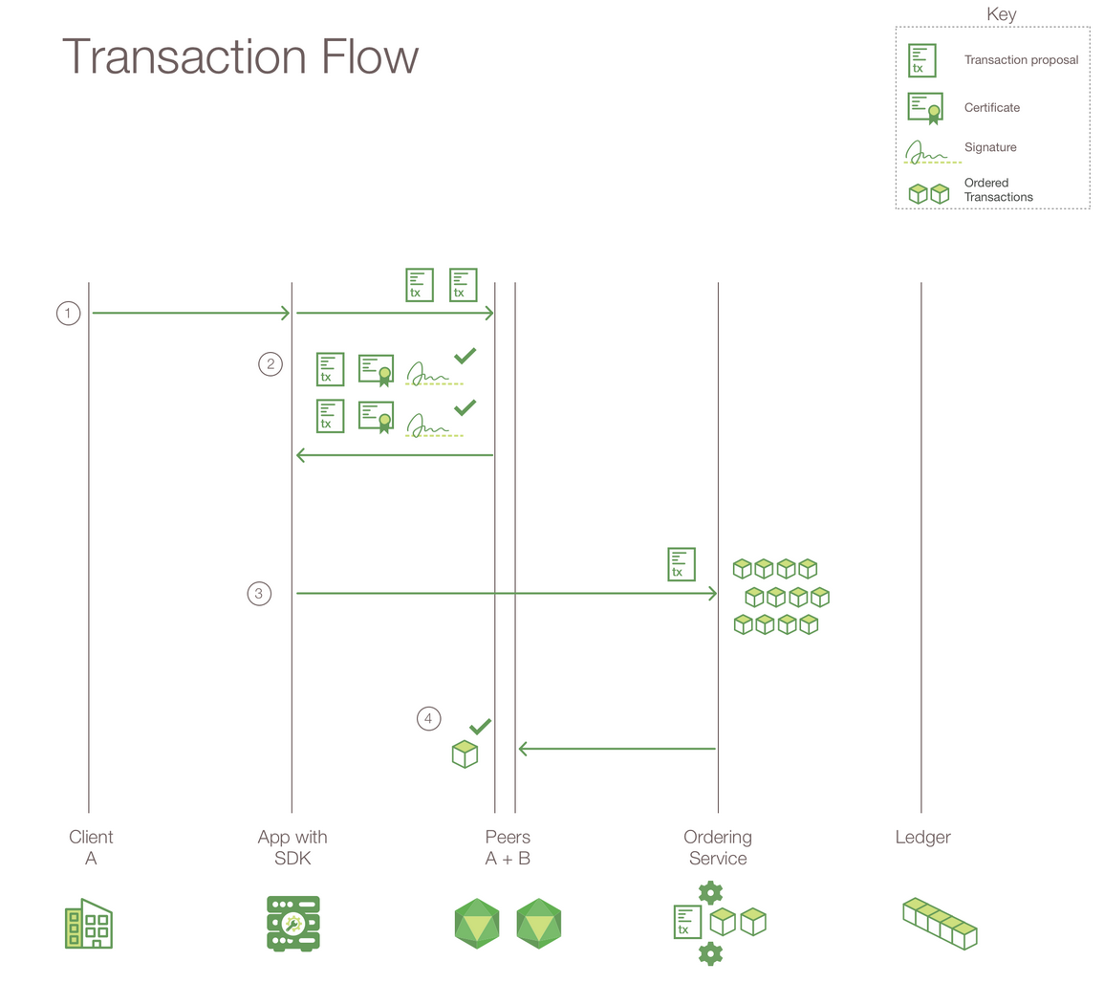
Putting It All Together
Using APIs available in the SDK, sends a request.
SDK makes it a transaction proposal and sends it to the peers.
Peers simulate the transaction and sends back responses to the SDK.
SDK collects responses and sends them to the orderer.
Orderer sends the block to the committing peers.
Photo Reference : https://www.ibm.com/support/knowledgecenter/bluemix_stage/services/blockchain/reference/v10_fabric.html
Notes:
SDK wants to make a transaction SDK makes a transaction proposal invoke a method on the chaincode and pass this parameters.
Then sending it to the peers and apply the endorsement policy to add a transaction two peers from two different org must sign the transaction or one from
Org 1 whatever you want it’s adaptable.
Peers receive the proposal they simulate the transactione xecute the chaincode so read values and write new values nothing changed.
Once done they add read write sets and sign the response and send it back to sdk.
Sdk collects all responses from different peers must be the same.
Next step send it to the orderer will validate the transaction it will wait for a block is full or a timeout passed then send ti to peers and the peers will add It to the ledger and update the world state.
The peer broadcast the event which sdk listens to it that the transaction approved or rejected.

Slide 11
3 The Infrastructure
Discussing the application infrastructure, Docker Container nodes, and node.js SDK

Slide 12
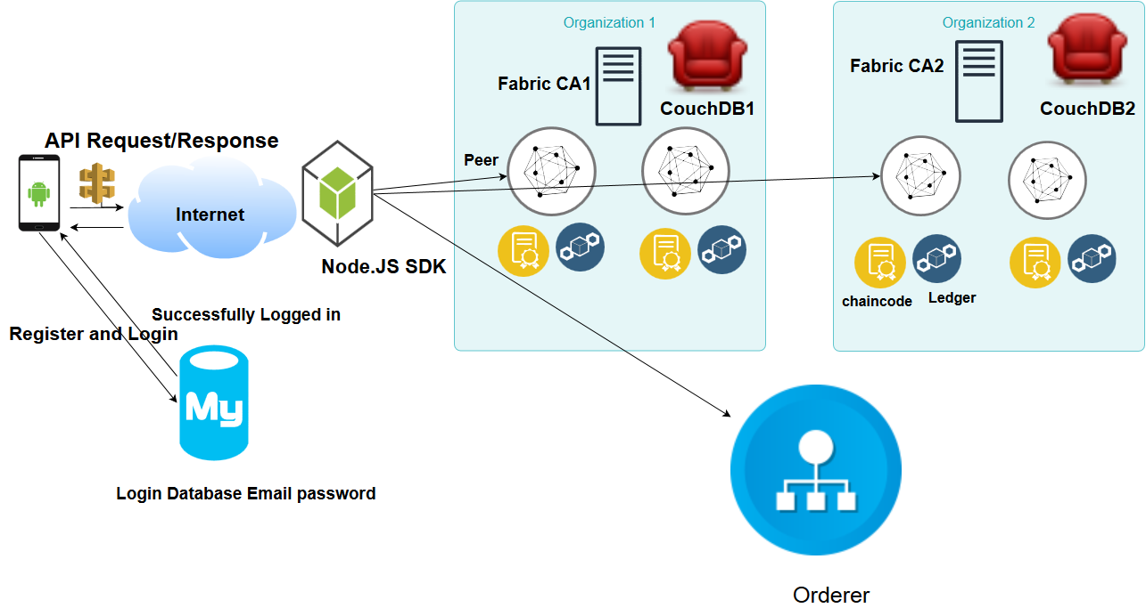
Inspired from Fabric Samples Balance Transfer Network
Notes:
Hyperledger fabric provides a sample network and shell scripts for using hyperledger fabric.
Fabric ca server will be responsible for enrolling users and generating certificate on the fly

Slide 13
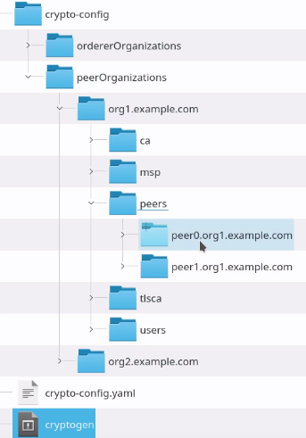
Building The Development Environment
Sample network and bash scripts in order to have an up-running network.
Defining network elements in a docker composer file such as organizations, peers, orderer and couch-database.
Generating the cryptographic material for network nodes.
Bringing up all docker container nodes.
Notes:
Using cryptogen tool certs and signing keys for different network entities.

Slide 14
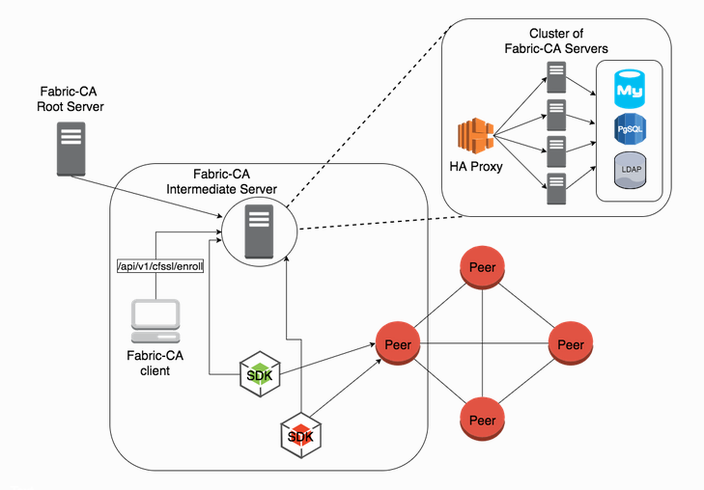
Fabric CA Server
Will responsible for enrolling users.
Also, it will dynamically generate the ecert, users private key and cacert chain PEM files.

Slide 15
Hyperledger Fabric Client SDK for Node.js
Fabric sample: is a sample Node.js app to demonstrate fabric-client, fabric-ca-client, and Node.js SDK APIs.
Node.js process that exposes hyperledger fabric network as a REST API similar to Hyperledger Composer REST server.
Fabric-client encapsulates the APIs to interact with Peers and Orderers of the Fabric network to install and instantiate chaincodes, send transaction invocations and perform chaincode queries.
Fabric-ca-client to interact with the fabric-ca to manage user certificates.
Notes:
Using cryptogen tool certs and signing keys for different network entities.

Slide 16
Node.Js App
Allows the communication with the hyperledger fabric network by using fabric node.js Libraries.
Enables the interaction with the fabric network using REST APIs.
Allows different operations using GET/POST requests, such as channel’s creation, joining the channel, installing and instantiating the chaincode.
In addition, Registering and enrolling new users in the network.
Querying and Invoking transactions.
Notes:
Users will first authenticate with email and password using traditional database.
Then they will request to enroll and join the network every user has a unqiue email and password and the app will generate a JSON webtoken.
Using this JWT will enable the user to interact with the network query chaincode and invoke transactions.

Slide 17
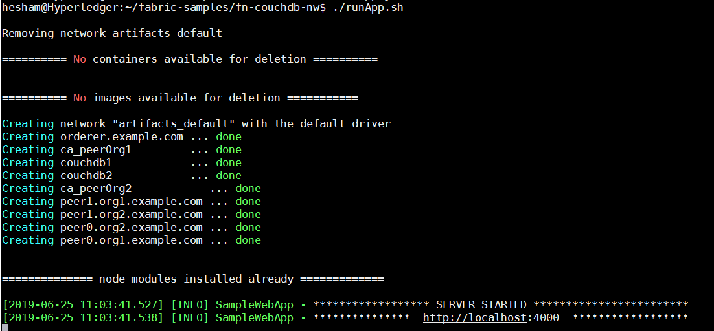
Node.Js SDK App
This launches the required network on the local machine.
Installs the fabric-client and fabric-ca-client node modules.
starts the node app on PORT 4000.
Running ./testAPI.sh to create the channel and install/instantiate the chaincode.

Slide 18
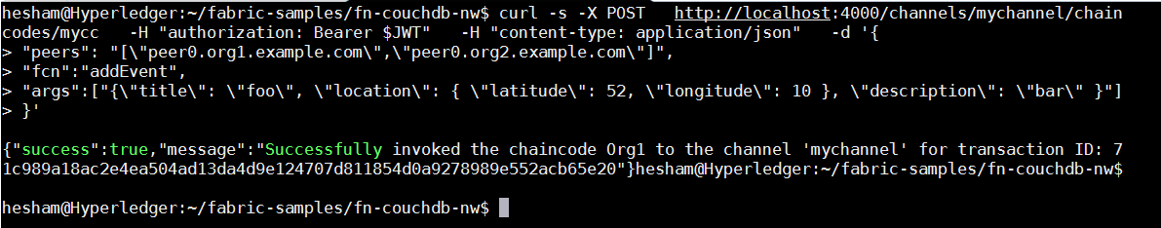
API Calls
In order to interact with the chaincode we are using API calls.
Making GET Request to query the chaincode and POST Request to invoke a transaction.
Calling the url endpoint and passing the chaincode function name and the arguments.
We are passing JWT in the request header and the sdk validates the authorization.
We receive the responses as JSON objects and process them on the application side.

Slide 19
4 The application Development
The android application development in details

Slide 20
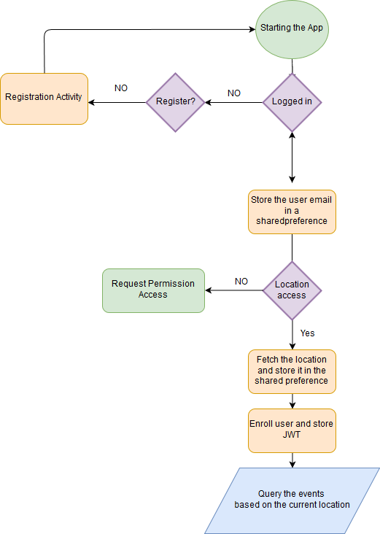
Mainactivity Walk-through
Starting the app and checking if the user logged-in.
If not directing to registration activity.
Check if the location access permission was guaranteed .
Enroll user and store JWT.
Fetch the nearby events based on the user location by querying the chaincode.

Slide 21
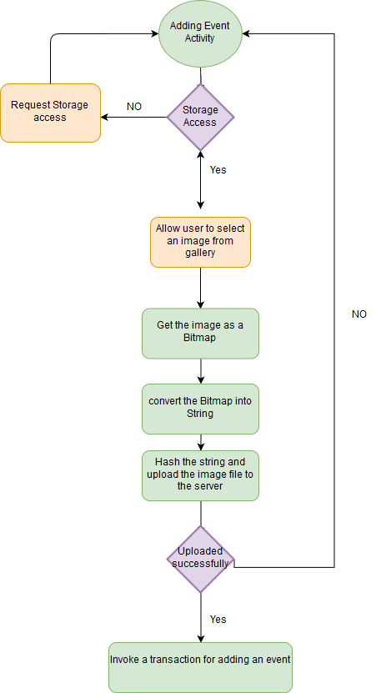
Adding an Event Walk-through

Slide 22
Hashing the Media File
For more efficient storage we store only the hash of the media file in the blockchain.
We are hashing the content using PBKDF2WithHmacSHA1
Serving the content from a CDN like amazon S3.

Slide 23
Home Feed
The main activity automatically fetches the events from the blockchain based on the location.
Displaying the events like Facebook or Instagram news feed.
This is done by using Recyclerview.Adapter and binding the data to the view holder.

Slide 24
Ranking Events
The user could simply rank the events by voting them up/down and adding photos with comments.

Slide 25
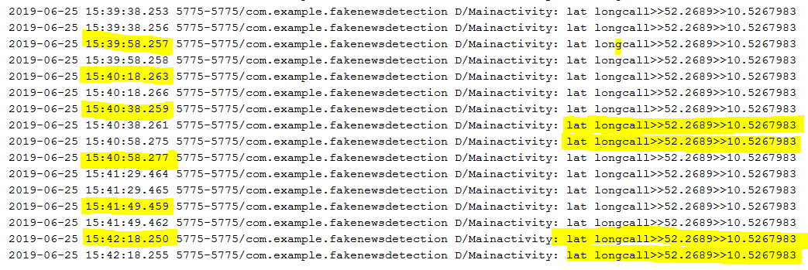
Location and Trustworthiness
The application automatically collects the users’ location.
The application should be integrated with another part that verifies the user’s location wasn’t faked or spoofed.
Assuming that the location wasn’t manipulated.
We are regularly capturing the location and sending it to the blockchain and this will increase the user’s trustworthiness.

Slide 26
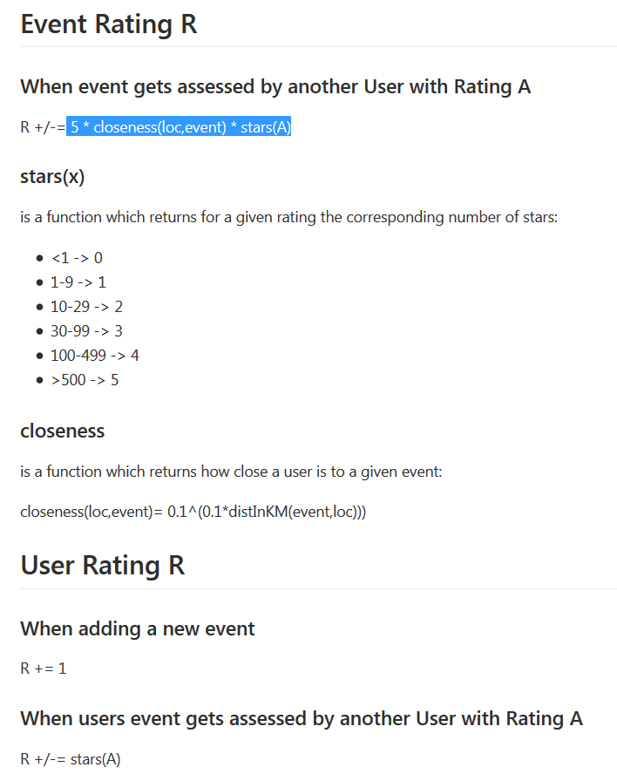
How Ranking Works
Every user starts with 0 reputation score.
This score increases the more the user interacts on the network.
Adding an event will increase his score by +1.
When other people rate his event this will directly reflect the user’s reputation score.
The algorithm considers the users rank and location trustworthiness.
What easily influence the user’s reputation. Is getting good/bad reviews from the highly ranked users.

Slide 27
Future Work
As it’s permissioned we could make a community and adding roles to the users.
Researchers verifiers, administrators.
Preventing users with bad reputation to post or vote.
Integrating machine learning more data and resources.
Making a community and based on the rank giving high privilege to the users, that they could delete posts or ban users.

Slide 28
Future work

