Slide 1

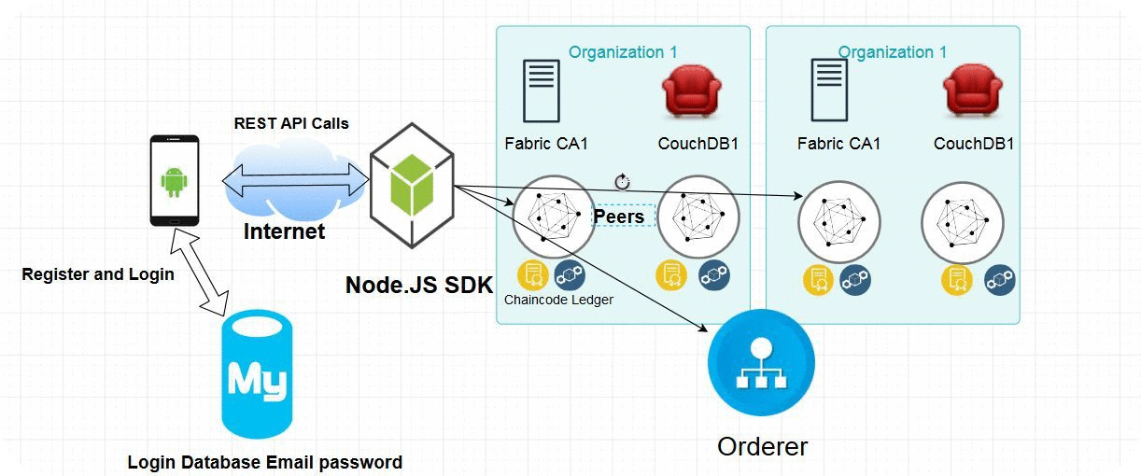

Trustworthy Recording of Media Files
Using Blockchains
Hesham Hosney, ITIS Student, TU Braunschweig
Prof. Dr. Rüdiger Kapitza & M.Sc. Signe Rüsch
Problem
Aim
Fake news or fabricated content deceitfully presented as real news
Fake news stories getting a lot of traction on social media, at times even outperforming actual news stories
Using Hyperledger Fabric as a blockchain platform
Prototyping a mobile application that depicts a use case scenario for detecting fake news
Method
Solution
Conclusion
A mobile application that mitigates the spread of fake news
Incenting people to share and rank stories and stash the results on the blockchain
We implemented a mobile app prototype using Android and Hyperledger Fabric
The data is immutably stored on a decentralized blockchain
The Chaincode will rank users and events based on the location and trustworthiness

