Slide 1
Trustworthy Recording of Media Files Using Blockchains Research Project
Hesham Hosney, 4th July 2019
ITIS TU Braunschweig
Supervisors: Prof. Dr. Rüdiger Kapitza & M.Sc. Signe Rüsch

Slide 2
The Motivation
The main idea and the application work flow
Notes:
Talk about the motivation and the main idea

Slide 3

Problem Statement
Fake news or fabricated content deceitfully presented as real news.
Outperforming actual news stories.
Biasing the public opinion.
No incentive to be honest.
Notes:
.
]]Facebook shows an endless stream of items from all over the web. Click an interesting headline and you may end up on a fake-news site, set up by a political propagandist or a teenager in Macedonia to attract traffic and generate advertising revenue. Peddlers of fake stories have no reputation to maintain and no incentive to stay honest; they are only interested in the clicks. Hence the bogus stories, among the most popular of 2016, that the pope had endorsed Donald Trump, or that Hillary Clinton had sold weapons to Islamic State. The impetus behind these was commercial rather than political; it transpired that Trump supporters were more likely to click and share bogus stories.
Ruins people reputation bias the political opinion and spread hatred

Slide 4
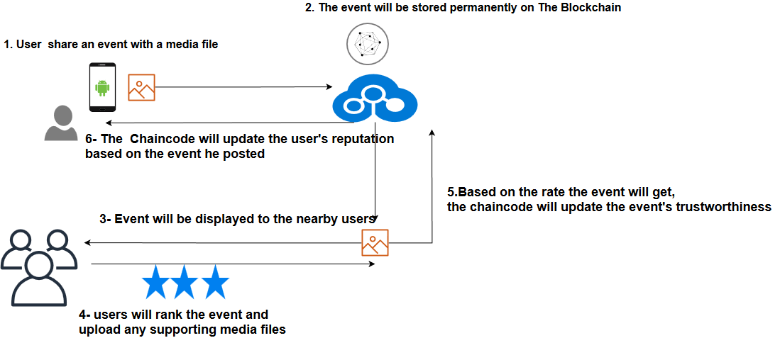
Fake News Detection a Case Study for Hyperledger Fabric
A real application use case scenario for fake news detection.
Trustworthiness will be based on the users’ location and the users’ rating.
Notes:
An Application that boosts our blockchain knowledge and gives us a profound understanding of the technology
The best way of learning anything is by doing
Proposed a mobile application for detecting the fake news by using the blockchain.
We incent users to share and rank others stories and other people in the area could view and interact and
Reputation
What we could do with application more generated more application why we used the blockcain concept .
Why it’s an interesting use case.

Slide 5

Blockchain and Hyperledger Fabric Background
Discussing the prerequisite background knowledge
The Infrastructure
Discussing the application infrastructure, Docker Container nodes, and node.js SDK
Android Application Development
The android application development in details
Roadmap
Issues, Future Work and Conclusion
Warp up all what have been discussed, Issues and Future work.
Demo
A live demonstration for the application capability.

Slide 6
Blockchain and Hyperledger Fabric Background
Discussing the prerequisite background knowledge

Slide 7
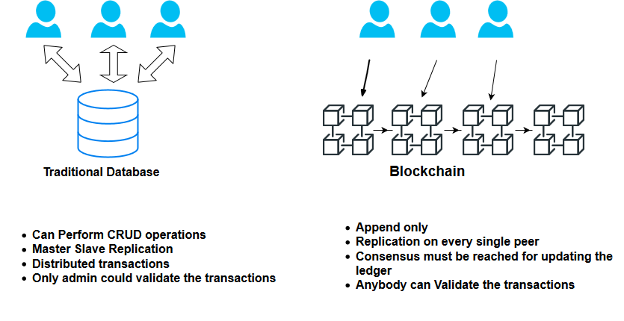
Blockchain
Blockchain is a distributed open ledger.
Very difficult to be tampered.
Data stored in blocks.
Decentralized.
No central management authority.
Notes:
One of the most hyped technology trends
Someone has to have access to servers and and update the event change or delete the data if it’s stored in normal database.
All business record will be managed via blockchain to hack you have to attack all the peers one by one to change the data .

Slide 8

Hyperledger Fabric
Hyperledger Fabric is an open source collaborative effort governed by The Linux Foundation.
Permissioned blockchain.
The smart contracts("chaincode") in general-purpose programming languages such as Java, Go and Node.js.
More efficient by using different consensus mechanism.
Modular Design.
Notes:
One of the most growing projects in the linux foundation
Permssioned blockchain unlike bitcoin not everyone could just simply join the network
permissioned blockchains only allow certain entities that have the right permission to be included in the blockchain network and to participate in trans-action execution and validation.
the smart contract in gppl eliminates the learning time.
Modular by design

Slide 9

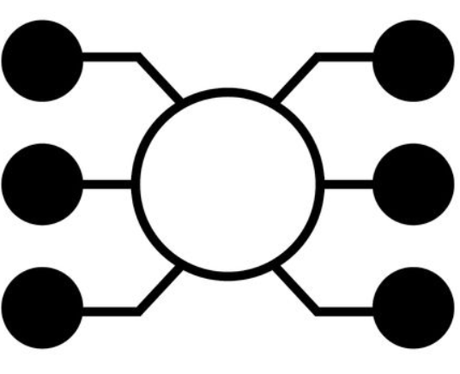


Hyperledger Fabric Terminology
Orderers: Order the transaction and create the blocks.
Peers: Network nodes host the ledger and the smart contract.
Chaincode (Smart Contracts):
The only way to interact with the ledger and holds the business logic.
The Ledger: It stores the information, and comprises of the blockchain and the world state.
Notes:
Blockchain a transaction log that records all
Order unique concept is a special node for ordering the transaction put them in order and create the block and sends it to the commiting peers to write it to the ledger.
By this they are eliminating the mining concept.

Slide 10
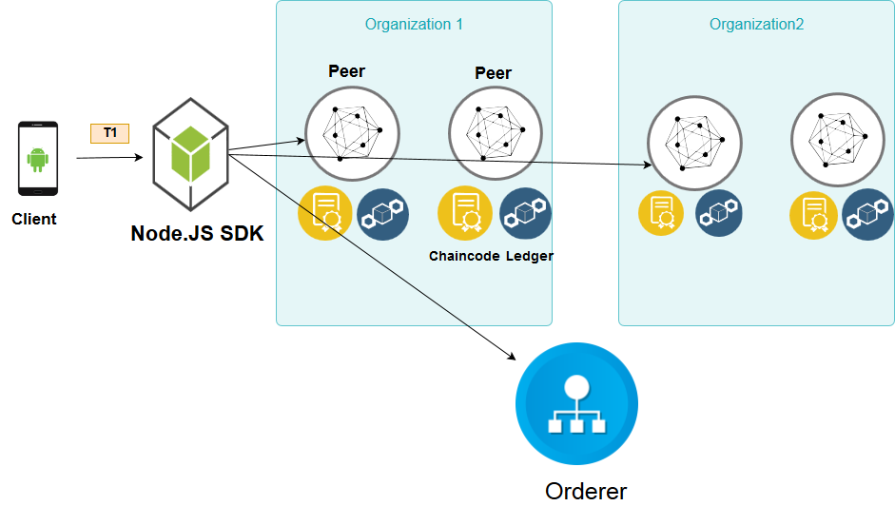
Transaction Flow
Photo Reference : https://www.ibm.com/support/knowledgecenter/bluemix_stage/services/blockchain/reference/v10_fabric.html
Notes:
Using APIs available in the SDK, sends a request.
SDK makes it a transaction proposal and sends it to the peers.
Peers simulate the transaction and sends back responses to the SDK.
SDK collects responses and sends them to the orderer.
Orderer sends the block to the committing peers.
SDK wants to make a transaction SDK makes a transaction proposal invoke a method on the chaincode and pass this parameters.
Then sending it to the peers and apply the endorsement policy to add a transaction two peers from two different org must sign the transaction or one from
Org 1 whatever you want it’s adaptable.
Peers receive the proposal they simulate the transaction execute the chaincode so read values and write new values nothing changed.
Once done they add read write sets and sign the response and send it back to sdk.
Sdk collects all responses from different peers must be the same.
Next step send it to the orderer will validate the transaction it will wait for a block is full or a timeout passed then send ti to peers and the peers will add It to the ledger and update the world state.
The peer broadcast the event which sdk listens to it that the transaction approved or rejected.

Slide 11
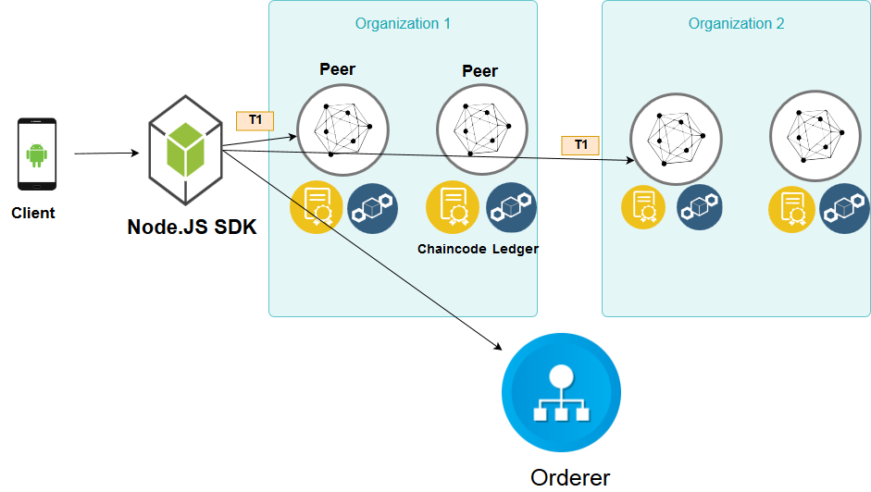
Transaction Flow
Photo Reference : https://www.ibm.com/support/knowledgecenter/bluemix_stage/services/blockchain/reference/v10_fabric.html
Notes:
Using APIs available in the SDK, sends a request.
SDK makes it a transaction proposal and sends it to the peers.
Peers simulate the transaction and sends back responses to the SDK.
SDK collects responses and sends them to the orderer.
Orderer sends the block to the committing peers.
SDK wants to make a transaction SDK makes a transaction proposal invoke a method on the chaincode and pass this parameters.
Then sending it to the peers and apply the endorsement policy to add a transaction two peers from two different org must sign the transaction or one from
Org 1 whatever you want it’s adaptable.
Peers receive the proposal they simulate the transaction execute the chaincode so read values and write new values nothing changed.
Once done they add read write sets and sign the response and send it back to sdk.
Sdk collects all responses from different peers must be the same.
Next step send it to the orderer will validate the transaction it will wait for a block is full or a timeout passed then send ti to peers and the peers will add It to the ledger and update the world state.
The peer broadcast the event which sdk listens to it that the transaction approved or rejected.

Slide 12
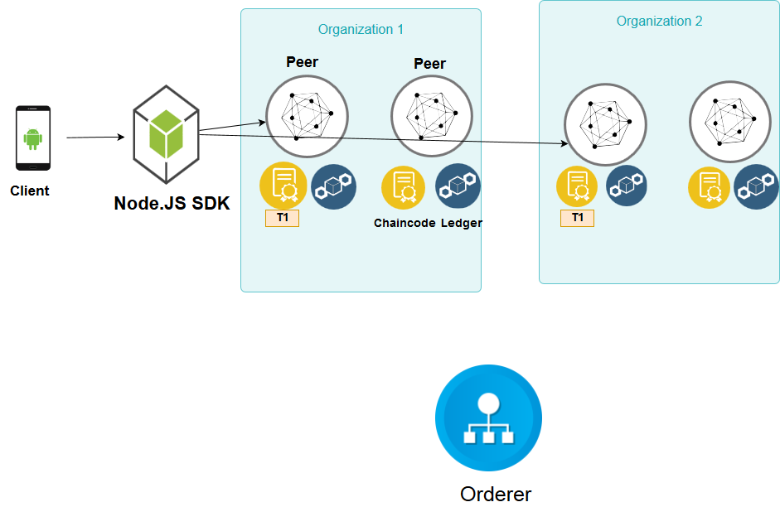
Transaction Flow
Photo Reference : https://www.ibm.com/support/knowledgecenter/bluemix_stage/services/blockchain/reference/v10_fabric.html
Notes:
Using APIs available in the SDK, sends a request.
SDK makes it a transaction proposal and sends it to the peers.
Peers simulate the transaction and sends back responses to the SDK.
SDK collects responses and sends them to the orderer.
Orderer sends the block to the committing peers.
SDK wants to make a transaction SDK makes a transaction proposal invoke a method on the chaincode and pass this parameters.
Then sending it to the peers and apply the endorsement policy to add a transaction two peers from two different org must sign the transaction or one from
Org 1 whatever you want it’s adaptable.
Peers receive the proposal they simulate the transaction execute the chaincode so read values and write new values nothing changed.
Once done they add read write sets and sign the response and send it back to sdk.
Sdk collects all responses from different peers must be the same.
Next step send it to the orderer will validate the transaction it will wait for a block is full or a timeout passed then send ti to peers and the peers will add It to the ledger and update the world state.
The peer broadcast the event which sdk listens to it that the transaction approved or rejected.

Slide 13
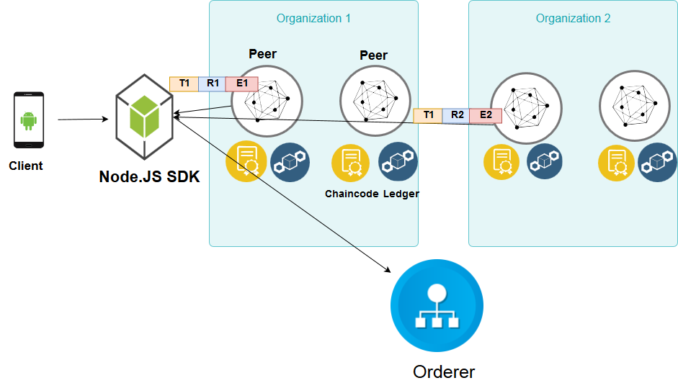
Transaction Flow
Photo Reference : https://www.ibm.com/support/knowledgecenter/bluemix_stage/services/blockchain/reference/v10_fabric.html
Notes:
Using APIs available in the SDK, sends a request.
SDK makes it a transaction proposal and sends it to the peers.
Peers simulate the transaction and sends back responses to the SDK.
SDK collects responses and sends them to the orderer.
Orderer sends the block to the committing peers.
SDK wants to make a transaction SDK makes a transaction proposal invoke a method on the chaincode and pass this parameters.
Then sending it to the peers and apply the endorsement policy to add a transaction two peers from two different org must sign the transaction or one from
Org 1 whatever you want it’s adaptable.
Peers receive the proposal they simulate the transaction execute the chaincode so read values and write new values nothing changed.
Once done they add read write sets and sign the response and send it back to sdk.
Sdk collects all responses from different peers must be the same.
Next step send it to the orderer will validate the transaction it will wait for a block is full or a timeout passed then send ti to peers and the peers will add It to the ledger and update the world state.
The peer broadcast the event which sdk listens to it that the transaction approved or rejected.

Slide 14
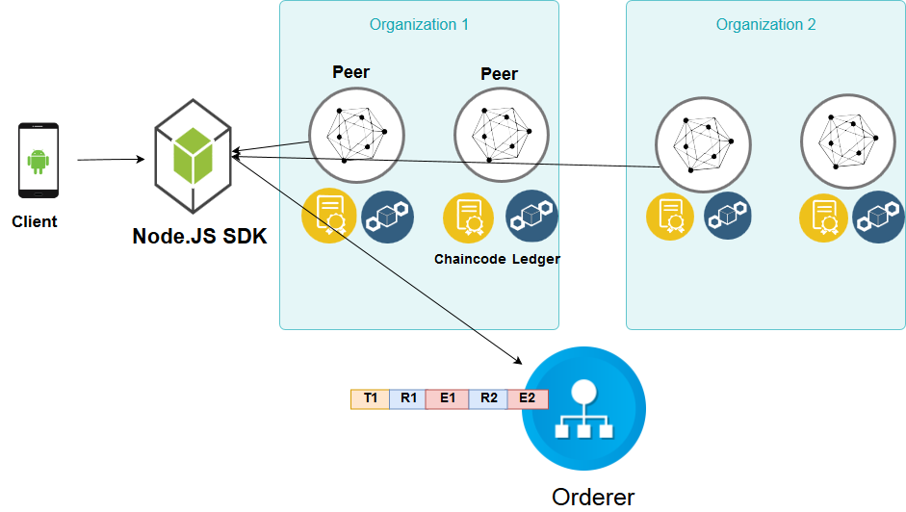
Transaction Flow
Photo Reference : https://www.ibm.com/support/knowledgecenter/bluemix_stage/services/blockchain/reference/v10_fabric.html
Notes:
Using APIs available in the SDK, sends a request.
SDK makes it a transaction proposal and sends it to the peers.
Peers simulate the transaction and sends back responses to the SDK.
SDK collects responses and sends them to the orderer.
Orderer sends the block to the committing peers.
SDK wants to make a transaction SDK makes a transaction proposal invoke a method on the chaincode and pass this parameters.
Then sending it to the peers and apply the endorsement policy to add a transaction two peers from two different org must sign the transaction or one from
Org 1 whatever you want it’s adaptable.
Peers receive the proposal they simulate the transaction execute the chaincode so read values and write new values nothing changed.
Once done they add read write sets and sign the response and send it back to sdk.
Sdk collects all responses from different peers must be the same.
Next step send it to the orderer will validate the transaction it will wait for a block is full or a timeout passed then send ti to peers and the peers will add It to the ledger and update the world state.
The peer broadcast the event which sdk listens to it that the transaction approved or rejected.

Slide 15
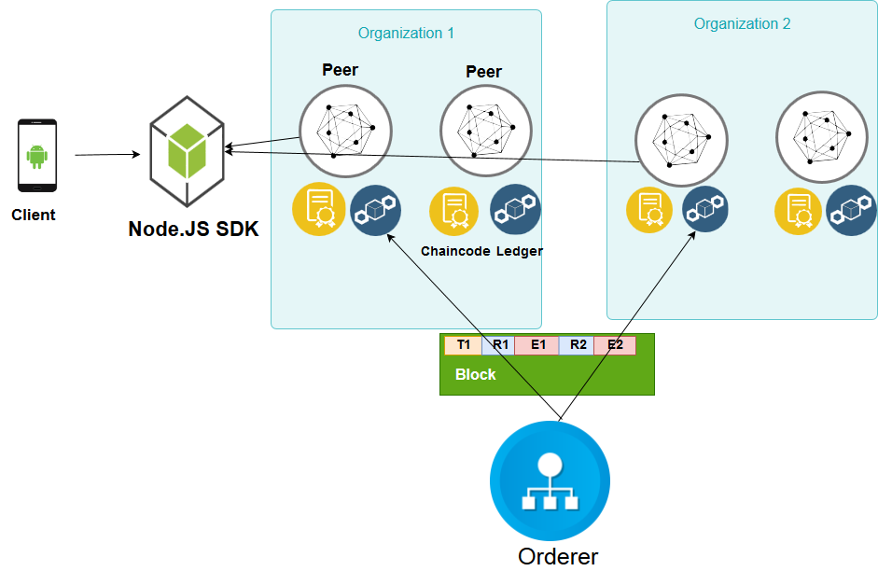
Transaction Flow
Photo Reference : https://www.ibm.com/support/knowledgecenter/bluemix_stage/services/blockchain/reference/v10_fabric.html
Notes:
Using APIs available in the SDK, sends a request.
SDK makes it a transaction proposal and sends it to the peers.
Peers simulate the transaction and sends back responses to the SDK.
SDK collects responses and sends them to the orderer.
Orderer sends the block to the committing peers.
SDK wants to make a transaction SDK makes a transaction proposal invoke a method on the chaincode and pass this parameters.
Then sending it to the peers and apply the endorsement policy to add a transaction two peers from two different org must sign the transaction or one from
Org 1 whatever you want it’s adaptable.
Peers receive the proposal they simulate the transaction execute the chaincode so read values and write new values nothing changed.
Once done they add read write sets and sign the response and send it back to sdk.
Sdk collects all responses from different peers must be the same.
Next step send it to the orderer will validate the transaction it will wait for a block is full or a timeout passed then send ti to peers and the peers will add It to the ledger and update the world state.
The peer broadcast the event which sdk listens to it that the transaction approved or rejected.

Slide 16
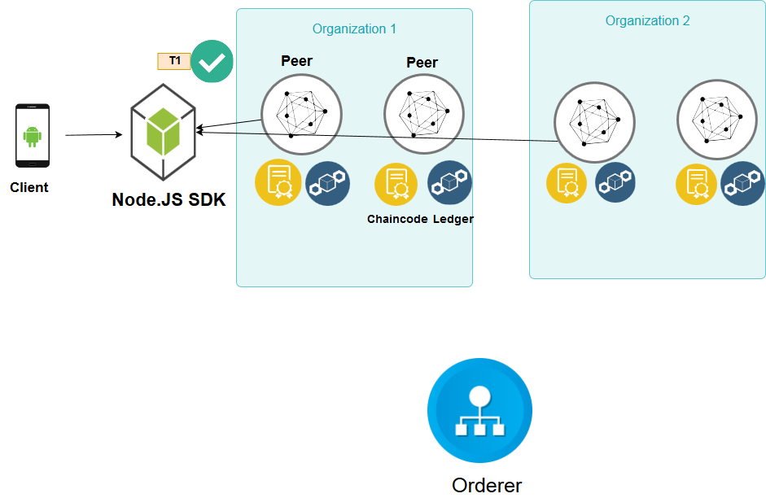
Transaction Flow

Slide 17
The Infrastructure
Discussing the application infrastructure overview, Docker Container nodes, and node.js SDK

Slide 18
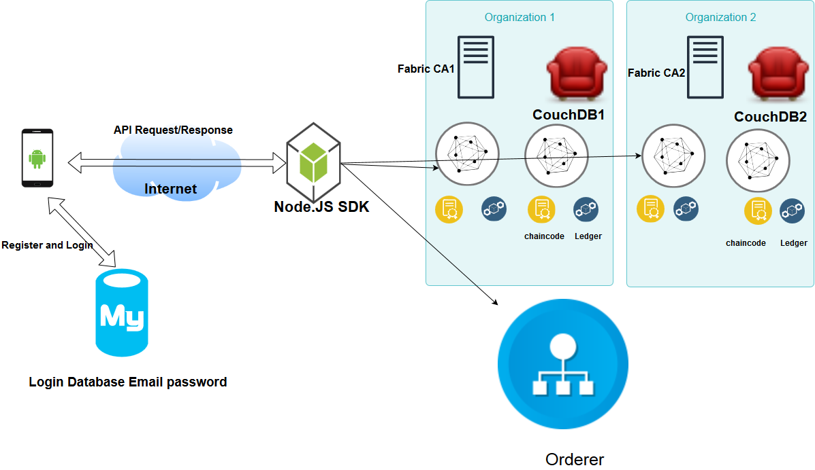
Platform Architecture and Design
Notes:
Note the size of the photo left and right
Hyperledger fabric provides a sample network and shell scripts for using hyperledger fabric.
Fabric ca server will be responsible for enrolling users and generating certificate on the fly
Solo orderer not in production

Slide 19
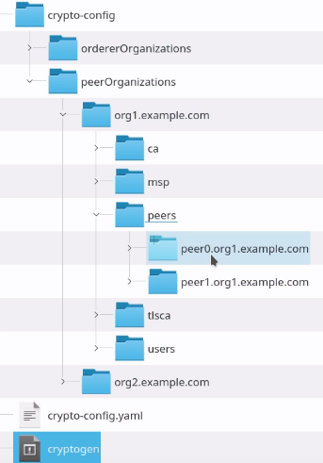
Building The Development Environment
Sample network and bash scripts in order to have an up-running network.
Defining network elements in a docker composer file such as organizations, peers, orderer and couch-database.
Generating the cryptographic material for network nodes.
Bringing up all docker container nodes.
Notes:
Using cryptogen tool certs and signing keys for different network entities.

Slide 20
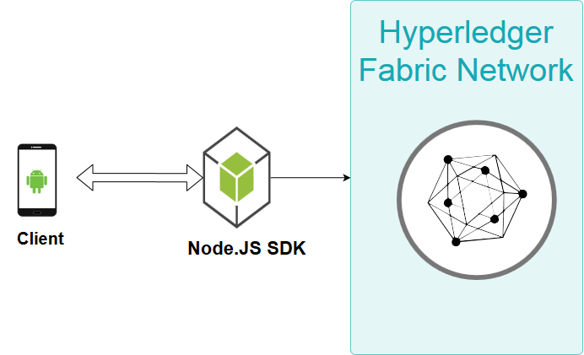
Hyperledger Fabric Client SDK using Node.js
SDKs encapsulate all access to the ledger.
Allow different Operations using API.
Node.js Libraries:
1- Fabric-client
2- Fabric-ca-client
Notes:
Using cryptogen tool certs and signing keys for different network entities.
SDKs encapsulate all access to the ledger
SDKs encapsulate all access to the ledger by allowing an application to communicate with smart contracts, run queries, or receive ledger updates.
Node.js process that exposes hyperledger fabric network as a REST API similar to Hyperledger Composer REST server.
Fabric-client encapsulates the APIs to interact with Peers and Orderers of the Fabric network to install and instantiate chaincodes, send transaction invocations and perform chaincode queries.
Fabric-ca-client to interact with the fabric-ca to manage user certificates.

Slide 21
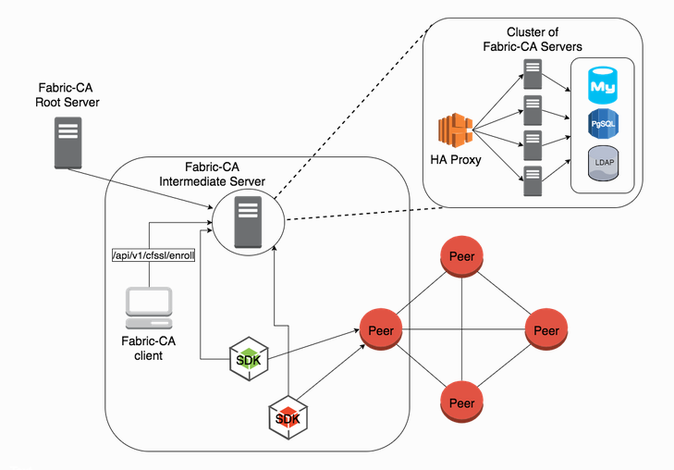
Fabric CA Server
Fabric CA Server Will be responsible for enrolling users.
Also, it will dynamically generate:
The ecerts.
Users private key.

Slide 22

Enrollment Procedures
Notes:
Using APIs available in the SDK, sends a request.
SDK makes it a transaction proposal and sends it to the peers.
Peers simulate the transaction and sends back responses to the SDK.
SDK collects responses and sends them to the orderer.
Orderer sends the block to the committing peers.
SDK wants to make a transaction SDK makes a transaction proposal invoke a method on the chaincode and pass this parameters.
Then sending it to the peers and apply the endorsement policy to add a transaction two peers from two different org must sign the transaction or one from
Org 1 whatever you want it’s adaptable.
Peers receive the proposal they simulate the transaction execute the chaincode so read values and write new values nothing changed.
Once done they add read write sets and sign the response and send it back to sdk.
Sdk collects all responses from different peers must be the same.
Next step send it to the orderer will validate the transaction it will wait for a block is full or a timeout passed then send ti to peers and the peers will add It to the ledger and update the world state.
The peer broadcast the event which sdk listens to it that the transaction approved or rejected.

Slide 23

Enrollment Procedures
Notes:
Using APIs available in the SDK, sends a request.
SDK makes it a transaction proposal and sends it to the peers.
Peers simulate the transaction and sends back responses to the SDK.
SDK collects responses and sends them to the orderer.
Orderer sends the block to the committing peers.
SDK wants to make a transaction SDK makes a transaction proposal invoke a method on the chaincode and pass this parameters.
Then sending it to the peers and apply the endorsement policy to add a transaction two peers from two different org must sign the transaction or one from
Org 1 whatever you want it’s adaptable.
Peers receive the proposal they simulate the transaction execute the chaincode so read values and write new values nothing changed.
Once done they add read write sets and sign the response and send it back to sdk.
Sdk collects all responses from different peers must be the same.
Next step send it to the orderer will validate the transaction it will wait for a block is full or a timeout passed then send ti to peers and the peers will add It to the ledger and update the world state.
The peer broadcast the event which sdk listens to it that the transaction approved or rejected.

Slide 24
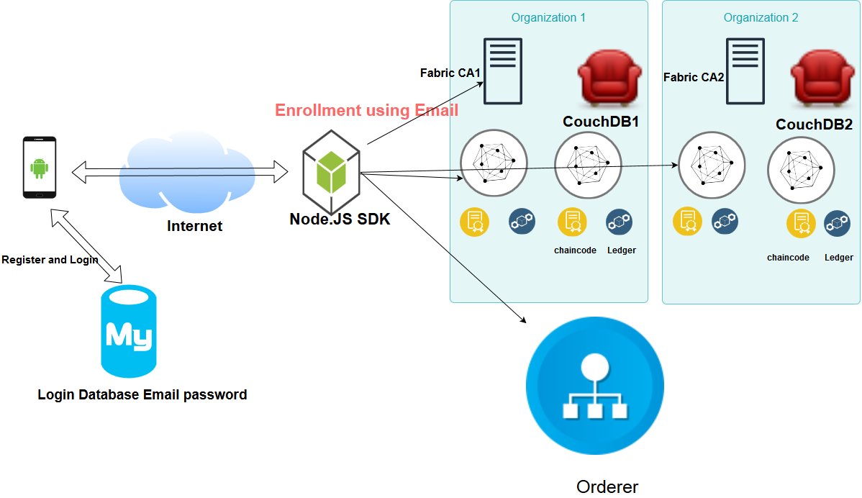
Enrollment Procedures
Notes:
Using APIs available in the SDK, sends a request.
SDK makes it a transaction proposal and sends it to the peers.
Peers simulate the transaction and sends back responses to the SDK.
SDK collects responses and sends them to the orderer.
Orderer sends the block to the committing peers.
SDK wants to make a transaction SDK makes a transaction proposal invoke a method on the chaincode and pass this parameters.
Then sending it to the peers and apply the endorsement policy to add a transaction two peers from two different org must sign the transaction or one from
Org 1 whatever you want it’s adaptable.
Peers receive the proposal they simulate the transaction execute the chaincode so read values and write new values nothing changed.
Once done they add read write sets and sign the response and send it back to sdk.
Sdk collects all responses from different peers must be the same.
Next step send it to the orderer will validate the transaction it will wait for a block is full or a timeout passed then send ti to peers and the peers will add It to the ledger and update the world state.
The peer broadcast the event which sdk listens to it that the transaction approved or rejected.

Slide 25

Enrollment Procedures
Notes:
Using APIs available in the SDK, sends a request.
SDK makes it a transaction proposal and sends it to the peers.
Peers simulate the transaction and sends back responses to the SDK.
SDK collects responses and sends them to the orderer.
Orderer sends the block to the committing peers.
SDK wants to make a transaction SDK makes a transaction proposal invoke a method on the chaincode and pass this parameters.
Then sending it to the peers and apply the endorsement policy to add a transaction two peers from two different org must sign the transaction or one from
Org 1 whatever you want it’s adaptable.
Peers receive the proposal they simulate the transaction execute the chaincode so read values and write new values nothing changed.
Once done they add read write sets and sign the response and send it back to sdk.
Sdk collects all responses from different peers must be the same.
Next step send it to the orderer will validate the transaction it will wait for a block is full or a timeout passed then send ti to peers and the peers will add It to the ledger and update the world state.
The peer broadcast the event which sdk listens to it that the transaction approved or rejected.

Slide 26

Enrollment Procedures
Notes:
Using APIs available in the SDK, sends a request.
SDK makes it a transaction proposal and sends it to the peers.
Peers simulate the transaction and sends back responses to the SDK.
SDK collects responses and sends them to the orderer.
Orderer sends the block to the committing peers.
SDK wants to make a transaction SDK makes a transaction proposal invoke a method on the chaincode and pass this parameters.
Then sending it to the peers and apply the endorsement policy to add a transaction two peers from two different org must sign the transaction or one from
Org 1 whatever you want it’s adaptable.
Peers receive the proposal they simulate the transaction execute the chaincode so read values and write new values nothing changed.
Once done they add read write sets and sign the response and send it back to sdk.
Sdk collects all responses from different peers must be the same.
Next step send it to the orderer will validate the transaction it will wait for a block is full or a timeout passed then send ti to peers and the peers will add It to the ledger and update the world state.
The peer broadcast the event which sdk listens to it that the transaction approved or rejected.

Slide 27
Balance transfer Node.js APP
is a sample Node.js app to demonstrate fabric-client, fabric-ca-client, and Node.js SDK APIs.
Allows the communication with the hyperledger fabric network by using fabric node.js Libraries.
Allows different operations using GET/POST requests, such as channel’s creation, joining the channel, installing and instantiating the chaincode.
Notes:
Users will first authenticate with email and password using traditional database.
Then they will request to enroll and join the network every user has a unique email and password and the app will generate a JSON webtoken.
Using this JWT will enable the user to interact with the network query chaincode and invoke transactions.

Slide 28
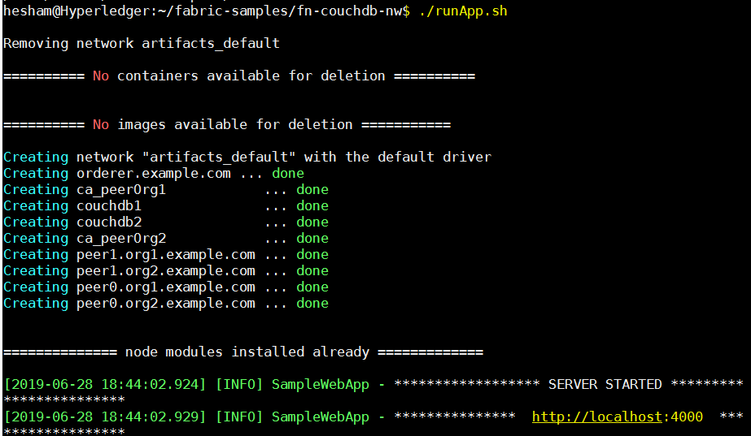
Node.Js App
This launches the required network on the local machine.
Installs the fabric-client and fabric-ca-client node modules.
starts the node app on PORT 4000.
Running ./testAPI.sh to create the channel and install/instantiate the chaincode.

Slide 29
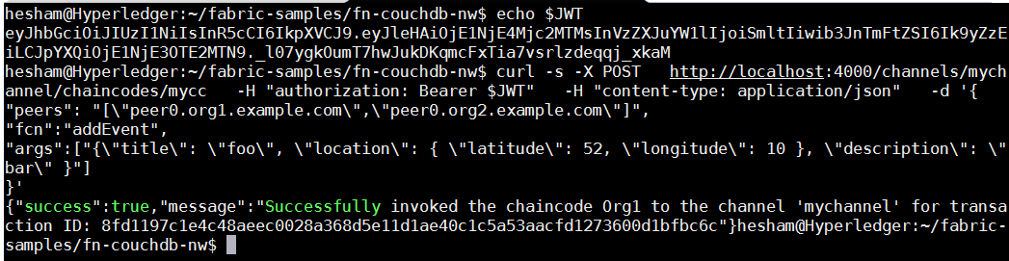
Simple REST API Call
Notes:
Making GET Request to query the chaincode and POST Request to invoke a transaction.
Calling the URL endpoint and passing the chaincode function name and the arguments.
We are passing JWT in the request header and the SDK validates the authorization.
Once the transaction was made the sdk Receives the JSON Response.

Slide 30
Android Application Development
The android application development in details

Slide 31
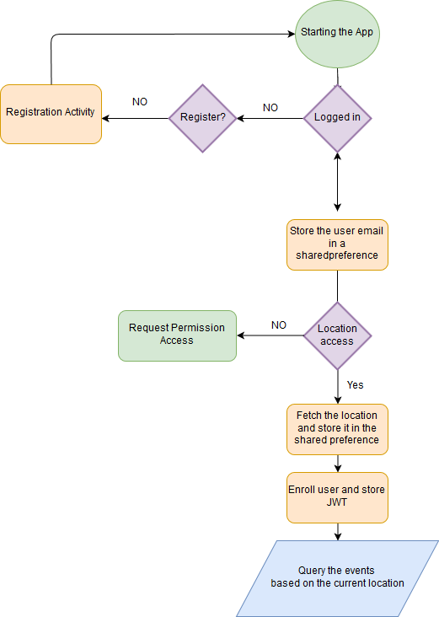
Main Activity Walk-through
Notes:
Starting the app and checking if the user logged-in.
If not directing to registration activity.
Check if the location access permission was guaranteed .
Enroll user and store the JWT.
Fetch the nearby events based on the user location by querying the blockchain

Slide 32
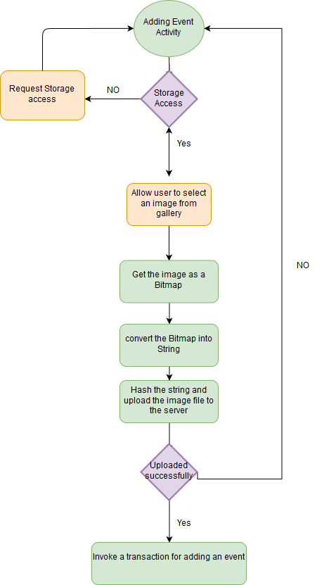
Adding an Event Walk-through

Slide 33
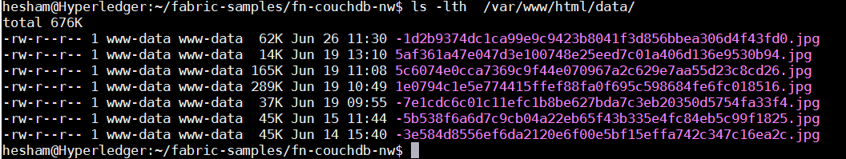
Hashing the Media File
For more efficient storage we store only the hash of the media file in the blockchain.
We are hashing the content using PBKDF2WithHmacSHA1
Serving the content from a CDN like amazon S3.

Slide 34
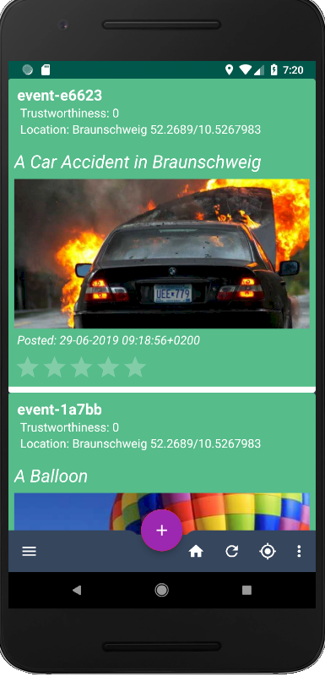
Home Feed
Automatically fetching the nearby events from the blockchain based on the location.
Displaying the events like Facebook or Instagram news feed in a chronological order.
Translating the latitude/longitude into a city name using Geocoder
Notes:
a chronological order most recent first

Slide 35
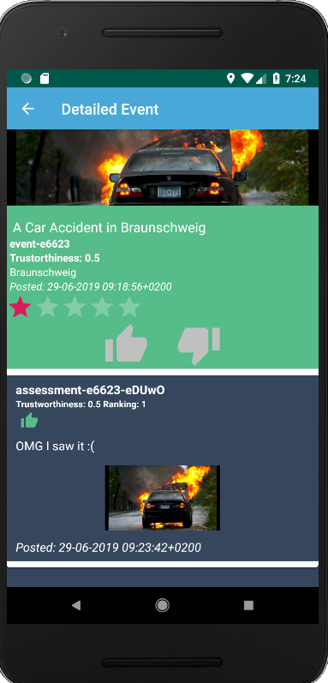
Ranking Events
The users could simply rank the events by voting them up/down.
In addition, they could also add photos and comments.

Slide 36
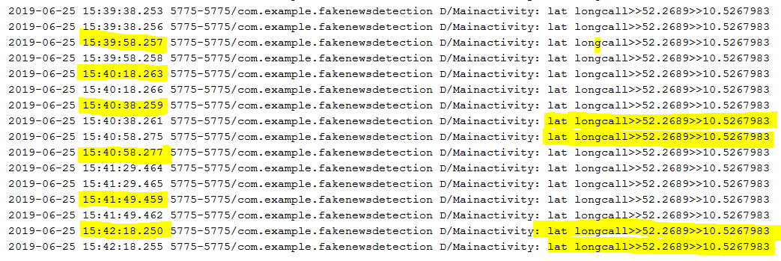
Location and Trustworthiness
The application automatically collects the users’ location.
Assuming that the location wasn’t manipulated.
We are regularly capturing the location and sending it to the blockchain and this will increase the user’s trustworthiness.
Notes:
Enforcing the business logic using the chaincode.

Slide 37
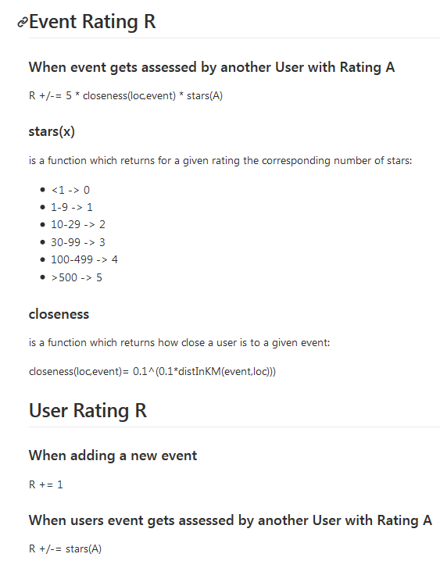
How Ranking Works
Every user starts with 0 reputation score.
Adding an event will increase his score by +1.
When other people rate his event this will directly reflect the user’s reputation score.
The algorithm considers the users rank and location trustworthiness(How Close).
What easily influences the user’s reputation. Is getting good/bad reviews from the highly ranked users.

Slide 38
5- Issues, Future Work and Conclusion
Warp up all what have been discussed, Issues and Future work.

Slide 39
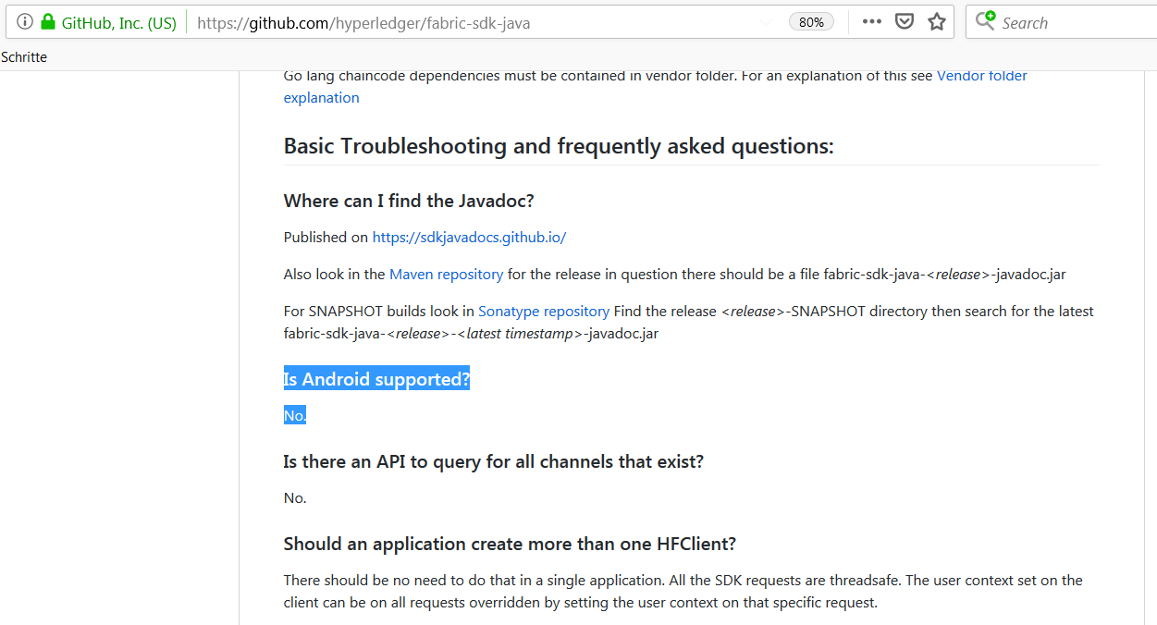
Issues and open question
1- Where should the SDK be installed from Architecture?
On the server side where the hyperledger fabric lives?
On the Client side (Android) no official support for an android SDK only GO, javascript and java.

Slide 40
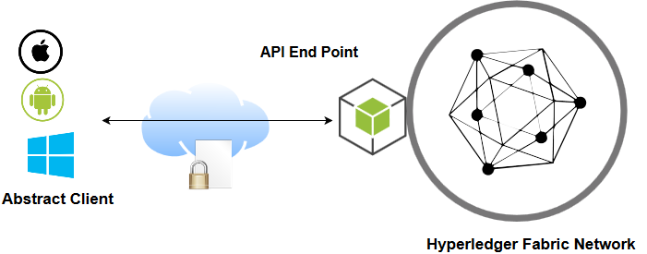
Why Obscuring The Network?
No Officially supported SDK for Android.
Abstract the client the knowledge of hyperledger fabric.
Standardizing the communication using APIs.
Avoid the latency and restrict all the transaction flow on the internal network.
The communication will be encrypted using SSL certificate.
Avoid the unnecessary SDK Library size on the smartphone.
SDK

Slide 41
Future Work
Different actors such as, Researchers, Verifiers and Administrators .
Making a community and based on the reputation we grant more privileges to the users, that they could delete posts or ban other users.
Preventing users with bad reputation from posting or voting.

Slide 42
Conclusion
We implemented an application for fake news detection based on Hyperledger Fabric.
Hyperledger Fabric is a complex solution and requires a concrete understanding of different technologies.
The application could be scaled, furthermore easily adopting more complex business logic.

Slide 43
5- Demo
A live demonstration for the application capability.

