Slide 1

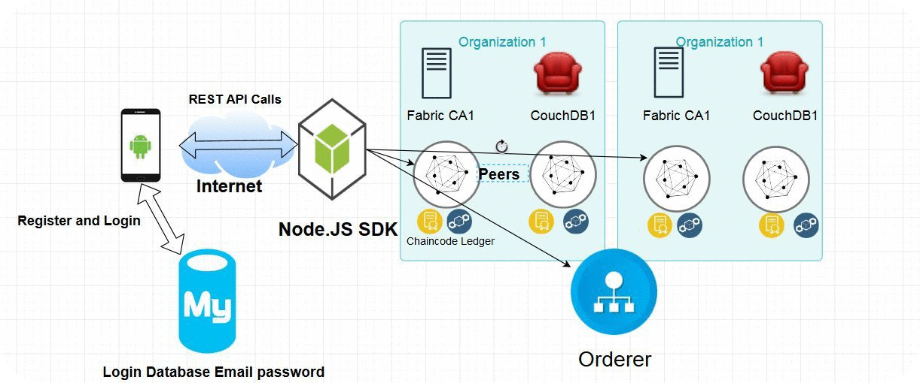

Trustworthy Recording of Media Files
Using Blockchains
Hesham Hosney, ITIS Student, TU Braunschweig
Prof. Dr. Rüdiger Kapitza & M.Sc. Signe Rüsch
Problem
Solution
Fake news or fabricated content deceitfully presented as real news.
Fake news stories getting a lot of traction on social media, at times even outperforming actual news stories.
A Mobile application that mitigates the spread of fake news.
Incenting people to share and rank stories and stash the results on the blockchain.
Method
Aim
Conclusion
Using Hyperledger Fabric as a blockchain platform.
Prototyping a mobile application that depicts a use case scenario for detecting fake news.
We implemented a mobile app prototype using Android and Hyperledger Fabric.
The data is immutably stored on a decentralized blockchain.
The Chaincode will rank users and events based on the location and trustworthiness.

