Slide 1

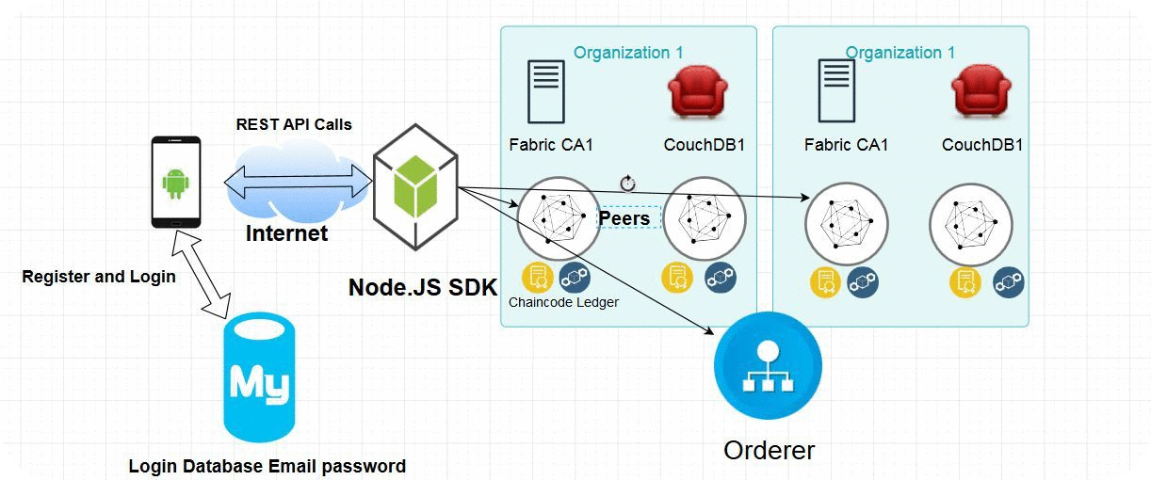


Trustworthy Recording of Media Files
Using Blockchains
Hesham Hosney, ITIS Student, TU Braunschweig
Prof. Dr. Rüdiger Kapitza & M.Sc. Signe Rüsch
Problem
Aim
Fake news or fabricated content deceitfully presented as real news
Fake news stories getting a lot of traction on social media, at times even outperforming actual news stories
Using Hyperledger Fabric as a blockchain platform
Prototyping an android application that depicts a use case scenario for detecting fake news
Method
Solution
Conclusion
Incenting people to share and rank stories, and stashing the hashed result on the blockchain
Collecting the location traces of the users and calculate the reputation score based on their contribution
We implemented a mobile app prototype using Android and Hyperledger Fabric
The data is immutably stored on a decentralized blockchain
The Chaincode will rank users and events based on the location and trustworthiness

