Slide 1
Mavlink and MSP Protocols Overview Graph Models and Simulation Research
Hesham Hosney, 25th October 2019
ITIS TU Braunschweig
Supervisors: Dr Umut Durak

Slide 2

Introduction
Discussing the prerequisite background knowledge
Mavlink Protocol
Discussing Mavlink Protocol
MSP Protocol
Discussing MSP Protocol
Roadmap
Messages Reference
Mapping messages between Protocols.
Conclusion

Slide 3
Introduction
Discussing the prerequisite background knowledge

Slide 4
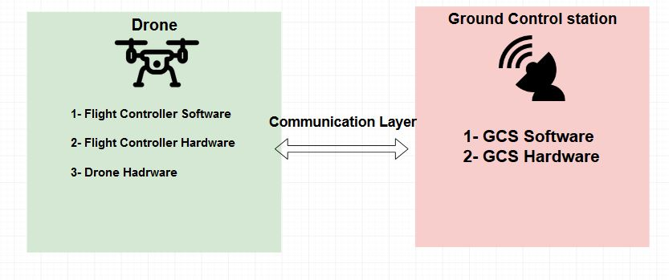
The Flight Stack
Ground Control Station
Drone
Communication Layer

Slide 5
Mavlink Protocol
Discussing Mavlink Protocol

Slide 6
Mavlink
Mavlink is a communication protocol which allows drones to communicate with ground stations.
facilitates exchanging messages between vehicles such as drones and ground station For instance monitoring the position or performing more actions.
Mavlink was released early 2009 by Lorenz Meier under LGPL.

Slide 7
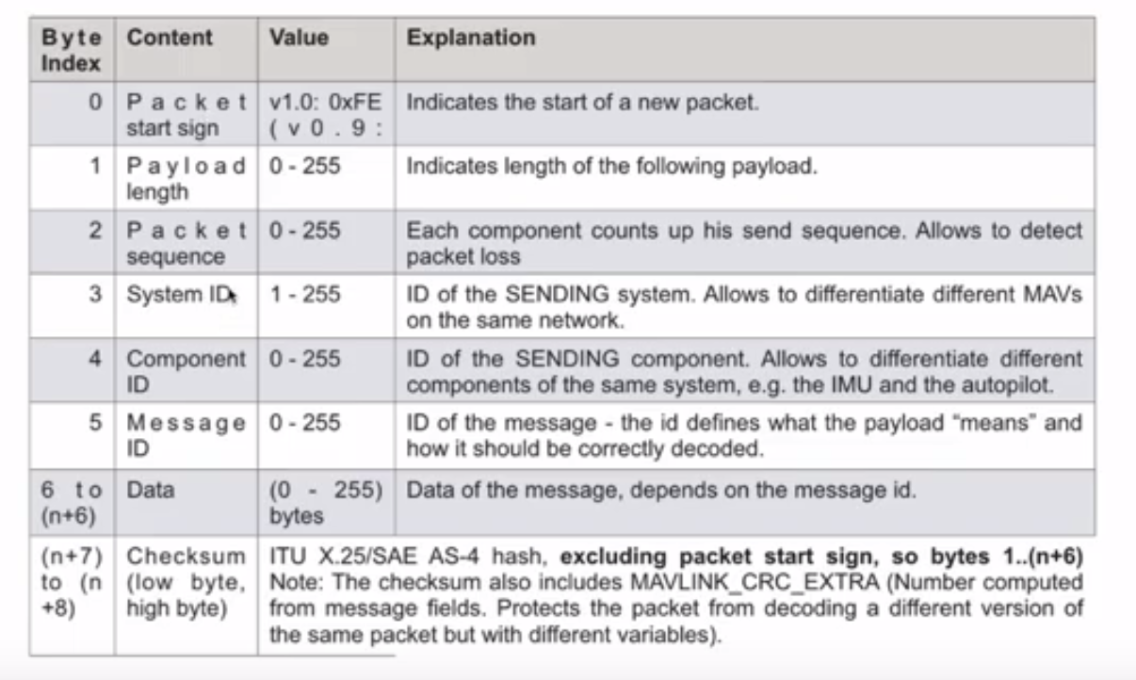
Mavlink Message Structure
Mavlink Message length is 17 Bytes.
6 bytes Header and 9 Payload.
Every Message has a unique ID.
Notes:
All mavlink messages contain a header appended to the payload of the message.
The header contains information about the message. And the payload contains the data carried out by the message.
The total Mavlink message is 17 bytes
6 bytes for the header and 9 byte for the payload and 2 byte for the checksum for verifying the message integrity and assuring that the message wasn’t altered during the transmission.
Header contains a packet start sign encoded into one byte which indicates the starting of the packet.
Payload length indicates the length of the following payload.
Packet sequence for sequencing the packets thus it’s a method to detect packet loss.
System Id to identify the system ground always 1-255.
Component id to identify the component sending the message inside the system usually zero.
Msg id identify the type of message in the payload for instance 0 is heartbeat. 33 it means the message is carrying out the GPs coordinates.
This is will be our main focus in the research.
Data: payload and it depends on the message id.
Last two bytes are for identifying the checksum,

Slide 8
Multiwwi Serial Protocol MSP
Discussing MSP Protocol

Slide 9
MultiWii Serial Protocol
MSP MultiWii Serial Protocol is the de-facto standard to interact with a MultiWii flight controller (FC).
Its implementation contains a list of the most common operations one would expect from a remote control/telemetry point of view.

Slide 10
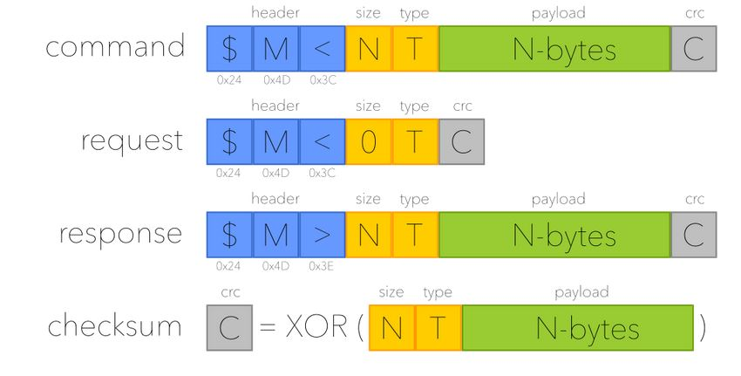
MSP Message
Command from drone to CS with some info
Request from drone to CS asking for info
Response from cs to drone responding to a request
Notes:
1.3.1 Header
The header is three bytes and contains the message start characters $M and a character showing
which direction the message is going. < denotes going to the ight controller (command and request),
> denotes coming from the ight controller (response).
1.3.2 Size
The fourth byte is the length (in bytes) of the data section. For example, if the data section had
three INT 16 variables then the size byte would be 6.
1.3.3 Type
The 5th byte is the type of MSP message similar to Mavlink message ID. Value 1xx identify requests
while 2xx identify commands. A full list of MSP[2]
1.3.4 Data
The data is where all the information is sent. Request messages have no data in them. Commands
and responses do, because they contain information.
1.3.5 Checksum
The nal byte of an MSP message is the checksum. "The checksum is the XOR of size, type and
payload bytes". For a request message the checksum is equal to the type.
Figure 1.3 Depicts MSP message structure.
4

Slide 11
Messages Reference
Mapping the related Messages Between Mavlink and MSP

Slide 12
Mapping Messages using a Comptability Matrix
Messages were highlighted with the following colors as an indication of the compatibility between Mavlink and MSP.
Green: Fully Compatible.
Yellow: Not Compatible.
LightGray: Partially Compatible different in the datatype.

Slide 13
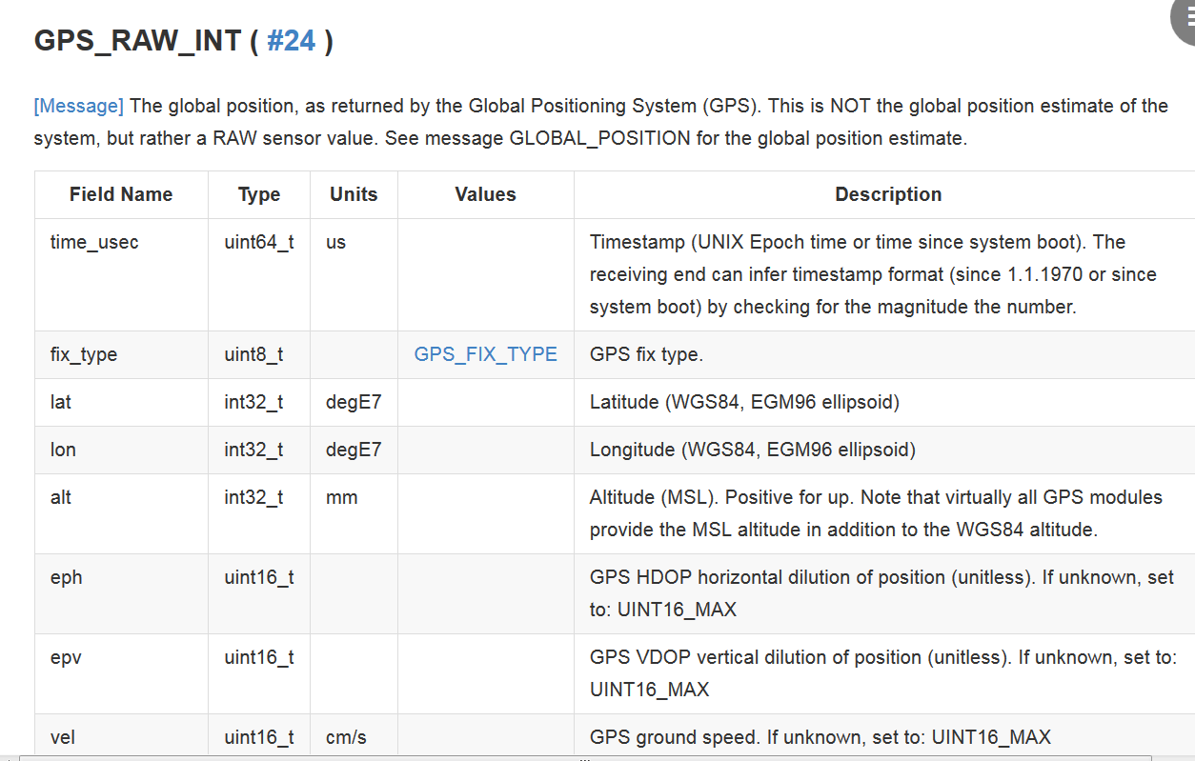
Mavlink Message Example

Slide 14
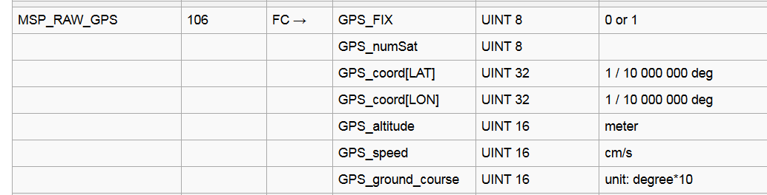
MSP Message Example

Slide 15
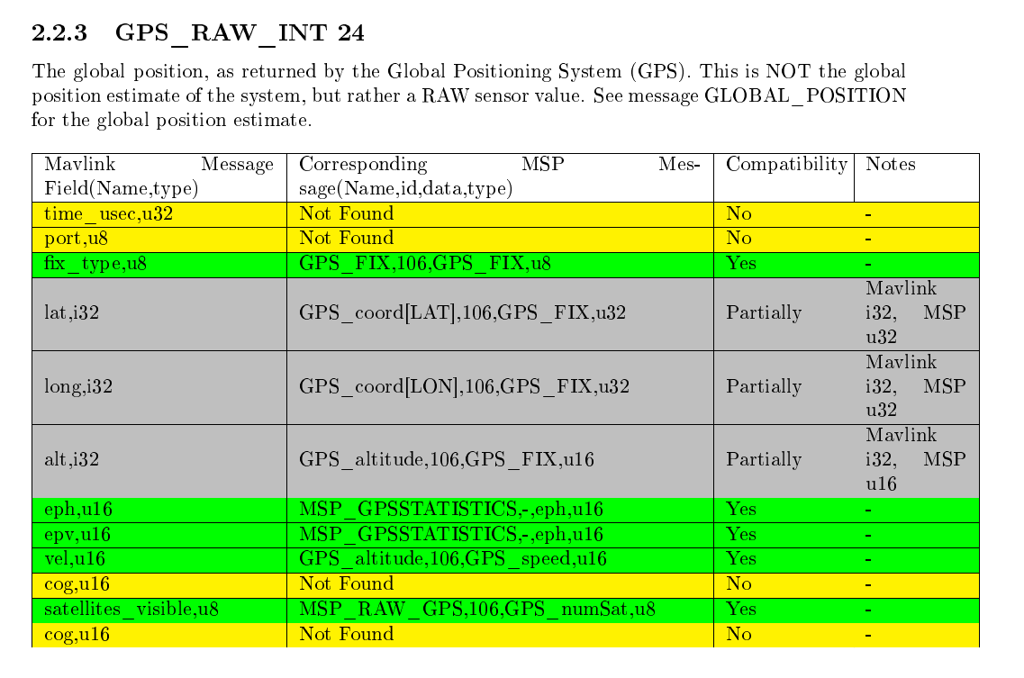
Example

Slide 16
Conclusion
Mapping the most Important MAVLink Messages to the related MSP Messages.

