Slide 1
Employee Retention Prediction

Slide 2

Agenda
Introduction
Objective
Data Understanding
Data Preprocessing
EDA (Exploratory Data Analysis)
Model Selection
Model Evaluation
Model Deployment with Streamlit
Conclusion & Recommendations

Slide 3

Introduction (Project Overview)
Focus: Predicting job change likelihood among data scientists
Why: High attrition disrupts projects, increases costs
How: Data-driven prediction using employee attributes
Goal: Support HR in proactive retention strategies

Slide 4

Objectives
Predict the probability of an employee seeking a job change.
Identify top factors influencing job change decisions.
Build a model with optimal accuracy and generalization.
Provide actionable insights for retention planning.

Slide 5
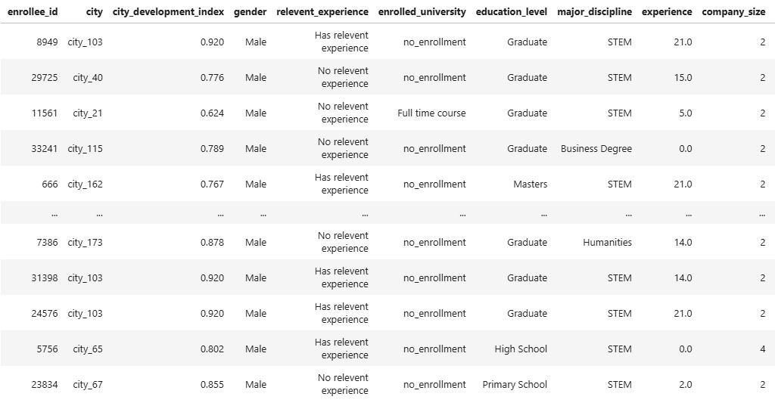
Data Acquisition
Dataset: Employee profiles with multiple features (experience, training, company size, etc.)
Target variable:
1: Employee is not likely to change jobs
0: Employee is not likely to change jobs
Variables: Mix of categorical & numerical
Size:
Rows: 19,158
Columns: 14

Slide 6
Model Development Process
Import Libraries
Load Dataset
Explore Data
Data Cleaning
Handle Missing Values
Visualization
Split Into Train & Test
Model Building
Model Evaluation

Slide 7
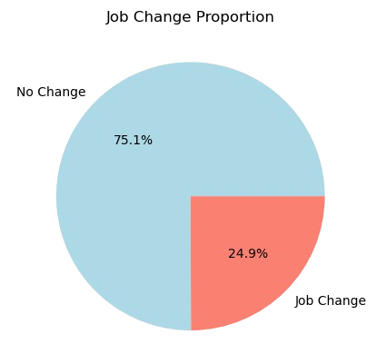
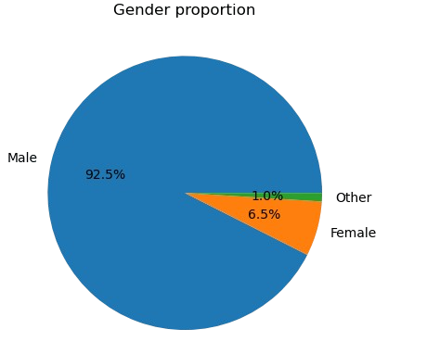
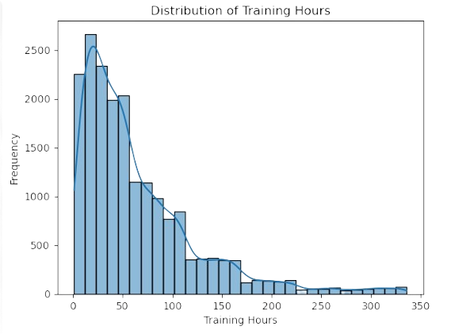
Explore Data Analysis (EDA)
UNIVARIATE ANALYSIS
Job Change Proportion
No Change: 75.1%
Job Change: 24.9%
Gender Proportion
Male: 92.5%
Female: 6.5%
Other: 1.0%
Training Hours Distribution
Skewed distribution — most employees have ≤100 hours of training.
Long tail up to ~350 hours → indicates some high-training outliers.

Slide 8
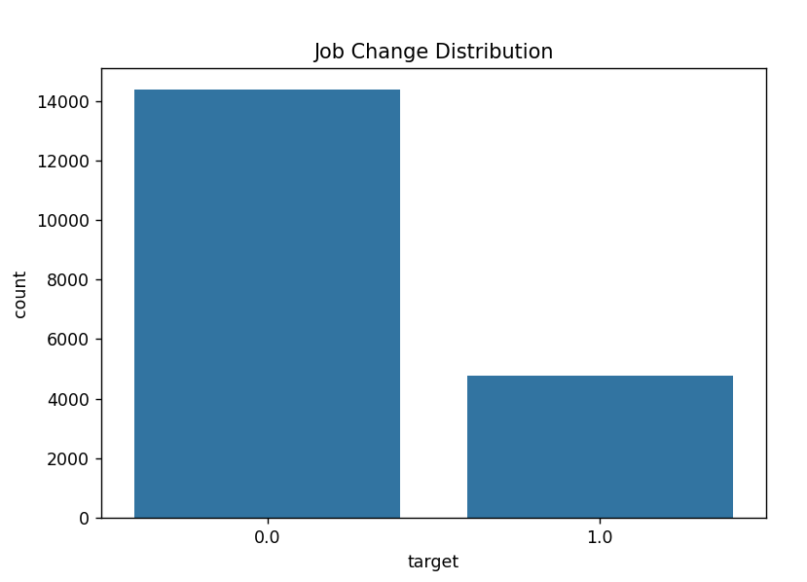
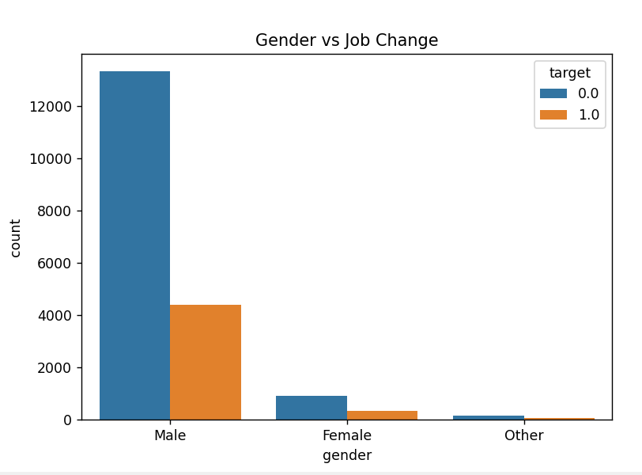
Continued…
Target Variable Distribution Analysis:-
This chart visualizes the count of employees who want to leave the
Company (Target 1) versus those
who want to stay (Target 0).
Gender vs Job Change:-
This analysis compares the job-seeking behavior across different genders (Male, Female, etc.)

Slide 9
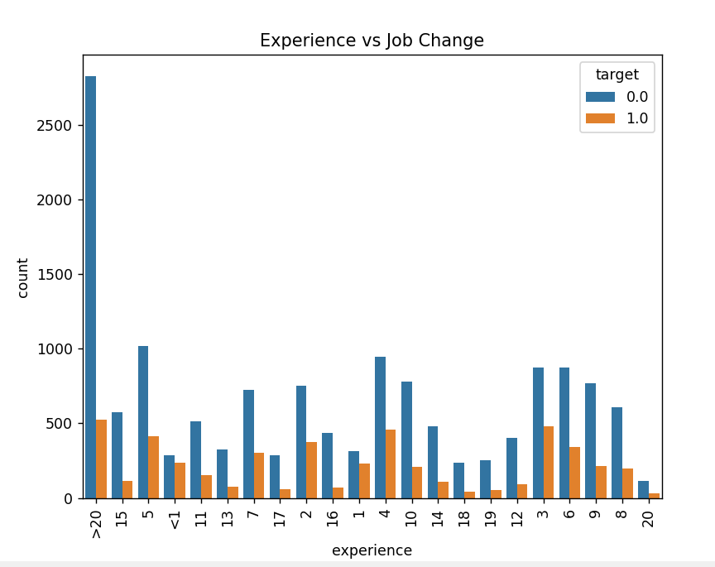
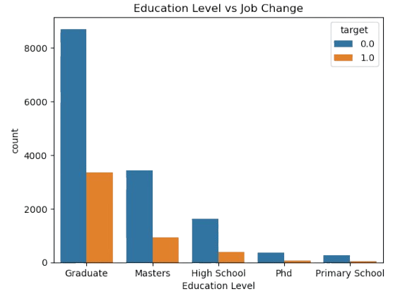
Continued…
Education Level vs Job Change:-
Graduates form the largest group and have significant job change activity.
Higher qualifications like PhDs and Masters have lower counts overall, but still show job change cases.
Experience vs Job Change:-
This graph displays the relationship between the total years of work experience and the probability of changing jobs

Slide 10
Model Selection
3 Machine learning models were chosen for this study, each serving a different purpose:
Logistic Regression
Acts as the baseline model.
Easy to interpret and explains how each factor affects the probability of a job change.
Tuned Decision Tree
Captures non-linear relationships between features and the target.
Hyperparameters tuned to improve recall while avoiding overfitting.
Recall-Focused Random Forest
Ensemble method combining multiple decision trees.
Optimized specifically to improve recall, ensuring more job changers are detected.
More robust and less sensitive to noise compared to a single decision tree.
The choice of these models balances interpretability (Logistic Regression) and predictive power (Random Forest) while focusing on the business requirement of high recall.

Slide 11
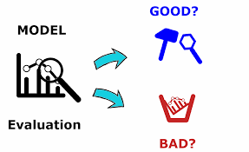
Evaluation metrics
Accuracy – Proportion of correct predictions among total predictions.
Precision – Out of predicted positives, how many are truly positive
Recall (Sensitivity) – Out of actual positives, how many were correctly identified.
F1 Score – Harmonic mean of Precision & Recall; balances both metrics.
ROC-AUC – Measures classification ability across thresholds; higher is better.

Slide 12
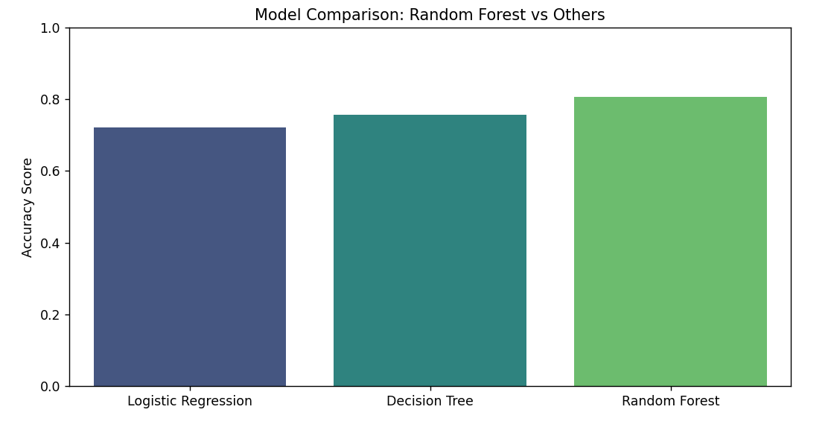
Model Comparison

Slide 13

Best Model
Best Model: Recall-Focused Random Forest
Why:
Significantly higher recall (0.729 on test) — critical for detecting actual job changers.
Best F1-score among all models — balances precision & recall.
Strong ROC-AUC (0.806) → better discrimination ability.
Trade-off: Slightly lower precision than others, but acceptable since false negatives are more costly in this problem.

Slide 14

Model Deployment with Streamlit
Web-Based Interface: Transformed a static Machine Learning model into an interactive web application using the Streamlit framework.
Model Serialization (Pickle): Utilized the pickle library to load the pre-trained Random Forest model and the StandardScaler object for consistent data transformation
Data Consistency: Implemented a logic to align real-time user input with the original training features using df.reindex
Instant Feedback: Used a "Predict" button to generate results without reloading the entire page.

Slide 15

Conclusion
Random Forest (The Winner): This model achieved the highest Accuracy of 80.67%. More importantly, it showed a balanced Recall (0.81) and F1-score (0.81) for both classes, making it the most robust tool for identifying potential leavers.
Decision Tree: While effective, it reached a lower Accuracy of 75.71%. It is less stable than the ensemble approach of Random Forest.
Logistic Regression: This model performed the weakest with an Accuracy of 72.15%. Its lower recall for class 1.0 (0.70) means it misses more employees who are actually planning to leave.
Significance: An AUC of ~0.89 indicates a strong ability to distinguish between employees who will stay and those who will leave, confirming the model's reliability for HR decision-making.

Slide 16
Thank You!
SHANU SINGH

