Slide 1



Software Engineering for Data Scientists
Knowledge and solutions for a changing world
Advancing data-intensive discovery in all fields
Be boundless
UW DIRECT
()
https://uwdirect.github.io
David A. C. Beck (dacb)
Chemical Engineering & eScience Institute

Slide 2
Agenda
Documentation
Communication around code
Standups
Technology reviews
Code review
Project stuff

Slide 3
PEP8

Slide 4
PEP8
Consistency

Slide 5
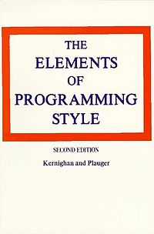
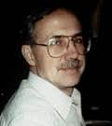
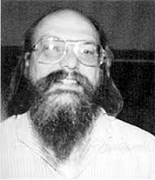
Documentation

Slide 6
Documentation
Two types
Code readers
What the code is doing and why
E.g.
Users
How to use your code
E.g.
Code comments
README.md

Slide 7
Documentation
.md
.md files are Markdown
Markdown is a lightweight text formatting language for producing mildly styled text
Ubiquitous (github.io, README.md, etc.)
E.g. Google markdown editor browser
http://dillinger.io

Slide 8
Documentation
What kind of stuff going in a repositories README.md?
https://github.com/kallisons/NOAH_LSM_Mussel_v2.0

Slide 9
Documentation
Comments
Shell script
#
Python
#

Slide 10
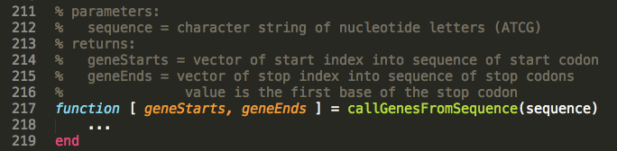
Documentation
Good comments
Make the comments easy to read
Write the comments in English
Discuss the function parameters and results

Slide 11
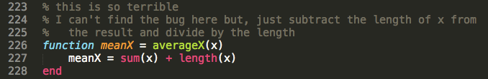
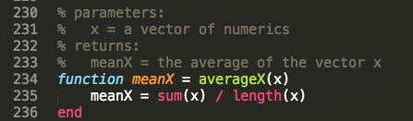
Documentation
Good comments
Don’t comment bad code, rewrite it!
Then comment it

Slide 12
Documentation
Good comments
Some languages have special function headers

Slide 13
Documentation
Good comments
Some languages have special function headers
This example is fantastic!
It describes
Calling synopsis (example usage)
The input parameters
The output variables
Aimed at coders and users

Slide 14
Documentation
Good comments
Some languages have special function headers
These comments should also describe side effects
Any global variables that might be altered
Plots that are generated
Output that is puked

Slide 15
Documentation / PEP8
Good comments
Inline comments
Comments inline with the code
Generally unnecessary (as above)
Inhibit readability

Slide 16
Documentation
Good comments
Wrong comments are?
When updating code, don’t forget to update?

Slide 17
Documentation
Good comments
Don’t insult the reader
If they are reading your code… they aren’t that dumb
Corollary: don’t comment every line!

Slide 18
Documentation
Good comments
Don’t comment every line!

Slide 19
Documentation
Good comments
Note how the block is commented
The code itself reads clearly enough
We used an obviously marked constant whose value is displayed if an error is encountered

Slide 20
Documentation / PEP8
Good comments
Comments should be sentences. They should end with a period. There should be a space between the # and the first word of a comment.
You should use two spaces after a sentence-ending period. (Easy for those of a certain age)

Slide 21

Documentation / PEP8
Good comments
Comments should be written in English, and
follow Strunk and White.

Slide 22
Documentation / PEP 0257
Docstrings
String literal as the first statement in
Modules
Functions
Classes
https://www.python.org/dev/peps/pep-0257/

Slide 23
Documentation / PEP 0257
Docstrings
They are triple quoted strings
What kind of quotes to use?
They can be processed by the docutils package into HTML, LaTeX, etc. for high quality code documentation (that makes you look smart).
They should be phrases (end in period).

Slide 24
Documentation / PEP 0257
Docstrings
One line doc strings are OK for simple stuff.
This example (taken from PEP 0257) is crap.

Slide 25
Documentation / PEP 0257
Docstrings
Multiline docstrings are more of the norm

Slide 26
Documentation / PEP 0257
Docstrings
For scripts intended to be called from the command line, the docstring at the top of the file should be a usage message for the script.

Slide 27
Documentation / PEP 0257
Docstrings
For modules and packages, list the classes, exceptions and functions (and any other objects) that are exported by the module, with a one-line summary of each.
Looking at scikit learn and seaborn (as examples) this didn’t seem to be the norm. However,
https://github.com/numpy/numpy/blob/master/numpy/__init__.py

Slide 28
Documentation / PEP 0257
Docstrings
Most importantly… For functions and methods, it should summarize its behavior and document its arguments, return value(s), side effects, exceptions raised.
Example from scikit learn:
https://github.com/scikit-learn/scikit-learn/blob/master/sklearn/cluster/dbscan_.py

Slide 29
Communcation
Documentation
Communication around code
Standups
Technology reviews
Code review
Project stuff

Slide 30
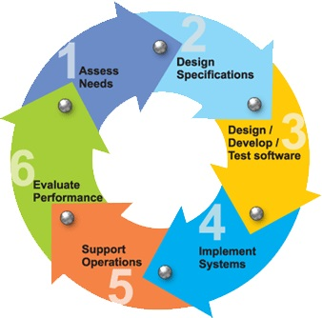
Software Development Phases

Slide 31
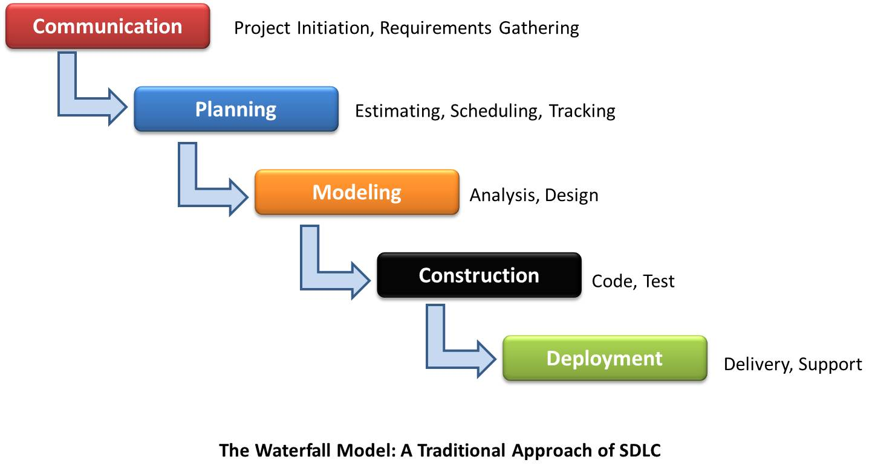
Waterfall Process Model
Software
Development
Why does this work poorly?

Slide 32
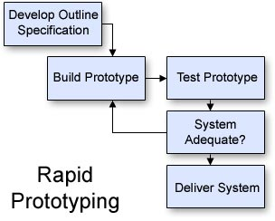
Rapid Prototyping
Cannot specify all requirements in advance
Revise the specification
Software
Development

Slide 33
Team Activities
Revise the
specification
Reqs gathering (functional spec.)
Design
Technology assessments
Write specifications
Review specification
Implementation
Code
Code review
Bug prioritization and resolution
Standups (status update)

Slide 34
Code Review Template
Why code review?
Improve code quality and find bugs
Background
Describe what the application does
Describe the role of the code being reviewed
Comment on
Choice of variable and function names
Readability of the code
How improve reuse and efficiency
How use existing python packages

Slide 35
In class exercise
Split into teams of two
~5 minutes
Partner A reviews B’s code
~5 minutes
Partner B reviews A’s code
~10 minutes
Report back on what you learned
About your code
About the process
ASK QUESTIONS!

Slide 36
In class exercise
This is a safe space
We are here to learn from and work with each other
Compliment sandwiches taste great
Follow the template and make notes

Slide 37
Technology Review Template
Why technology reviews?
Evaluate a package for deployment in a project
Background
Requirements that indicate a need for the proposed package
Discuss
How the package works
Appeal of using the package
Drawbacks of using the package

Slide 38
Technology Review: NEXT WEEK
Next Wed. every project will present
Max 15 minutes – I will cut you off
Everyone in the team will speak
Background
How it works
Appeal
Drawbacks
Things to think about, as a starting point:
Availability of relevant examples
Look at open issues on GitHub
Questions?

Slide 39
Standup Template
Why standups?
Communicate status and actions within and between teams
Should be presented in 1-2 minutes
Progress this period
How it compares with the plan
If behind plan, how compensate to make plan end date
Deliverables for next period
Challenges to making next deliverables such as:
Technology uncertainties and blockers
Team issues

Slide 40
Standups
The week after next..
Each class will have some time for standups
Everyone in class will give at least one standup
These are 1 to 2 minutes, don’t prepare too much

Slide 41
Remainder of today…
Take some time in your project team…
What open questions do you have about the project process?
About your project specifically?
We’ll resume as a class and you can ask Jim and I for clarifications.

