Slide 1

STOCK PRICE PREDICTION ANALYSIS
-A COMPREHENSIVE
OVERVIEW OF METHODS AND FINDINGS
BY YASH GAIKWAD
(21je1071@iitism.ac.in)
(Github)

Slide 2

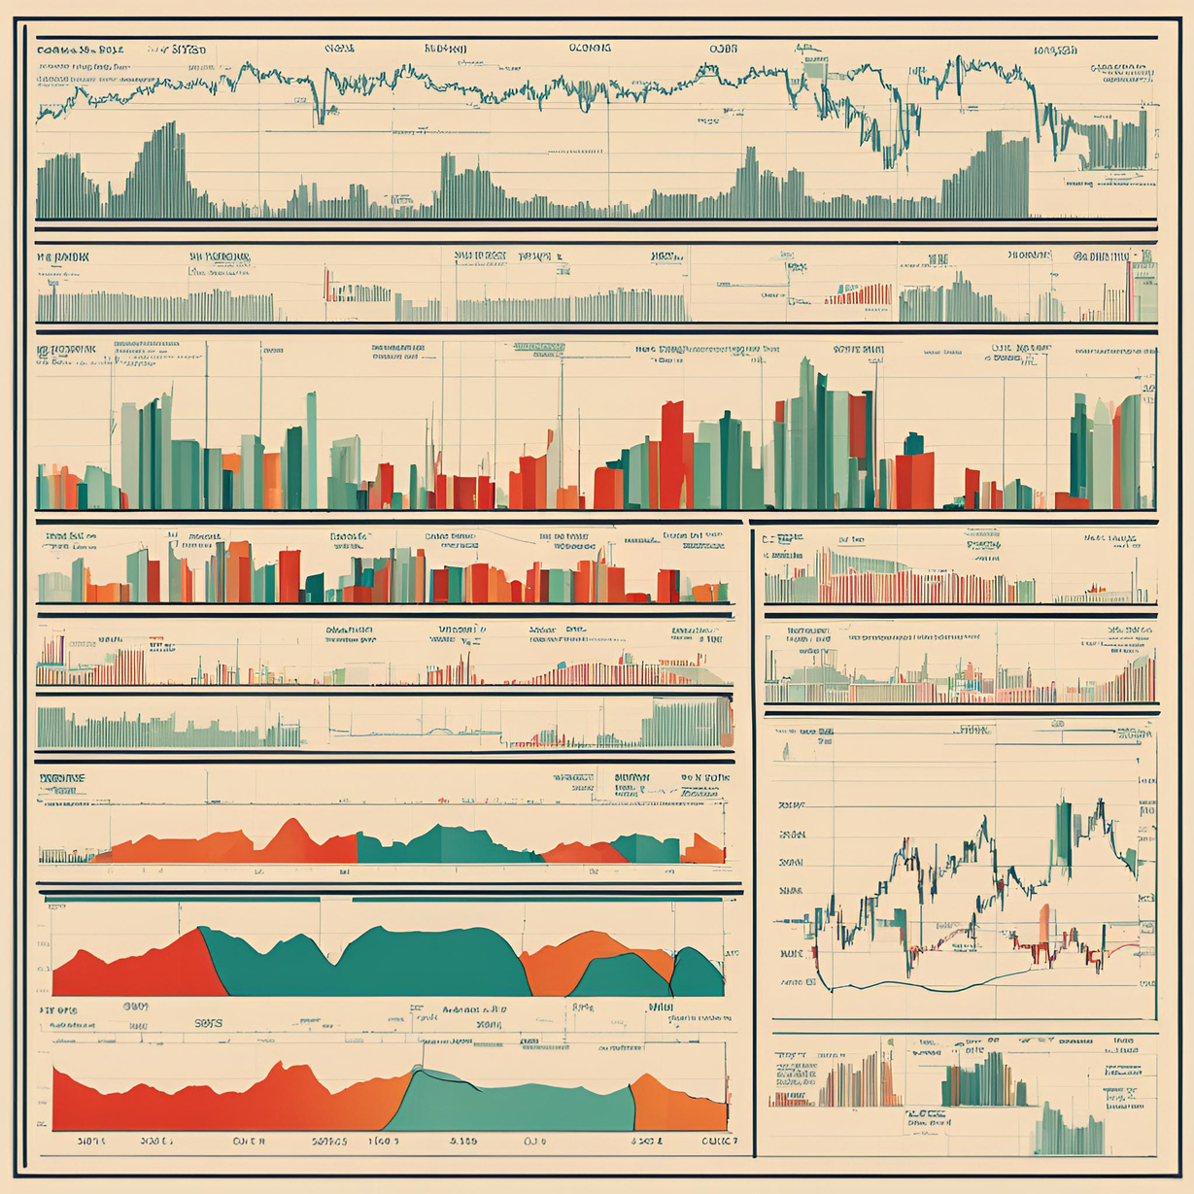



IMPORTANT OF STOCK PRICE PREDICTION
Stock price prediction plays a crucial role in financial markets, guiding investment strategies and risk management.
Accurate predictions can help investors make informed decisions, potentially leading to higher returns.

Slide 3


STRATEGY
Data understanding and EDA
Data Preprocessing and Feature Engineering
Model Selection and Training
Model Evaluation and Results Analysis
STEP 1
STEP 2
STEP 3
STEP 4
Summary of results and preparation of presentation materials
Consider improvement measures and retrain the model
STEP 6
STEP 5

Slide 4

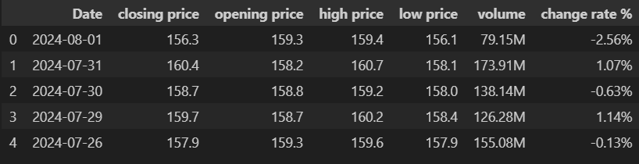

Data preprocessing steps taken, including handling missing values and outlier detection.
EXPLORATORY DATA ANALYSIS (EDA) RESULTS
Key patterns identified in historical stock price data, including trends and seasonality.
Challenges faced during data collection and cleaning processes.

Slide 5
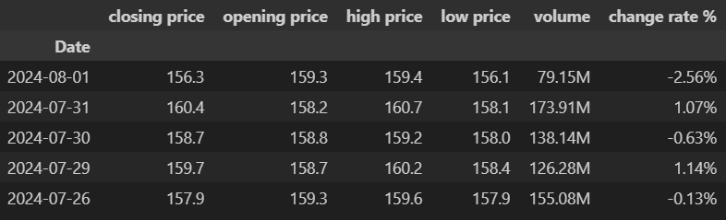

The 'Date' column was parsed and set as the index for the DataFrame, allowing for effective time series analysis.
EXPLORATORY DATA ANALYSIS (EDA) RESULTS
Various curves were plotted to visualize trends, seasonality, and price movements over time.
Encountered issues with missing values and outlier detection during data cleaning.

Slide 6

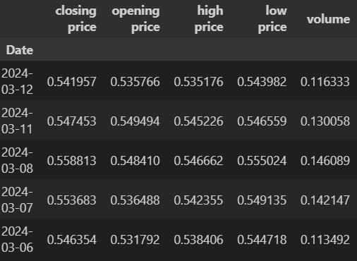
DATA PREPROCESSING AND FEATURE ENGINEERING
Identified and addressed missing values in the dataset to ensure data quality.
Changed volume data from billions (B) to millions (M) for consistency and ease of interpretation.
Removed the '%' sign from the 'Change Rate %' column to convert it into a numerical format suitable for analysis.

Slide 7
DATA PREPROCESSING AND FEATURE ENGINEERING
Created lag features to capture historical price movements, enhancing the model's ability to make future predictions.
Applied MinMaxScaler to normalize the data, transforming it to a range between 0 and 1.

Slide 8

MODELS USED
01
02
03
04
05
LSTM
ARIMA
PROPHET
RANDOM
FOREST
LINEAR REGRESSION
Chosen for its ability to learn long-term dependencies in sequential data.
Suitable for time series forecasting due to its autoregressive nature.
Effective for handling seasonality and trend changes.
A versatile model that handles non-linearity well
Used for its simplicity and interpretability.

Slide 9
EVALUATION INDICATORS
RMSE (Root Mean Squared Error) was used as the primary evaluation metric for model performance.
LSTM
ARIMA
Prophet
0.0248
0.3095
0.3198
Random Forest
Linear Regression
0.0248
0.0114
Lower RMSE values indicate better predictive accuracy.

Slide 10
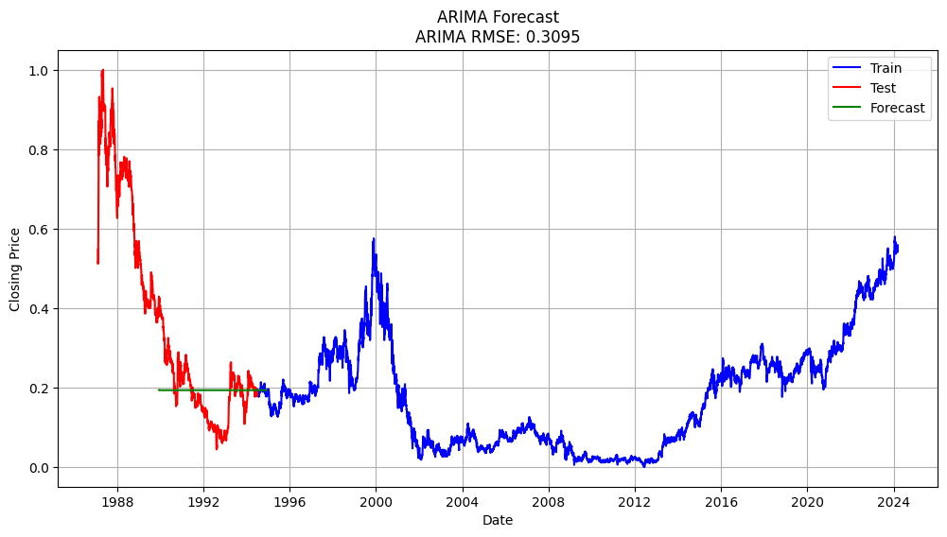
1)ARIMA (AUTOREGRESSION INTEGRATED MOVING AVERAGE)
Stationarity: ARIMA works well for stationary data, making it suitable for our preprocessed stock price data.
Seasonality and Trends: Captures trends and seasonality in historical stock price movements effectively.
Interpretability: Provides clear insights into model parameters, aiding in understanding the influence of past values on future predictions.
ARIMA Test RMSE: 0.3095

Slide 11
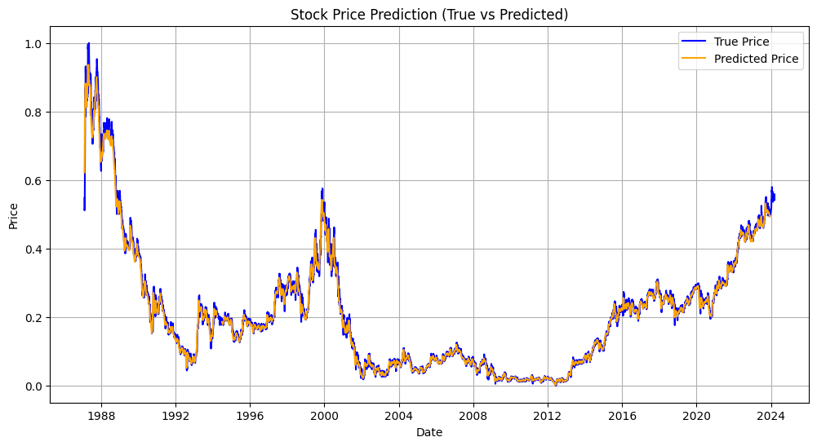
2)LSTM (LONG SHORT TERM MEMORY)
Sequential Data: LSTM is designed to work with sequences, making it ideal for time series forecasting like stock prices.
Long-Term Dependencies: Capable of learning long-term dependencies, which is crucial for stock price prediction based on historical data.
Performance: Known for its ability to outperform traditional methods in complex datasets with nonlinear relationships.
LSTM Test RMSE: 0.0248

Slide 12
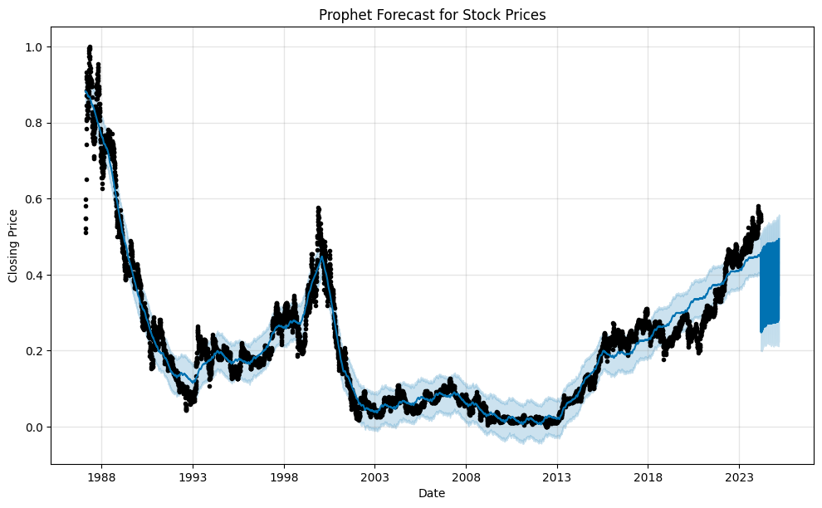
3)PROPHET
User-Friendly: Designed for users with little experience in forecasting, allowing for intuitive adjustments of model parameters.
Seasonal Trends: Handles seasonal effects well and is robust to missing data and outliers.
Flexibility: Easy to incorporate holidays and special events, which can impact stock prices.
Prophet Test RMSE: 0.31975254603888253

Slide 13
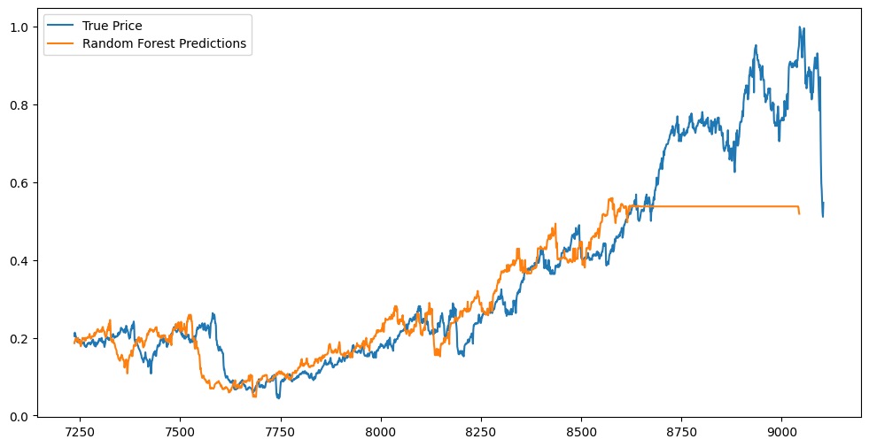
4)RANDOM FOREST
Non-Linear Relationships: Capable of modeling complex non-linear relationships in the data.
Robustness: Reduces overfitting compared to single decision trees by averaging multiple trees.
Random Forest RMSE: 0.12512584531256538
Feature Importance: Provides insights into feature importance, aiding in understanding which factors impact stock prices

Slide 14
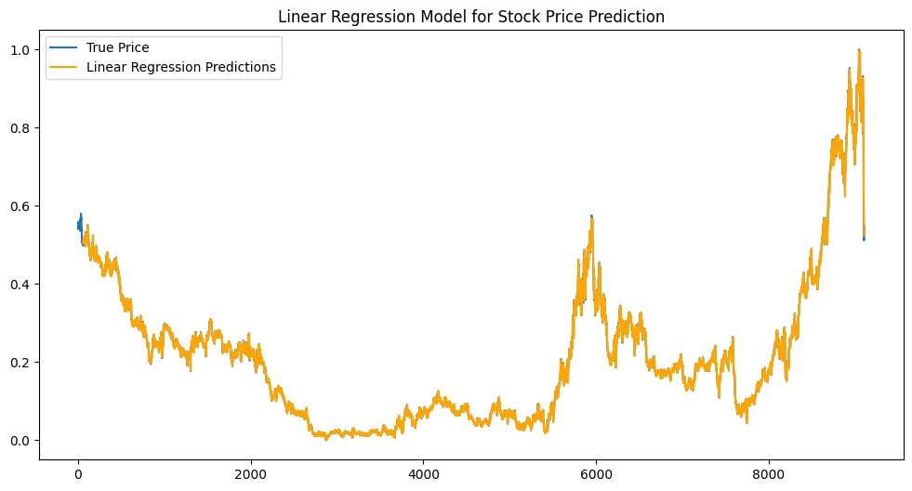
5)LINEAR REGRESSION
Simplicity: Easy to interpret and implement, serving as a benchmark for other models.
Baseline Model: Acts as a baseline model to compare more complex models against.
Linear Regression Train RMSE: 0.005684
Linear Regression Test RMSE: 0.0113970
Speed: Quick to train and predict, making it suitable for initial analysis.

Slide 15
IMPROVEMENT MEASURES FOR ALL MODELS
LSTM: Experiment with different architectures, such as varying the number of LSTM layers, units, and dropout rates to prevent overfitting.
ARIMA: Fine-tune parameters (p, d, q) using AIC/BIC for better accuracy in capturing temporal dependencies.
Hyperparameter
Tuning
Random Forest: Optimize the number of trees, maximum depth, and minimum samples per leaf to enhance model robustness.
Linear Regression: Test polynomial features and interaction terms to capture non-linear relationships better.
Prophet: Adjust seasonalities and holidays settings to better reflect market behaviors and trends.

Slide 16
IMPROVEMENT MEASURES FOR ALL MODELS
Introduce new features such as moving averages, exponential smoothing, and technical indicators (e.g., RSI, MACD) to enhance model inputs.
Feature Engineering
Create additional lag features to capture historical trends and seasonality effectively.
Data Augmentation
Incorporate external data sources, such as economic indicators, market news, and social sentiment analysis, to enrich the dataset and improve model performance.
Implement ensemble techniques like stacking or blending to combine predictions from multiple models, potentially improving overall accuracy.
Model Ensembling
Cross-Validation
Utilize k-fold cross-validation to ensure robust model evaluation and prevent overfitting, ensuring better performance on unseen data.

Slide 17

FUTURE OUTLOOK
Explore ensemble methods to combine predictions from multiple models.
Investigate deep learning architectures such as GRU and CNN for time series data.
Continuously update models with new data to improve accuracy over time.

Slide 18

SUMMARY
BEST PERFORMANCE AMONG THE MODELS, INDICATING ITS EFFECTIVENESS IN CAPTURING COMPLEX PATTERNS IN STOCK PRICE MOVEMENTS.
LSTM = 0.0248
RF = 0.1251
GOOD PERFORMANCE, SUITABLE FOR CAPTURING NON-LINEAR RELATIONSHIPS IN THE DATA.
WHILE IT PERFORMED RELATIVELY WELL, IT MAY NOT CAPTURE THE COMPLEXITIES OF STOCK PRICE DYNAMICS AS EFFECTIVELY AS LSTM AND RANDOM FOREST.
LR = 0.0114
ARIMA = 0.3095
PERFORMANCE SUGGESTS IT STRUGGLED WITH NON-STATIONARY DATA, WHICH MAY HAVE AFFECTED ITS FORECASTING CAPABILITY.
ALTHOUGH DESIGNED FOR SEASONAL DATA, IT UNDERPERFORMED COMPARED TO THE OTHER MODELS IN THIS CONTEXT.
PROPHET = 0.3198

Slide 19
REFERENCES
Basics of slide writing
Techniques for creating slides
Lecture on Slide Writing (Slideshare)

Slide 20

THANK YOU FOR YOUR ATTENTION
Thank you for taking the time to explore my project on stock price prediction.I hope you found the analysis insightful and informative.
ありがとう
I welcome any questions, suggestions, or feedback you may have (Email - 21je1071@iitism.ac.in)

