Slide 1
CDP 7.1.9 (Hive 3) • on-prem • Isilon • MySQL metastore
hive-tools
Keeping the Hive Metastore and its MySQL backend healthy.
Orphan Cleanup
Metadata Pressure Monitor
Two standalone Python tools (3.6+, standard library only). This deck: why they exist, what they do, and their limits — the repo README is the full guide.

Slide 2
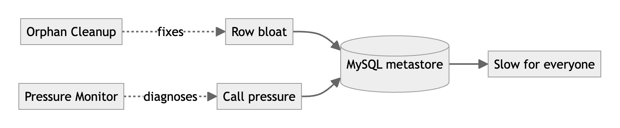
Why these tools exist
The metastore's MySQL DB is a shared, single-writer bottleneck. Two things degrade it:
• Row bloat — data deleted straight off storage leaves orphaned table/partition rows behind in MySQL. Millions of dead rows slow every plan, backup, and upgrade.
• Call pressure — badly-shaped workloads flood the HMS with API calls; each is a MySQL round-trip, so metadata gets slow for everyone.
hive-tools • overview
2 / 16

Slide 3
The two tools at a glance
Tool | What it does | Changes the cluster?
Orphan Cleanup hive_orphan_cleanup.py | Finds & removes Hive tables/partitions whose storage is gone, using standard Hive DML — shrinking metastore row counts on MySQL. | Only with --execute read-only by default
Pressure Monitor metadata_pressure_monitor.py | Reads HMS logs to find what/who is overloading the metastore, correlates to Hive operations & likely queries/apps, and prescribes fixes. | Never strictly read-only
Both are dependency-free: copy one script to an edge node and run it.
hive-tools • overview
3 / 16

Slide 4
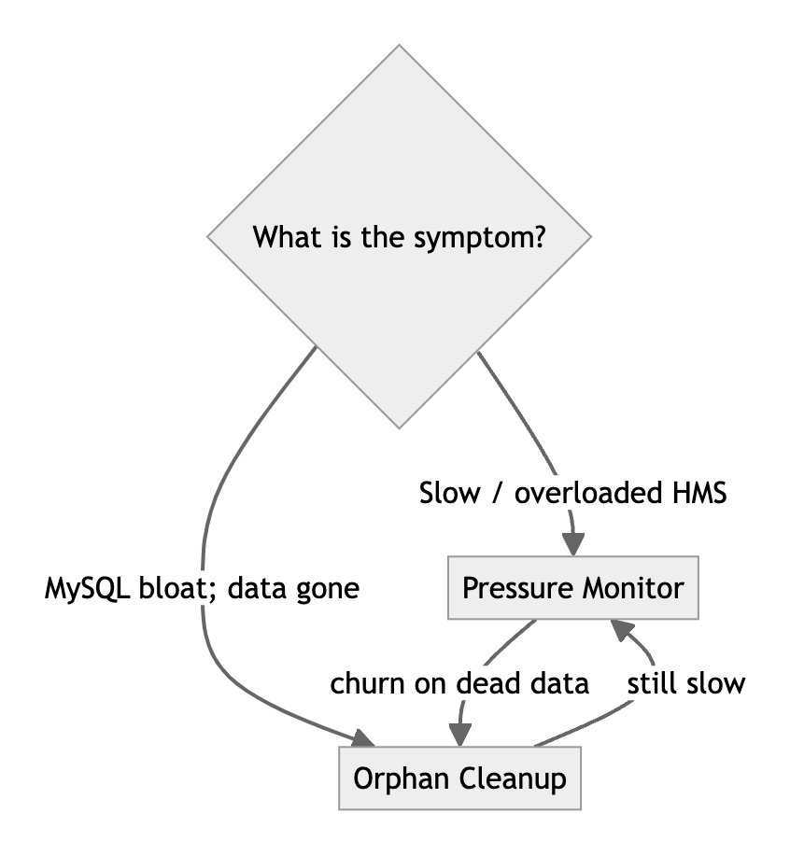
Which tool, when?
Not the right tool when…
• You want to tune MySQL itself or change Cloudera Manager configs.
• You want to find unused tables — orphan = storage genuinely gone, not idle.
• You expect it to apply fixes — the monitor only recommends.
• You want to reclaim disk — cleanup removes metadata, not data.
hive-tools • overview
4 / 16

Slide 5
Requirements & scope
Need | Orphan Cleanup | Pressure Monitor
Python | 3.6+ , standard library only (RHEL 8 friendly)
Cluster connection | beeline + hdfs on an edge node | None — reads log files
Auth | Kerberos ticket (or keytab / principal) | None
Platform | Built & verified for CDP 7.1.9 / Hive 3 / Isilon / MySQL
Install | Nothing — no pip, no virtualenv
In scope: metastore metadata health (row bloat + call pressure). Out of scope: deleting user data, MySQL tuning, applying configs.
hive-tools • overview
5 / 16

Slide 6
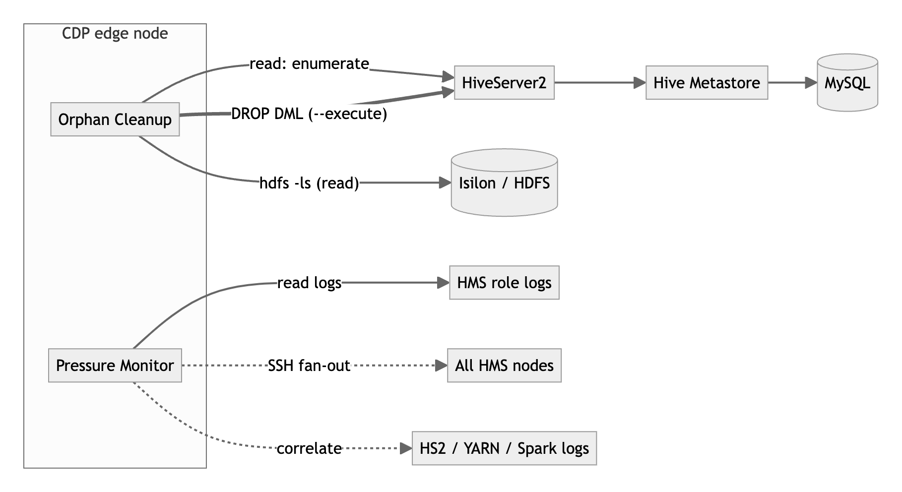
Architecture — systems these tools touch
Legend: thin arrow = read-only | thick arrow = potentially mutating (Orphan Cleanup, only with --execute, only via Hive DML) | dotted = optional. No tool ever issues raw DELETE against MySQL.
hive-tools • overview
6 / 16

Slide 7
Orphan Cleanup — what it does
Three modes; the recommended flow is report → review → apply.
Mode | What it does | Mutates?
report | Enumerate HMS, check storage, write CSV + JSON + summary. | No
clean | Detect and clean. Dry-run by default. | With --execute
apply | Clean exactly the rows in a prior (trimmed) report. | With --execute
Cleanup is standard Hive DML (DROP TABLE / ALTER TABLE … DROP PARTITION), which cascades away the backing rows in TBLS / PARTITIONS / SDS / … — the MySQL win.
hive-tools • overview
7 / 16

Slide 8
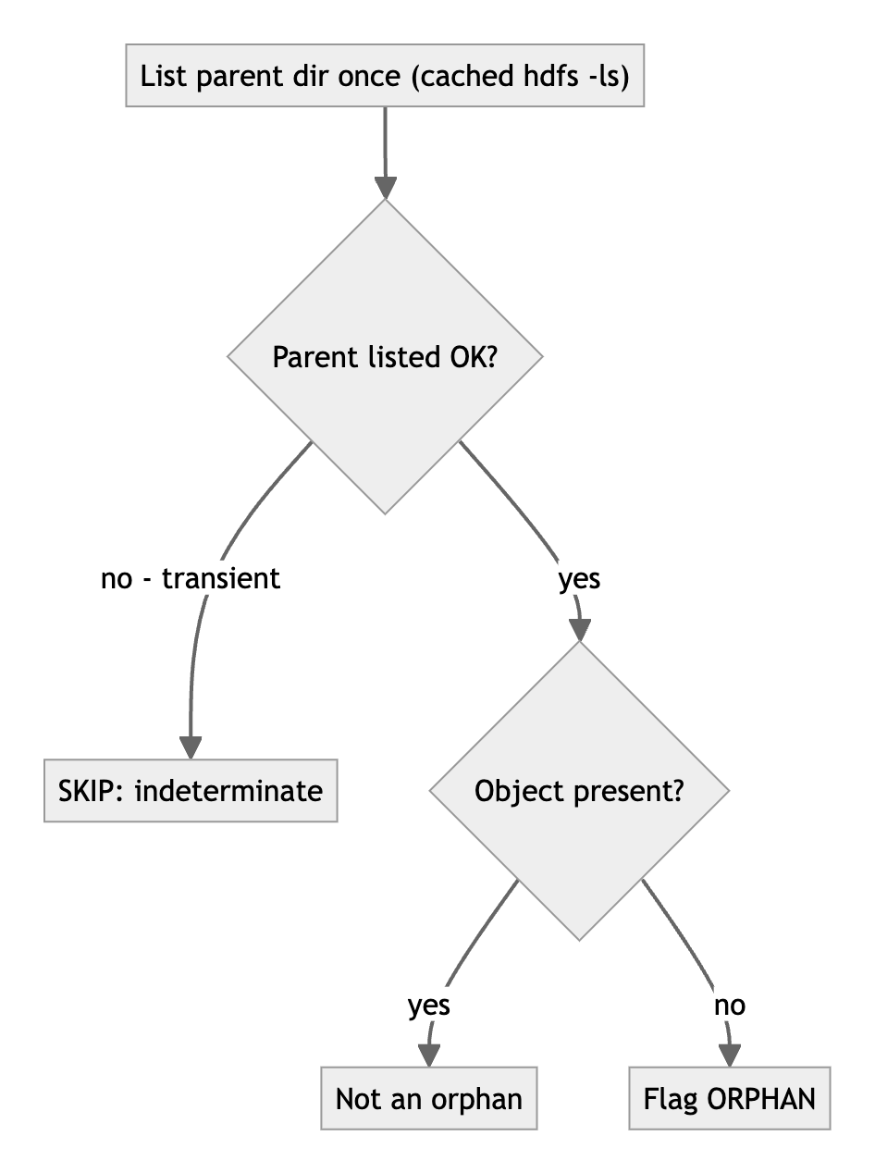
Orphan Cleanup — how detection works
Positive proof of absence
• An object is flagged only when its parent lists successfully and it is genuinely missing.
• Any indeterminate result (outage, NameNode blip) is skipped — a storage hiccup cannot manufacture orphans.
• Listings are batched one per parent dir and cached, keeping load off Isilon.
hive-tools • overview
8 / 16

Slide 9
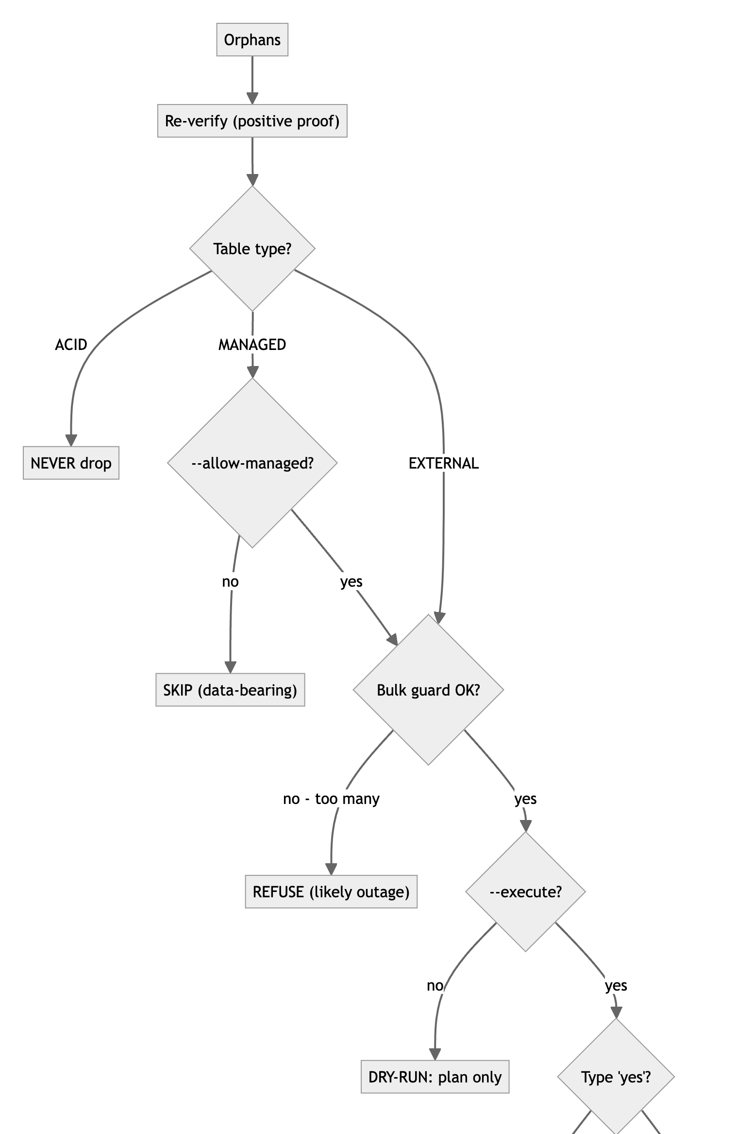
Orphan Cleanup — safety model
Gate | Default | Loosen with
Dry-run | on | --execute
External-only | managed skipped | --allow-managed
ACID protection | always | none
Positive proof | always | discouraged
Bulk guard | on | --allow-bulk
Typed confirm | type yes | --yes
Loosening one gate never weakens the others: --yes skips only the keystroke; ACID is never droppable.
hive-tools • overview
9 / 16

Slide 10
Pressure Monitor — what it answers
• Which HMS methods dominate call volume and total time?
• Which Hive operations (DROP / ALTER / ADD PARTITION, CREATE / DROP TABLE, ANALYZE) drive them?
• Which users, client IPs, tables, and HMS hosts contribute most?
• How does load trend over time — where are the storms?
• Which patterns look like loops / repetitive calls — and how to fix them?
For every finding it prints a concrete remediation: batching, partition pruning, breaking loops, delegation-token store, stats tuning, …
hive-tools • overview
10 / 16

Slide 11
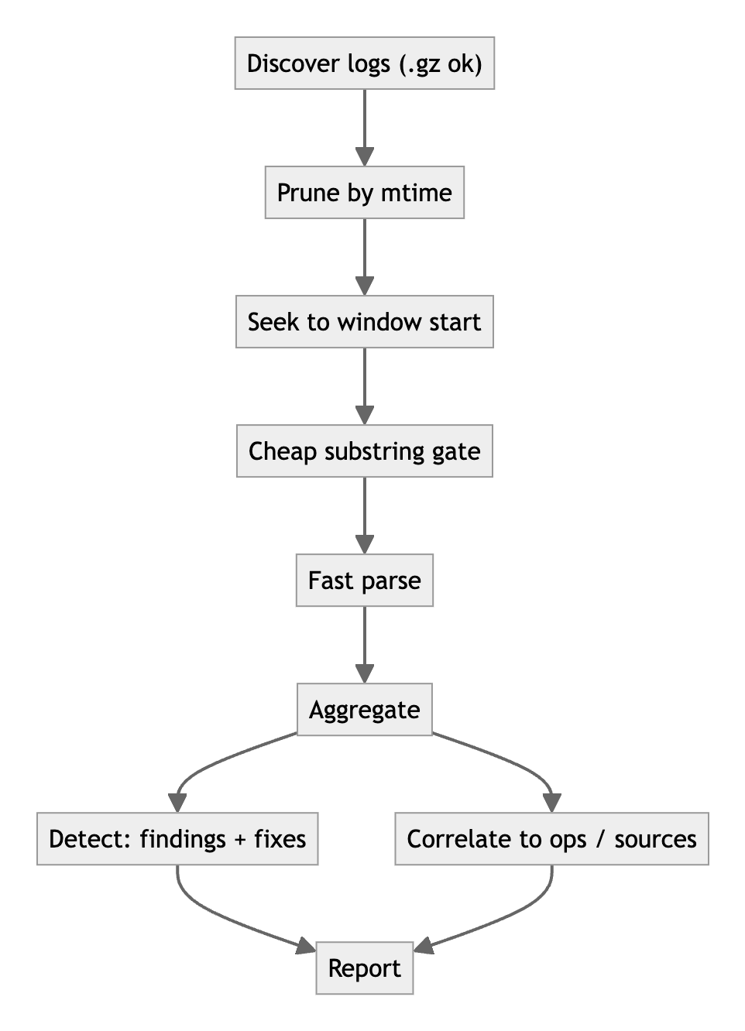
Pressure Monitor — how a run works
Mode | Use | Mutates?
report | Analyze a window; fan-out & incremental options. | No
monitor | Scheduled tail with de-duplicated alerts. | No
agg | Per-node worker for SSH fan-out. | No
• Fast: a --last 1h scan of a multi-GB log runs in well under a second.
• Incremental (--state-dir): re-runs parse only new bytes.
• Fleet (--hosts): each HMS node parses its own logs.
Cheap → expensive, so most lines are discarded before any regex.
hive-tools • overview
11 / 16

Slide 12
Pressure Monitor — attributing the load
Beyond “which method is hot”, the report names who / what to go fix: top contributors, and up to a Top-5 likely source per operation with a confidence score.
Evidence available | Confidence | Shown as
user + table from HMS audit only | ranked, capped < 100% | “NN%” (guess)
+ client op matched on table and time | higher % | “NN%” + queryId / appId
single unambiguous driver | 100% | CONFIRMED
Honest by design: HMS audit logs share no id with HS2, so attribution is a ranked guess unless HS2 / YARN / Spark logs confirm it. Treat the Top-5 as leads.
hive-tools • overview
12 / 16

Slide 13
Implementation highlights
Built for production
• Python 3.6+, stdlib only — no install.
• Verified on RHEL 8 / CDP 7.1.9.
• Read-only by default; every drop is audited.
• Third-party safety audit + automated test harness.
Built for repeated runs
• Fast filtering + cached parsing (~16× faster timestamps).
• Incremental re-runs (process only new log bytes).
• Fleet fan-out over SSH — no central log collection.
• Batched, cached hdfs -ls to spare Isilon.
hive-tools • overview
13 / 16

Slide 14
Limitations & caveats
• Scope: tuned for CDP 7.1.9 / Hive 3 on-prem (RHEL 8, Isilon, MySQL). Other versions untested.
• Orphan Cleanup needs a healthy filesystem view — run when Isilon / HDFS + NameNode are healthy; the bulk guard is a backstop, not a substitute.
• “Orphaned” ≠ “unused” — tables whose data still exists are never flagged.
• Correlation is best-effort — a ranked guess with a confidence score unless client logs confirm it.
• Logs must be readable & standard — parsing targets Cloudera PERFLOG + AUDIT lines; live tail reads uncompressed logs.
• Change control — back up the metastore (MySQL dump) before large cleanups.
hive-tools • overview
14 / 16

Slide 15
A safe end-to-end workflow
Diagnose with the monitor → remove dead metadata with cleanup → confirm the metastore got faster. Execution stays a human-reviewed step.
hive-tools • overview
15 / 16

Slide 16
Where to learn more
The repository README files are the comprehensive guide.
Doc | Contents
README.md | Overview, which-tool, systems, safety model, caveats.
orphan-cleanup/README.md | Detection, safety gates, options, scheduling.
pressure-monitor/README.md | Pipeline, fan-out, correlation, findings catalog.
AUDIT.md | Third-party safety & compatibility audit.
Start read-only: report --paths /var/log/hive --last 24h / report --jdbc-url … --output-dir ./out
hive-tools • overview
16 / 16

