Slide 1

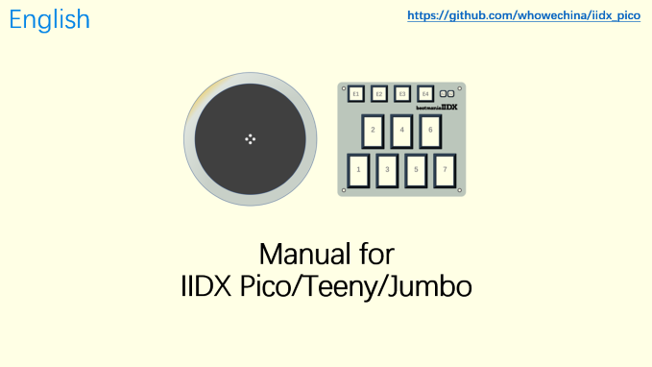
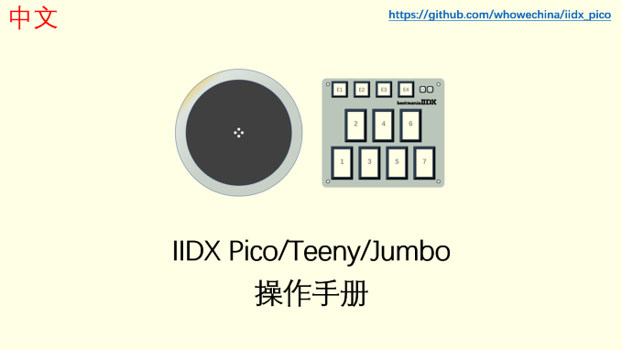

Slide 2
English
https://github.com/whowechina/iidx_pico
Manual for
IIDX Pico/Teeny/Jumbo

Slide 3
POWER-ON
Device Mode will be saved in flash.
NORMAL Device
KONAMI Device
Firmware Update

Slide 4
NORMAL MODE
Switch Profile
Hold 5 Seconds
LED LEVEL Mode
Profile 1
Profile 2
Profile 3
Profile 4
SETUP Mode
TT Effect
Key Off Light
Choose Function
Key Theme
Key On
Light

Slide 5
LED LEVEL MODE
Turntable
Buttons
Level means maximum brightness.
Level for turntable and buttons are separate.
LED Level
OK
Cancel
17%
50%
83%
0%
33%
67%
100%
1-7 Quick Set

Slide 6
SETUP MODE
Normal Reversed
Set First LED
Set Last LED
LED
Direction
Sensor
Mode
Normal
Reversed LR2
LED Select
OK
Cancel
Buttons
Turntable
E1~E4
LED Color Format
256/200 ppr
160/128 ppr
96/64 ppr
48/32 ppr
Turntable Resolution

Slide 7
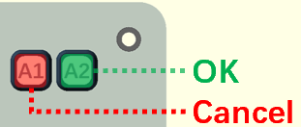

Key On/Off Light
1. Set Hue (Color)
2. Set Saturation (Vividness )
3. Set Value (Brightness)
Start
Confirm
Select Keys to Apply (Toggle during the process)

Slide 8
中文
https://github.com/whowechina/iidx_pico
IIDX Pico/Teeny/Jumbo
操作手册

Slide 9
上电
设备模式会存储在 flash 里。
普通设备
KONAMI 设备
固件更新

Slide 10
一般模式
切换配置槽
按压 5 秒
LED 亮度设置
配置 1
配置 2
配置 3
配置 4
基础设定
转盘 灯效
松键 灯光
选择 配置项
键盘 灯效
压键 灯光

Slide 11
LED 亮度设置
转盘
按键
亮度是指全局最大亮度。
转盘和按键的亮度可以分开设置。
LED 亮度调整
确认
取消
17%
50%
83%
0%
33%
67%
100%
1-7 快捷设置

Slide 12
基础配置
正常 反向
设置首个 LED
设置末尾 LED
LED
方向
传感器 模式
正常
反向 LR2 专用
LED 设置
确认
取消
按键
转盘
E1~E4
LED 像素格式
256/200 ppr
160/128 ppr
96/64 ppr
48/32 ppr
转盘分辨率

Slide 13
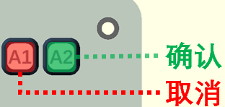
Key On/Off Light
1. 设置色度 (颜色)
2. 设置灰度 (色彩饱和度)
3. 设置明度 (亮度)
开始
完成确认
选择需要应用的键 (设置过程中随时切换)

