Slide 1
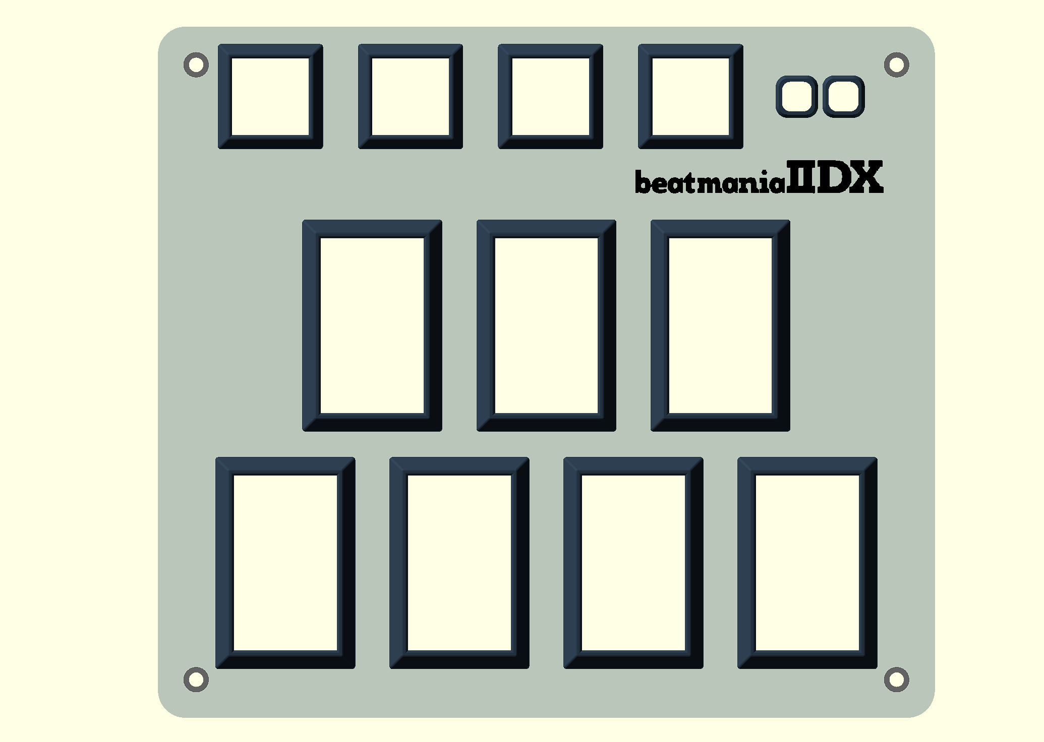
https://github.com/whowechina/iidx_pico
E1
E2
E3
E4
A1
A2
2
4
6
1
3
5
7
Manual for IIDX Pico/Teeny/Jumbo

Slide 2
POWER-ON
Device Mode will be saved in flash.
NORMAL Device
KONAMI Device
Firmware Update

Slide 3
NORMAL MODE
Switch Profile
Hold 5 Seconds
LED LEVEL Mode
Profile 1
Profile 2
Profile 3
Profile 4
SETUP Mode
TT Effect
Key Off Color
Choose Function
Key Theme
Key On
Color

Slide 4
LED LEVEL MODE
Turntable
Buttons
Level means maximum brightness.
Level for turntable and buttons are separate.
LED Level
OK
Cancel
17%
50%
83%
0%
33%
67%
100%
1-7 Quick Set

Slide 5
SETUP MODE
Normal Reversed
Set First LED
Set Last LED
LED
Direction
Sensor
Mode
Normal
Reversed LR2
LED Select
OK
Cancel
Buttons
Turntable
E1~E4
LED Color Format
256/200 ppr
160/128 ppr
96/64 ppr
48/32 ppr
Turntable Resolution

