Slide 1
DeepPurpose: a deep learning library for drug–target interaction prediction
Literature discussions
Dongdong Zhang
Song Xia
December 21st 2020

Slide 2
What we know about DeepPurpose
Solve drug-target interaction (DTI) problems, drug properties predictions
Implementing 15 compound and protein encoders and over 50 neural architectures
By merely specifying an encoder’s name, users can automatically connect a encoder of interest with the relevant decoder
DeepPurpose then trains the corresponding encoder-decoder model in an end-to-end manner
Notes:
Accurate identification of molecular drug targets is fundamental for drug discovery and development.

Slide 3
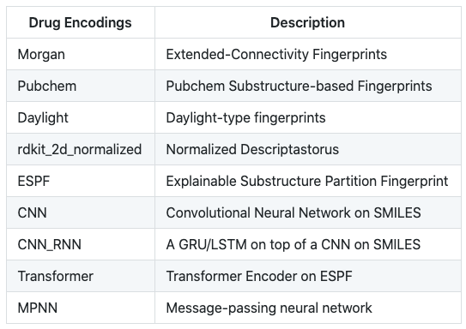
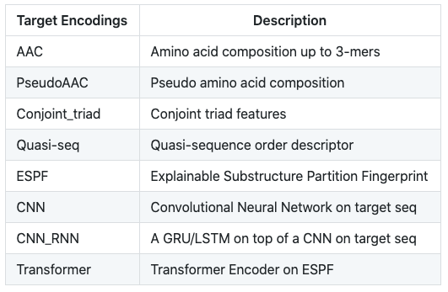
Overview of the encoders

Slide 4
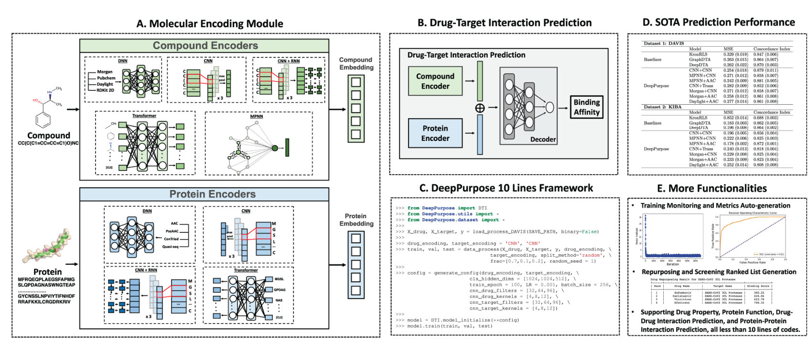
Overview of this framework

Slide 5
Compound properties: FreeSol benchmark
Encoder | Test RMSE (kcal/mol)
Morgan | 2.01
CNN | 1.81
MPNN | 1.56
Transformer | 3.78
By Dongdong
100 epochs
3 encoder layers
128 in dimension

Slide 6
Drug-target Interaction benchmark
Number | Drug Encoder | Target Encoder | Testing MSE | Pearson Correlation | Concordance Index
1 | Transformer | Transformer | 0.75 | 0.31 | 0.64
2 | MPNN | Transformer | 0.70 | 0.41 | 0.71
3 | Morgan | Transformer | 0.50 | 0.62 | 0.79
4 | Morgan | CNN | 0.52 | 0.62 | 0.80
5 | MPNN | CNN | 0.58 | 0.54 | 0.76
6 | Transformer | CNN | 0.75 | 0.31 | 0.65
By Song

Slide 7
Pros and cons
Pros:
Easily call for different encoding methods for compounds and proteins
Training deployment is also very convenient
Good to compare traditional Fingerprint-based QSAR with GNN and NLP
Cons:
Only one type of MPNN model provided
Only the very fundamental transformer framework provided
Not good for customizing and designing new models

