Slide 1
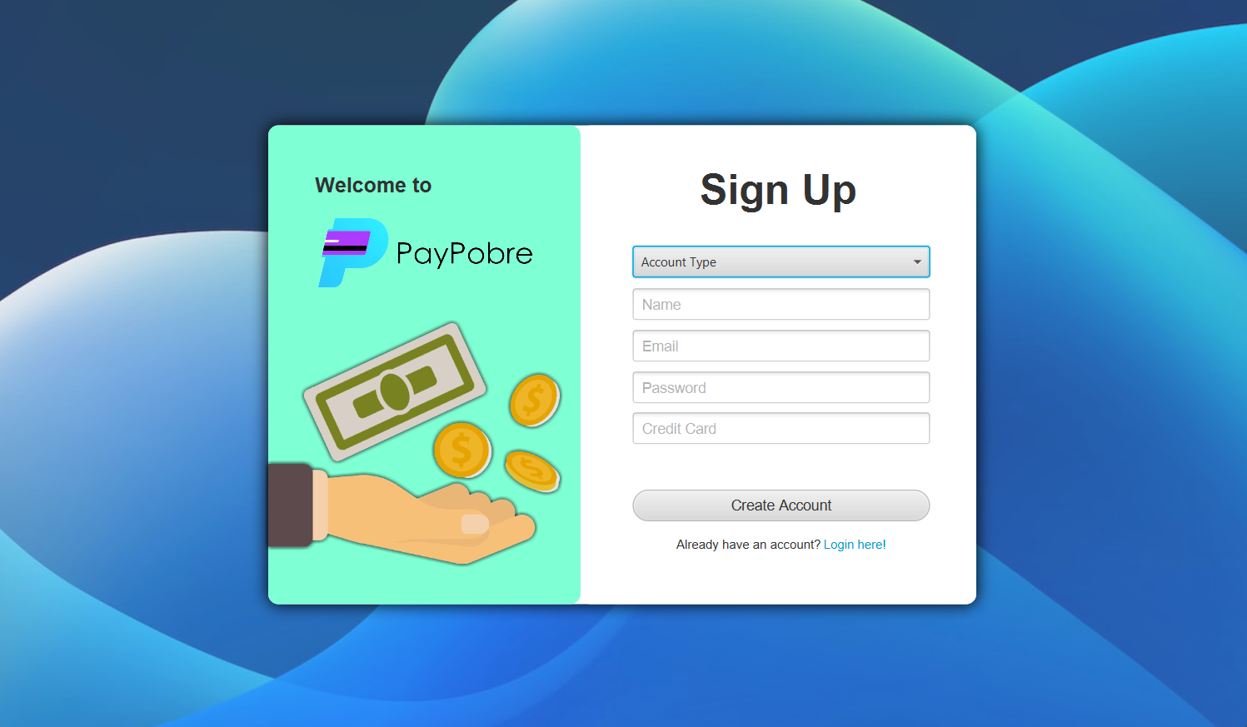

1

Slide 2
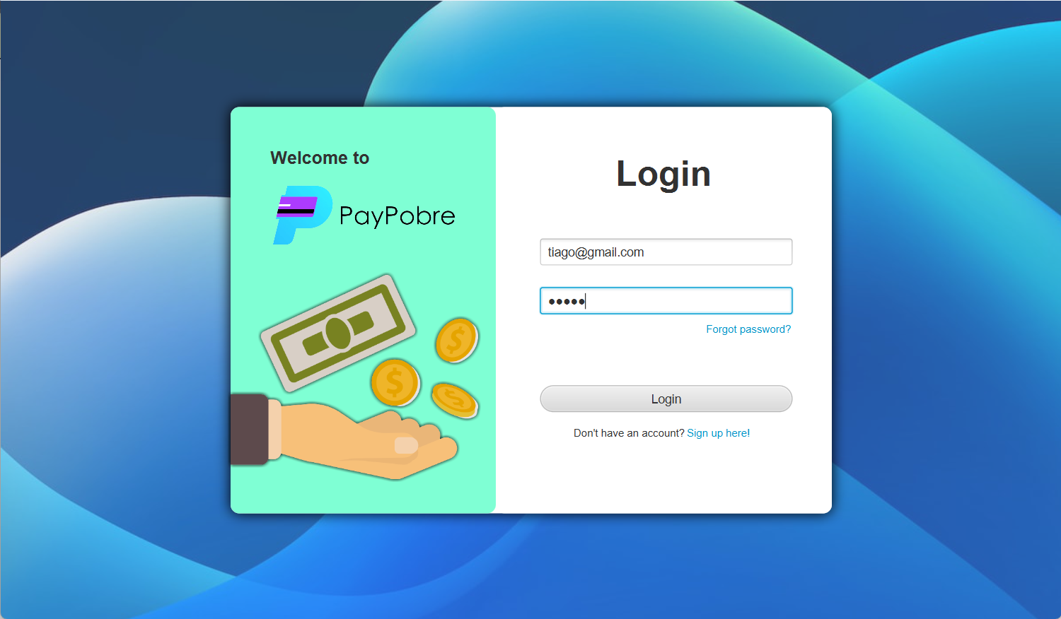


2

Slide 3
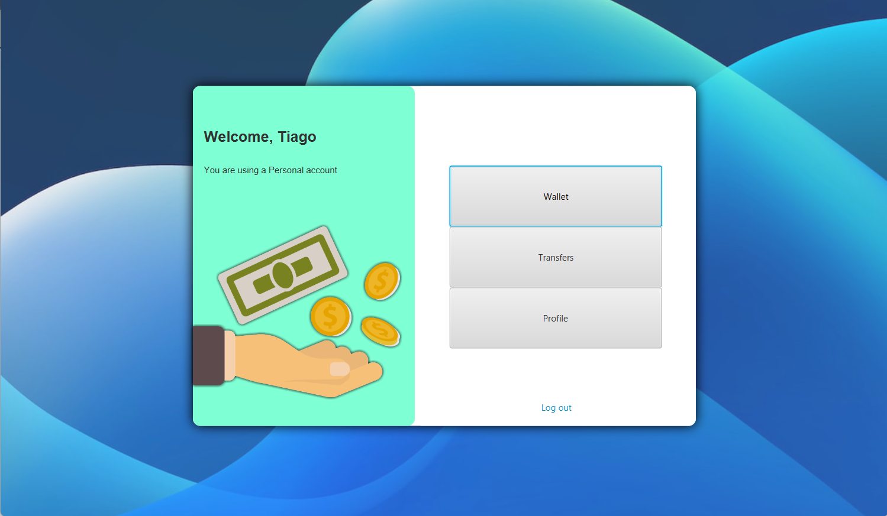
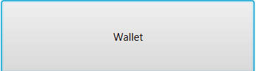



4

Slide 4
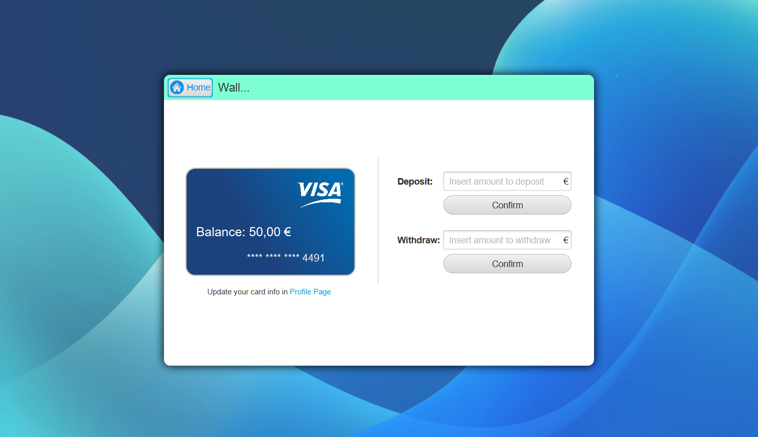
3

Slide 5
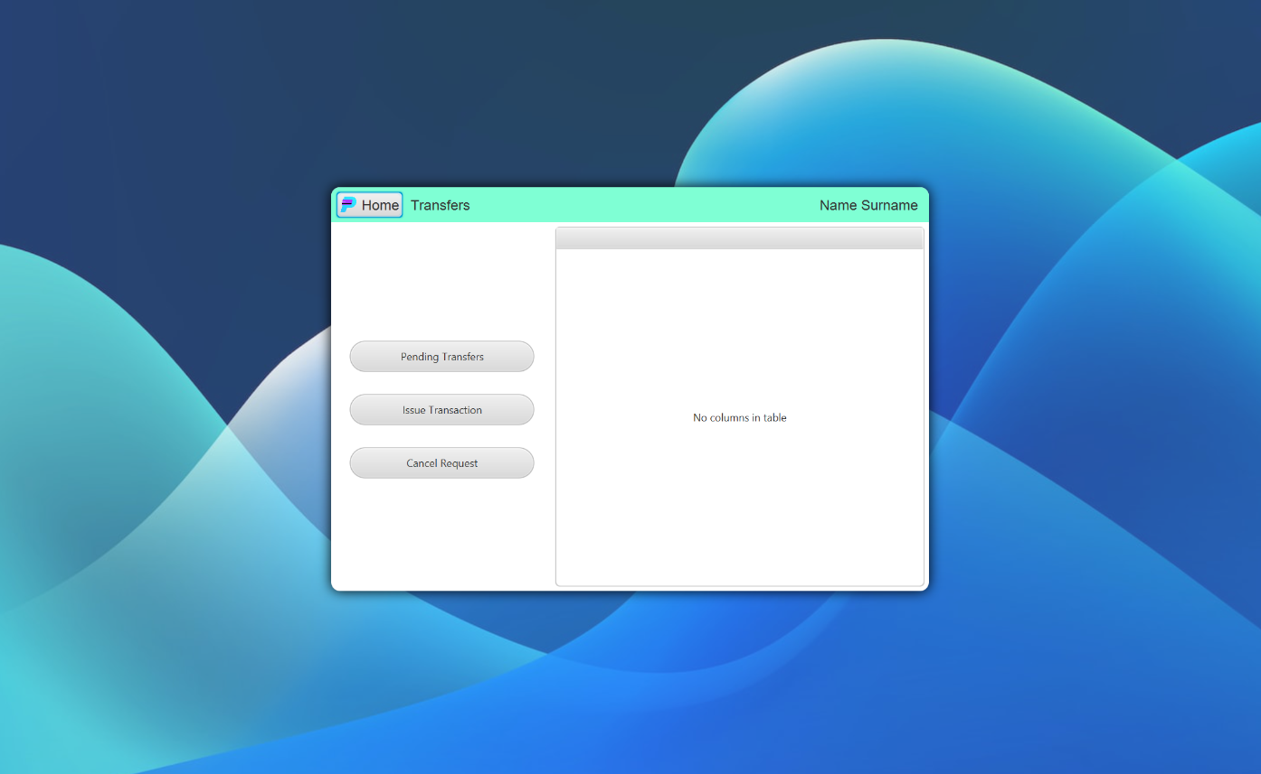




5
ID | Name | Amount | State | Date
99999| Alex | 50.00$ | Pending | 17-12-2022

Slide 6
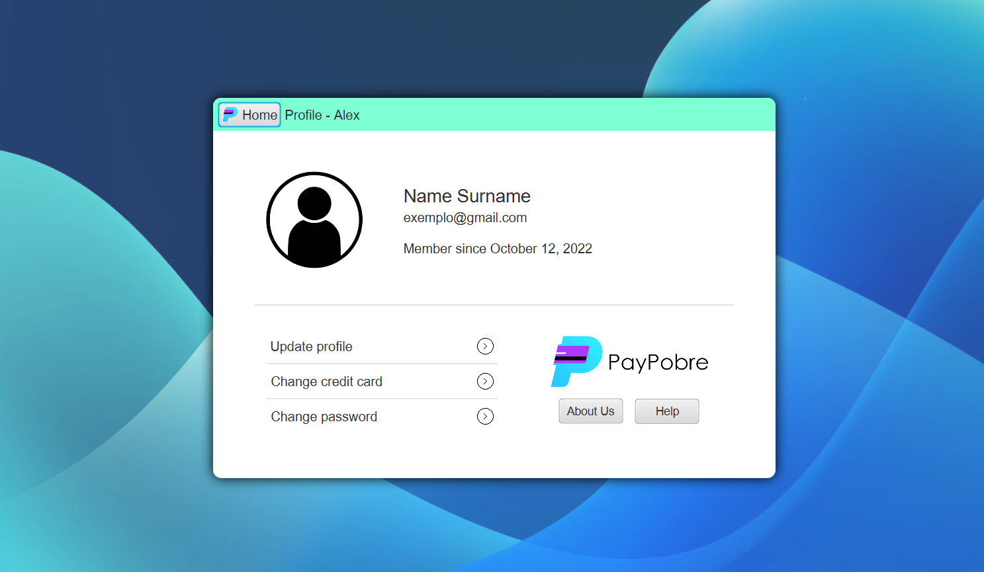

6
tiago@gmail.com

Slide 7
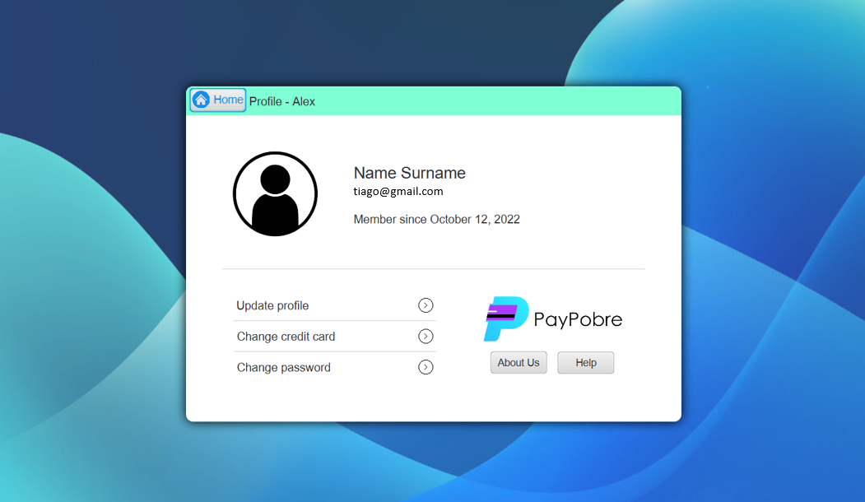
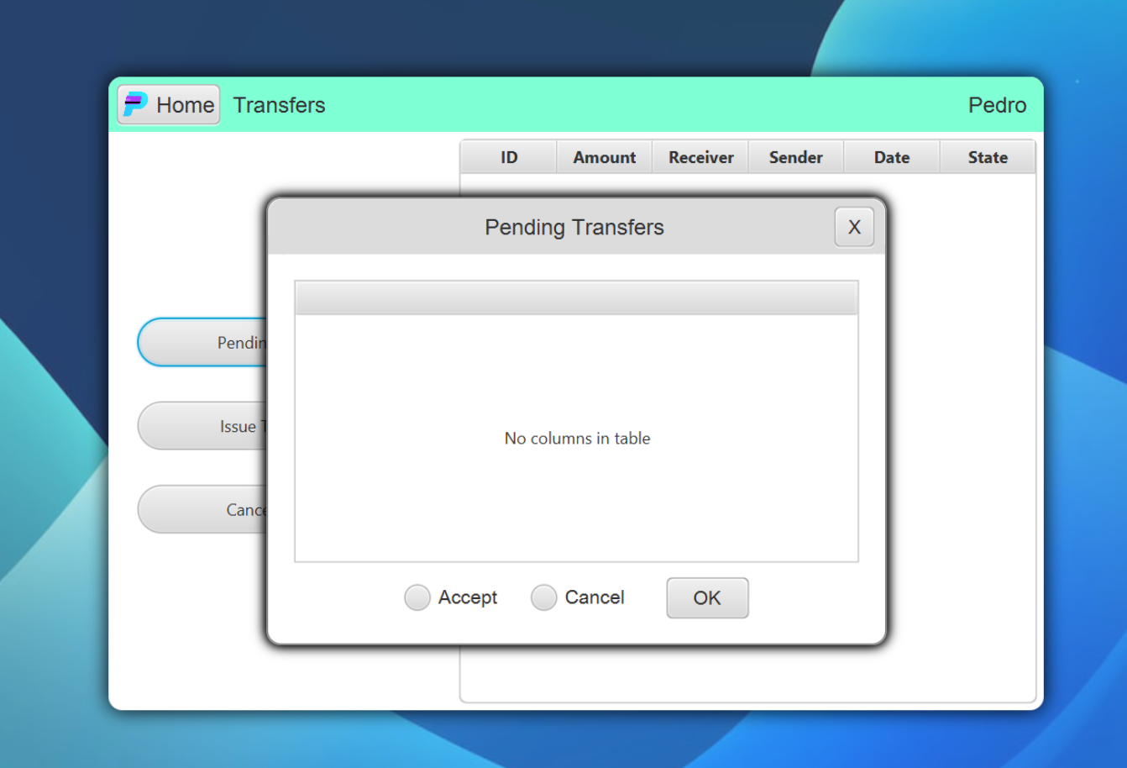

7
ID | Name | Amount | State | Date
99999 | Alex | 50.00$ | Pending | 17-12-2022 21:00:59

Slide 8
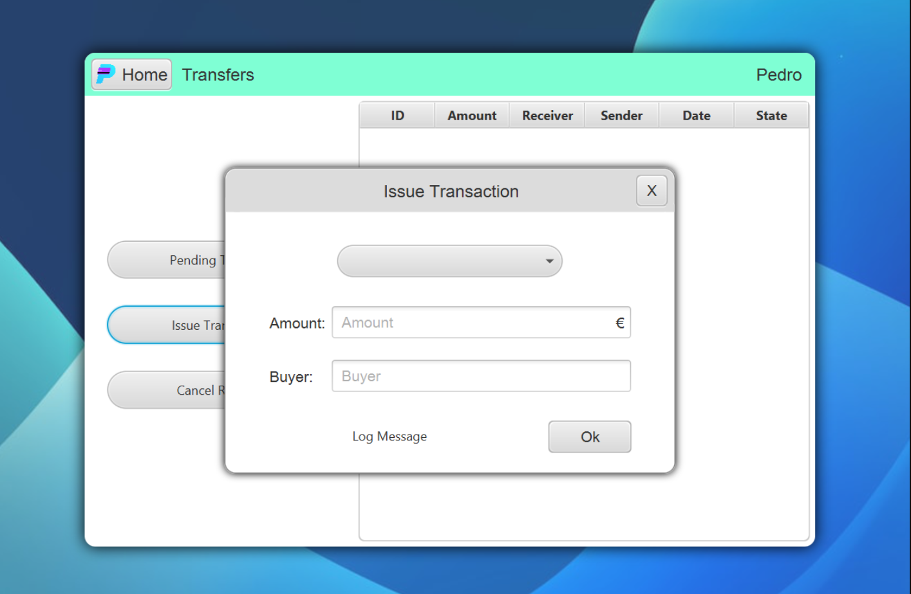

8

Slide 9
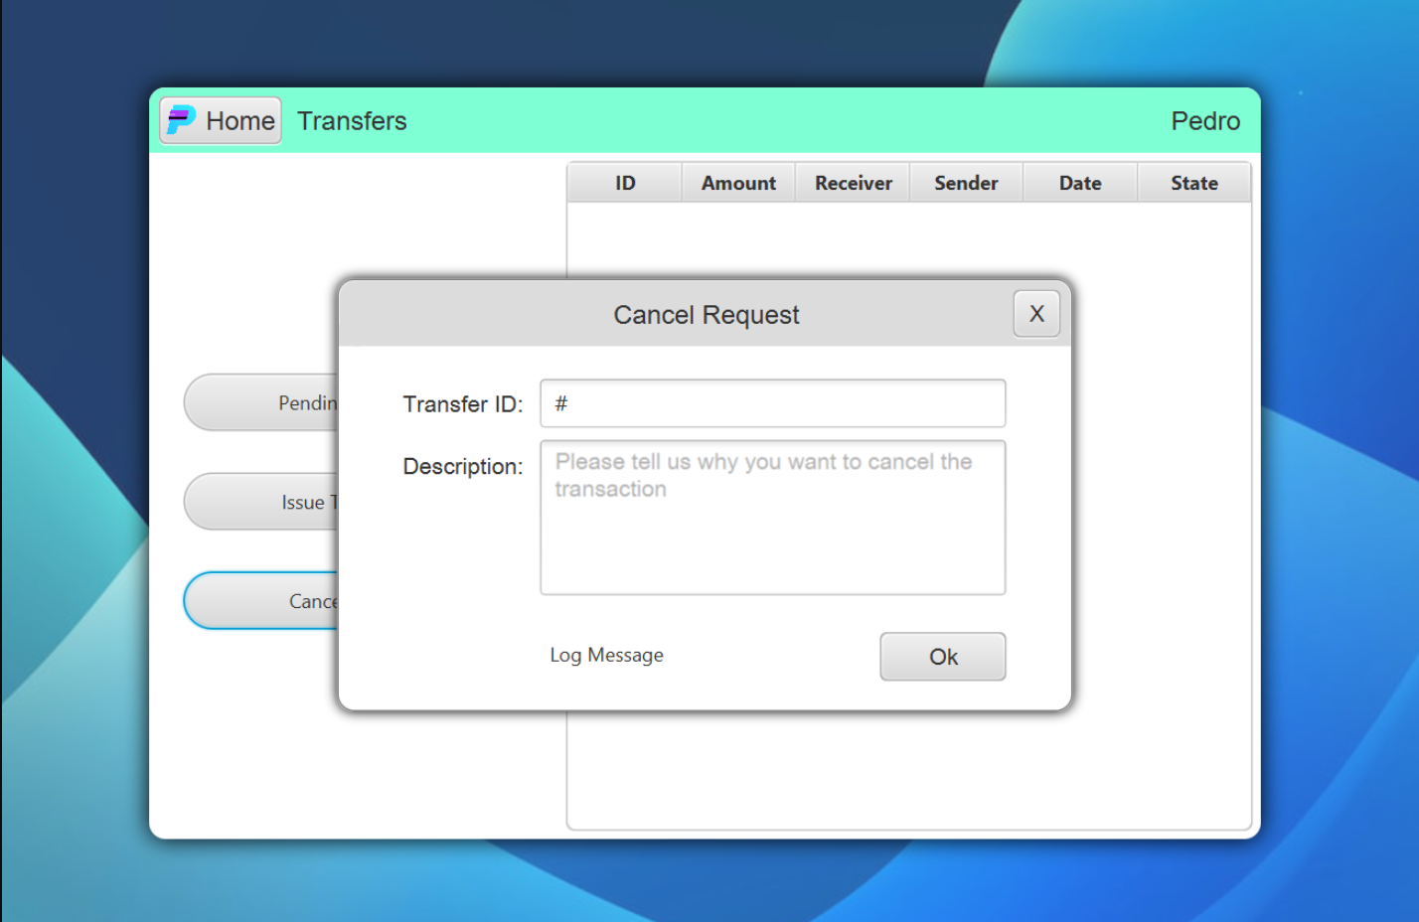
9

Slide 10
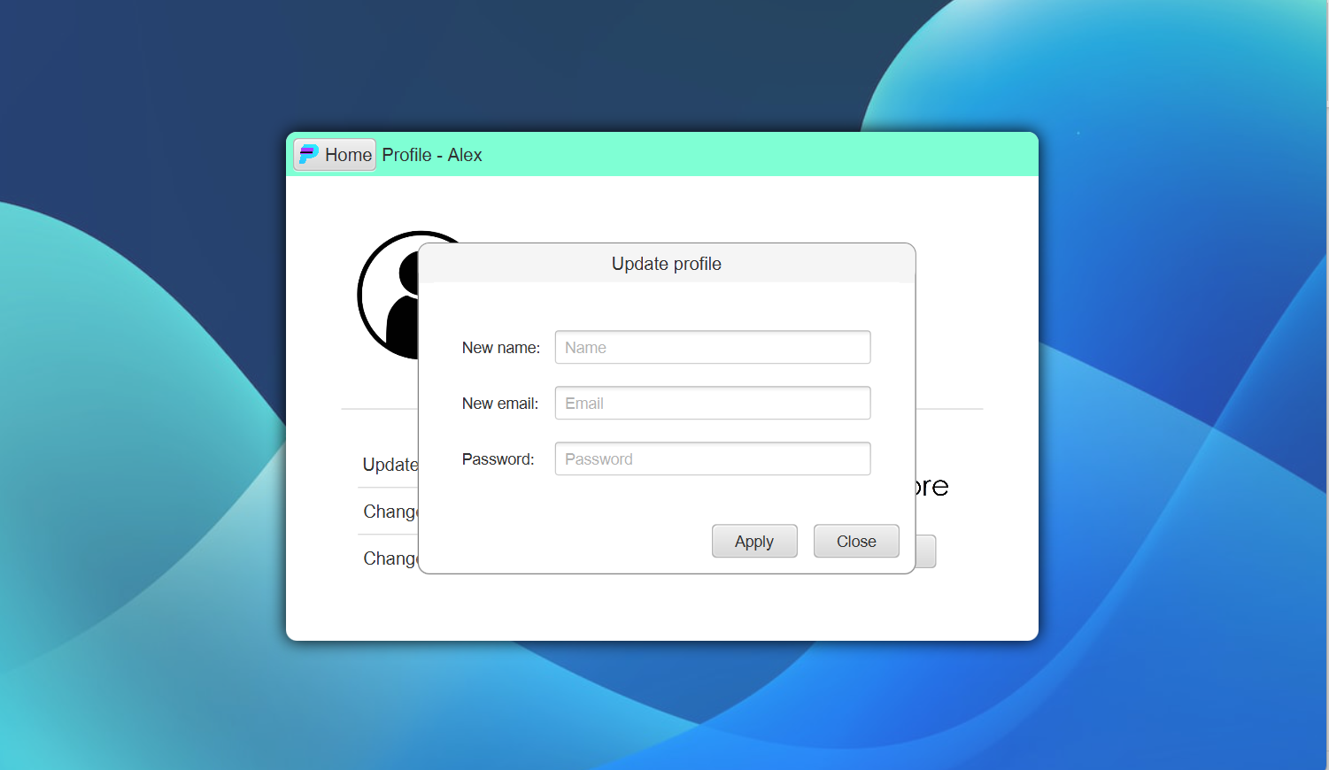

10

