Slide 1
STAT 460 · Stochastic Processes · Final Project
Stochastics of News Article Propagation
Modelling counts and reliability dynamics around the 2017 Las Vegas shooting
Harry Wang · Sriyan Madugula · Ruthesh Thavamani
University of Michigan

Slide 2
Introduction
Joint stochastic modelling of news volume and reliability after a singular event
Problem
Prior work
• A single high-impact event triggers a cascade of articles across many outlets over the following days/weeks
• Coverage volume decays, but the *mix* of reliable vs unreliable sources also evolves — and is itself a stochastic process
• Test case: 2017 Las Vegas shooting — clean, isolated, exogenously-triggered news shock
Point-process models of online attention
• Crane & Sornette (PNAS, 2008) — endogenous vs exogenous bursts in YouTube views via Hawkes-type response functions
• Zhao et al. SEISMIC (KDD, 2015); Mishra, Rizoiu & Xie (2016) — self-exciting models for tweet and retweet cascades
• Daley & Vere-Jones (2003) — standard reference for inhomogeneous Poisson and Hawkes processes
Misinformation and reliability
• Vosoughi, Roy & Aral (Science, 2018) — false news spreads farther and faster than true news on Twitter (descriptive, not generative)
• Allcott & Gentzkow (JEP, 2017) — economics of fake news during the 2016 election
• Tambuscio et al. (2015) — SIR-style compartmental models of hoax diffusion
Reliability labels
• NewsGuard, Media Bias / Fact Check — outlet-level reliability scores; used downstream of classification, rarely as the response in a stochastic model
Our contribution
• Joint event-level study: counting process for N(t) (Part A) plus a shared-likelihood comparison of Hawkes and Markov dynamics for π_{pos}(t) (Part B)
Questions and gap
• Part A: what stochastic process best describes the daily article count N(t) following the event?
• Part B: what process governs the reliable / unreliable composition π_{pos}(t) of that coverage?
• Gap addressed
– Volume dynamics and reliability dynamics are typically studied in isolation — we model both on the same event window
– Stochastic-process treatment of the reliability *mix* at event-level granularity is rare
– Cross-excitation between reliable and unreliable streams is largely unexamined
Stochastics of News Article Propagation — Wang · Madugula · Thavamani

Slide 3
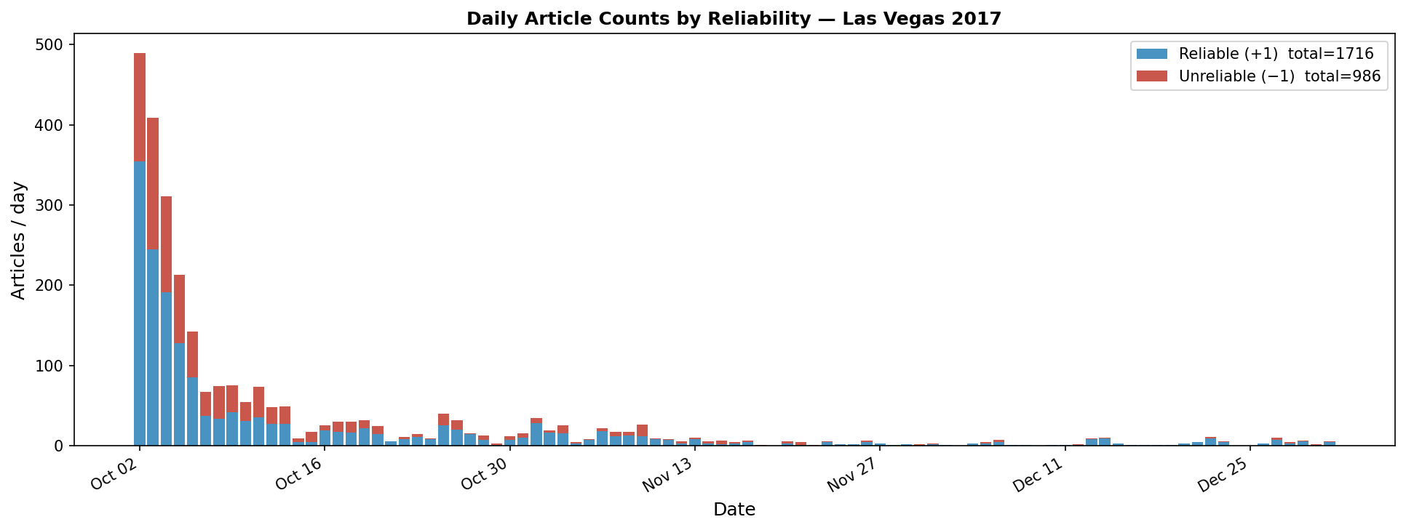
Dataset Overview
CC-News articles cross-joined with NewsGuard reliability scores
• Source: CC-News crawl, filtered to articles covering the 2017 Las Vegas shooting
• Date range: 2017-10-02 → 2017-12-31 (91 days, zero-filled)
• 2,702 articles · 29.7 articles/day mean · peak 489 on day 0
• Reliability label constructed by joining CC-News with NewsGuard scores
– Score thresholded at the median to produce a binary label ± 1
– 63.5% reliable / 36.5% unreliable across the corpus
• Limitations of the dataset
– Binary reliability label — the underlying NewsGuard score is continuous
– Daily granularity only — within-day burst structure is invisible
– Single event window — generality across event types is untested
– Coverage gaps on quiet days are zero-filled, not imputed
Stacked daily counts by reliability category
Stochastics of News Article Propagation — Wang · Madugula · Thavamani

Slide 4
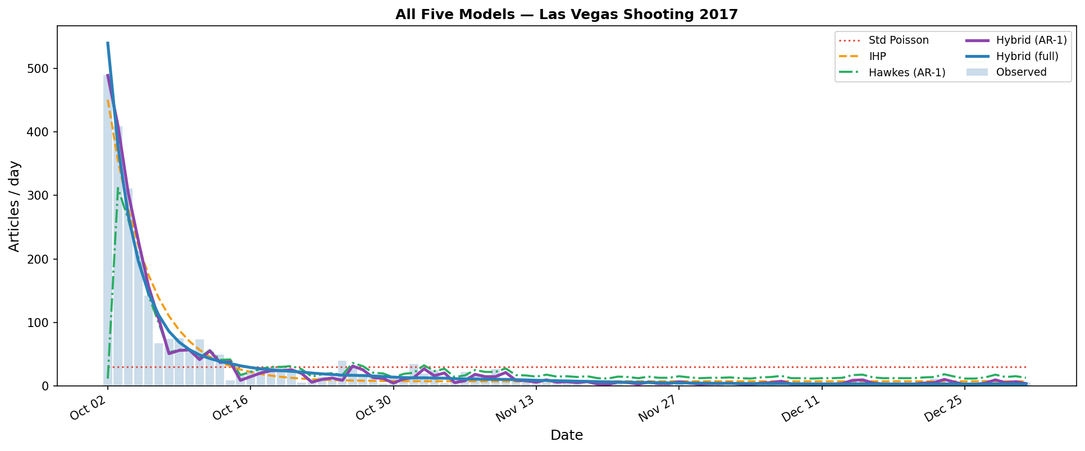
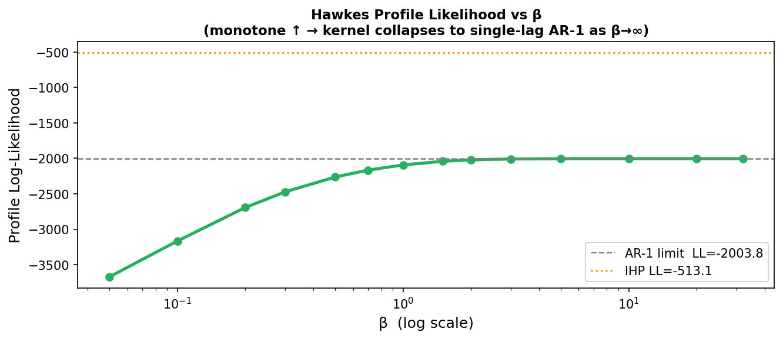
Part A · Modelling the Counting Process
Three base models fit by maximum conditional Poisson log-likelihood
• Standard Poisson — λ(t) = λ (1 param, null model)
• Inhomogeneous Poisson — λ(t) = A\,e^{−β t} + c (3 params)
• Discrete-time Hawkes — λ(t) = μ + α\,R(t), R(t) = e^{−β}\,[R(t−1) + N(t−1)]
• β-profile sweep collapses to AR(1) limit as β → ∞
– Optimal kernel: λ(t) = 11.50 + 0.614\,N(t−1)
Model | k | log L | AIC | Pearson Var
Standard Poisson | 1 | −3835.11 | 7672.22 | 196.3
Inhomog. Poisson | 3 | −513.15 | 1032.29 | 8.52
Hawkes (AR-1) | 2 | −2003.81 | 4011.62 | 225.1
IHP wins decisively — absorbs the day-0 exogenous shock the Hawkes cannot.
Stochastics of News Article Propagation — Wang · Madugula · Thavamani

Slide 5
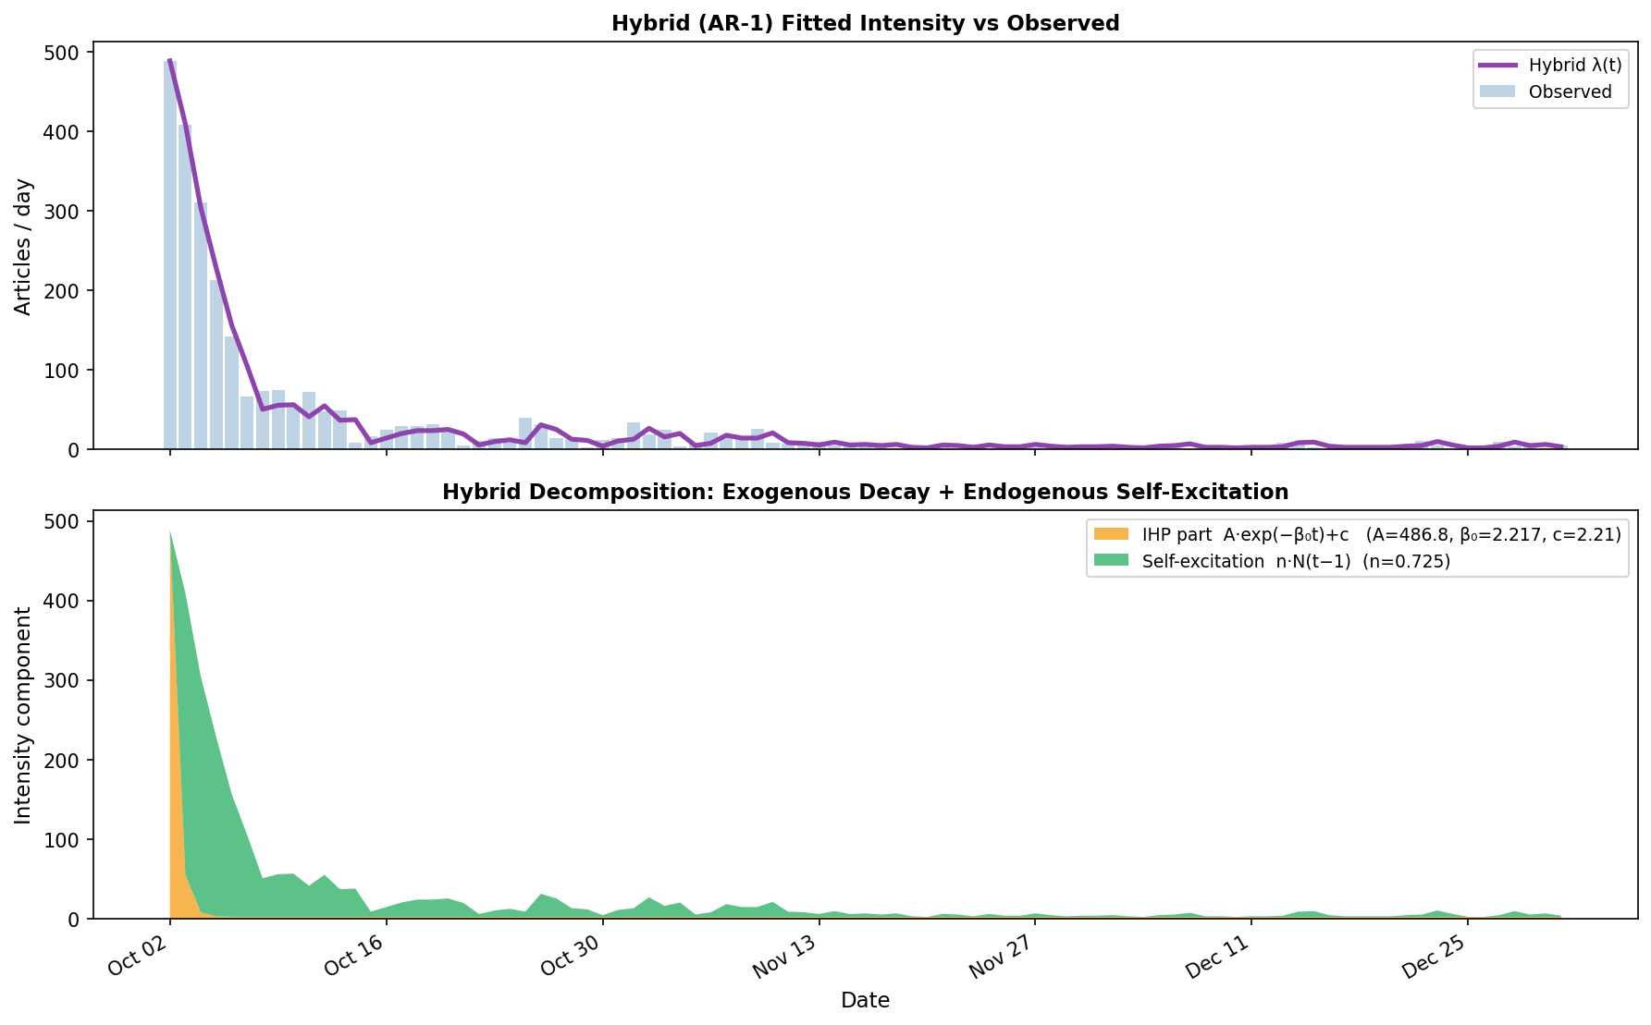
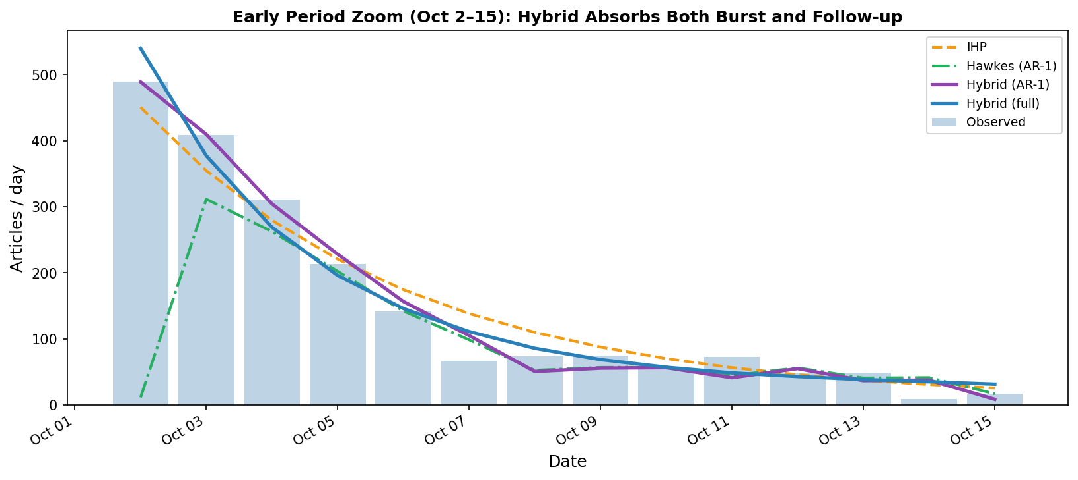
Part A · Hybrid IHP + Hawkes Wins
Combining exogenous trigger with endogenous self-excitation
Hybrid (full): λ(t) = A\,e^{−β}0 ^{t} + c + α\,R(t)
• IHP term absorbs the day-0 burst (489 articles)
• Hawkes term carries the self-exciting tail
• Two timescales: fast exogenous decay (half-life ≈ 1.75 d) + slow endogenous persistence (half-life ≈ 8.2 d)
• LRT IHP → Hybrid-AR1: Δℓ = 124.4, p ≈ 0
• LRT Hybrid-AR1 → Hybrid-full: p = 3.7× 10⁻⁹
Model | k | AIC | BIC
Standard Poisson | 1 | 7672.22 | 7674.73
Inhomog. Poisson | 3 | 1032.29 | 1039.82
Hawkes (AR-1) | 2 | 4011.62 | 4016.65
Hybrid IHP+Hawkes (AR-1) | 4 | 785.59 | 795.63
Hybrid IHP+Hawkes (full) | 5 | 752.80 | 765.35
Stochastics of News Article Propagation — Wang · Madugula · Thavamani

Slide 6
Part B · Setup and the Shared Binomial Likelihood
Conditioning on N_{tot}(t) puts Hawkes and Markov on a common scale
• Goal: model the reliable / unreliable split, not the total volume
– q_{t} = P(article on day t is reliable)
• Daily observations: N_{neg}(t),\, N_{pos}(t); N_{tot}(t) = N_{neg}(t) + N_{pos}(t); π_{pos}(t) = N_{pos}(t) / N_{tot}(t)
• Why a shared likelihood is needed
– Hawkes natively scores (N_{neg}, N_{pos}) via a Poisson log-likelihood
– Markov natively scores the transition π_{t−1} → π_{t} via a multinomial
– Native AICs are on different scales — not directly comparable
• Resolution: condition on the observed total N_{tot}(t) and score the composition only
– Justified by the Poisson–binomial superposition identity (right)
– Semantically correct: Part B is about the *distribution*, not the volume
• Constant-in-q_{t} terms (the log C(N_{tot}, N_{pos}) factor) cancel in every model comparison
Poisson – binomial superposition
If X ∼ Pois(λ₁) and Y ∼ Pois(λ₂) independently,
X | (X + Y = n) \;∼\; Binomial\left(n,\; λ₁ / λ₁ + λ₂\right)
⇒ applied to (N_{neg}, N_{pos}), this is the binomial that scores the split
Conditional binomial log-likelihood
Per day t with N_{tot}(t) > 0:
ℓ_{t} \;=\; log C(N_{tot}(t), N_{pos}(t)) \,+\, N_{pos}(t) log q_{t} \,+\, N_{neg}(t) log (1 − q_{t})
Total: ℓ = ∑_{t:\, Ntot(t) > 0} ℓ_{t}, effective sample size n_{eff} = 86
Model-specific reliable fraction q_{t}
Hawkes (Poisson superposition):
q_{t} \;=\; \dfrac{λ_{pos}(t)}{λ_{pos}(t) + λ_{neg}(t)}
Markov (one-step transition):
q_{t} \;=\; \big(π_{t−1}\, P_{t}\big)_{pos} \;=\; π_{neg}(t−1)\, P_{neg → pos} \,+\, π_{pos}(t−1)\, P_{pos → pos}
Stochastics of News Article Propagation — Wang · Madugula · Thavamani

Slide 7
Part B · Model Specifications
Four candidates on the shared binomial scale — full functional forms and derivations
1. Multivariate Hawkes (AR-1 limit, 6 params)
2z. Homogeneous Markov (null, 2 params)
λ_{k}(t) \;=\; μ_{k} \;+\; ∑_{j ∈ {neg,\, pos}} n_{k,j}\, N_{j}(t−1),\quad k ∈ {neg,\, pos}
• Parameters: baselines μ_{neg},\, μ_{pos} and 2× 2 branching matrix n
• Stationarity constraint: spectral radius ρ(n) < 1, enforced during optimisation
• Derivation: direct 2-D lift of Part A's AR(1) Hawkes; β → ∞ collapse inherited
• Implied split: q_{t} = λ_{pos}(t) / (λ_{pos}(t) + λ_{neg}(t))
P \;=\; \begin{pmatrix} P_{neg→ neg} & P_{neg → pos} \\ P_{pos → neg} & P_{pos → pos} \end{pmatrix},\quad rows sum to 1
q_{t} \;=\; (π_{t−1}\, P)_{pos} \;=\; π_{neg}(t−1)\, P_{neg → pos} \,+\, π_{pos}(t−1)\, P_{pos → pos}
• Two free parameters (one per row after the simplex constraint)
• Derivation: assume article-level first-order Markov; aggregate to daily proportions
• Stationary π· solves π· P = π· ≈ (0.39,\, 0.61) — null benchmark
2a. State-dependent Markov (regime-switching, 4 params)
2b. Mean-field Markov (logistic links, 4 params)
x_{t−1} \;=\; argmax_{k}\, π_{k}(t−1) ∈ {neg,\, pos}
q_{t} \;=\; \big(π_{t−1}\, P^{(x}t−1⁾\big)_{pos},\quad P^{(neg)},\, P^{(pos)} separately fit
• Two regime-specific transition matrices, keyed on yesterday's majority class
• Derivation: treat the shock regime (neg-majority, \le 12 days) as a discrete latent state
• Threshold at π_{pos} = 0.5 is model-imposed and abrupt — smoothed by 2b below
P_{neg → pos}(t) \;=\; σ\!\big(a₀ + a₁\, π_{pos}(t−1)\big)
P_{pos → neg}(t) \;=\; σ\!\big(b₀ + b₁\, π_{pos}(t−1)\big)
• Remaining entries from the row-sum constraint; σ(u) = 1/(1 + e^{−u})
• Derivation: continuous analogue of 2a — regime dependence becomes a smooth function of the empirical proportion
• Nests the null at a₁ = b₁ = 0 ⇒ clean LRT, df = 2; precursor to McKean–Vlasov
Stochastics of News Article Propagation — Wang · Madugula · Thavamani

Slide 8
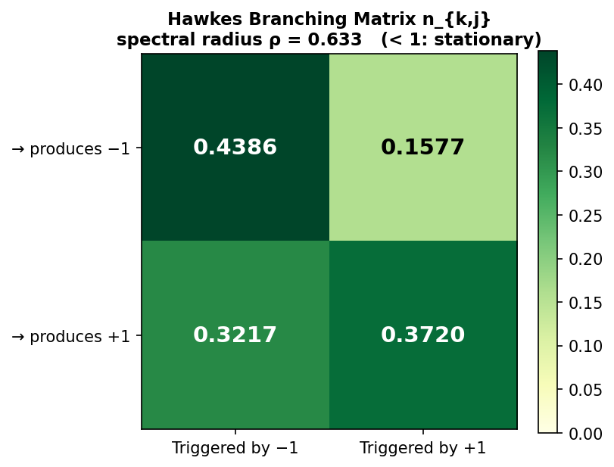
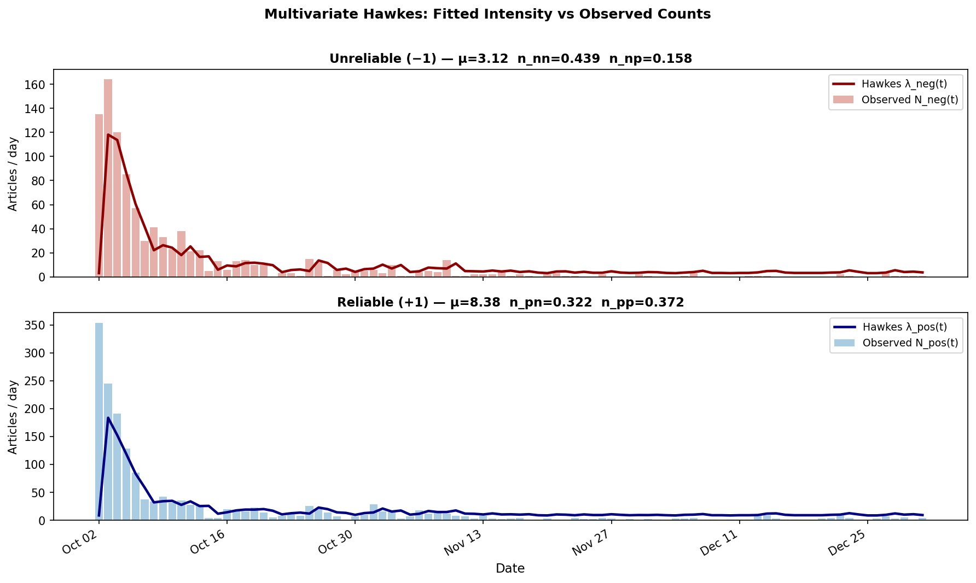
Part B · Multivariate Hawkes — Cross-Excitation
Branching matrix between reliable and unreliable streams
• Baselines: μ_{neg} = 3.12, μ_{pos} = 8.38
• Spectral radius ρ(n) = 0.633 → stationary
• Within-category excitation: n_{nn} = 0.44, n_{pp} = 0.37
• Cross-excitation is non-trivial: n_{pn} = 0.32, n_{np} = 0.16
• Reliability is not a closed ecosystem — streams interact
Justification: Hawkes is the natural multivariate generalisation of Part A's winner;
branching matrix gives mechanistic, interpretable cross-excitation estimates.
Interpretation
• An unreliable article today triggers ≈ 0.32 reliable articles tomorrow
• A reliable article today triggers ≈ 0.16 unreliable articles tomorrow
• Mildly diagonal-dominant, sub-critical, and consistent with Part A
Stochastics of News Article Propagation — Wang · Madugula · Thavamani

Slide 9
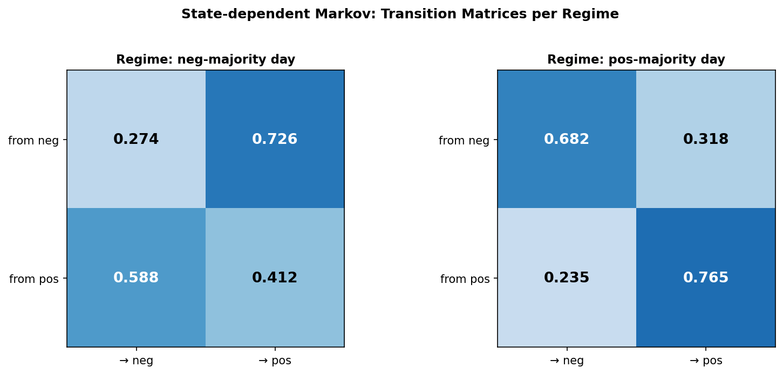
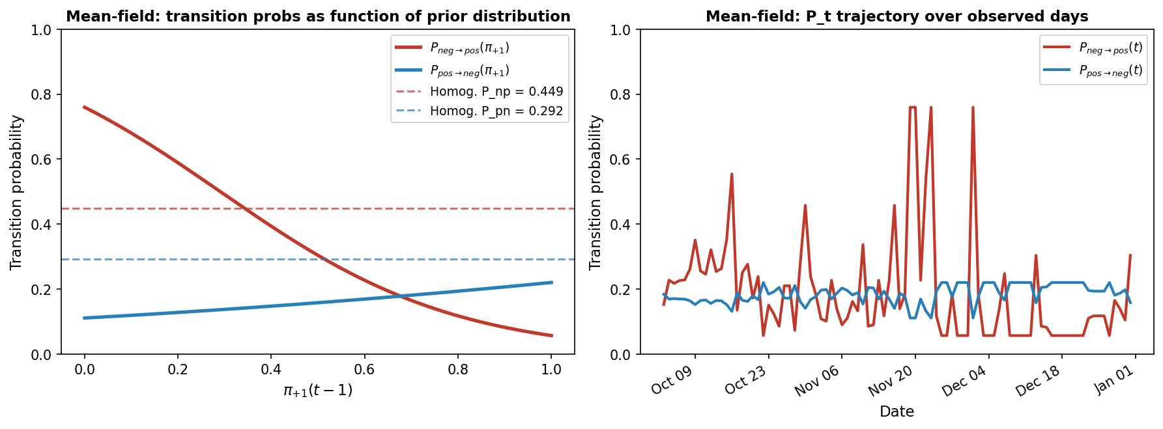
Part B · Markov Variants — Regime Switching & Mean-Field
Two parameterisations of state-dependent transition probabilities
State-dependent (regime-switching) Markov
• Two transition matrices keyed on yesterday's majority state
• Pos-majority regime: both classes sticky (P_{nn} = 0.68, P_{pp} = 0.76)
• Neg-majority regime: dynamics push toward reliable (P_{neg → pos} = 0.73)
Mean-field Markov
• Logistic links: P_{neg → pos} = σ(a₀ + a₁\,π_{pos}), P_{pos → neg} = σ(b₀ + b₁\,π_{pos})
• Fitted: a₀ = +1.15, a₁ = −3.96 → strong mean reversion
• When reliable share ↓, conversion to reliable ↑ sharply (0.76 → 0.06)
• Smooth, identifiable analogue of the regime-switching matrix
Stochastics of News Article Propagation — Wang · Madugula · Thavamani

Slide 10
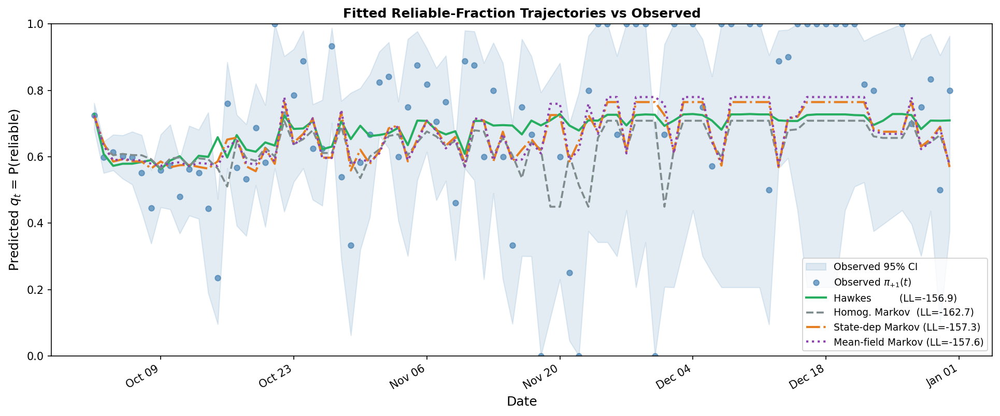
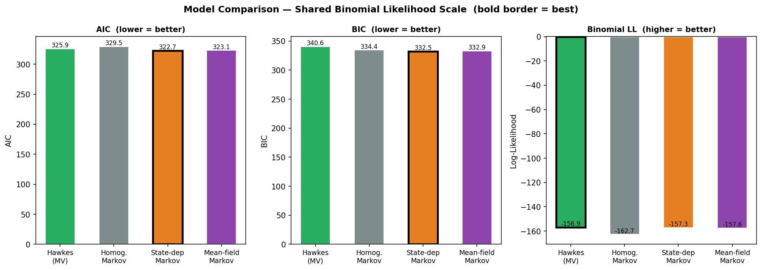
Part B · Model Comparison on Shared Binomial Scale
Effective sample size n_{eff} = 86 days with at least one article
Model | k | log L | AIC | BIC
Multivariate Hawkes | 6 | −156.93 | 325.87 | 340.60
Homogeneous Markov | 2 | −162.75 | 329.50 | 334.41
State-dependent Markov | 4 | −157.33 | 322.65 | 332.47
Mean-field Markov | 4 | −157.56 | 323.13 | 332.94
Likelihood ratio tests vs homogeneous baseline
• State-dep Markov: LR = 10.85, df = 2, p = 4.4× 10⁻³
• Mean-field Markov: LR = 10.37, df = 2, p = 5.6× 10⁻³
Why Markov beats Hawkes here
• Hawkes spends parameters on total counts, not the split
• ∼ 86\% of days are pos-majority — a single P captures most dynamics
Stochastics of News Article Propagation — Wang · Madugula · Thavamani

Slide 11
Part B · Interpretation — A Mean-Reverting Reliability Ecology
What the winning models say about the news ecosystem
• The system has a stable equilibrium near π_{pos} ≈ 0.63 — the empirical reliable share
• When the reliable share drops below 0.5 (only at the initial shock), strong restoring forces fire
– State-dependent Markov: P_{neg → pos} jumps to 0.73 in the neg-majority regime
– Mean-field Markov: P_{neg → pos} is a steeply decreasing function of π_{pos}
• Hawkes branching matrix encodes the same story mechanistically
– Reliable articles preferentially trigger more reliable articles (n_{pp} > n_{np})
– Unreliable articles trigger reliable and unreliable articles nearly symmetrically
• Choice of model depends on the question being asked
– Distribution dynamics → Markov variants are most efficient
– Mechanistic cross-excitation → Multivariate Hawkes is most informative
• Synthetic recovery passed (max rel. error 20\% at T = 500) — estimates are trustworthy
Stochastics of News Article Propagation — Wang · Madugula · Thavamani

Slide 12
Conclusions and Next Steps
Summary of findings
Next steps
• Counting process is best modelled by a hybrid IHP + Hawkes
– Exogenous shock + endogenous amplification at distinct timescales
• Reliability split is best modelled by a state-dependent Markov chain
– Mean-field Markov is statistically indistinguishable and smoother
• Cross-excitation between reliable and unreliable streams is non-trivial
• Reliability ecology is mean-reverting around the empirical equilibrium
• McKean–Vlasov formulation for continuous-time, distribution-dependent transitions
– Replace discrete P_{t} with an SDE driven by the empirical π_{pos} measure
• Use raw NewsGuard scores (continuous) instead of the binary label
– Recovers within-class heterogeneity lost to the median threshold
– Enables regression / functional models on a real-valued reliability axis
• Replicate across additional events to test generality of the hybrid + Markov story
• Extend hybrid model with explicit weekly seasonality (Δ AIC ≈ −148 in exploration)
Stochastics of News Article Propagation — Wang · Madugula · Thavamani

