Slide 1
Machine Learning
Stock Selection
Household and Personal Products Sector | FIN 427
Harry Wang • Vincent Antonio • Kepler Huntress • Matthew Meilinger
whrui@umich.edu | antonvin@umich.edu | keplerh@umich.edu | mattmeil@umich.edu
April 7, 2026

Slide 2
Introduction
Research Question: Using machine learning, which stock in the Household and Personal Products sector (GICS 3030) will deliver the highest industry-adjusted return in November 2024?
Dataset
Six Models Evaluated
• 1,053,738 stock-month observations (Jan 2001 – Nov 2024)
• All GICS sectors; prediction restricted to 38 sector stocks
• 15 winsorized predictor variables
• Target: industry-adjusted monthly return (indadjret)
1. Ordinary Least Squares (OLS)
2. LASSO Penalized Regression
3. Vanilla Decision Tree
4. Random Forest
5. Gradient Boosting (XGBoost)
6. Simple Neural Network (MLP)
★ Recommendation: NAII (Natural Alternatives International Inc.) — top-3 under OLS and XGBoost; top-8 under four of six models
FIN 427 | Machine Learning Stock Selection | April 2026

Slide 3
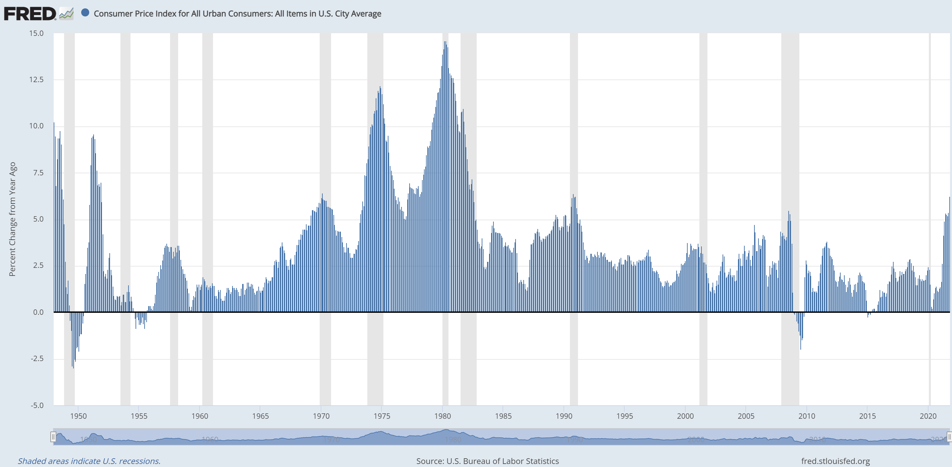
Data Overview
Dataset Scope
Spearman Correlation Matrix of Predictors (Training Set)
• Panel: January 2001 – November 2024
• Universe: All GICS sectors (~1.05 M observations)
• Prediction universe: 38 stocks (GICS sector 30 / group 3030)
• Sources: CRSP, Compustat, WRDS Financial Ratios, OptionsMetrics, BoardEx
Predictor Variable Categories (15 variables)
Size
Log real market capitalization
Value
Book-to-market equity
Momentum
12-month & 11-month momentum
Profitability
Net profit margin, ROIC, ΔROA
Governance
Board age diversity, % male directors
Risk / Liquidity
Beta, Amihud illiquidity, current ratio
Capital Structure
Net WC/assets, log share change, O/S ratio
FIN 427 | Machine Learning Stock Selection | April 2026

Slide 4
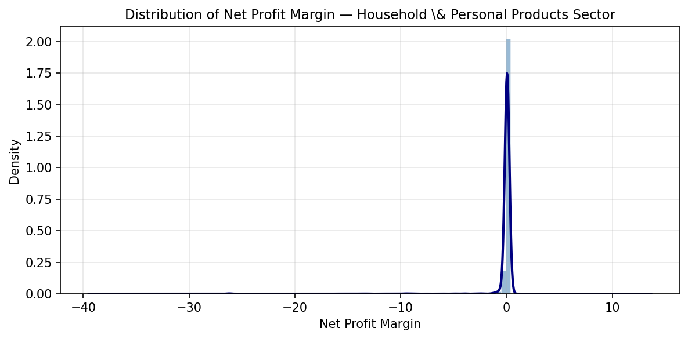
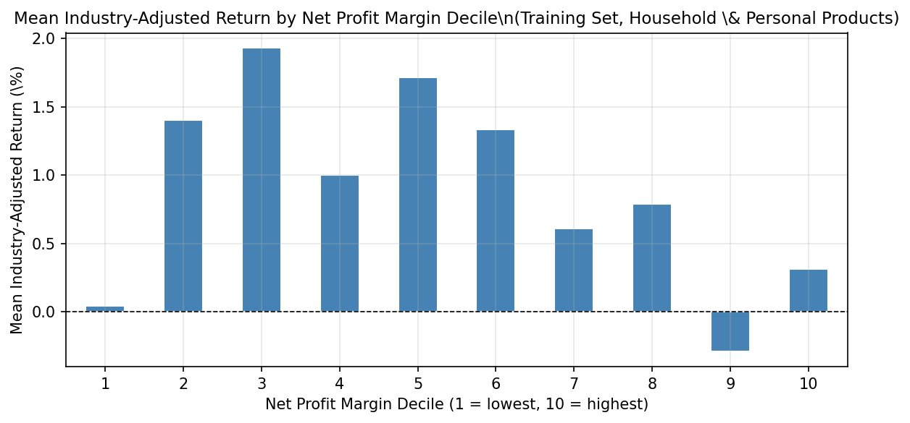
Variable of Interest: Net Profit Margin
Why Net Profit Margin?
Distribution of finnpm (Sector 3030)
Net profit margin (net income ÷ total sales) captures how efficiently a firm converts revenue into earnings — a fundamental profitability signal in a sector driven by brand equity and operational efficiency.
• Sustained margins signal durable competitive advantages
• Supported by Novy-Marx (2013): profitable firms earn significantly higher returns
• Winsorized at 1st–99th percentile; two sequential trimming passes removed ~2.2% of extreme observations
• Final distribution: median 0.036; range [−22.14, 0.36]
Mean Industry-Adjusted Return by Decile of Net Profit Margin
Full sample: 1,053,738 obs. | Missingness: ~5% | Variable code: finnpm
FIN 427 | Machine Learning Stock Selection | April 2026

Slide 5
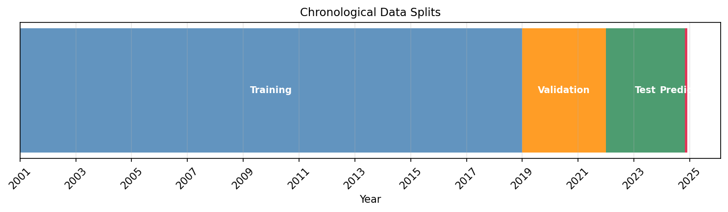
Data Splits & Methodology
Training
Validation
Test
Prediction
Jan 2001 – Dec 2018
Jan 2019 – Dec 2021
Jan 2022 – Oct 2024
November 2024
Fit all model parameters
18 years, multiple business cycles
Hyperparameter tuning
Includes COVID-19 structural break
Out-of-sample performance
(R², RMSE, Spearman ρ)
Features as of Oct 31, 2024
indadjret never used in training
FIN 427 | Machine Learning Stock Selection | April 2026

Slide 6
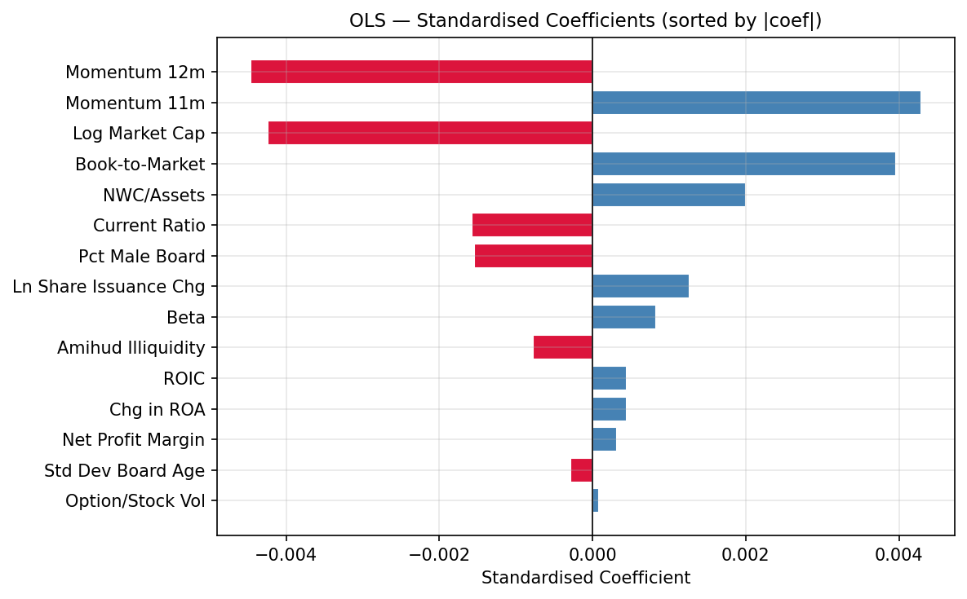
OLS Regression
R² (Test)
RMSE
MAE
Spearman ρ
−0.0012
0.1852
0.1078
−0.0441
Key Findings
Standardized coefficient estimates (|coef| sorted, blue = positive, red = negative)
• Predictive accuracy is near zero — consistent with the empirical difficulty of forecasting cross-sectional returns
• Momentum (Mom11, Mom12), size (log market cap), and book-to-market equity have the largest standardized coefficient magnitudes
• Positive predictors: Mom11, Mom12, B/M
• Negative predictors: Log Market Cap, Amihud illiquidity, O/S ratio
FIN 427 | Machine Learning Stock Selection | April 2026

Slide 7
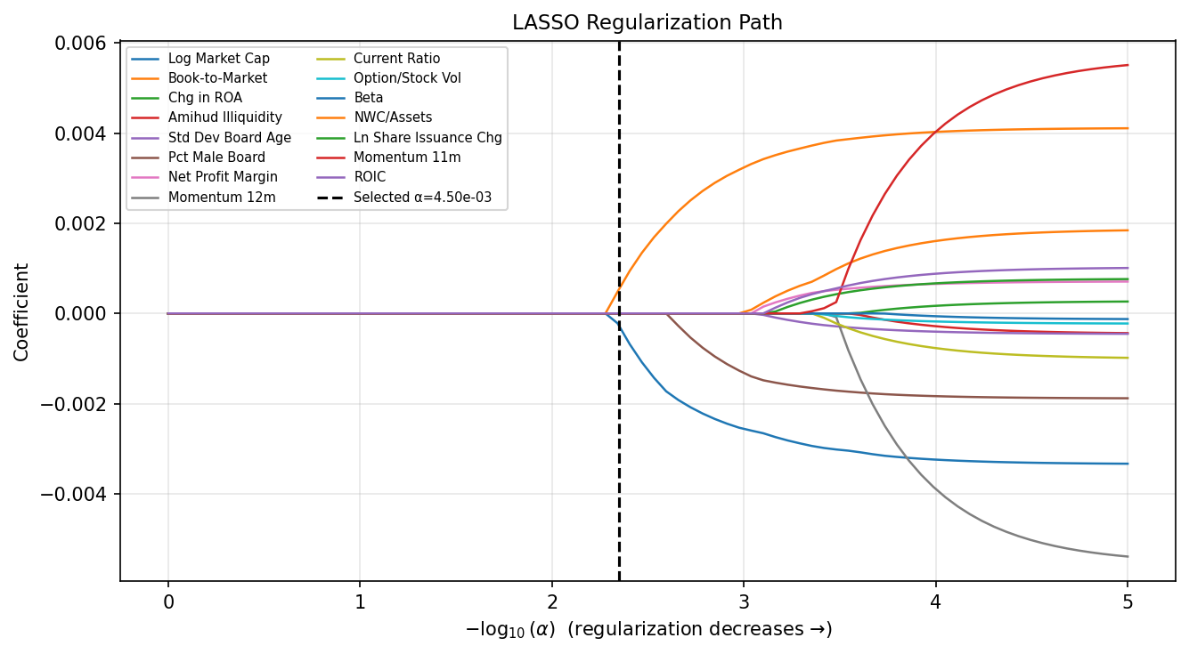
LASSO Penalized Regression
R² (Test)
Optimal α
Predictors Zeroed
Spearman ρ
−0.0012
0.00450
13 of 15
−0.0576
Key Findings
LASSO regularization path — dashed line marks cross-validated optimal α
• LASSO variable selection: only 2 of 15 predictors survive with non-zero coefficients
• Surviving predictors: Log Market Cap and Book-to-Market equity only
• Performance virtually identical to OLS — additional features contribute mostly noise
• Stark result: 87% of predictors are irrelevant under regularization
FIN 427 | Machine Learning Stock Selection | April 2026

Slide 8
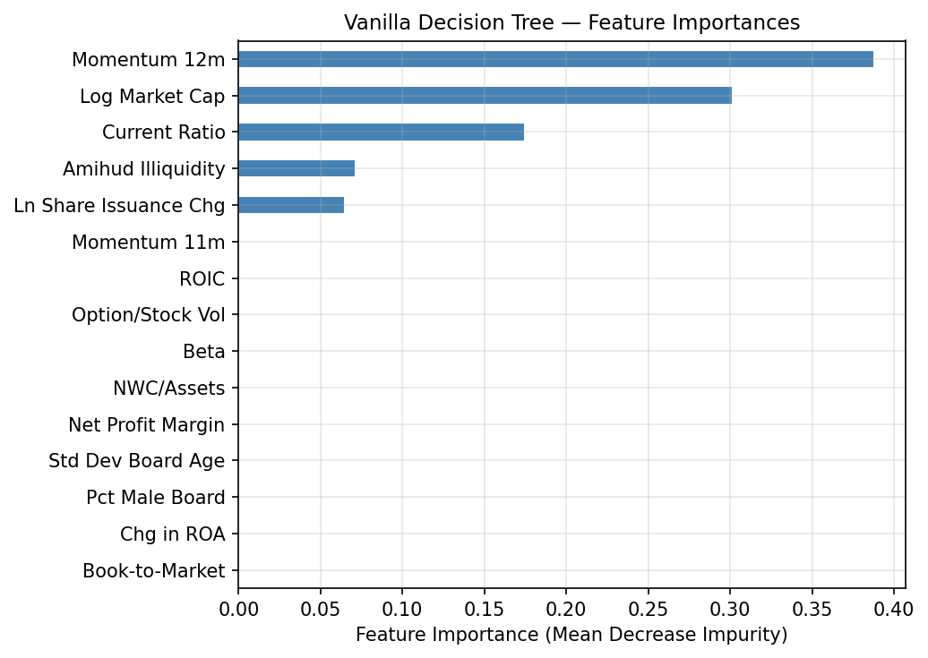
Vanilla Decision Tree
R² (Test)
Optimal Depth
Val. R²
Top Splitter
−0.0095
3
0.0032
Mom12
Key Findings
Feature importances (mean decrease in impurity) — only features assigned non-zero importance shown
• Max depth = 3 selected via validation-set grid search — prevents severe overfitting
• 12-month momentum (finmom12) is the most important splitting feature across all branches
• Worst out-of-sample R² among all models, but the simple structure reveals momentum’s dominance clearly
• Shallow depth limits ability to capture complex variable interactions
FIN 427 | Machine Learning Stock Selection | April 2026

Slide 9
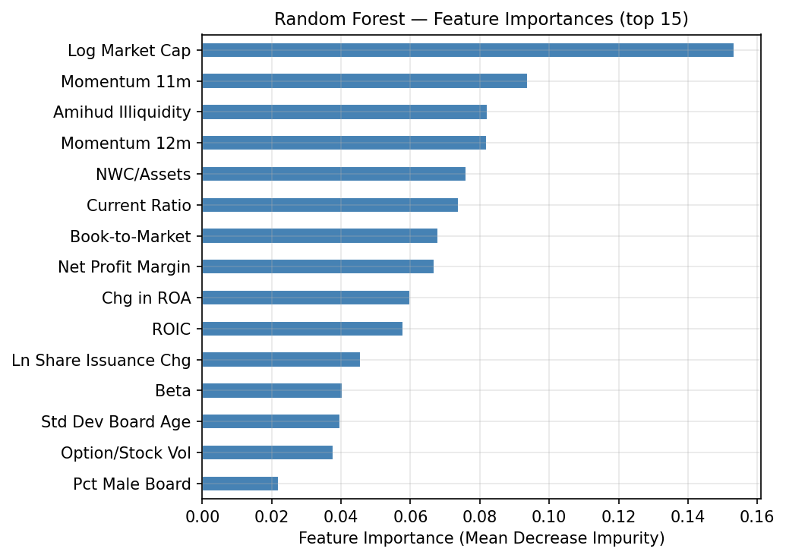
Random Forest
R² (Test)
Trees
Max Depth
Max Features
−0.0090
200
10
√n
Key Findings
Feature importances (mean decrease in impurity, top 15, normalized to sum to 1)
• Optimal hyperparameters via grid search: n=200 trees, depth=10, features=√n
• Validation R² = 0.0054 — best among tree-based methods during tuning
• Ensemble averaging reduces variance vs. single tree, but out-of-sample improvement is marginal
• Momentum (finmom12) again dominates feature importance; B/M and size are secondary
FIN 427 | Machine Learning Stock Selection | April 2026

Slide 10
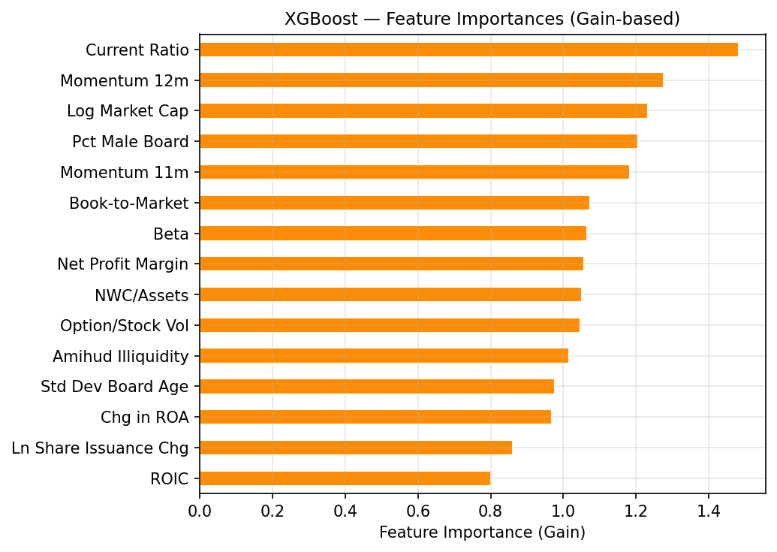
Gradient Boosting (XGBoost)
R² (Test)
Best R² (All)
Stopped At
Spearman ρ
−0.0041
#1 of 6
Iter 79
+0.0014
Key Findings
Feature importances by gain (total improvement in loss attributed to each feature)
• Best out-of-sample R² among all six models (R² = −0.0041), though improvement is marginal
• Early stopping halted training at iteration 79 of 1,000 — the predictive signal is quickly exhausted
• Only model with a positive (near-zero) Spearman ρ = 0.0014, though not statistically significant (p = 0.605)
• Momentum and book-to-market dominate gain-based feature importance
FIN 427 | Machine Learning Stock Selection | April 2026

Slide 11
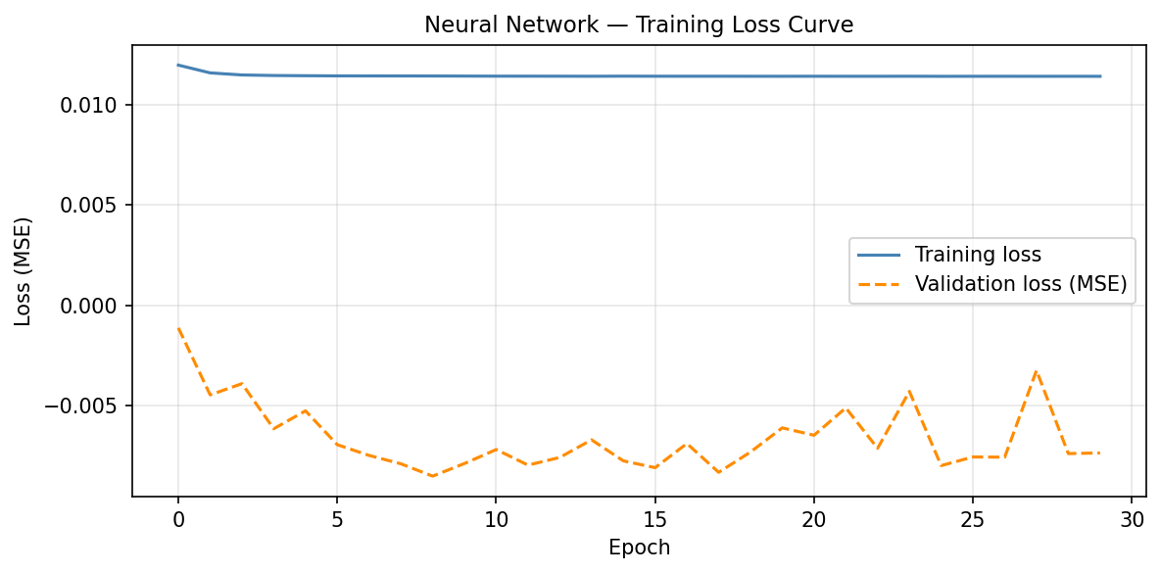
Neural Network (MLP)
R² (Test)
Architecture
Early Stop
Parameters
−0.0059
128→64→32
Epoch 30
12,417
Key Findings
Training vs. validation loss curves — dashed line marks early-stopping epoch
• 3-layer MLP: hidden layers (128, 64, 32), ReLU activations, Adam optimizer (η = 0.001), L2 weight decay (α = 0.001)
• Inputs standardized with a StandardScaler fitted on the training set only
• Loss curves show no signs of severe overfitting — regularization and early stopping are working
• Spearman ρ = −0.0027 (p = 0.304, not statistically significant)
FIN 427 | Machine Learning Stock Selection | April 2026

Slide 12
Interesting & Unusual Findings
All Six Models Produce Near-Zero or Negative R²
LASSO Eliminates 87% of Predictors
Every model fails to beat a naive mean predictor on the 2022–2024 test set. Even the best model (XGBoost) achieves only R² = −0.0041. This confirms the well-established empirical result that cross-sectional stock returns are extremely difficult to predict.
At the optimal penalty α = 0.00450, only Log Market Cap and Book-to-Market survive. 13 of 15 carefully constructed predictors — including governance, profitability, and liquidity variables — are shrunk exactly to zero. The signal is concentrated in just two classic factors.
Cross-Model Consensus Despite Poor Individual Fit
XGBoost Exhausts Signal at Iteration 79 of 1,000
Despite near-zero R² across all models, NAII ranks in the top tier consistently. Models with essentially no predictive power still agree on relative ordering — suggesting the top picks are driven by strong factor signals (particularly momentum) rather than noise.
With a patience of 50 and up to 1,000 boosting rounds, XGBoost stopped at just iteration 79. The predictable content of 15 firm characteristics for monthly return prediction is exhausted almost immediately, consistent with near-random cross-sectional returns in this sector.
FIN 427 | Machine Learning Stock Selection | April 2026

Slide 13
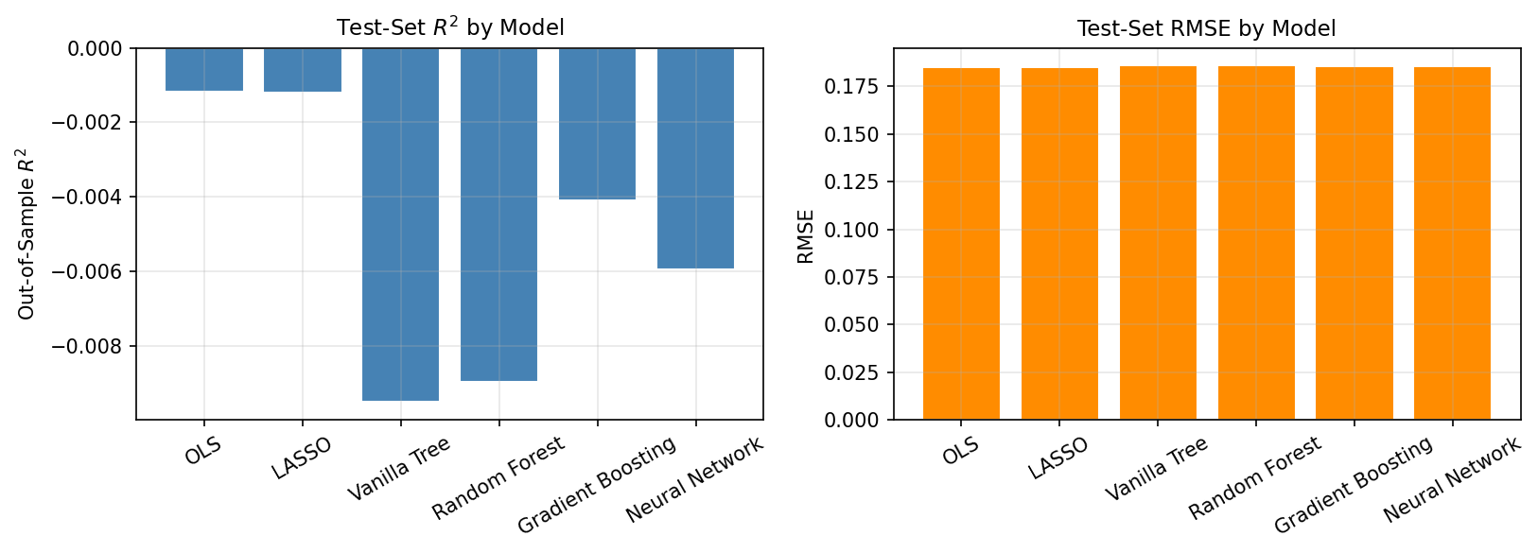
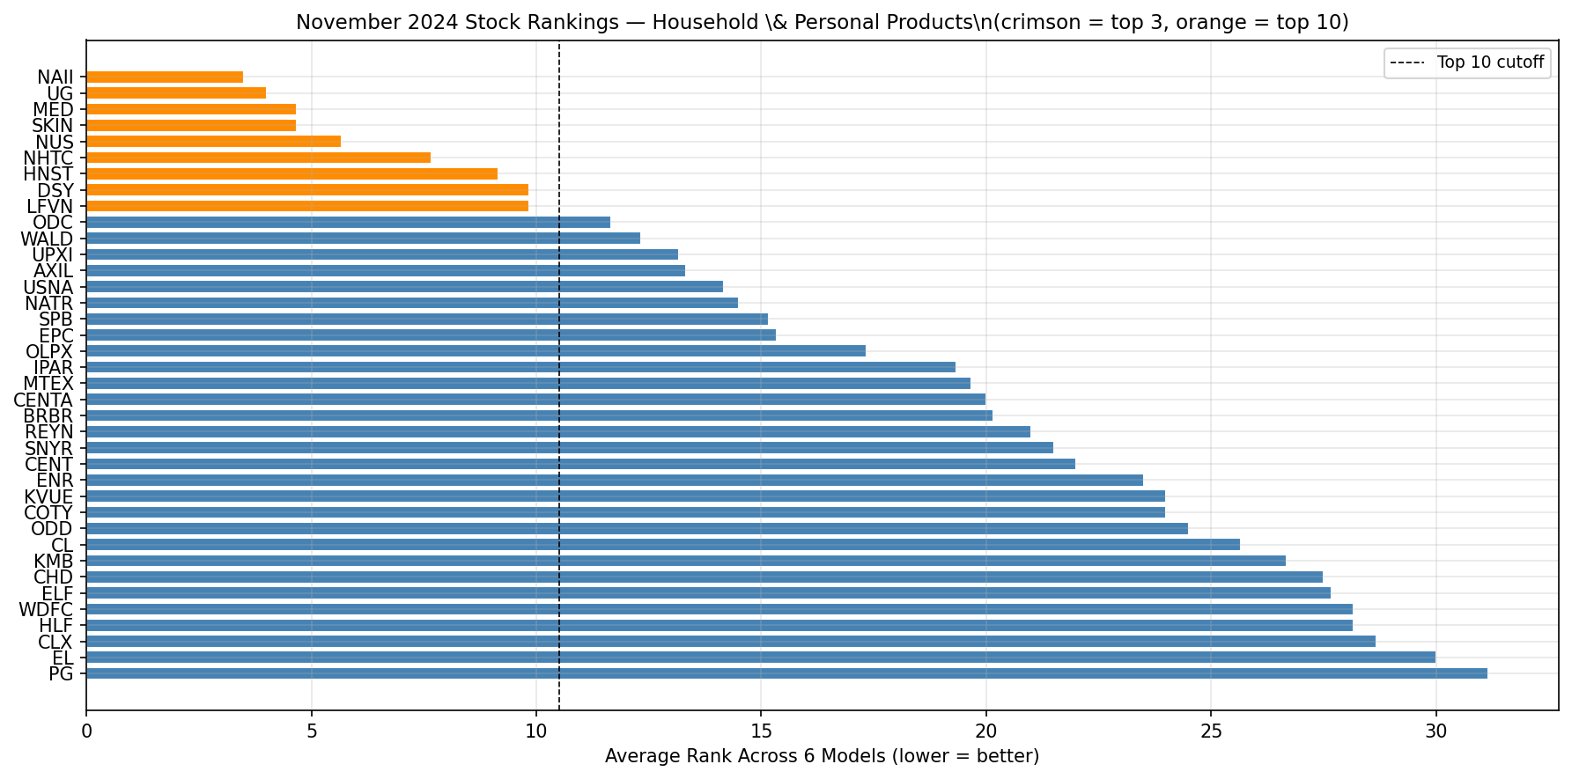
Model Comparison & Stock Rankings
Out-of-Sample R² & RMSE by Model
Average Rank Across 6 Models — All 38 Sector Stocks (Nov 2024)
Out-of-Sample Performance Summary
Model
R² (Test)
RMSE
Spearman ρ
p-value
Nov 2024 Top Pick
OLS
−0.0012
0.1852
−0.0441
0.0000
—
LASSO
−0.0012
0.1852
−0.0576
0.0000
—
Decision Tree
−0.0095
0.1860
−0.0469
0.0000
—
Random Forest
−0.0090
0.1860
−0.0278
0.0000
—
XGBoost
−0.0041
0.1855
+0.0014
0.6047
NAII (rank 1)
Neural Net
−0.0059
0.1857
−0.0027
0.3041
—
FIN 427 | Machine Learning Stock Selection | April 2026

Slide 14
Conclusion
Buy Recommendation: NAII — Natural Alternatives International Inc.
Top-3 under OLS and XGBoost • Top-8 under 4 of 6 models • Strong 12-month momentum signal
1
All six models produce near-zero or slightly negative out-of-sample R² on the 2022–2024 test period — consistent with the well-established empirical result that individual stock returns are very difficult to predict.
2
12-month momentum is the most consistently important predictor across all six methods. LASSO further reduced the feature set to just market cap and book-to-market, eliminating 87% of predictors.
3
Cross-model consensus provides additional confidence: even weak directional signals, when aggregated across many stocks and methods, improve rank stability and support the NAII recommendation.
4
Future work: ensemble stacking, alternative targets (sector-relative rank), richer feature sets including sentiment from earnings calls, and longer prediction horizons.
FIN 427 | University of Michigan | April 2026

