Slide 1
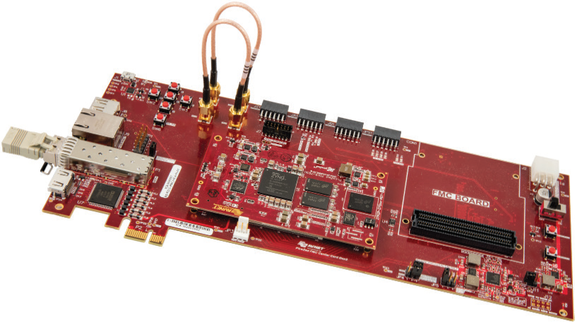

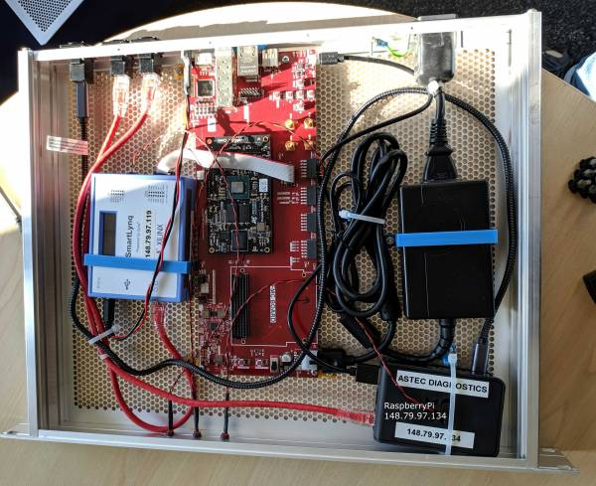
Open EVR Progress
Adam Gryko & Will Smith
11/05/2020

Slide 2
Aims
Take the firmware released by Jukka and implement it
https://github.com/jpietari/mrf-openevr
http://www.mrf.fi/pdf/workshop2017/Jukka.pdf
Understand hardware requirements
By implementing it understand more about how EVR works
Add to the MRF open EVR firmware
Add timestamping functionality
Add ability to decode data bus
Add FIFO that timestamps received events from the bus
Build development infrastructure (Petalinux)
Image © STFC John Dawson

Slide 3
Open EVR
What it is
Firmware to decode MRF timing protocol
Recover the event clock
Receive event codes
Delay Compensation
What it is not
Hardware replacement for existing MRF products
bus/ register interface for mrfioc2
pulse generators, sequencer etc
Image © STFC John Dawson

Slide 4
Possible Use Cases
Data acquisition with synchronous sample clock with 10’s picosecond timing jitter.
Synchronous triggering of firmware from events for physically distributed systems.
Timestamping of acquired data or events within firmware design
Not a replacement for standalone EVR’s and output modules for interface with systems that take TTL triggers
Image © STFC John Dawson

Slide 5
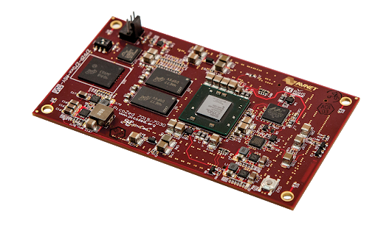
Hardware Requirements
Xilinx Kintex-7 based FPGA with GTX transceivers.
Applicable for the released firmware only. This is not a general requirement of a DC EVR. Other EVR’s with delay compensation have been implemented with various FPGAs and Transceivers (PSI). See later slides
SFP Transceiver
Reference clock for the GTX transceiver
Image © STFC John Dawson

Slide 6
Development System
Picozed with 7Z030
Power Supply
Network connected JTAG for programming
Raspberry Pi to monitor the serial output of the device.
Carrier card with SFP transceiver (and FMC)
Image © STFC John Dawson

Slide 7
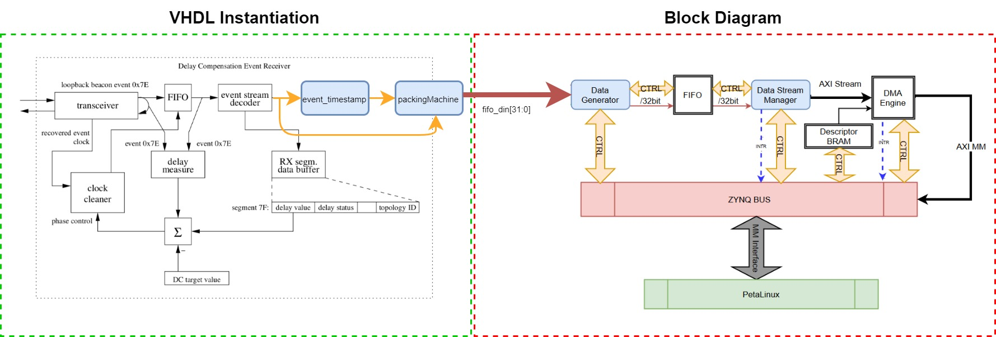
Implementation
We implemented this
Image © STFC John Dawson
And used this to investigate integration with the PS

Slide 8
Timestamping
Load 0 (0x70)
32-bit Seconds Shift Reg
Load 1 (0x71)
Reset Event (0x7D)
Sync
32-bit Seconds Register
reset
32-bit Timestamp Counter
Event Clock
32-bit Seconds | 32-bit Timestamp | Event
32-bit Seconds | 32-bit Timestamp | Event
| | | | |
32-bit Seconds | 32-bit Timestamp | Event
Image © STFC John Dawson
Notes:
https://github.com/whs92/mrf-openevr/blob/master/ip/openevr_event_timestamp/openevr_event_timestamp.srcs/sources_1/new/event_timestamp.vhd

Slide 9
Data-bus
Implemented by existing open EVR Firmware
https://github.com/jpietari/mrf-openevr/blob/master/vhdl/databuf_rx_dc.vhd
We tested it using the ILA
Image © STFC John Dawson

Slide 10
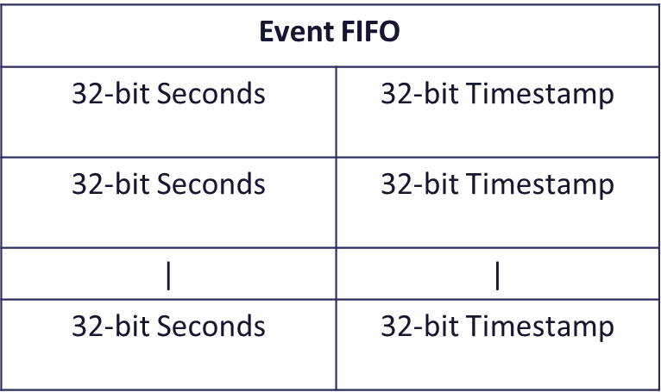
Testing
Set up a test system
Clock
1PPS
VME EVR used mrfioc2 to expose timestamps of received events codes.
OpenEVR ran a script on the PS in Petalinux OS that monitors events and their timestamps (interrupt driven.)
They were the same!
EVG
83 MHz
1PPS
VME EVR
Open EVR
IFC1210, mrfioc2
Petalinux, monitor.c
Image © STFC John Dawson

Slide 11
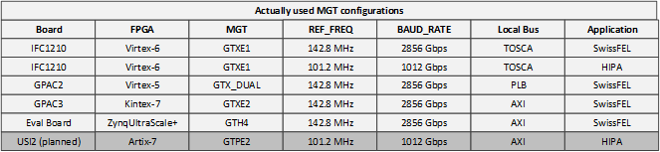
PSI Implementations
Koprek Waldemar (PSI) waldemar.koprek@psi.ch
Image © STFC John Dawson

Slide 12
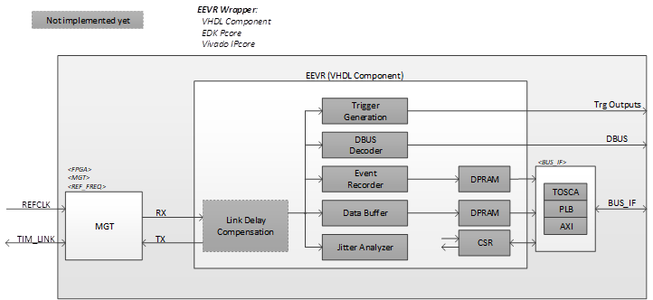
PSI Implementations
Image © STFC John Dawson

Slide 13
What’s Next
STFC unlikely to continue development in the near future. Adam Gryko has left and I am leaving in September to got to BESSY. Contact graham.cox@stfc.ac.uk
Source code available on git-hub https://github.com/whs92/mrf-openevr
Can be integrated into a firmware design that has access to correct oscillator and GTX transceivers.
Interface to PS (Petalinux) and some register control and interrupt handling.
Is compatibility with something like mrfioc2 even useful? Applications that require embedded EVR’s need timestamp, clock, and maybe to respond to particular triggers. I think aim should be to keep it light weight!
Image © STFC John Dawson

