Slide 1
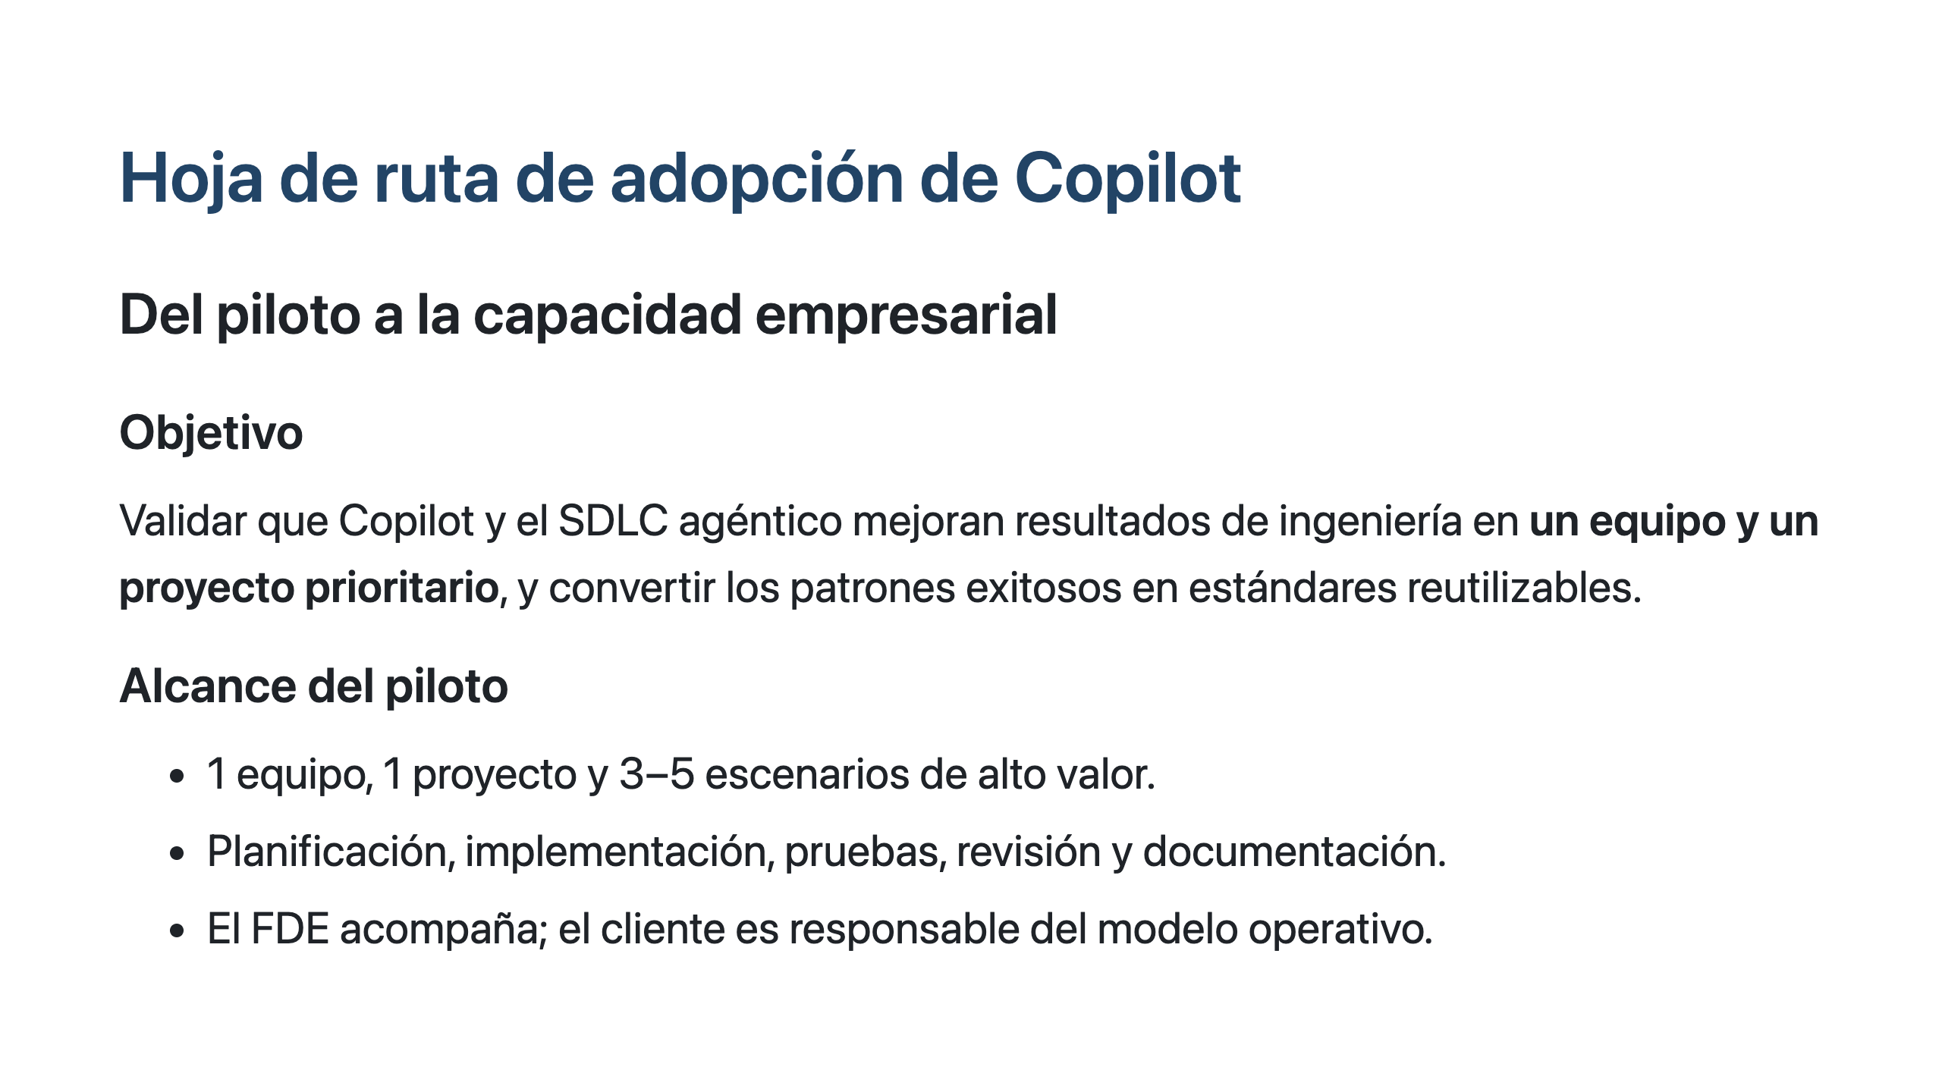

Slide 2

Implementation Roadmap

Slide 3
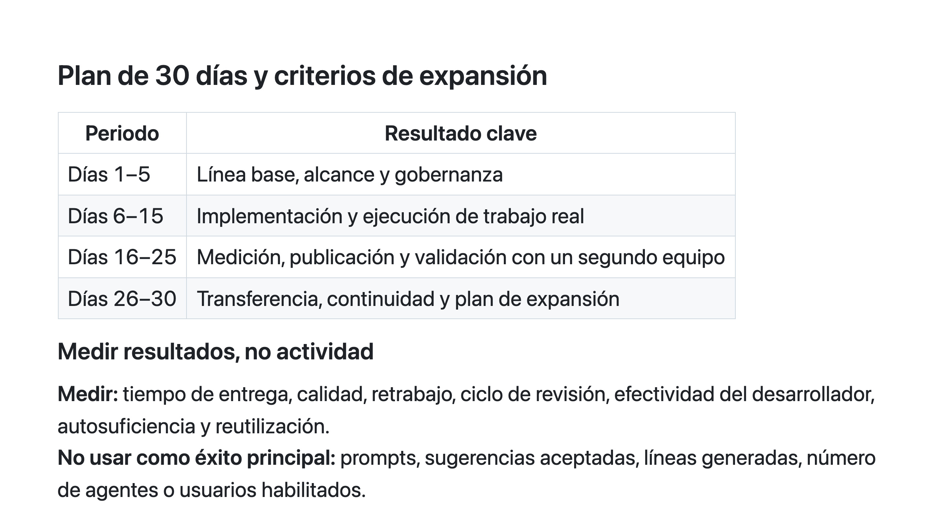

Slide 4
