Slide 1
Face Detection using
Template Matching
Deepesh Jain
Husrev Tolga Ilhan
Subbu Meiyappan
EE 368 – Digital Image Processing
Spring 2002-2003
05/30/03

Slide 2
Face Detection
Objectives
System Architecture
Skin Color Segmentation
Studied Methods
Iterative Template Matching
Classification
Experimental Results
Conclusions

Slide 3
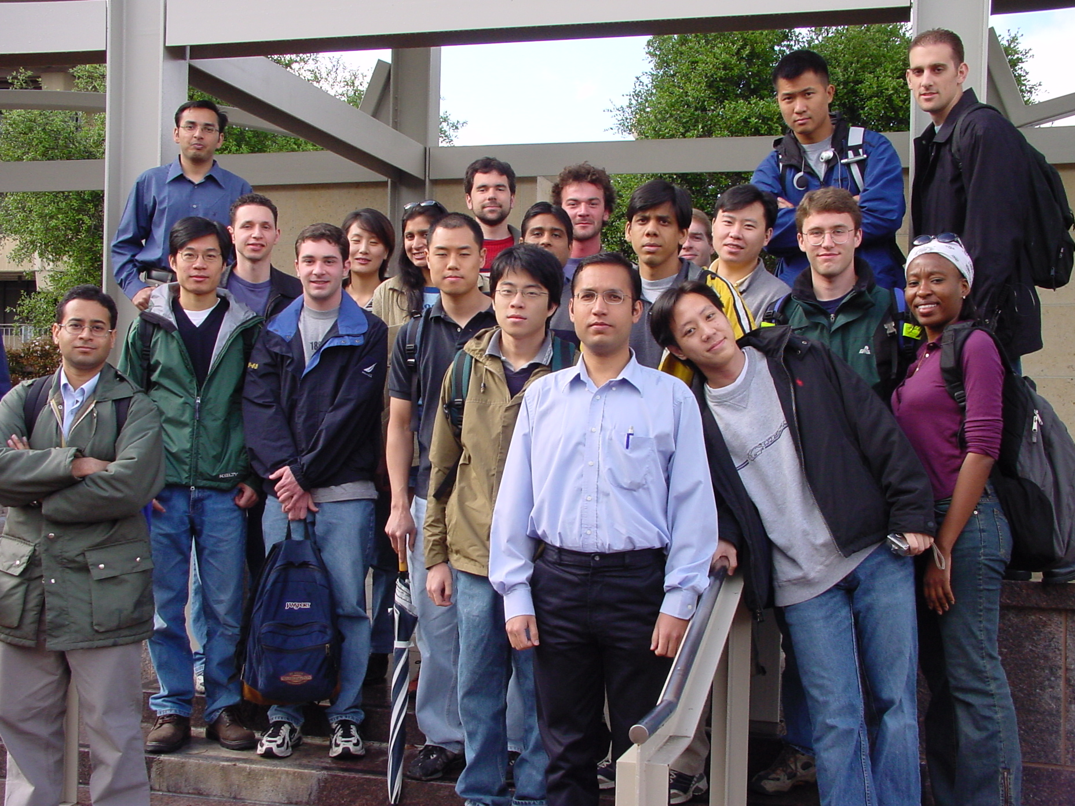
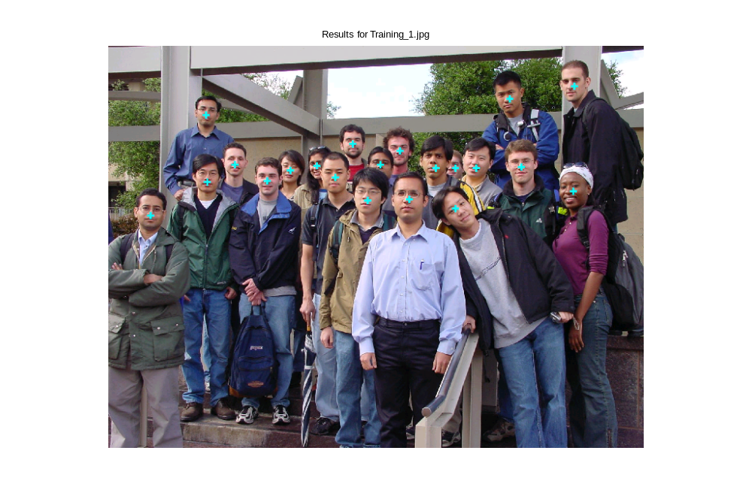
Objectives
Devise Simple and Fast algorithm for face detection
Detect as many faces as possible in the training images, including occluded ones
Minimize detection of non-faces and multiple detects

Slide 4
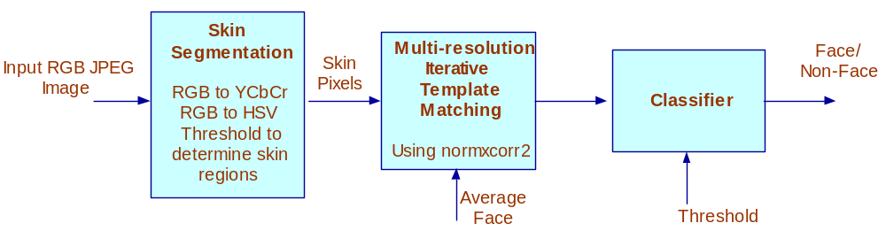
System Architecture

Slide 5
Skin Segmentation
Skin segmentation using (Cr, Cb, Hue) space.
Cleanup using morphological operators
rgb2ycbcr()
Skin pixel If
142 < Cr < 160
100 < Cb < 150
0.9 < Hue, Hue < 0.1
Skin Pixels
Input
Image
rgb2hsv()

Slide 6
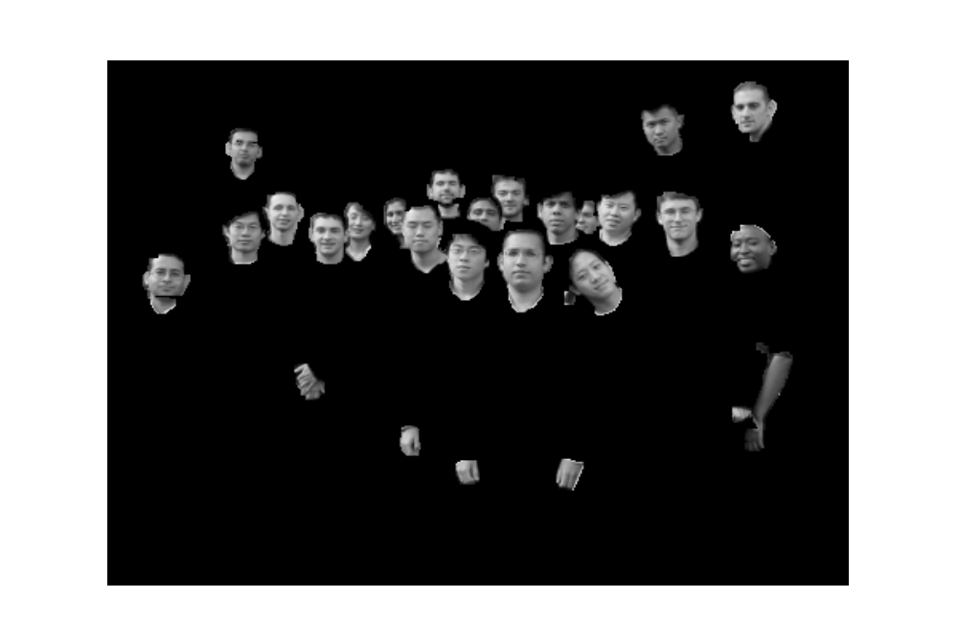
Skin Segmentation Results

Slide 7
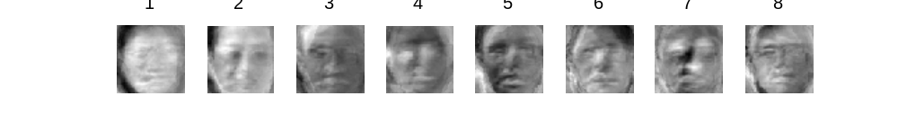


Investigated Methods for Face Detection
Eigen Decomposition of faces
  Dropped, eigenimages could not classify occluded images
  For full face images, had 100% accuracy for both face detection and gender recognition
Template Matching
  Template matching with various average face pyramid levels
Wavelets and Neural Nets
  Wavelets for multiresoltion analysis and ANNs for classification (Linear Vector Quantization approach)

Slide 8
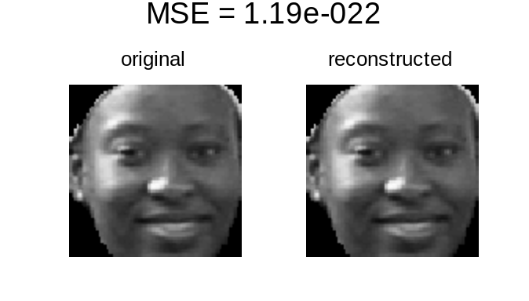
Eigen Decomposition
Sirovich and Kirby method
MSE Calculation (original & reconstructed)
First 8 Eigen Images
Original and Reconstructed Images

Slide 9
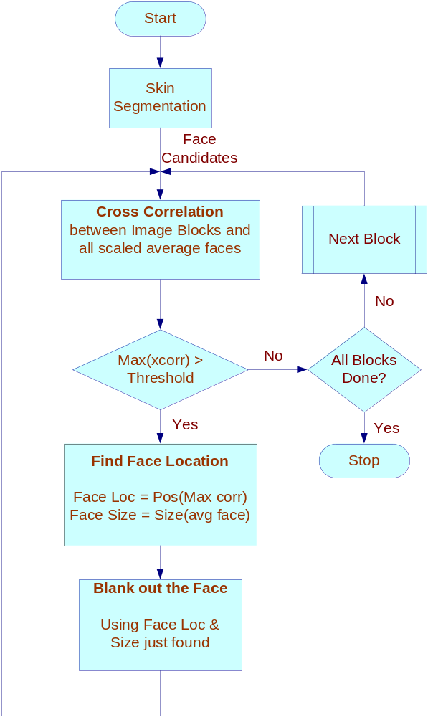
Template Matching
Average Faces

Slide 10
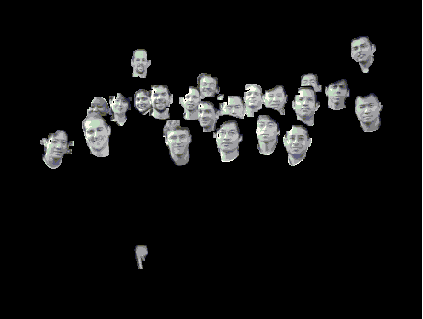
Temple Matching – Initially
image block
image

Slide 11

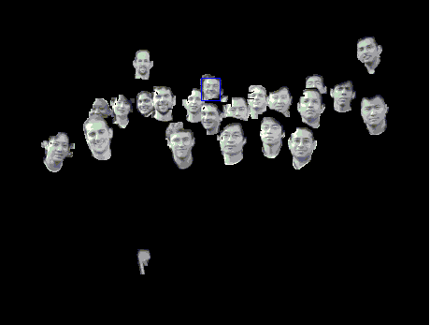
Temple Matching – Step 1
image block
image

Slide 12

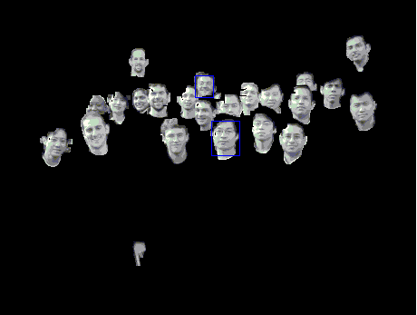
Temple Matching – Step 2
image block
image

Slide 13


Temple Matching – Step 3
image block
image

Slide 14


Temple Matching - Finally
image block - residue
image

Slide 15
Results on a Sample Image
Training_1.jpg

Slide 16
Results
TrainingImage | Final Score | Detect Score | # Hits | # Repeats | # False Positives | Dist. to Centroid | CPU time
Training_1 | 21 | 21 | 21 | 0 | 0 | 12.10 | 163.87
Training_2 | 20 | 20 | 23 | 1 | 2 | 16.61 | 172.76
Training_3 | 23 | 23 | 25 | 0 | 2 | 8.84 | 161.54
Training_4 | 21 | 21 | 24 | 1 | 2 | 15.87 | 133.66
Training_5 | 23 | 23 | 23 | 0 | 0 | 11.91 | 146.11
Training_6 | 23 | 23 | 24 | 0 | 1 | 9.46 | 147.51
Training_7 | 20 | 20 | 22 | 1 | 0 | 17.55 | 198.78

Slide 17
Conclusion
Good skin segmentation is a key factor for good face recognition
Eigenimages did not do well with occluded faces
Template matching did very well for face detection
  Fast algorithm (<4 mins)
“Multi-resolution Pyramid” scheme necessary to match faces of various sizes

Slide 18
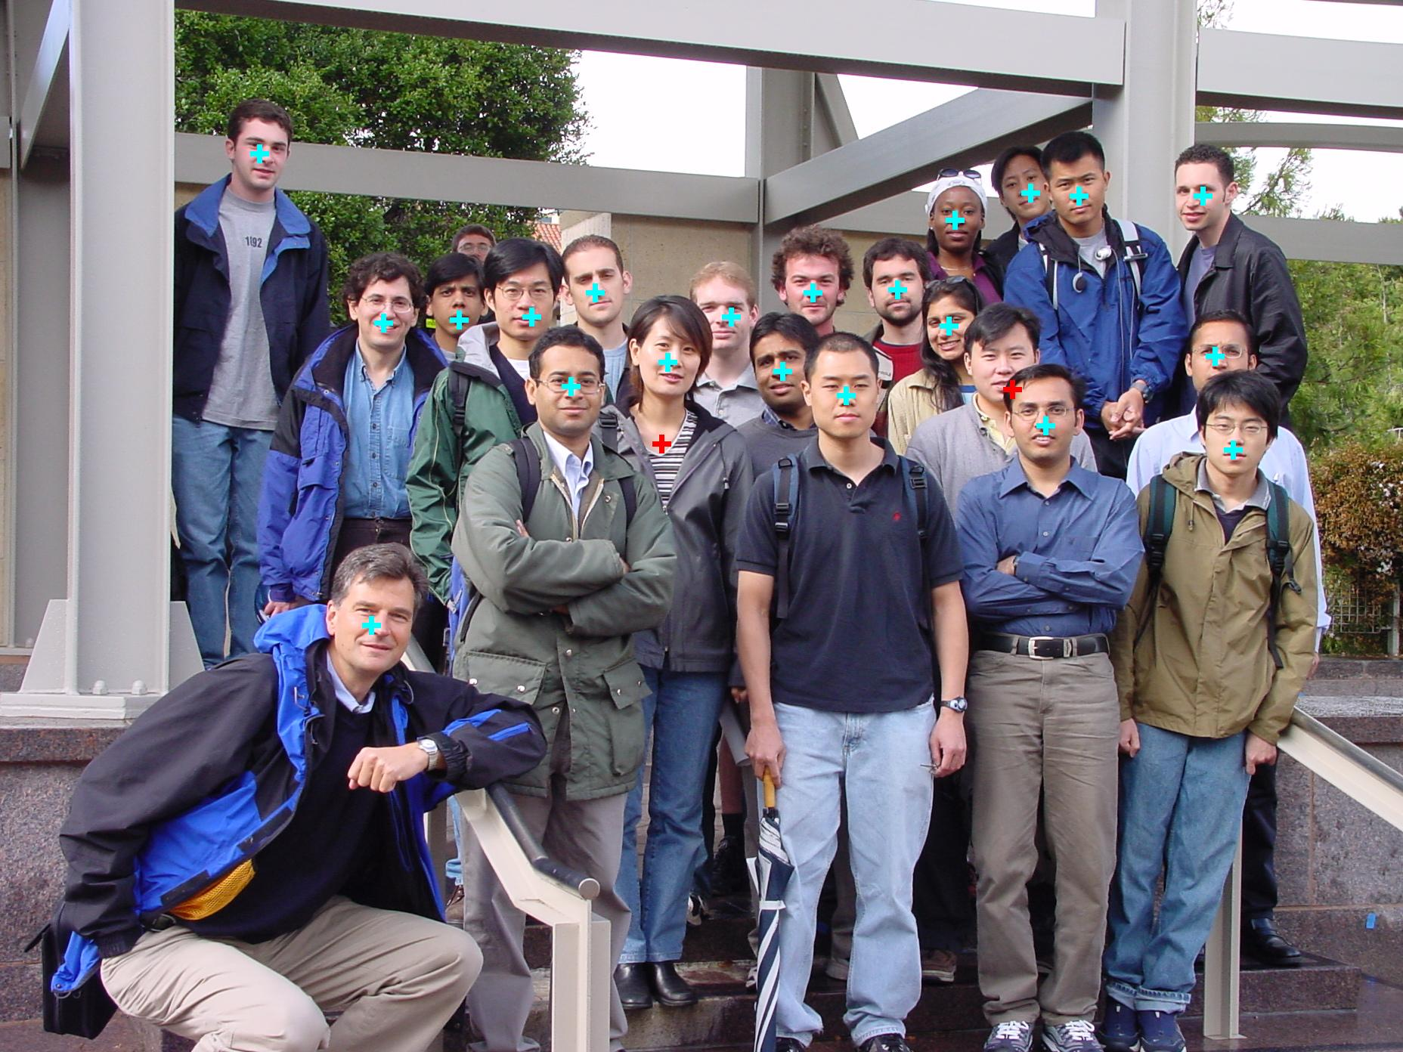

Slide 19
