Slide 4

模型训练流程 | Model training process
数据采集
数据清洗
数据标注
模型训练
模型测试
Data Collection
Data Cleaning
Data Annotation
Model Training
Model Testing

Slide 6
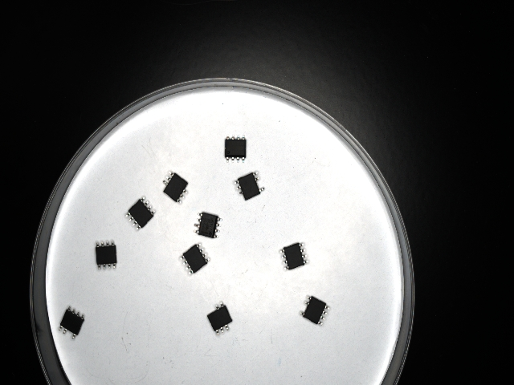
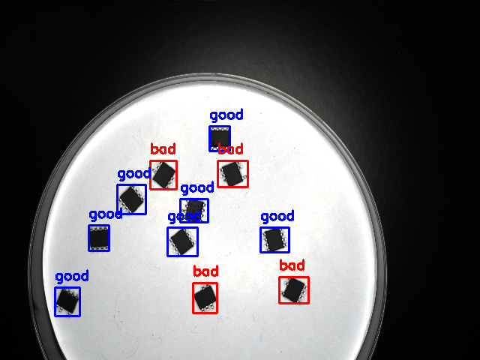
理想测试效果 | The desired test results
Original image
Image after defect detection

Slide 7
为什么我们自己训练的模型效果不好 | Why do the models we train ourselves perform poorly?
图片数据量小
训练次数少
CPU训练耗时
CPU Training Slow
Small Dataset
Few Training Epochs
训练样本不足，模型泛化能力差
epochs设置较小，模型未充分学习
未使用GPU加速，训练效率低
Insufficient training samples, poor model generalization
Low epoch count, insufficient model learning
No GPU acceleration, low training efficiency

Slide 9
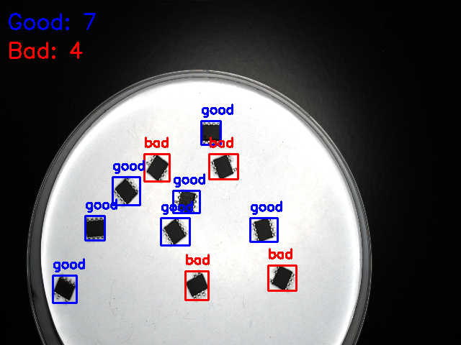
模型训练好了，我们可以用这个模型来干什么？ | The chip defect model is trained, what can we do with this model?
Demo

Slide 11

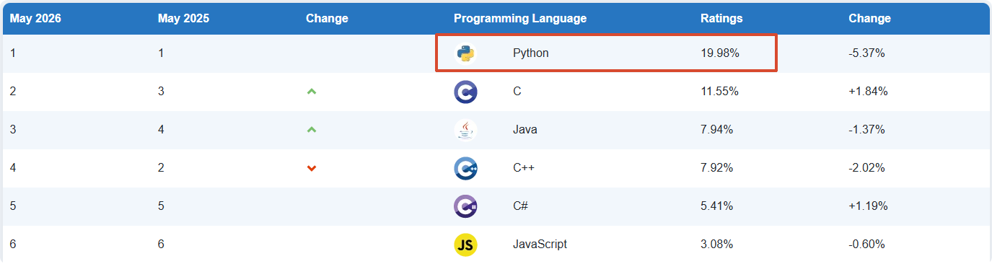

Python 编程 | Python：A programming language
Python is a very popular programming language for AI
TIOBE官网：https://www.tiobe.com/tiobe-index

Slide 12


PyCharm集成开发环境 | PyCharm： Used for Python programming and development
简要介绍：一种Python IDE（Integrated Development Environment，集成开发环境），带有一整套开发时提高效率的工具，比如调试、语法高亮、代码跳转、智能提示、单元测试、版本控制等。
官方网址：https://www.jetbrains.com.cn/en-us/pycharm/

Slide 13
单张图片芯片数量统计功能编程实现 | Programming implementation of chip counting function for single images

