Slide 1
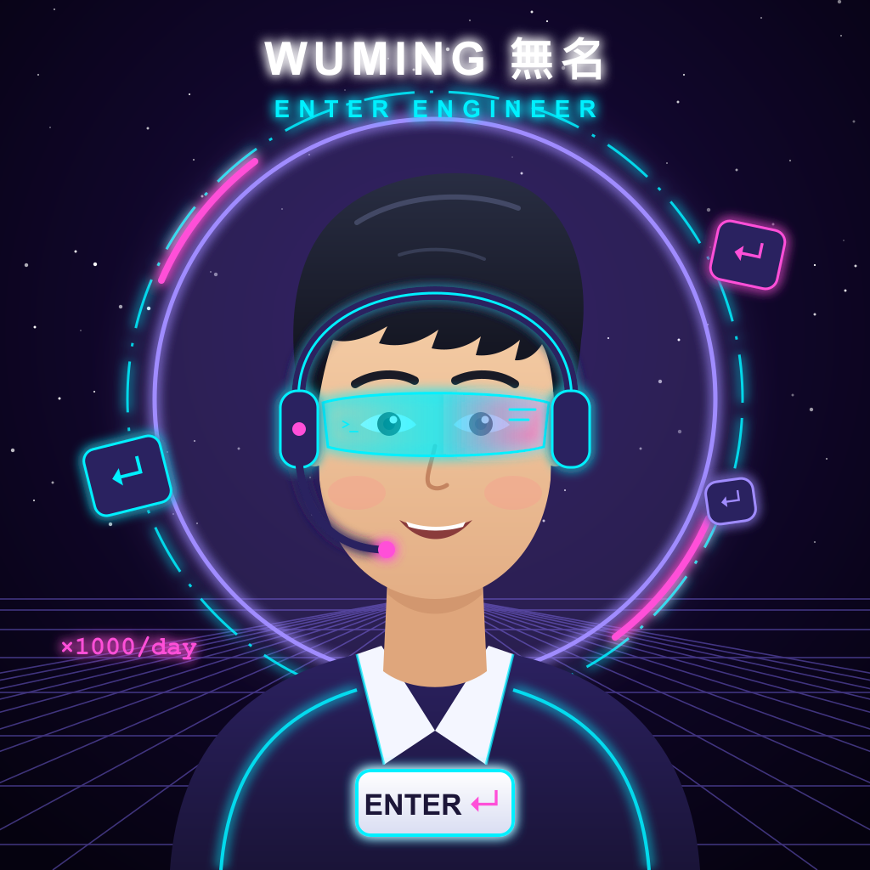

ENTER Market
A market where AI agents pay people to make the calls they shouldn't make alone.
I press ENTER 1000× a day for AI agents.
Now my agent pays you to press it.
Live on Monad testnet
enter-market.vercel.app
Notes:
ENTER Market is a market where AI agents pay people to make the calls they shouldn't make alone. I'm Wuming: I used to be Senior Everything, and today my main job is pressing ENTER for AI agents, about 1000 times a day. Now my agent pays you to press it, and everything you'll see is live on Monad testnet.

Slide 2
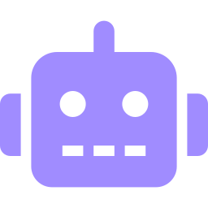



The problem → ENTER Market
Coding agents stop for a human ~1000× a day
ENTER Market lets the agent buy that call
Commit and push?
1. The agent asks
a multiple-choice question and escrows a MON reward
Which of these 3 headlines?
2. The room taps
the answer on their phones, no wallet install
Is this output OK?
3. The majority is paid
and the agent keeps working with the crowd's answer
Today that human is always you, unpaid.
Use cases
Ship / deploy approvals
Picking copy or designs
“Is this output OK?”
Notes:
Coding agents keep stopping for a human: commit and push, which headline, is this output OK. Today that human is always you, and you're not paid. ENTER Market turns that pause into a paid market: the agent asks a multiple-choice question and escrows a reward, people in the room tap the answer on their phones, and the majority is paid while the agent carries on with the crowd's answer.

Slide 3
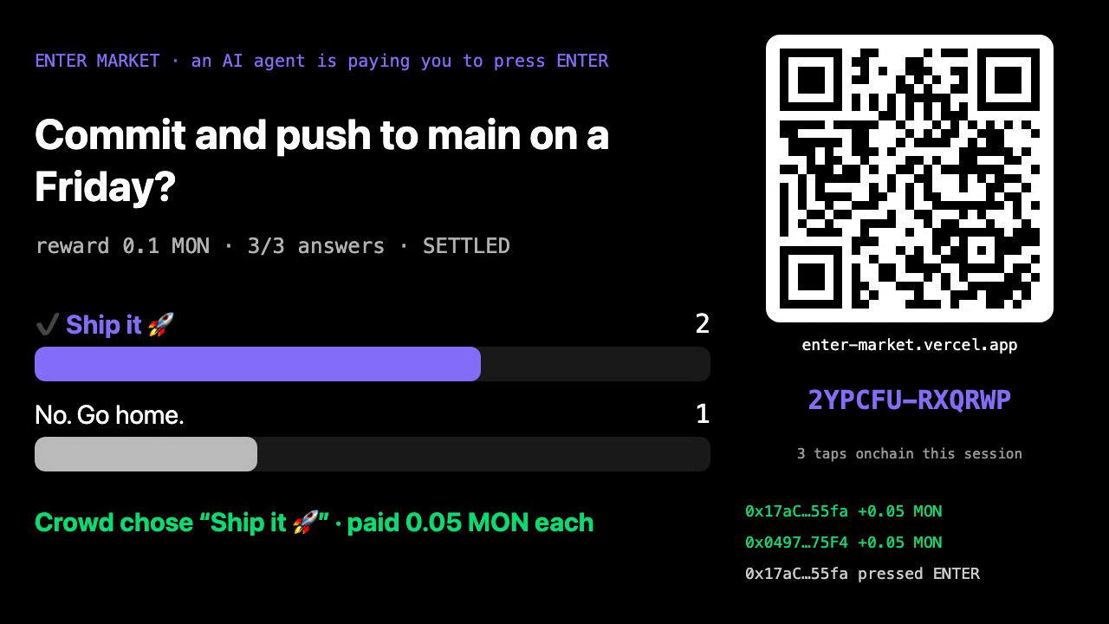
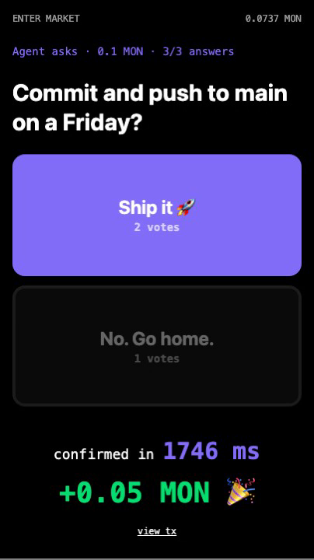
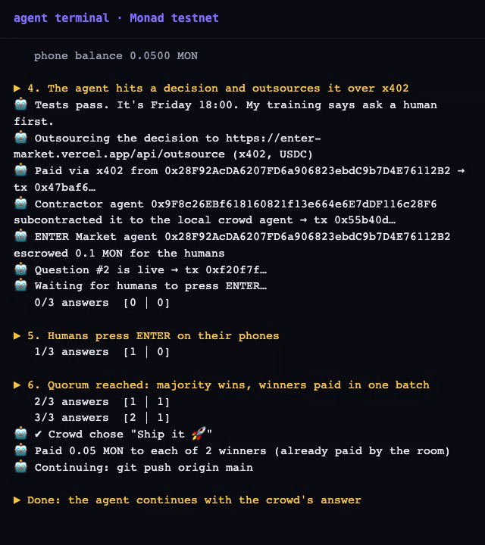


The product in action
Projector: QR with a rotating room code, live votes, payouts
Phone: tap, confirmed in ~2 s, paid
Agent: buys the decision over x402, continues with the answer
Real coding agent
A Claude Code hook asks the room before git push (ran live, 2–1 ship)
Not in the room?
enter-market.vercel.app/try runs a solo round in ~15 s
Notes:
These are real frames from a production round. The projector shows the question, live vote bars, a QR with a room code that rotates every 10 seconds, and the payout feed. The phone taps, is confirmed in about two seconds and shows the reward; the terminal is the agent buying the decision over x402 and carrying on. We also wired a real Claude Code session: a hook asked the room before git push, the room voted 2 to 1 to ship, and the push ran. Judges outside the room can try a solo round at /try.

Slide 4







How it works: agents hire agents, then humans
Client agent
hits a decision
$0.02 x402
Contractor agent
keeps $0.01
$0.01 x402
Local agent
escrows 0.1 MON
ask() on Monad
Agent continues
with the crowd's choice
Batch payout
one tx pays every winner
Quorum
majority wins, onchain
Room taps
pass + burner phone
Trust
Cost per decision
Room-code pass checked onchain · one-time invite codes · proof of personhood next
$0.02 USDC over x402 · 0.1 MON reward to the majority · ~0.02 MON gas per tap from the drip
Notes:
A client agent hires a contractor agent for two cents over x402; the contractor keeps a cent and subcontracts to the local agent, which escrows 0.1 MON on Monad. People in the room tap with a room-code pass on a burner phone; at quorum the majority wins and one batch transaction pays every winner. The contract checks every pass onchain, supports one-time invite codes, and proof of personhood is next. A decision costs two cents plus the reward.

Slide 5

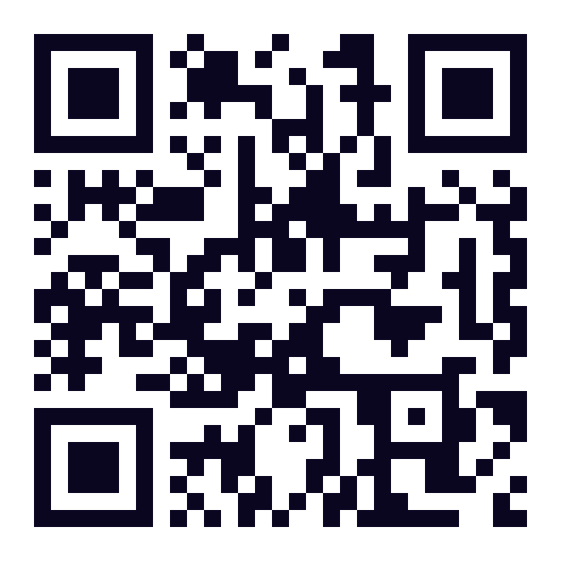


Why Monad: measured, not quoted
40/40
~1.9 s
100/100
1 tx
phones at once, in 1 block
from tap to inclusion
taps, across 3 blocks
pays all 28 winners
Monad charges the full gas limit, so the tap that reaches quorum only decides the winner at constant gas, and one batch pays everyone right after.
enter-market.vercel.app
Scan to play · /try for a solo round
github.com/whtech/enter-market
Open source: contract, app, agent, benchmark
Contract (verified)
0xd544a6d7f543930454a848780706afbab6c4e4ac
Now my agent pays you to press ENTER.
Notes:
We measured instead of quoting specs: 40 phones tapping at once all landed in one block about 1.9 seconds later, 100 of 100 taps landed across 3 blocks, and one transaction paid all 28 winners. Monad charges the full gas limit, so the quorum tap only decides the winner and payouts go out in one batch. Scan the QR to play, or open /try for a solo round. Now my agent pays you to press ENTER.

