Slide 1

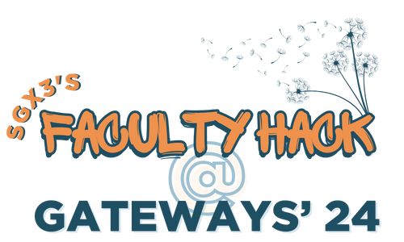

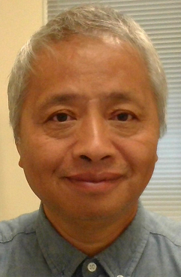
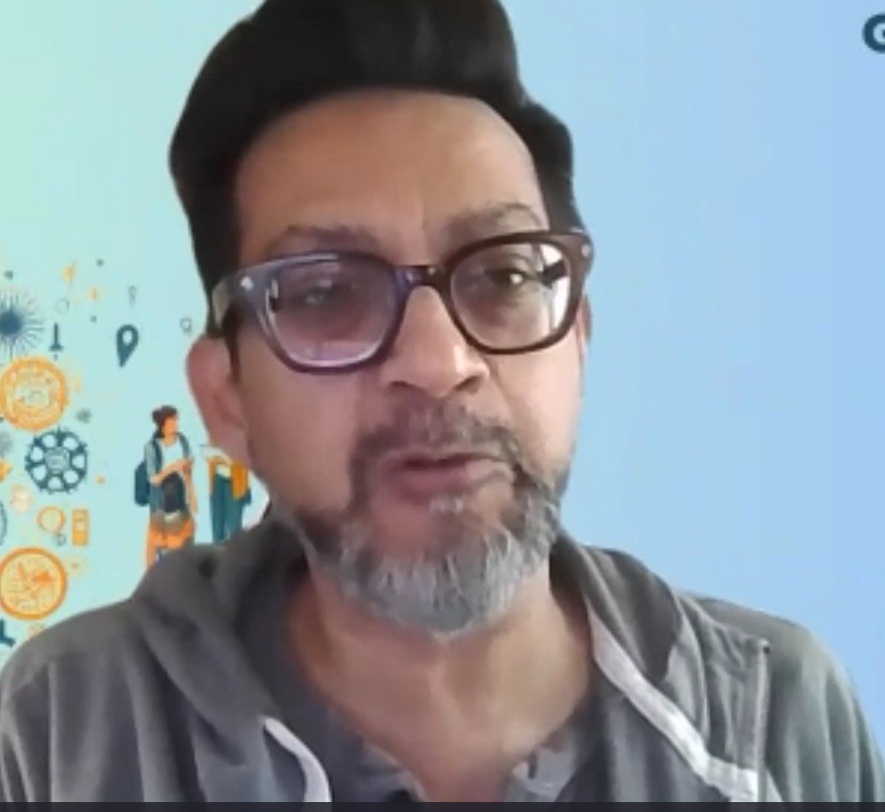
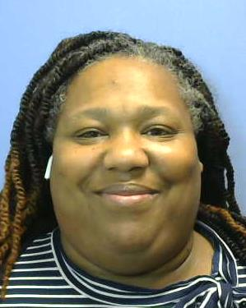
Teaching Computational Informatics Using HPC Resources
SGX3 award #
Revised Course Description
Sample HPC/Gateways Exercises
Gateway Community Mentor Syllabus Suggestions
Originally, this course focuses on topics such as: (1) how information is represented and transmitted in biological systems; (2) Biological Technical Scenes, Patterns and Downloading Datasets (Protein Databanks, SWISS-PROT, EMBL and GenBank), Database Management (Pharmacogenomics and Aggression); (3) Search Engines Algorithms (Intelligent Agents and User Interface Tools Programming with PERL Database); (4) Data Mining (Statistics and Sampling), Web Technologies (Internet Sequence Retrieval System) and Data Visualization (Animation and Visualization Tools).
Now, we will use HPC resources and set a focus on using HPC resources such as: (1) using ACCESS-CI resources such as Anvil center for Jupiter notebook; (2) Use HPC to run some algorithms; (3) Swiss Protein Knowledge Base (UniProtKB) for gene information inside protein; (4) NCBI for human genomes.
Using UniProtKB for genes inside protein. In this exercise, students will learn how to use the Universal Protein Knowledgebase to search for gene information inside a particular protein of an organ, e.g., cat paw.
Jupiter notebook for programming assignment. In this exercise, students will use Jupiter notebook to write and explain their coding to convert DNA sequence from Nucleic Acid to Amino Acid according to the standard codon table.
Implement the Needleman Wunsch algorithm using Jupiter Notebook and run it on DNA sequence obtained from UniProtKB or NCBI resources
Implement the Smith Waterman algorithm using Jupiter Note book and run it on DNS sequence obtained from UniProtKB or NCBI resources.
Two or three sequence assemblers.
Mentors from Science Gateways provide the following changes to syllabus
Use the Anivl center for running algorithms related to sequence alignment/ fragment assembly
2. Use online resources such as
a.https://www.ahd.com/states/hospital_TX.html
b. Hospitalization Rates and Characteristics of Patients Hospitalized
c. BioQUEST Curriculum Consortium (qubeshub.org)
d. QUBES - Resources (qubeshub.org)
e. Data.gov Home - Data.gov
f. Johns Hopkins Genomics | Johns Hopkins Medicine
3. Add students to my ACCESS-CI project so that they can use the resources to do coursework.
4. Attend the Science Gateway 2024 meeting and learn more from others.
5. The new learning outcomes of this course can be updated to reflect the
HPC resources.
Possible Expansions
Two courses situation: This course is taught in the Department of Math, CS & Physics. Students who enrolled in this course are CS majors. They may not have background in Biology. A similar course BIOL 3506 Bioinformatics is taught in the department of natural science of ASU. Students in that course require BIOL 3501L (Principles of Genetics).
Future consideration: We are considering two options: (1) either consolidate the two courses and carefully arrange the contents; (2) develop some type of interdisciplinary collaboration such as a Bioinformatics lab to expand opportunities in that direction to our students. Currently, such kind of collaboration is missing at ASU.
Implementation Schedule
Datasets
Students’ Learning Outcomes
Authors
We are teaching the CSCI 2300 Computational Informatics course at Albany State University in this semester. We are adopting HPC resources in the rest of the semester.
The following timeline will be followed:
September 2024, (completed) Create ACCESS-CI account, and apply for allocation and create a project that uses SGX3 resource.
October 2024 (In progress) Install ThinClient and connect to ANVIL center.
October 2024 (in progress) Use Jupiter Notebook via Anvil Center for creating teaching materials.
November 2024 (TBA) Use Anvil Center to run some algorithms regarding sequence alignment and fragment alignment.
Attend workshop/conference provided by science gateways regarding HPC.
UniProtKB
NCBI Datatsets
Using he HPC resources help improve the learning outcomes of this course.
Get familiar with the HPC resources such as ACCESS-CI, Anvil, Globus
Know how to use resources such as UniProtKB/NCBI to do research/projects
Learn how to document and program in Python using Jupiter Notebook
Author
Photo
Wanjun Hu
Department of Math, CS & Physics
Albany State University, GA
whu@asurams.edu
Related Algorithms
Sequence Alignment
Wagner-Fischer Algorithm
Needleman–Wunsch algorithm
Smith-Waterman algorithm
BLAST algorithm
Fragment Assembly
De-novo sequence assembler
Mapping/Aligning using templates
De Bruijn Graph
HPC/Gateways Mentor
Dr. Charlie Dey
Director, Training & Professional Development
University of Texas at Austin
Email: charlie@tacc.utexas.edu
HPC For Students
Through coursework using HPC, our students will have first hand knowledge of the HPC resources. They will create account with ACCESS-CI, Globus. Then they will transfer DNA datasets from either UniProtKB or NCBI to resources such as Anvil or Globus for processing. Further, they will develop their own Jupiter notebook notes and coding that text algorithms written in Python.
Resource Needs/List
HPC/Gateways Mentor
Dr. LaTasha Roberts
Coordinator, BAS CyberSecurity
Austin Community College
Email: lrobert2@austincc.edu
The following resource will be required.
ACCESS-CI allocation
Anvil center access to use Jupiter Notebook and run algorithms
DNA datasets from NBCI/UniProtKB
Computing power to run sequence alignment and fragment assembly algorithms
Further support from SGX3
MORE INFORMATION →
https://github.com/whu-asurams/GatewayHPC_for_CompInfo

