Slide 1
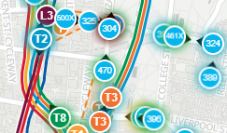







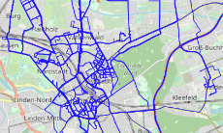







Streaming Trajectories
Sydney Real-time
Bus Locations
Real-time Bus Locations
Memory
Streaming
Trajectory
Data
Real-time Queries
Frequent
Writes
Results
Vehicle Tracking
Hybrid
Results
One-time
Write
Historical Trajectory
Data
Trip Planning
Historical Queries
Real-time Search
Vehicle Trajectory Dataset
Persistant Store
Public Transpo-
rtation Planning
Historical Search
Traffic Conge-
stion Prediction

Slide 2
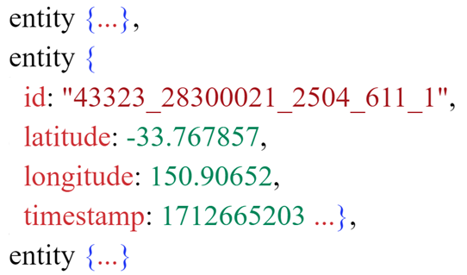


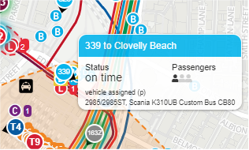
Memory
Streaming Trajectories
Sydney Real-time
Bus Locations
Streaming
Trajectory Data
Queries
Frequent Writes
Results
Cold Data
Vehicle Tracking
?
Hybrid
Results
Trip Planning
Historical Trajectory Data
Queries
Real-time Search
Persistant Store
Public Transpo-
rtation Planning
Historical Search
Traffic Conge-
stion Prediction

Slide 3
Streaming Trajectories
Sydney Real-time
Bus Locations
Memory
Queries
Streaming
Trajectory Data
Frequent Writes
Results
Vehicle Tracking
Flushing
Hybrid
Queries
Trip Planning
Historical Trajectory Data
Real-time Search
Results
Persistant Store
Public Transpo-
rtation Planning
Historical Search
Traffic Conge-
stion Prediction

Slide 4

Memory
Streaming Trajectories
Sydney Real-time
Bus Locations
Vehicle Tracking
Streaming
Trajectory Data
Frequent Writes
Trip Planning
Writes
Public Transpo-
rtation Planning
Hybrid
Historical Trajectory Data
Traffic Conge-
stion Prediction
Real-time Search
Persistant Store
Historical Search

Slide 5


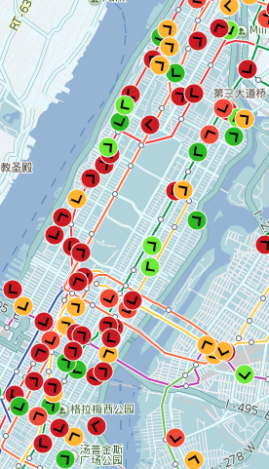
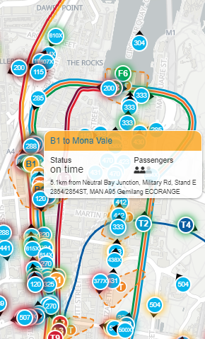

NYC Real-time
Bus Locations
Sydney Real-time
Bus Locations
Streaming Trajectories
Bus Location
Real-time Search
Trip Planning
Hybrid
Bus Arrival Time Prediction
Historical Search
Traffic Conge-
stion Prediction
17 GB
10 GB
Historical Trajectories

Slide 6
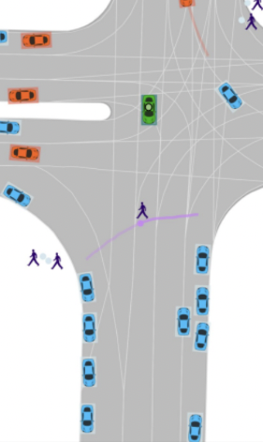






Argoverse Trajectories
NYC Real-time
Bus Locations
Sydney Real-time
Bus Locations
Streaming Trajectories
Bus Location
$$T_{3}$$
$$T_{6}$$
Real-time Search
$$T_{2}$$
Trip Planning
$$T_{1}$$
$$T_{5}$$
Hybrid
$$T_{4}$$
Bus Arrival Time Prediction
Historical Search
Traffic Conge-
stion Prediction
31 GB
17 GB
10 GB
Historical Trajectories

Slide 7
Streaming Trajectories
Real-time Search
Real-time Bus Location
Historical Search
Real-time Sydney Bus Map
31 GB
17 GB
10 GB
Historical Trajectories
Real-time NYC Bus Map
Argoverse Trajectories

Slide 8
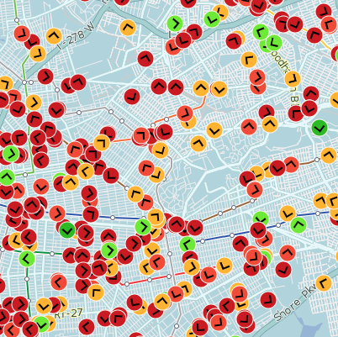
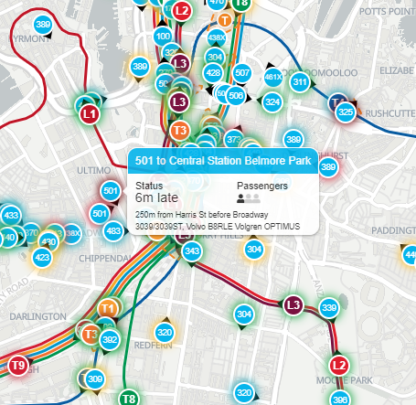

Streaming Trajectories
Real-time Search
Hybrid Search
(a) 17 GB of Bus Trajectory Data Generated Per Month in NYC
Historical Search
(b) 10 GB of Bus Trajectory Data Generated Per Month in Sydney
Data Collected For a Month
17 GB
10 GB
Historical Trajectories

