Slide 1
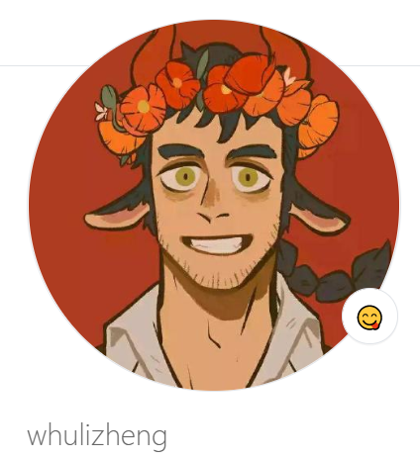

Slide 2

我的GitHub主页

Slide 3
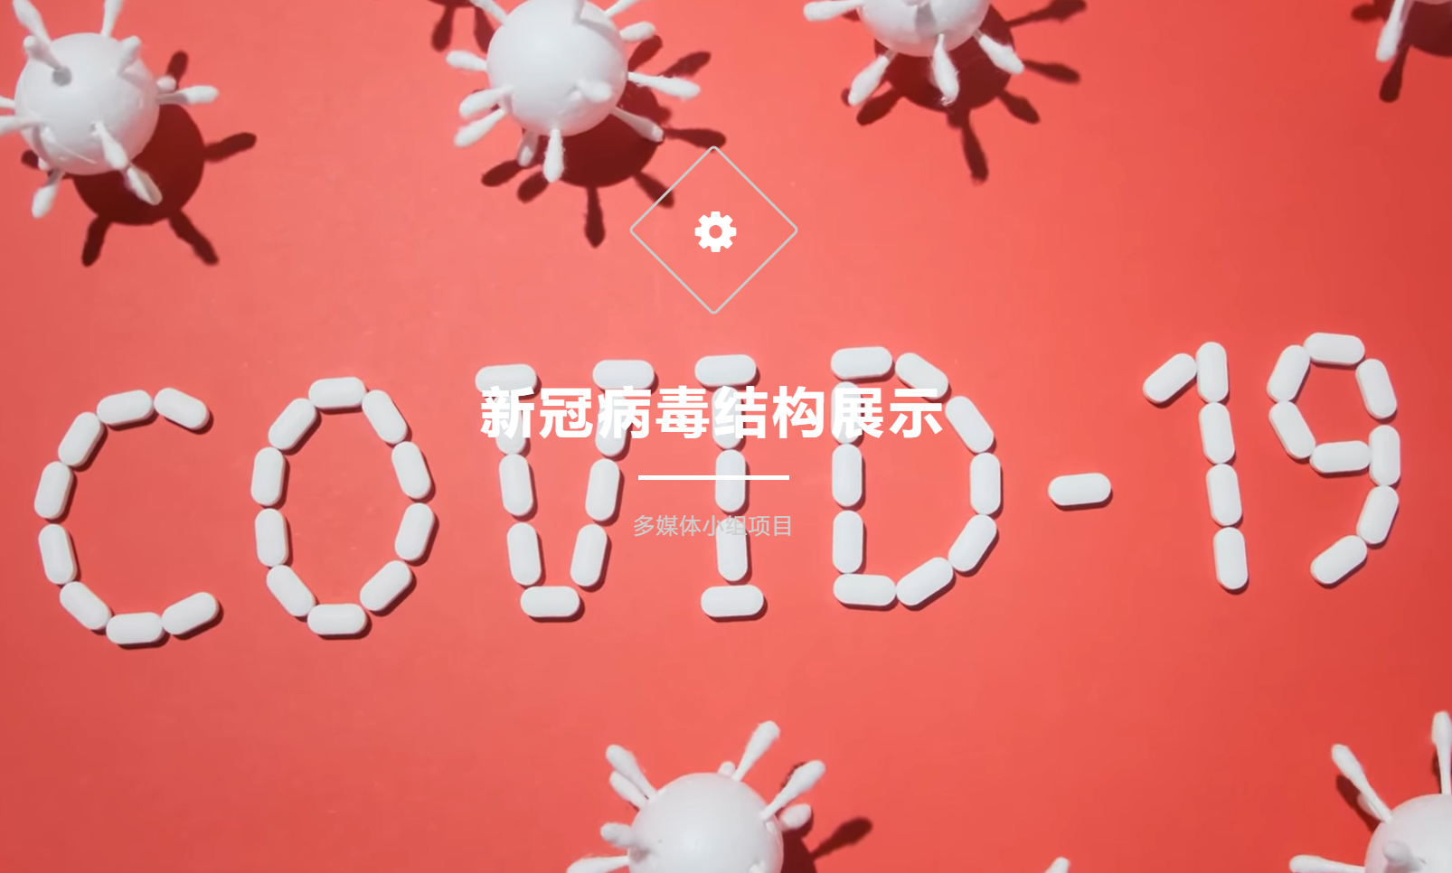

Slide 4

CXK
hub

Slide 5

coming soon
……

Slide 6
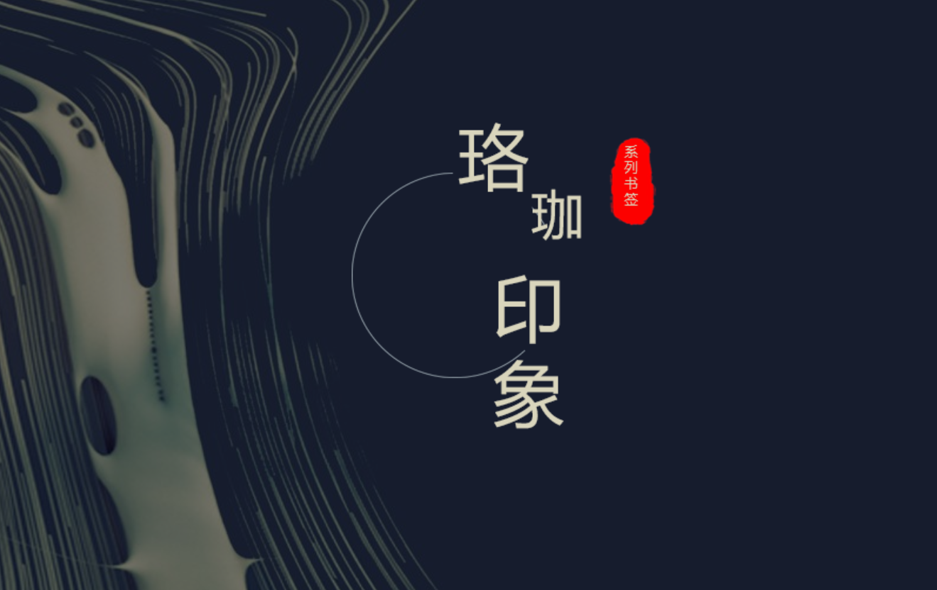

Slide 7

Mi amor

Slide 8
paper
TSA-GAN:
A Robust Generative Adversarial
Networks for Time Series Augmentation

