Slide 1



Hacking WebRTC: An Analysis of Videoconferencing Vulnerabilities Apollo Lo, Wiley Hunt
Background
WebRTC is used by many prominent video-conferencing platforms Google Hangouts, JitsiMeet, etc.)
Built-in to most popular browsers (Chrome, Firefox, Safari, etc.)
Focus
Where is WebRTC vulnerable?
What sort of attacks could be performed?
What information could these attacks leak?
Conclusions
Potential vulns across signaling, media, and session initiation/termination layers
Users provide WebRTC services with potentially sensitive information – trust and system integrity is key!
Installing/using open-source packages/tools can lead to privacy compromise (monitoring/recording, IP leaks, continued access to camera/mic)
Future exploration needed of vulns associated with screensharing, chat features, etc.
Signaling Attack
Created compromised signaling server
Instead of directly connecting peers, connected them to attacker
Results
Attacker views users’ media without them knowing
Attacker can implement audio/video recording
Signal Server
WebRTC Signaling
Session Termination Exploit
Initiate calls in pop-up window
On hang-up, minimize and hide window without terminating media session
Results
Window remains open (though appears closed)
Other user retains full-access to camera and microphone
Media Stream
Stream Relay
TURN Server Compromise
Noted tendency of “leaked” private TURN servers to appear in open-source code
Studied information that could be captured by a rogue TURN server
Results
Traffic passing through server leaks users’ IPs and open ports
Studying packet size indicates number of users and type of media shared
TURN Server

Slide 2
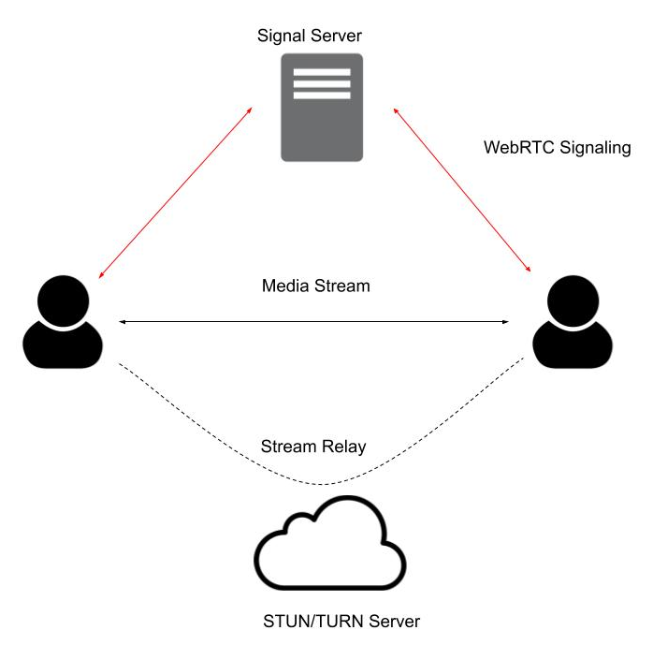
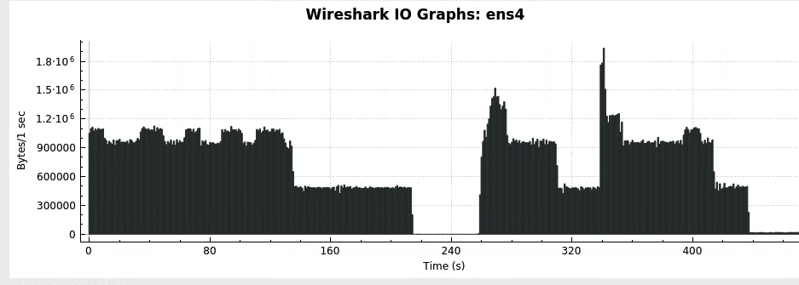
Hacking WebRTC: An Analysis of Videoconferencing Vulnerabilities Apollo Lo, Wiley Hunt
Background
WebRTC
Blah
Blah
Research Questions
WebRTC
Blah
Blah
Conclusions
WebRTC
Blah
Blah
Signalling Attack
1
2
3
Session Termination Attack
1
2
3
TURN Attack
1
2
3

Slide 3
Hacking WebRTC: An Analysis of Videoconferencing Vulnerabilities Apollo Lo, Wiley Hunt
Background
WebRTC is used for multiple video-conferencing solutions (e.g. Google Hangouts)
Automatically enabled in many browsers
Research Questions
Where is WebRTC vulnerable?
What sort of attacks could be performed?
What information could these attacks leak?
Conclusions
Vulns across the signaling, media, and session initiation/termination layers
Exploitations can compromise user privacy and reveal information such as IP addresses
Signal Server
Signaling Attack
Created compromised signaling server
Instead of directly connecting peers, connected them to attacker
Results
Attacker views audio/video streams of users
Users remain unaware of attacker’s presence
Attacker can implement video recording
WebRTC Signaling
Session Termination Attack
Instantiate calls in pop-up window
On hang-up, minimize and hide window without terminating media session
Results
Window remains open (though appears closed)
Other user retains full-access to camera and microphone
Media Stream
Stream Relay
TURN Server Compromise
Noted tendency of “leaked” private TURN servers to appear in open-source code
Studied information that could be captured by a rogue TURN server
Results
Traffic passing through server leaks users’ IPs and open ports
Studying packet size indicates number of users and type of media shared
TURN Server

Slide 4
Hacking WebRTC: An Analysis of Videoconferencing Vulnerabilities Apollo Lo, Wiley Hunt
Background
WebRTC is used for multiple video-conferencing solutions (e.g. Google Hangouts)
Automatically enabled in many browsers
Research Questions
Where is WebRTC vulnerable?
What sort of attacks could be performed?
What information could these attacks leak?
Conclusions
Vulns across the signaling, media, and session initiation/termination layers
Exploitations can compromise user privacy and reveal information such as IP addresses
Signal Server
Signaling Attack
Created compromised signaling server
Instead of directly connecting peers, connected them to attacker
Results
Attacker views audio/video streams of users
Users remain unaware of attacker’s presence
Attacker can implement video recording
WebRTC Signaling
Session Termination Attack
Instantiate calls in pop-up window
On hang-up, minimize and hide window without terminating media session
Results
Window remains open (though appears closed)
Other user retains full-access to camera and microphone
Media Stream
Stream Relay
TURN Server Compromise
Noted tendency of “leaked” private TURN servers to appear in open-source code
Studied information that could be captured by a rogue TURN server
Results
Traffic passing through server leaks users’ IPs and open ports
Studying packet size indicates number of users and type of media shared
TURN Server

