Slide 1
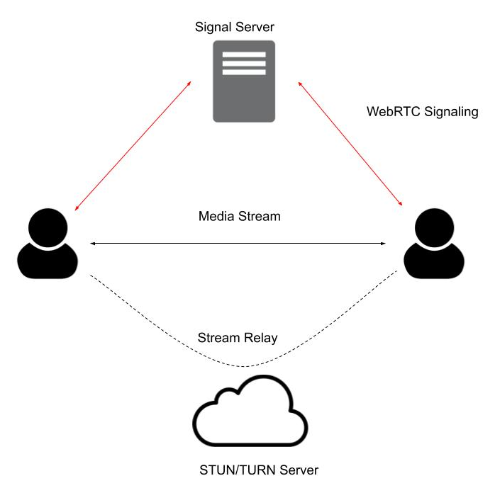
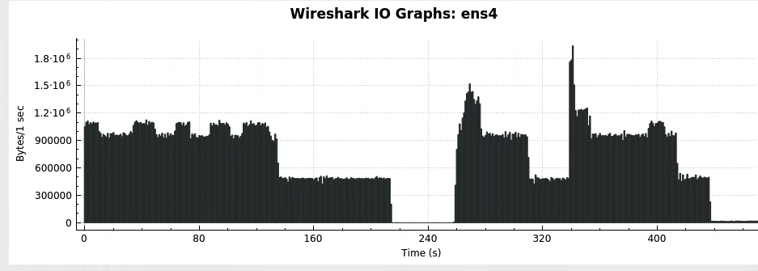
Hacking WebRTC: An Analysis of Videoconferencing Vulnerabilities Apollo Lo, Wiley Hunt
Background
WebRTC
Blah
Blah
Research Questions
WebRTC
Blah
Blah
Conclusions
WebRTC
Blah
Blah
Signalling Attack
1
2
3
Session Termination Attack
1
2
3
TURN Attack
1
2
3

