Slide 1
PatchMatch

Slide 2
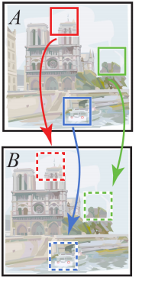
PatchMatch - NearestNeighborField
Goal:
Find the best match patch
Efficiency to find every pixel pair:
AImg = (25*25) BImg = (500*500)
0.031s by patchmatch
66.3s by brute force

Slide 3
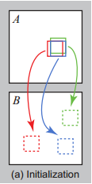
PatchMatch NNF – step 1
Initialization
Random assign the target
ann(i, j) = random()
annd(I, j) = dist((i,j), ann(i,j))

Slide 4
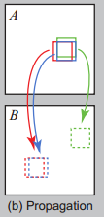
PatchMatch NNF – step 2
Propagation
Check Sibling pixel for better result
target = ann[neighor]
if dist((i,j), target) is better:
ann(i, j) = target
annd(I, j) = dist((i,j), target)

Slide 5
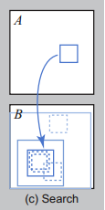
PatchMatch NNF – step 3
Random Search
Randomly Search near pixels for better result
target = ann[i, j] + random()*windowSize
if dist((i,j), target) is better:
ann(i, j) = target
annd(I, j) = dist((i,j), target)

Slide 6
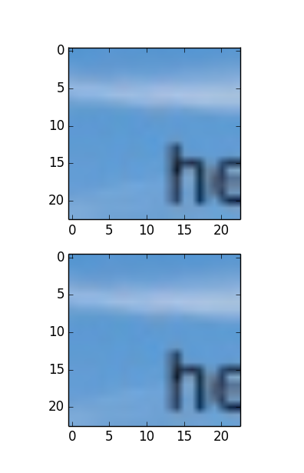
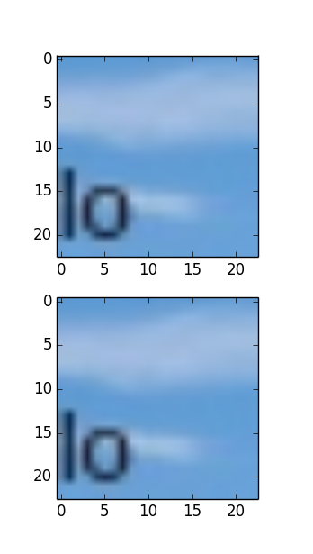
Result NNF
Almost match!!!
In 0.006 s

Slide 7
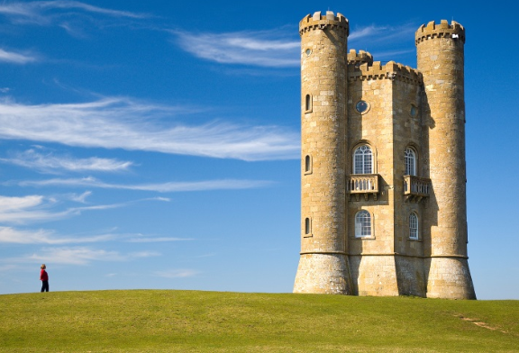
Inpainting

Slide 8
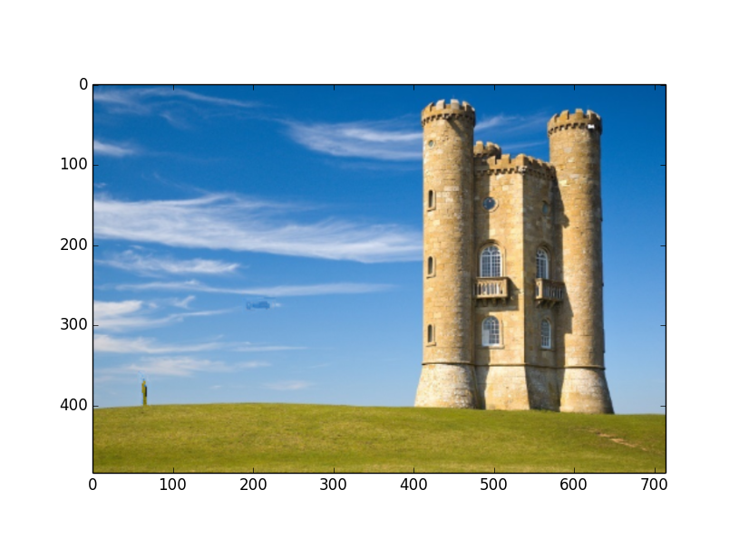
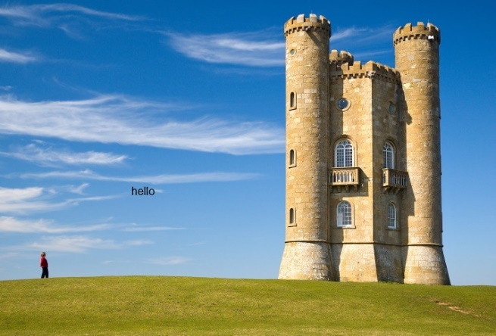
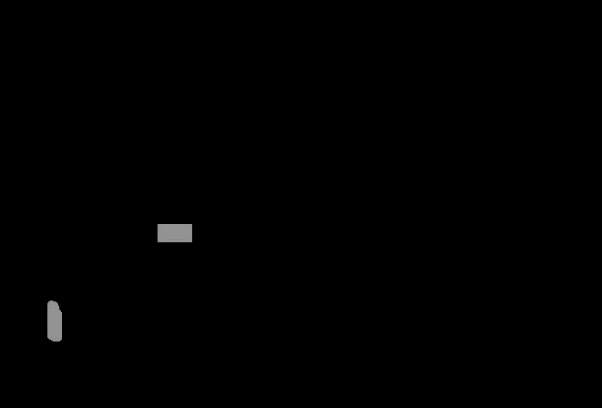
Result - inpaint
Grass 長上去了@_@

Slide 9
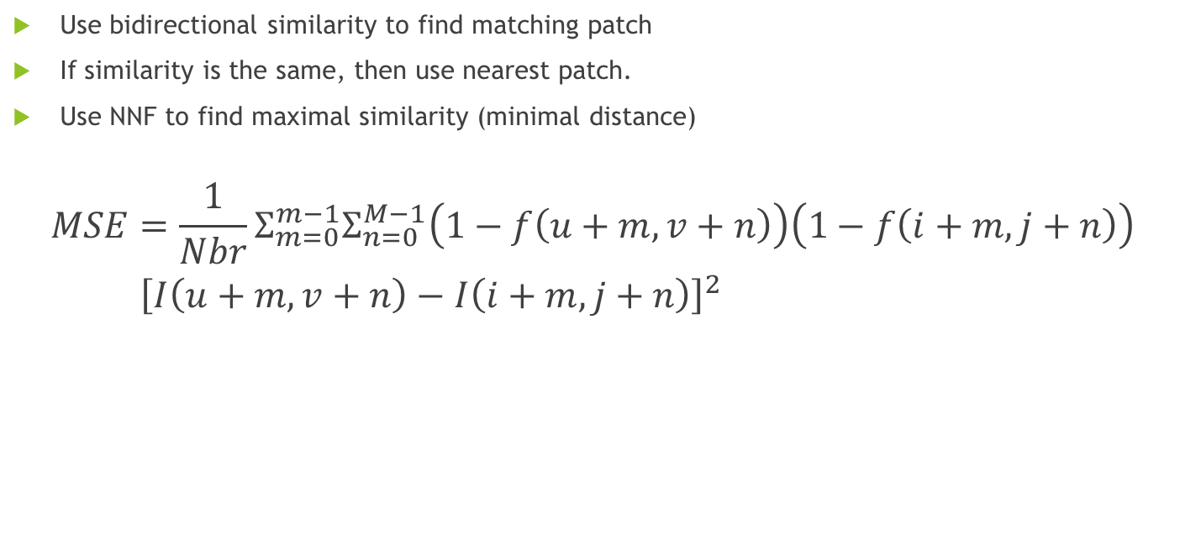
Inpainting
Use bidirectional similarity to find matching patch
If similarity is the same, then use nearest patch.
Use NNF to find maximal similarity (minimal distance)
$$\begin{aligned}MSE&=\frac{1}{Nbr}Σ_{m=0}^{m−1}Σ_{n=0}^{M−1}\left(1−f\left(u+m,v+n\right)\right)\left(1−f\left(i+m, j+n\right)\right) \\ &{\left[I\left(u+m, v+n\right)−I\left(i+m, j+n\right)\right]}^{2}\end{aligned}$$

Slide 10
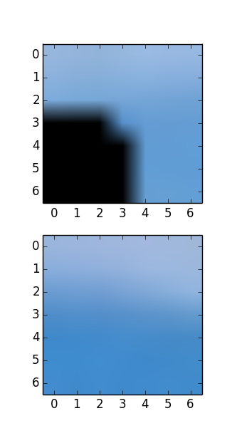
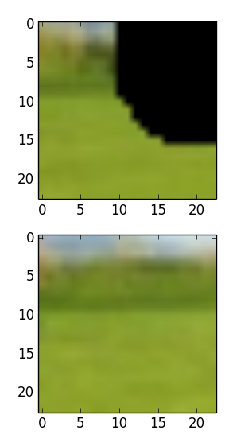
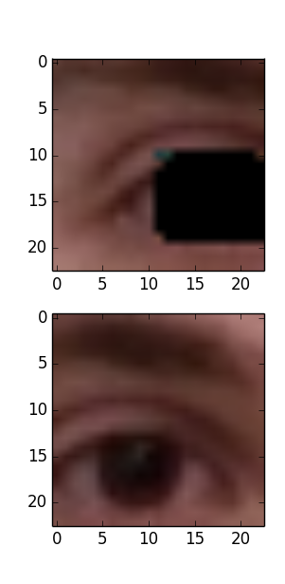
Result - inpaint

Slide 11
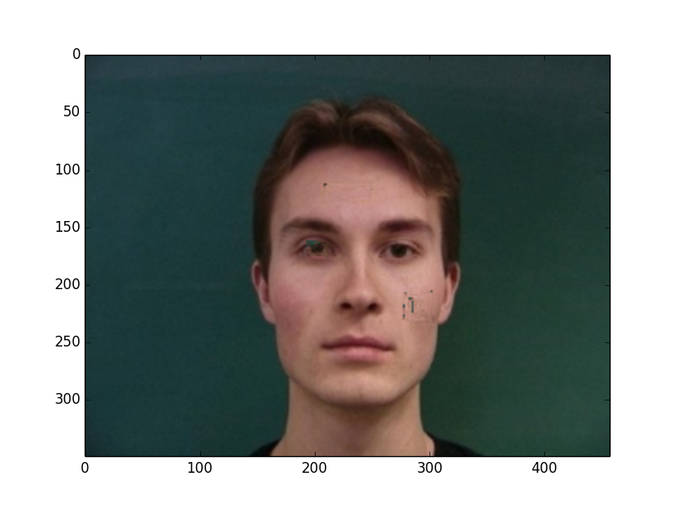
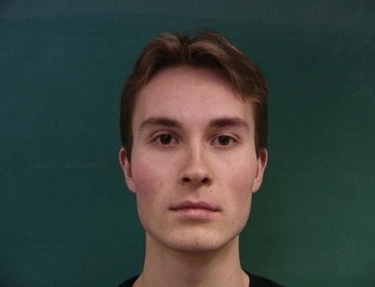
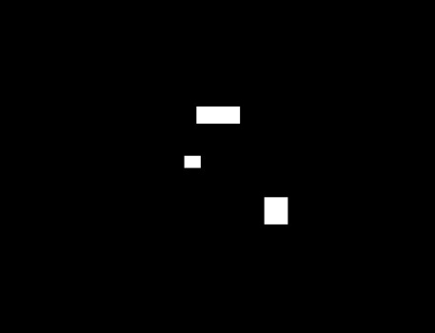
Result - inpaint

Slide 12
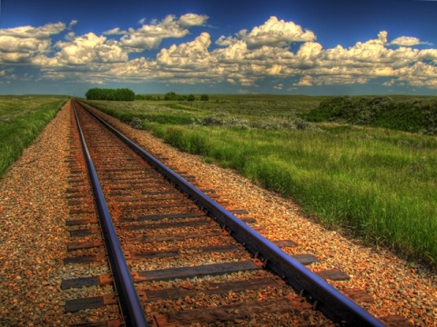
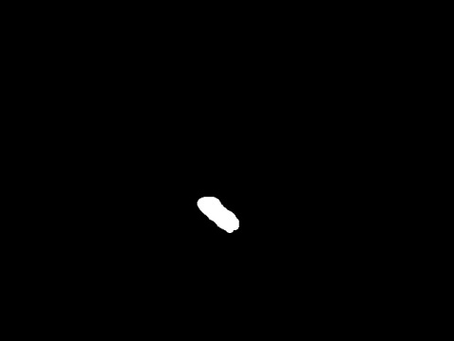
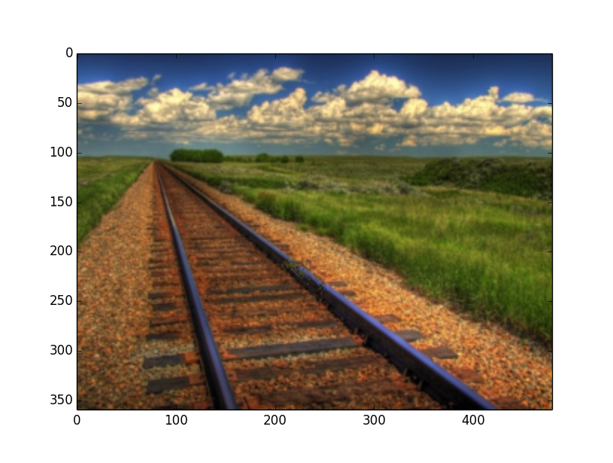
Result - inpaint

Slide 13
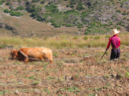

retargeting

Slide 14

Bidirectional similarity
Use bidirectional similarity to find matching patch
Use NNF to find maximal similarity (minimal distance)

Slide 15
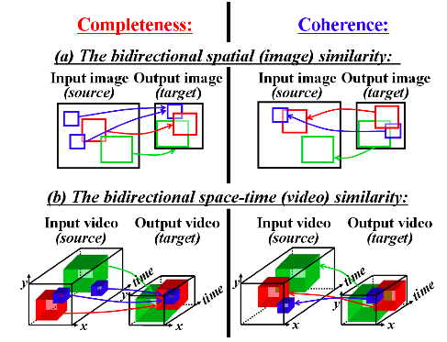

Slide 16
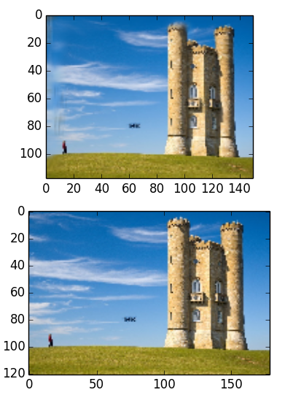
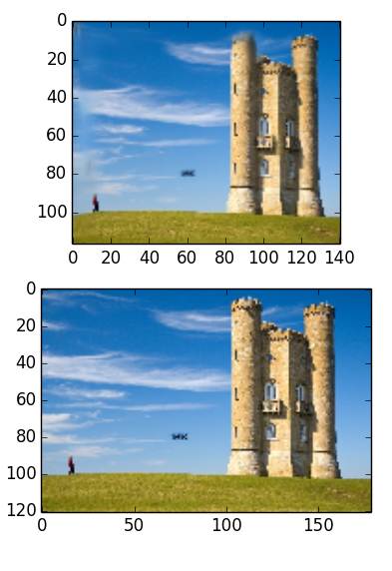
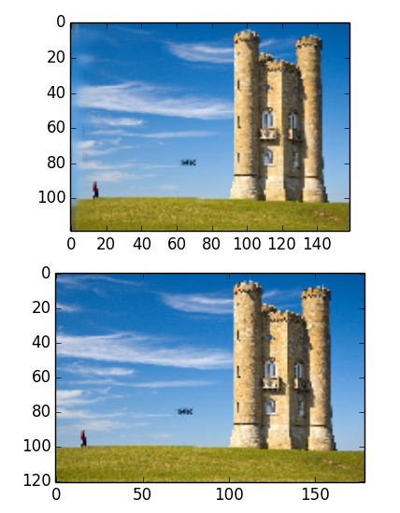
Result - Retarget

