Slide 1
Unleashing the Intrinsic Visual Representation Capability of Multimodal Large Language Models
Hengzhuang Li et al. | CVPR 2026
Presenter：刘 煜
2026.11.05
01

Slide 2
Preliminaries: visual tokens and language modeling
01 | PROBLEM
An image is first processed by a vision encoder to produce visual features.
A connector (e.g., an MLP) maps these features into the LLM's input embedding space.
The LLM processes visual tokens and text tokens.
The standard LLM loss(L_LM) makes the model learn to predict the tokens in the target text.
视觉路径
Image → vision encoder → connector → visual tokens
语言路径
Text and visual tokens → LLM → next-token prediction
02

Slide 3
Background
01 | PROBLEM
MLLMs combine the language reasoning ability of LLMs with visual perception from vision encoders.
The paper describes a modality-imbalance problem: visual information is often underused relative to text in deeper layers.
Consequences: weaker visual-task performance and a higher risk of visual hallucinations.
The authors connect this problem to training dominated by next-text-token prediction.
MLLM核心问题
如何让模型不仅学会用文字描述图片，还能在内部精准保留图片中不同细节（视觉 token）之间的差异。下一词元预测：根源；视觉表征同质化：根源导致的过程；模态不平衡：同质化累积后的“结果”
解决方法
LaVer 增加了潜空间掩码图像建模（MIM）以及正则化项Clipped Gram-Anchoring (CGA)。两者和语言建模损失（L_LM）共同构成联合优化目标。
03

Slide 4
Why next-token prediction may be insufficient
01 | PROBLEM
Common MLLMs generate the next text token based on input visual and text tokens.
The visual input influences the language objective indirectly through its contribution to text prediction.
This paper argues that this training method lacks direct constraints for retaining "discriminative key visual features".
In the LLM's latent semantic space, LaVer introduces an auxiliary visual reconstruction objective(MIM).
标准LLM目标
预测下一个文本词元
解决方法
MIM-重建被掩码的视觉表征
04

Slide 5
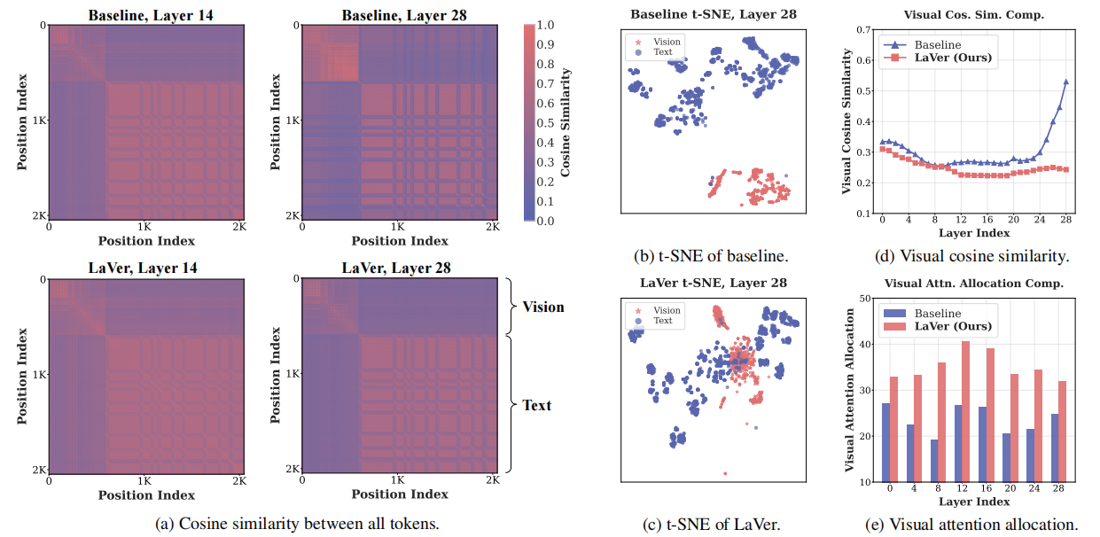
Evidence of visual representation homogenization in deep networks
01 | PROBLEM
LaVer alleviates visual representation homogenization, preserving the discriminative information of visual tokens, while making the visual and text representations more aligned.
05

Slide 6
Positioning vs. Prior Work
02 | RELATED WORK
Prior work includes MLLM architectures and methods that aim to improve visual understanding.
Another related research direction explores vision-enhanced MLLMs and stronger visual supervision.
LaVer's focus is not to replace the MLLM architecture; it adds a training framework for learning more discriminative visual representations.
The unique combination is latent-space masked image modeling(MIM) and Clipped Gram Anchoring(CGA), alongside the original language objective.
06

Slide 7
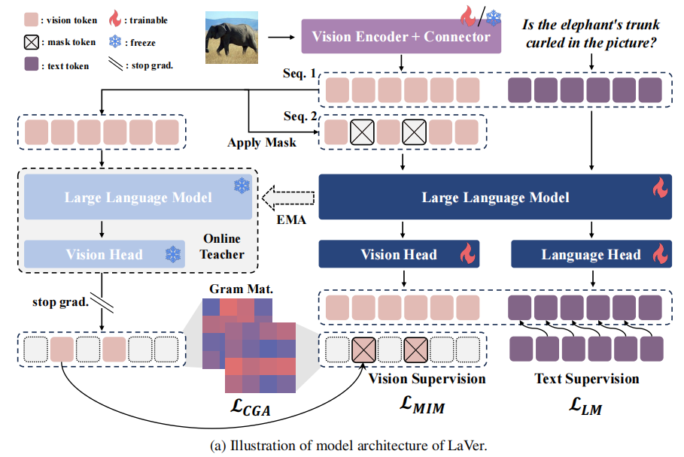
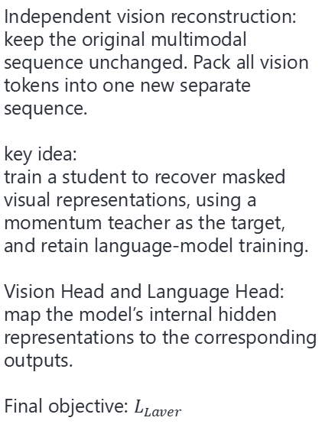
Architecture of LaVer
03 | ARCHITECTURE
Independent vision reconstruction:
keep the original multimodal sequence unchanged. Pack all vision tokens into one new separate sequence.
key idea:
train a student to recover masked visual representations, using a momentum teacher as the target, and retain language-model training.
Vision Head and Language Head:
map the model’s internal hidden representations to the corresponding outputs.
Final objective: $L_{Laver}$
07

Slide 8
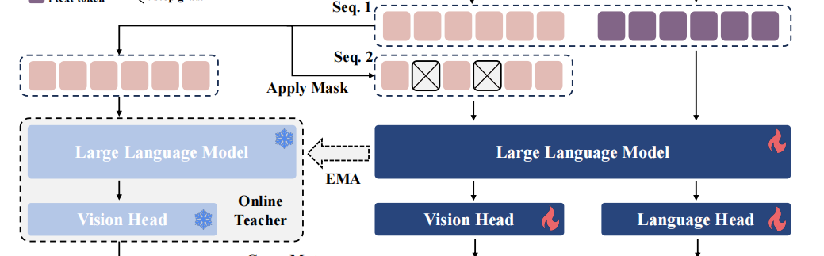
Latent-space masked image modeling
04 | ONE METHOD
Visual tokens are randomly selected for masking.
The student processes the masked sequence and predicts target distributions at masked positions.
The teacher generates target representations from the unmasked token.
The teacher's parameters are updated using an exponential moving average (EMA) of the student's parameters,rather than by backpropagation.
学生模型
利用剩余的视觉上下文，预测被掩码位置对应的目标视觉表示。
教师模型
从未掩码的视觉词元生成目标视觉表征。教师模型并非简单地“提供完整信息”，而是作为一个稳定、高质量的“语义提炼器”发挥作用。它把充满噪声的原始视觉信号，转化为平滑、高级且具有结构性的语义目标去指导学生模型。
08

Slide 9
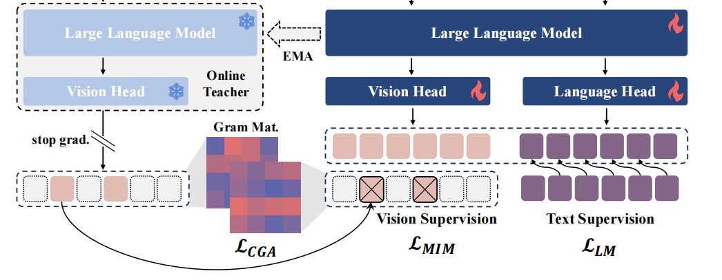
MIM objective: reconstruct masked visual tokens
04 | ONE METHOD
The MIM loss is computed only at masked visual-token positions.
Student predictions and teacher targets are converted into probability distributions using softmax.
A cross-entropy loss(L_MIM)aligns the student's predictions with the teacher's target distributions.
This adds MIM direct visual supervision to the standard next-token prediction objective.
匹配的是什么？
掩码位置上的学生预测分布与教师目标分布。
为什么用潜空间？
LaVer在LLM的语义空间中重建高级视觉表征，而非原始图像像素。
09

Slide 10
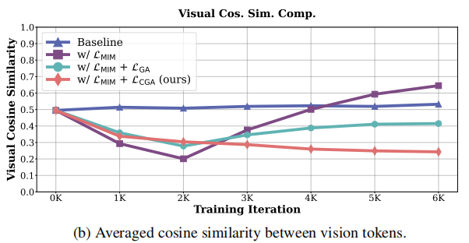
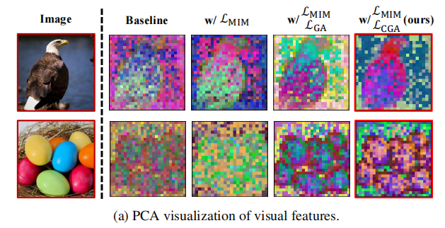
A failure mode: visual feature inconsistency
05 | MOTIVATION
If the model only uses MIM, it may output similar features for all visual tokens to lower the loss, leading to inconsistent visual features.
The main reason is that the loss only makes the student and teacher match on single masked tokens. It does not keep the whole set of visual tokens structurally diverse.
The authors use this analysis to propose an additional constraint(CGA) that helps retain discriminative feature.
10

Slide 11

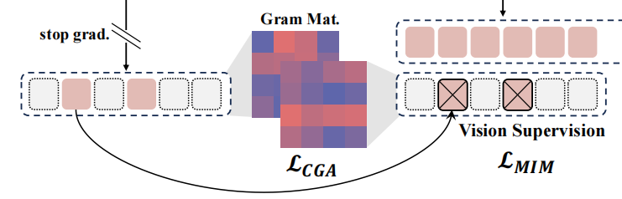

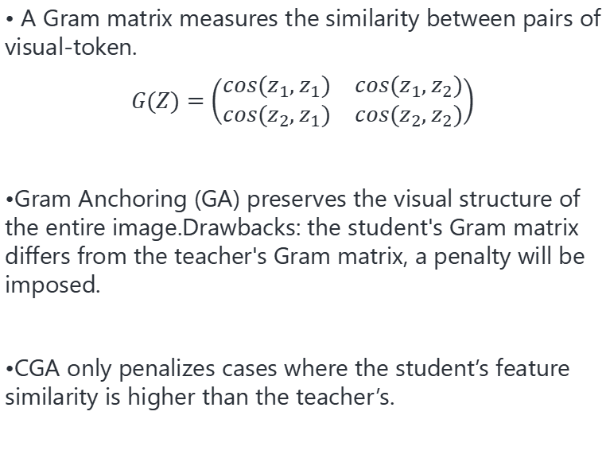
Gram Anchoring(GA) and Clipped Gram Anchoring(CGA)
06 | ANOTHER METHODS
• A Gram matrix measures the similarity between pairs of visual-token.
$$G(Z)=\left(\begin{matrix}cos(z_{1},z_{1}) & cos(z_{1},z_{2}) \\ cos(z_{2},z_{1}) & cos(z_{2},z_{2})\end{matrix}\right)$$
•Gram Anchoring (GA) preserves the visual structure of the entire image.Drawbacks: the student's Gram matrix differs from the teacher's Gram matrix, a penalty will be imposed.
•CGA only penalizes cases where the student’s feature similarity is higher than the teacher’s.
Clipped裁剪的作用
GA的目标是让学生模型的视觉特征结构更接近教师；CGA的额外目标是允许学生模型变得更好。
11

Slide 12
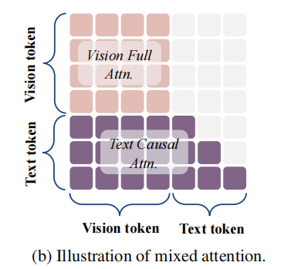
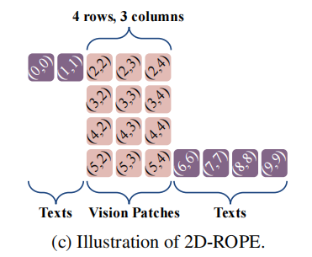
Improving spatial awareness: mixed attention and 2D RoPE
06 | ANOTHER METHODS
Mixed Attention solves how tokens can interact with each other.
2D-RoPE lets tokens know their spatial positions.
12

Slide 13
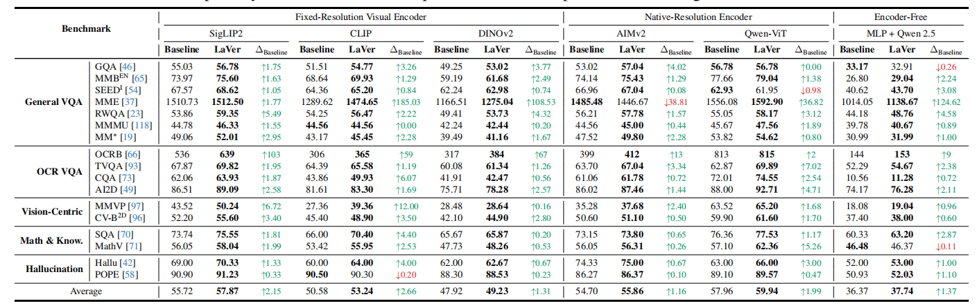
Benchmark
07 | EXPERIMENTS
key data:OCRB—dense visual task CQA—chart understanding task
MMVP—visual discrimination TVQA—Video Question Answering
LaVer is not limited to adapting to one specific visual encoder; instead, it works well in some ways with all the different visual encoding methods.
13

Slide 14
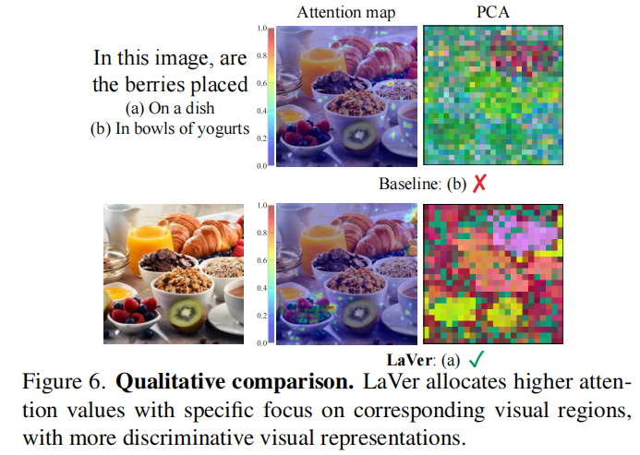
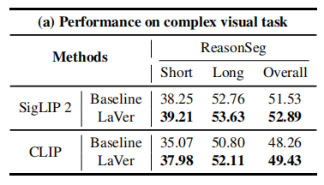
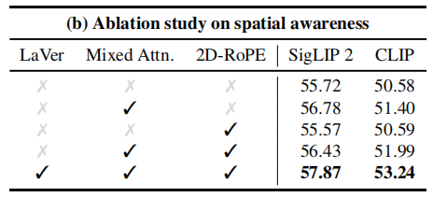
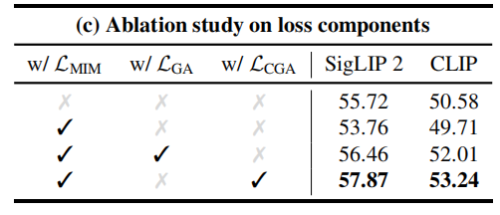
Qualitative evidence and Ablations
07 | EXPERIMENTS
Conclusion: LaVer adds direct latent visual supervision(MIM) and a Gram-based constraint(CGA) to the standard language-modeling.
14

