Slide 1
ICLR 2026 · PAPER SHARING
MetaEmbed
Scaling Multimodal Retrieval at Test-Time with Flexible Late Interaction
Presenter: 黄清华 2026.11.03
Xiao et al. · Meta Superintelligence Labs / Rice University
01 / 22

Slide 2
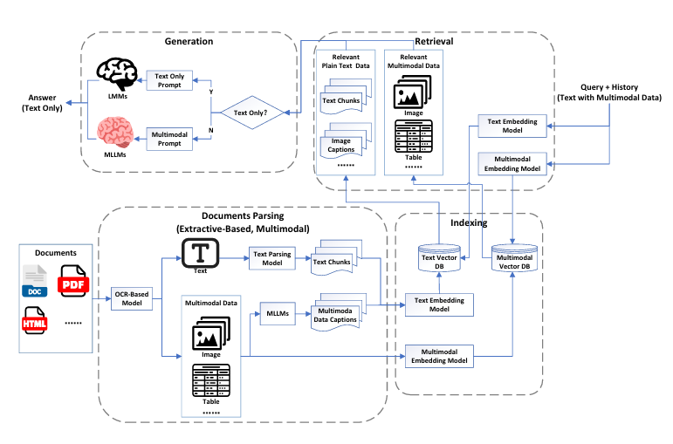
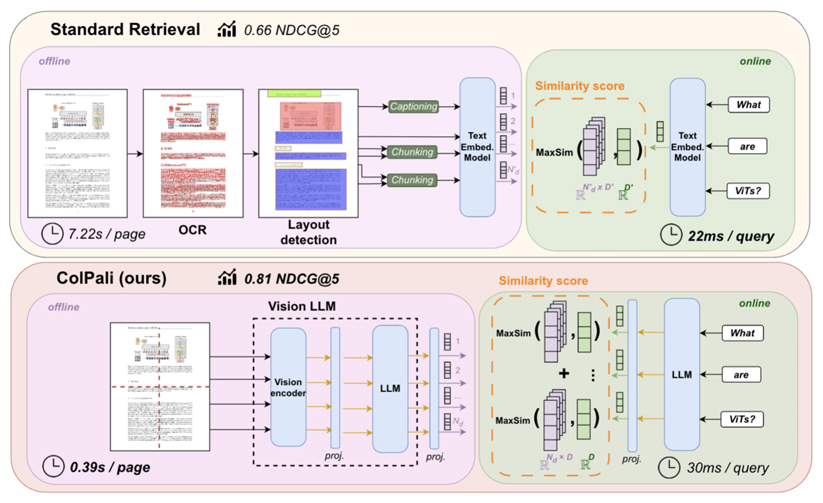
01 · PRIOR METHODS
Two approaches to document retrieval
Document parsing before retrieval
ColPali: direct page retrieval
OCR, layout parsing and captioning produce indexable content. A wrong cell boundary or a missing caption can separate a value from its label.
The lower panel encodes the page image directly. Keeping many patch vectors preserves local evidence but increases index size and matching cost.
02 / 22

Slide 3
01 · RESEARCH QUESTION
One trained retriever, multiple retrieval budgets
Can the same learned representation serve both low-cost and high-quality retrieval?
The central question is not just “more vectors or fewer vectors”.
01
02
03
REPRESENT
TRAIN
RETRIEVE
How do we keep rich semantics
in a compact vector set?
How can every short prefix
remain useful on its own?
How do we change the budget
without training a new model?
Story: representation → matching → multi-prefix training → test-time use → evidence
03 / 22

Slide 4
01 · MOTIVATION
Why multimodal retrieval needs a vector budget
Both the query and the candidate can be text, images, or a text–image mixture.
Retrieval task
One vector
Compact, but may discard fine-grained evidence.
Encode a query q and N candidates.
Score each query–candidate pair,
then return the most relevant item.
Multi-vector
Multiple vectors can store more fine-grained information,but they bring higher computation and storage costs.
The target: preserve fine-grained matching while reducing the overhead.
04 / 22

Slide 5
02 / METHOD
A question and two plausible document pages
Running example: “Which electrolyte(电解质) has the highest conductivity(导电率) at 25 °C?” The retriever must return a page that contains the evidence.
The relevant page
Page A lists the electrolytes and their conductivities at 25 °C. Page B has a similar table for the same materials, measured at 80 °C.
What gets encoded?
The query and each page image go through the same encoder separately. Each input produces an ordered set of retrieval vectors.
What gets ranked?
The query vectors are matched against each page’s vectors. A successful retriever ranks A above B even though both pages mention conductivity.
05 / 22

Slide 6
02 · ARCHITECTURE OVERVIEW
MetaEmbed: the complete architecture
Query
Candidate
Image / text
16 Learnable meta tokens
Image / text
64 Learnable meta tokens
VLM
Read Mq positions in the final layer · L2 normalize
Read Mc positions in the final layer · L2 normalize
MetaEmbed
Q =
q₁
q₂
···
q₁₆
16 × D
C =
c₁
c₂
···
c₆₄
64 × D
Pair nested prefixes from the same two ordered vector sequences
Budget 1
Budget 2
Budget 3
Budget 4
Budget 5
Q[1:1]
Q[1:2]
Q[1:4]
Q[1:8]
Q[1:16]
C[1:1]
C[1:4]
C[1:8]
C[1:16]
C[1:64]
MaxSim score s1
MaxSim score s2
MaxSim score s3
MaxSim score s4
MaxSim score s5
InfoNCE loss L1
InfoNCE loss L2
InfoNCE loss L3
InfoNCE loss L4
InfoNCE loss L5
Joint training loss L = L₁ + L₂ + L₃ + L₄ + L₅
06 / 22

Slide 7
02 / ENCODING
How a Meta Token becomes a retrieval vector
A Meta Token starts with a learned input embedding shared across examples. Its output changes with the words and visual content in this particular input.
Inside one forward pass
The transformer processes the content tokens and appended Meta Tokens together. The paper writes the input order as visual tokens, text tokens, then the two Meta Token banks.
Read the final layer
For the question, read the positions in the query bank ($M_{q}$). For each page, read the candidate bank ($M_{c}$). Normalize each output vector to unit length before matching.
Reading the diagram
$Q$ contains 16 query vectors; $C$ contains 64 candidate vectors. $D$ is the number of coordinates per vector. $Q\left[1:k\right]$ or $C\left[1:k\right]$ keeps the first $k$ vectors with all coordinates.
07 / 22
Notes:
框架图中两条分支各自编码。输入端的可学习标记在不同样本之间复用。读出的向量已经包含该样本的上下文，因此同一标记在两张页面上会得到不同的输出。每一行向量都分别归一化。

Slide 8

















03 · MATCHING
Late interaction: every query vector finds its best match
For a query q and a page c, each matrix cell is the dot product of a query vector and a page vector.
$$s\left(q,c\right)=\sum_{i=1}^{r_{q}}{\max_{1≤j≤r_{c}}}⟨E_{q}^{\left(i\right)},E_{c}^{\left(j\right)}⟩$$
The selected budget retains $r_{q}$ query vectors and $r_{c}$ candidate vectors. Row $i$ uses the $i$-th query vector, $E_{q}^{\left(i\right)}$. Column $j$ uses the $j$-th page vector, $E_{c}^{\left(j\right)}$.
EXAMPLE BUDGET: $\left(2,4\right)$
$$c_{1}$$
$$c_{2}$$
$$c_{3}$$
$$c_{4}$$
$$q_{1}$$
$$0.61$$
$$0.82$$
$$0.22$$
$$0.50$$
$$max=0.82$$
SUM
$$1.71$$
$$q_{2}$$
$$0.40$$
$$0.48$$
$$0.89$$
$$0.37$$
$$max=0.89$$
Page A scores 1.71. If page B scores 1.20, the same query ranks A first.
08 / 22

Slide 9






04 · PREFIX STRUCTURE
MMR: five nested prefixes of the same representation
Matryoshka Multi-Vector Retrieval
Every larger group contains the earlier vectors; no extra encoder or separate model is introduced.
BUDGET (r_{q}, r_{c})
QUERY PREFIX / 16
CANDIDATE PREFIX / 64
SCORE
$$\left(1,1\right)$$
$$s^{1}$$
$$\left(2,4\right)$$
$$s^{2}$$
$$\left(4,8\right)$$
$$s^{3}$$
$$\left(8,16\right)$$
$$s^{4}$$
$$\left(16,64\right)$$
$$s^{5}$$
Each small rectangle is one $D$-dimensional vector.
The nesting axis is vector count—not embedding dimensions, words, patches, or physical regions.
09 / 22

Slide 10
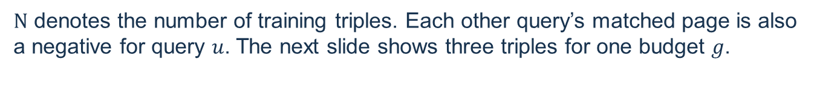

04 / TRAINING DATA
What one training example tells the model
Training uses MMEB-train and ViDoRe-train. Each example pairs a query with a relevant candidate and one explicit hard negative.
One labeled triple
For query $u$ about conductivity at 25 °$C$, the matching page is $c_{u}^{+}$ (page A). The hard negative $h_{u}$ (page B) is topically close but reports a different temperature.
$$(q,c^{+},h_{u})$$
Other examples in the batch
$N$ denotes the number of training triples. Each other query’s matched page is also a negative for query $u$. The next slide shows three triples for one budget $g$.
Read one matrix row
With three triples, query 1 competes over four candidates: its matched page, the other two queries’ matched pages and its own hard negative.
10 / 22
Notes:
每条训练样本由查询、正例和显式难负例组成。难负例与问题相关但不满足关键信息。批内其他样本的正例也参与竞争，其他查询的显式难负例不进入当前查询的分母。

Slide 11



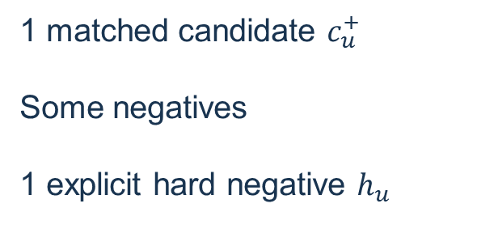













04 · TRAINING DATA FLOW
Training signals: one positive and two types of negatives
Each query competes against other positives in the mini-batch and its own explicit hard negative.
EXAMPLE: $B=3$, ONE PREFIX GROUP $g$
$$c_{1}$$
$$c_{2}$$
$$c_{3}$$
For query $q_{u}$
$$q_{1}$$
$$+$$
$$−$$
$$−$$
hard $−$
$$h_{1}$$
1 matched candidate $c_{u}^{+}$
Some negatives
1 explicit hard negative $h_{u}$
$$q_{2}$$
$$−$$
$$+$$
$$−$$
hard $−$
$$h_{2}$$
$$q_{3}$$
$$−$$
$$−$$
$$+$$
hard $−$
$$h_{3}$$
Repeat this positive-vs-negative comparison for every trained prefix group.
11 / 22

Slide 12
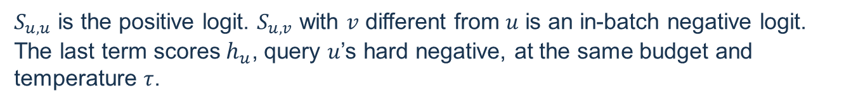
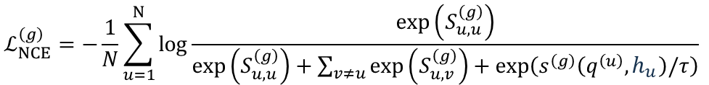
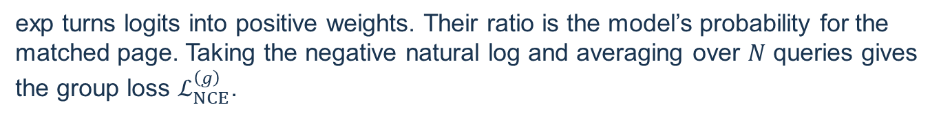
04 / TRAINING OBJECTIVE
The contrastive loss for one budget
For each query, the numerator rewards its matched page. The denominator compares it with all matched pages in the batch and that query’s own hard negative.
$$ℒ_{NCE}^{\left(g\right)}=−\frac{1}{N}\sum_{u=1}^{N}{log}\frac{exp\left(S_{u,u}^{\left(g\right)}\right)}{exp\left(S_{u,u}^{\left(g\right)}\right)+\sum_{v≠u}^{​}{exp}\left(S_{u,v}^{\left(g\right)}\right)+exp\left(s^{\left(g\right)}\left(q^{\left(u\right)},h_{u}\right)/τ\right)}$$
Read the denominator
$S_{u,u}$ is the positive logit. $S_{u,v}$ with $v$ different from $u$ is an in-batch negative logit. The last term scores${ h}_{u}$, query $u$’s hard negative, at the same budget and temperature $τ$.
What the loss measures
exp turns logits into positive weights. Their ratio is the model’s probability for the matched page. Taking the negative natural log and averaging over $N$ queries gives the group loss $ℒ_{NCE}^{\left(g\right)}$.
12 / 21
Notes:
若错误的八十度页面得分很高，分母中它的权重会增大，正确页面的概率随之降低，损失升高。模型通过减小这一损失来提高正确页面相对其他页面的得分。

Slide 13
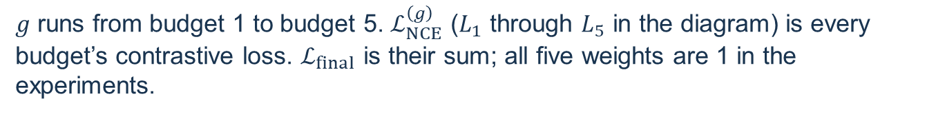
04 / PARAMETER UPDATE
Five prefix losses drive one parameter update
Encode each input once for its role. Reuse the resulting ordered vectors to score the same batch at every budget.
$ℒ_{final}=\sum_{g=1}^{5}{ℒ_{NCE}^{\left(g\right)}=}$ $ℒ_{1}+ℒ_{2}+ℒ_{3}+ℒ_{4}+ℒ_{5}$
Joint objective
$g$ runs from budget 1 to budget 5. $ℒ_{NCE}^{\left(g\right)}$ ($L_{1}$ through $L_{5}$ in the diagram) is every budget’s contrastive loss. $ℒ_{final}$ is their sum; all five weights are 1 in the experiments.
Why the prefix matters
The first vector participates in all five losses. Query vector 16 appears only in the largest group. Short prefixes therefore receive a direct signal to distinguish A from B.
What changes?
Backpropagation updates trainable encoder parameters and Meta Token embeddings. Each new input gets fresh output vectors from the updated encoder.
13 / 21
Notes:
同一份完整输出取出五对嵌套前缀，分别算损失再求和。第一个向量在五档中都出现，因此训练迫使它在只保留一个向量时也能区分页面。输出向量随模型参数更新而变化。

Slide 14
05 / TEST-TIME RETRIEVAL
Using the trained model at a chosen budget
Return to the conductivity question. Retrieval needs a score for each candidate page. Labels, hard negatives and training losses are no longer needed.
Build the page index
Encode each of the $N$ candidate pages. Store $r_{c}$ vectors per page, each with $D$ coordinates. Keeping only the first four saves storage; keeping all 64 enables later use of the full budget.
Score a new query
Encode the query and select its first $r_{q}$ vectors. At budget $\left(2,4\right)$, each page requires eight vector dot products. At $\left(16,64\right)$, it requires 1,024. Rank pages by their MaxSim scores.
Two different savings
Storing a shorter candidate prefix reduces index size. Using a shorter prefix from a full index reduces scoring work while leaving the stored index size unchanged.
14 / 21
Notes:
降档主要节省向量匹配开销。如果离线只存四条候选向量，就不能直接使用需要六十四条候选向量的最高档。若已存完整索引，可在查询时只使用前四条。

Slide 15
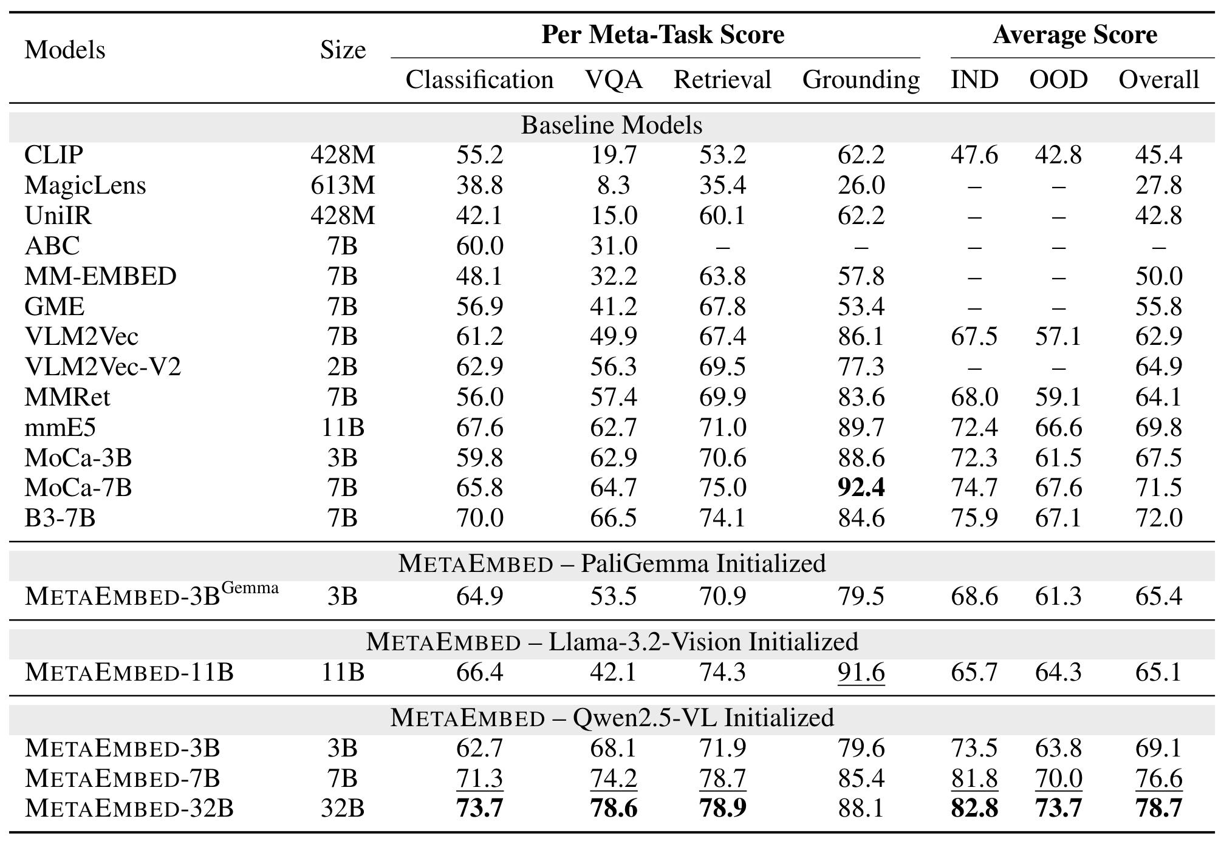
06 / RESULTS
MetaEmbed reaches 76.6 on MMEB at 7B
Overall Precision@1 across 36 tasks, using the full (16, 64) budget.
15 / 21

Slide 16
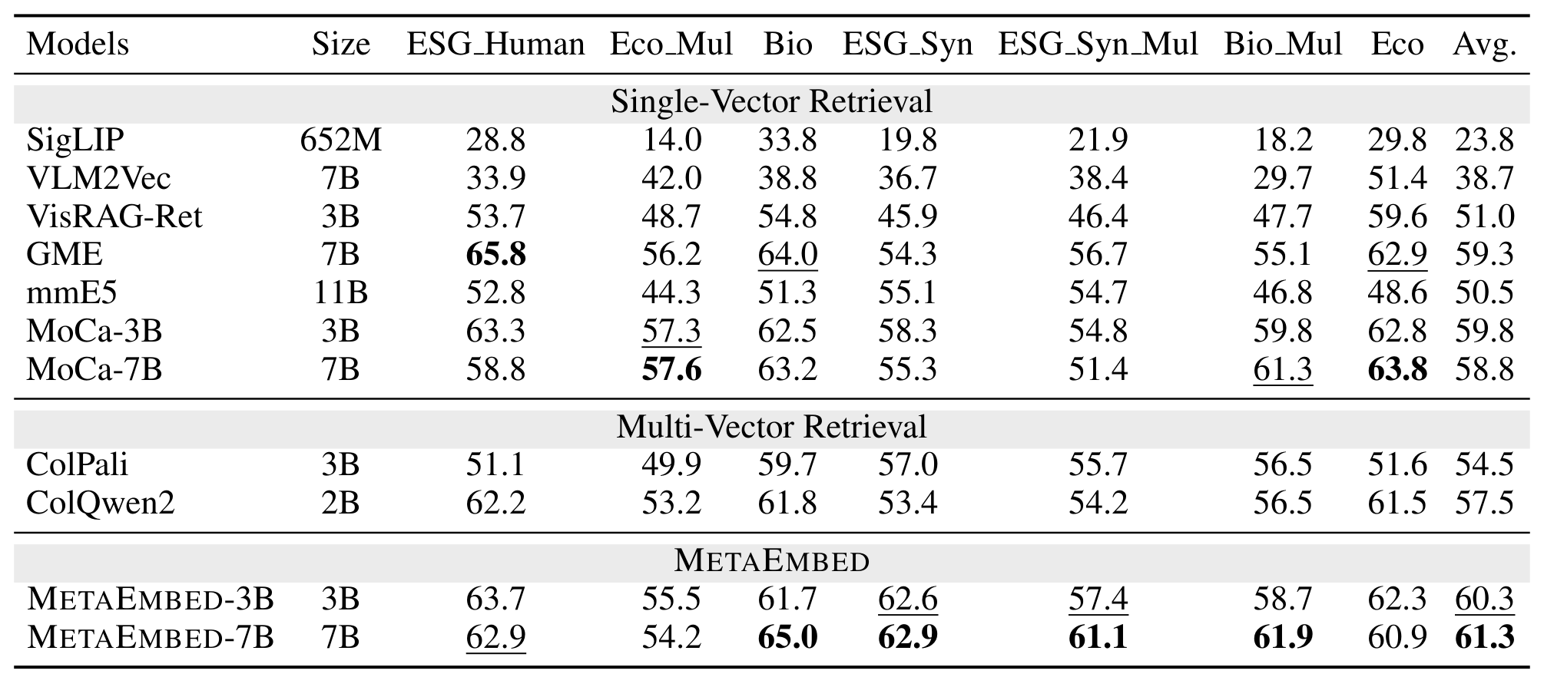
06 / RESULTS
Visual document retrieval improves on ViDoRe v2
At full budget, MetaEmbed-7B scores 61.3 mean nDCG@5 across seven tracks.
At 3B, MetaEmbed scores 60.3 versus 54.5 for ColPali, a gain of 5.8 points.
16 / 21

Slide 17
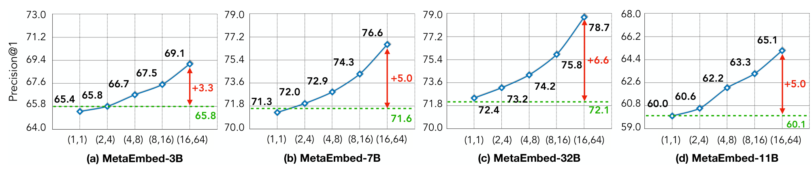
06 / RESULTS
Larger prefixes improve retrieval within each model
The four panels vary the query and candidate vector counts while keeping the trained weights fixed.
On the 7B curve, Precision@1 rises from 71.3 at (1, 1) to 76.6 at (16, 64), a gain of 5.3 points.
17 / 21

Slide 18
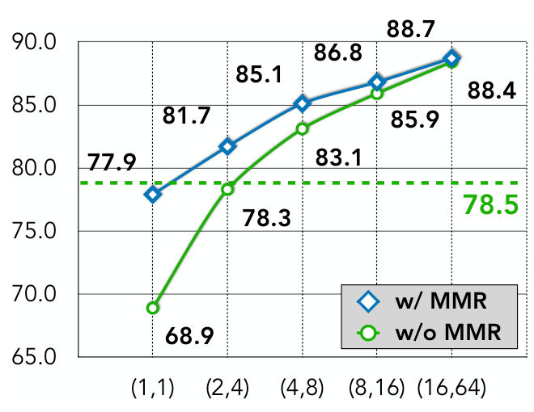
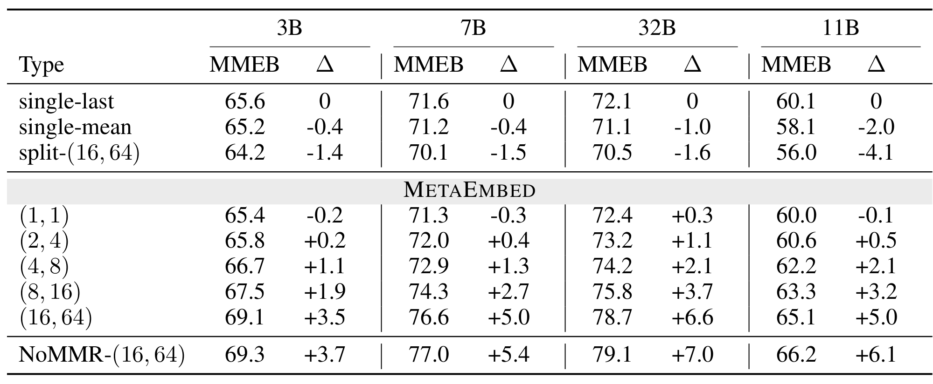
06 / RESULTS
Joint prefix training matters most at low budgets
Two ablations separate the effect of prefix training from the choice of representation.
ViDoRe v1 / 3B
MMEB / matched training settings
At (1, 1), MMR gains 9.0 nDCG@5 points over training only the full prefix.
At 7B and (16, 64), MetaEmbed scores 76.6 versus 70.1 for split pooling and 77.0 for Meta Tokens trained only at full budget.
single-last: Take the hidden state of the last token from the final layer of the VLM.
single-mean: Compute the average over the hidden states of all tokens in the final layer.
18 / 21

Slide 19
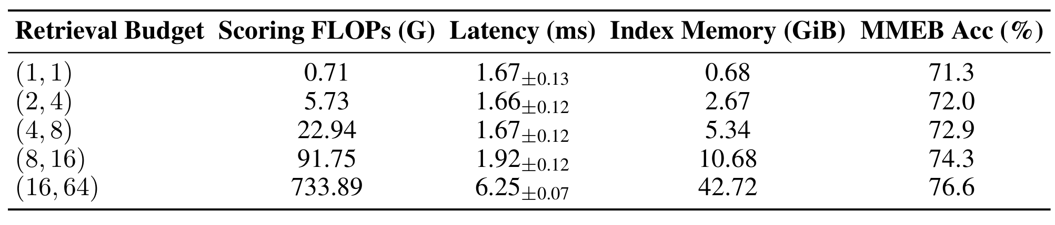
06 / RESULTS
The second budget uses one sixteenth of the full index
MetaEmbed-7B scores 100,000 candidates on an A100 using BF16. Latency covers scoring only.
$$ColPali :100000×1030×128×2÷{1024}^{3}≈24GB$$
Moving from (16, 64) to (2, 4) cuts the index from 42.72 to 2.67 GiB. MMEB Precision@1 falls by 4.6 points, from 76.6 to 72.0.
19 / 21

Slide 20
07 / SUMMARY
MetaEmbed: contributions
One trained retriever can use five different vector budgets at test time.
Compact page vectors
Learnable Meta Tokens collect evidence from each input. Their final states give up to 16 query vectors and 64 candidate vectors for MaxSim matching.
Training for shorter prefixes
Five nested prefixes share the same encoder outputs. Each has its own contrastive loss, so even the shortest prefix learns to rank relevant pages.
Storage and accuracy
On MMEB, the 7B model retains 72.9% Precision@1 at tier 3 versus 76.6% at tier 5, using one eighth of the full index for 100,000 candidates.
20 / 21

Slide 21
08 / LIMITATIONS
Limitations
How does a low-budget MetaEmbed compare with other retrievers on visual documents?
Full-budget comparison
On ViDoRe v2, Table 2 reports 60.3 nDCG@5 for MetaEmbed at tier 5 and 54.5 for ColPali-3B. It gives no tier-3 or other result for this comparison. What we most care about is whether we can achieve low storage footprint while maintaining high accuracy.
Encoding overhead
MetaEmbed reduces index size and late-interaction scoring cost, but it does not solve the expensive VLM encoding step. For image queries, query encoding can still dominate total retrieval latency.
Empirical budget design
The five retrieval budgets are manually chosen: (1,1), (2,4), (4,8), (8,16), and (16,64). The paper does not fully study whether other settings, such as (16,32),(8,32) could offer a better trade-off between storage and accuracy.
21 / 21

