Slide 1
Paper Reading · Group Meeting · Nov 2026
Cache-Craft
Managing Chunk-Caches for Efficient Retrieval-Augmented Generation
ACM SIGMOD 2025（DOI 10.1145/3725273）
Topic: LLM Inference Systems · Retrieval-Augmented Generation
A few hot chunks are prefilled over and over
■ Reuse cached K / V of chunks
■ Recompute only a tiny affected part
■ Cut prefill cost by over half

Slide 2
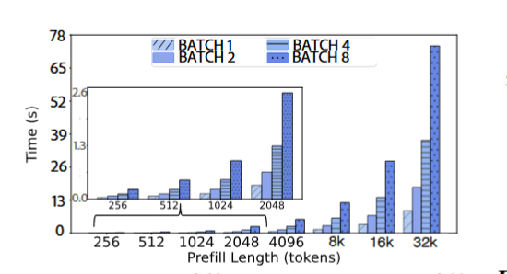
2.2 Prefill Dominates Decode in RAG
RAG = long input + short output
A RAG request first prefills the whole retrieved context (tens of thousands of tokens), then decodes a short answer (usually a few hundred). Prefill is compute-bound: O(n²) complexity, exploding with context length, while decode handles only one new token per step.
30K : 600
average prefill-to-decode token ratio
O(n²)
prefill compute grows quadratically
Prefill time grows steeply with context length across batch sizes — from ~13 s at 2K tokens to ~76 s at 32K (batch 8, 70B).
32k tokens, batch 8, LLaMA-3-70B, 4×A100 — a single prefill takes 76 s, and over 100 s in production.

Slide 3
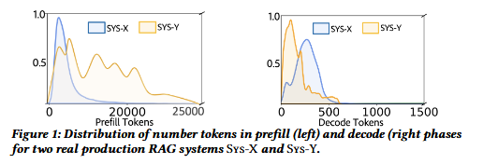
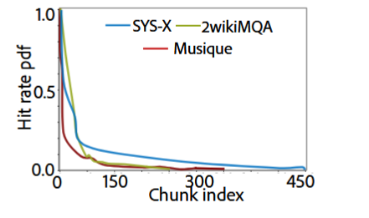
2.3 Evidences of Chunk-Reuse
Production measurement
Opportunity — chunks repeat a lot
55.4%
Sys-X prefill time share — 19.3× the decode compute; ~30K prefill vs 600 decode tokens
Top 5% hot chunks serve 60% of requests (Sys-X / MuSiQue); Sys-X wastes ~12B tokens/month of re-prefill ≈ $50K.
76%
Sys-Y prefill time share — 46× the decode compute; extreme in long-document workloads
But existing caches don't help
77%
worst-case share of total inference time; 32k tokens batch 8 on a 70B model takes 76 s
· Prefix caching: only 8% of requests / 18% of tokens share a full prefix
· Ordered k=5 chunk tuples: reuse density drops to ~5
We need chunk-granular reuse that tolerates reordering and cross-chunk dependencies.

Slide 4
2.4 Why Cache-Reuse is Non-trivial?
01
Reordering — relative position encodings go wrong
A chunk sits at a different position in the new request; without correction, RoPE relative position encodings shift the attention results.
02
Cross-chunk dependency — missing its "neighbors"
Part of a chunk's attention points to the question and other chunks (inter-attention); stitching K/V from different histories already corrupts these representations.
03
Causal-mask mismatch — "see only the past" breaks
Cached K/V carries imprints of its original positions and visibility; it conflicts with the new request's causal structure and must be repaired explicitly.
Measured consequences — naive per-chunk reuse (RPE fixed only) drops ROUGE to 0.65; with 5 chunks from 5 different past requests, F1 falls by 50%.

Slide 5
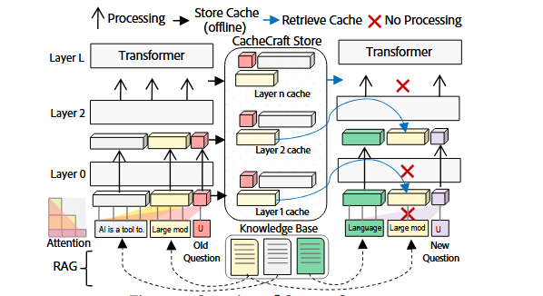
3 Cache-Craft Design
① 3.1 Determine reusability
CCI and β′ computed offline from inter / intra attention, stored with K/V.
② 3.2 Fix via recomputation
CFO selects the top inter-attention tokens to recompute; early stopping freezes the rest (−55%).
③ 3.3–3.5 Store and serve
100×5 variants per chunk with hash retrieval and eviction; layer-wise pipelined preload across GPU / CPU / SSD tiers.
Three reuse cases — per chunk, Cache-Craft chooses direct reuse, selective recompute, or no reuse.
Design goal: reach ≈30% recomputation while achieving 90%+ of full-recompute (Full-Recomp) quality — turning the quality–cost tradeoff from linear into nearly flat.

Slide 6
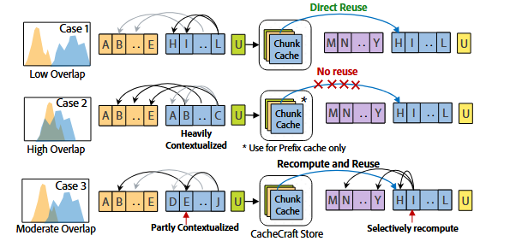





3.1 Determining Cache Reusability: CCI and β′
β is the share of the chunk's inter-attention still landing on tokens present in the new request;
γ is the normalized Kendall-Tau distance, penalizing reordering. Together they decide how much position information survives.
β′ combines overlap and order into a single position-trustworthiness score.
$CCI=σ(\bar{a}/\bar{b})$
·ā is mean inter-attention, b̄ is mean intra attention; CCI → 1 means self-contained (reuse), → 0 means context-dependent (repair).
Higher CCI and lower β′ → safer reuse; the two quantities decide at runtime "how much to repair" and "how much to trust the position".

Slide 7

3.2 Fixing Chunk-Cache via Recomputation: Selective Recompute
Effect
Chunk Fix Overhead — the fraction of the chunk to recompute, combining reusability (CCI) and position trustworthiness (β′).
30%
1. On a cache hit, load K / V and CCI and skip the full prefill
2. Per chunk, recompute only the top-⌈CFO·|C|⌉ tokens with the highest inter-attention
3. Write the recomputed K / V back to the cache for future requests
α is a global coefficient calibrated on a validation set under a target-F1 constraint (Eq. 13) — if quality falls short, recompute a bit more everywhere.
Recomputing only ~30% of prefill reaches 90%+ of full-recompute ROUGE — the quality–cost curve flattens beyond 30%.

Slide 8
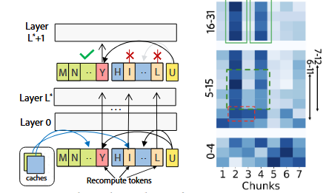
3.2 Fixing Chunk-Cache via Recomputation: Early Stopping
Observation: as layers go deeper, inter-attention between chunks and the question quickly concentrates on a few truly relevant chunks, with a clear changepoint.
Method:
· Accumulate each chunk's share of inter-attention layer by layer
· Run entropy changepoint detection (Algorithm 1) to locate focused chunks
· Once the changepoint appears, freeze the other chunks' K / V and stop monitoring
Focused chunks are identified layer by layer and repaired first.
80% of queries settle focused chunks by layer 10–15 (of 32)
−55% of recomputation saved by early stopping
Early stopping makes the "which chunks need fine repair" decision approximate too — you don't need all layers to know where attention will land.

Slide 9
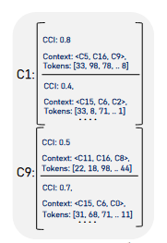
3.3 Cache Variants: Retrieval and Eviction
Chunk-granular hashing: unlike vLLM's whole-prefix hash, every chunk is addressed independently — a chunk hits regardless of where it appears in the new request
Cache variants: each chunk stores N×M = 100×5 position / order variants, so a hit is found for almost any placement — 50 GB (8B), 150 GB (70B)
Retrieval: on a new request, hash each retrieved chunk and look up its variants; the entry's CCI / β′ metadata decides how to repair it
Frequency-aware eviction: on a hit, fr += 1/CFO — the harder a chunk is to repair, the more worthwhile it is to keep
A cache entry — K / V variants plus CCI and β′ metadata computed offline.
Hits are decided per chunk — reuse density no longer depends on chunk order across requests.

Slide 10
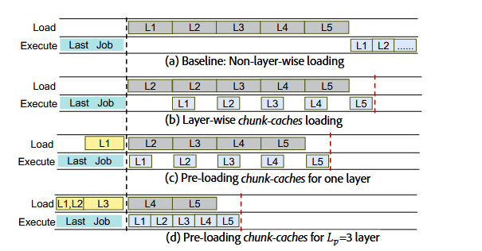
3.4 Chunk-Cache Reuse Pipeline
Layer-wise loading: the transformer consumes chunk K/V layer by layer, so the cache streams variants one layer at a time instead of loading everything up front
Pipelined preloading: while layer l computes, the K/V vectors for layer l+1 are loaded in the background — loading is overlapped with compute
Preload depth Lₚ: how many layers to preload ahead is chosen adaptively against the current load, balancing compute and transfer
Effect: pre-loading hides most of the transfer latency in the shadow of layer computation
(a) Baseline loads all layers up front; (b) layer-wise chunk-cache loading; (c)(d) pre-loading Lₚ layers overlaps loading with compute.
The reuse pipeline turns cache loading from a serial bottleneck into a background shadow of layer computation.

Slide 11
3.5 Hierarchical Chunk-Cache Management
Three-tier hierarchy: hot chunk variants sit in GPU HBM, warm data in CPU memory, and the full variant set on SSD
Layer-wise upward streaming: the reuse pipeline moves data up the tiers one layer at a time, right before it is needed
Load-adaptive preload depth: preload Lₚ deep when idle, shallow under heavy load — tier capacity and bandwidth are balanced against compute
Frequency-aware placement: chunks that are hit often and hard to repair stay in the upper tiers
GPU memory
hot chunk variants · layer-wise preload target
CPU memory
warm data · millisecond swap-in
SSD
full chunk variants · 50–150 GB
Tiered storage — preload depth Lₚ balances compute and loading (Eq. 16).
Capacity is hierarchical: only the working set of hot variants needs to reach GPU memory.

Slide 12
4 Implementation
Built on vLLM: the chunk-cache hooks into vLLM's scheduler — hashing, store lookup, and pipelined preload are transparent to the model
Decoupled RPE and K: the cache stores position-free K; a custom CUDA kernel applies the inverse rotation at the new position at runtime
Modified FlashAttention kernel: applies RPE and the causal mask at the new positions while recomputing the selected tokens
xFormers / Triton: attention and cache operations implemented with xFormers and Triton kernels
Entropy changepoint detection (Algorithm 1) runs on the side with negligible overhead

Slide 13
5.1 Experimental Set up
Model | LLaMA-3-8B (TP1) / LLaMA-3-70B (TP4)
GPU | 8 × NVIDIA A100 80 GB
Production | Sys-X real production RAG request traces
Public | SQuAD / DROP (single-hop) · 2WikiMQA / MuSiQue (multi-hop) · CNN/DM / XSUM (summarization)
Baselines | Full-Recomp · Full-Cache · Prefix-Cache · Lingua2 · MapReduce
Quality is measured by ROUGE / F1; performance is measured under ORCA continuous batching, against the two extremes of Prefix-Cache and full recompute.

Slide 14
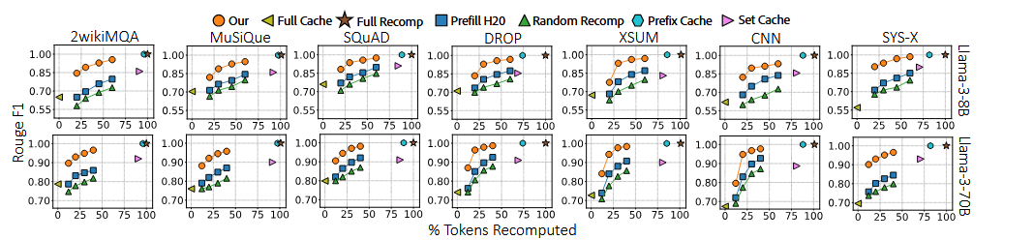
5.2 Generation Quality with KV Chunk Reuse
· Recomputing only ~30% of prefill reaches 90%+ of Full-Recomp quality; the curve flattens quickly across all 7 datasets and both model sizes
· On Sys-X production data: 0.87 vs 0.59 for Full-Cache
ROUGE / F1 vs % tokens recomputed · baselines: Full-Cache, Prefix-Cache, Set-Cache, Prefill-H2O, Random-Recomp.
Takeaway — the quality gap to Full-Recomp is small (p<0.05); ~30% selective recompute preserves answer quality.

Slide 15
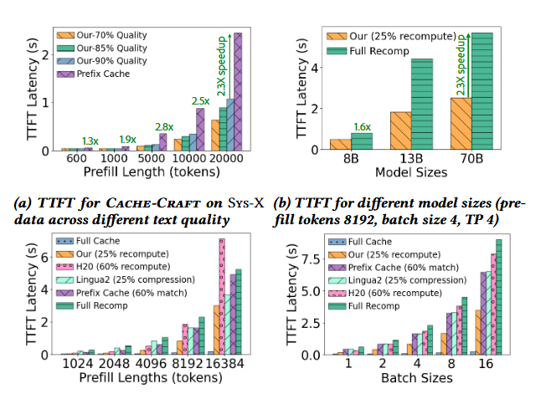
5.4 Controlled Evaluations for TTFT
· (a) 1.3–2.8× faster than Prefix-Cache across quality targets (70–90% of Full-Recomp)
· (b) 1.6–2.3× speedup over Full-Recomp holds from 8B to 70B
· (c) Consistently lower TTFT than Full-Cache, H2O, and Lingua2 at matched recompute budgets
· (d) The advantage widens as batch size grows (1 → 16)
Controlled setting: prefill tokens 8192, batch 4, TP 4 unless varied on the axis.
TTFT measured across quality levels, model sizes, baselines, and batch sizes.

Slide 16
Takeaways & Limitations
01
Chunk-level caching cuts RAG prefill cost by more than half (1.6× throughput, 2×+ lower latency, −51% token compute) with negligible quality loss.
02
Attention structure (intra / inter ratio) is a reliable prior for chunk reusability — a single CCI scalar tells "reuse directly" from "needs repair".
03
"Selective recompute + early stopping" makes the quality–cost curve nearly flat — ~30% recompute reaches 90%+ of full-recompute quality, and early stopping saves another 55%.
Limitations
When the context contains too many chunks, focused-chunk selection degrades and quality drops slightly from ~0.91; the metrics rely on offline attention statistics, and their applicability to very long contexts and non-retrieval settings remains to be validated.

