Slide 1
MRCA: Metric-level Root Cause Analysis for Microservices via Multi-Modal Data
Yidan Wang、Zhouruixing Zhu、Qiuai Fu、Yuchi Ma、Pinjia He∗

Slide 2
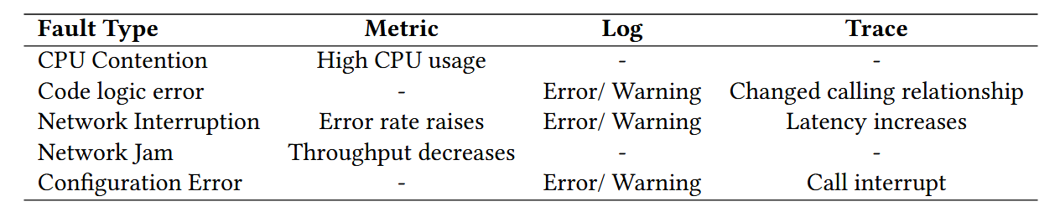
Limitation
Insufficient exploitation on multi-modal data
Current RCA methods overlook the importance of anomaly detection
Coarse-grained root cause localization at the service level
Notes:
多模态数据利用不足；当前的RCA方法忽视了异常检测的重要性；服务层面的粗粒度根本原因定位

Slide 3
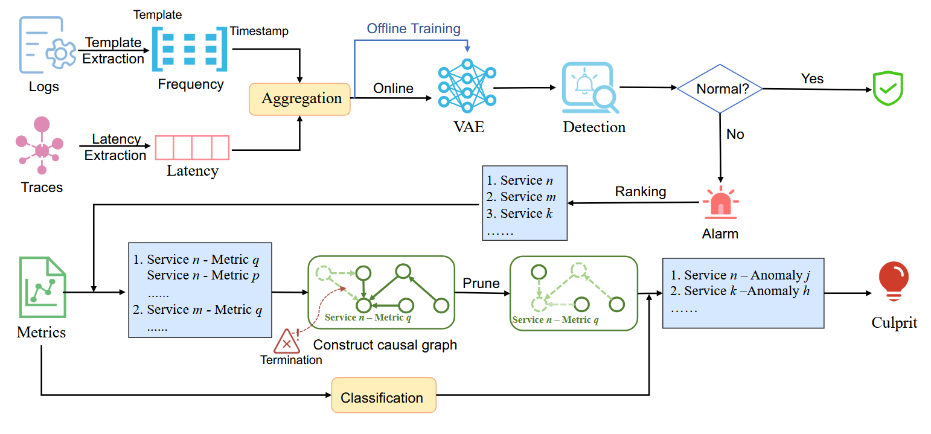
Overview

Slide 4
Anomaly Detection
VAE consists of two parts: encoder and decoder.
The encoder maps input data to a latent space distribution (usually Gaussian),
while the decoder maps latent space points back to the original data.
We use the logs and traces of the historical data when the system is running normally to train the VAE model to obtain the variance and mean.
Then input the data in the online stage into the VAE to calculate the reconstruction error.
Notes:
VAE包括编码器和解码器
编码器将输入数据映射到潜在空间分布（通常是高斯分布），而解码器则将潜在空间点映射回原始数据。
当系统正常运行时，我们利用历史数据的日志和痕迹来训练VAE模型，以获得方差和均值。然后在线阶段的数据输入VAE计算重建误差。+

Slide 5
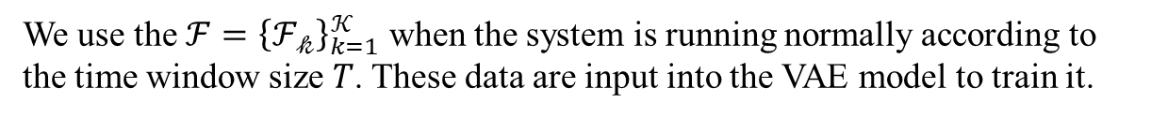
Anomaly Detection
We use the $ℱ={\left\{ℱ_{𝓀}\right\}}_{k=1}^{𝒦}$ when the system is running normally according to the time window size $T$. These data are input into the VAE model to train it.
When an anomaly occurs, there are significant changes in the data distribution. Once an abnormality occurs, due to the difference between abnormal data and normal data, it is difficult for VAE to reconstruct abnormal data, which means the reconstruction probability decreases significantly.
We need to set a threshold ε for the reconstruction probability.
When the reconstruction probability of any service is lower than this threshold, the system will generate an anomaly alert.
Notes:
当系统正常运行时，根据时间窗口大小 T，这些数据被输入VAE模型进行训练。
当异常发生时，数据分布会发生显著变化。一旦发生异常，由于异常数据与正常数据的差异，VAE很难重建异常数据，这意味着重建概率显著降低。
需要为重建概率设定一个阈值ε。当任意服务的重建概率低于该阈值时，系统将生成异常警报

Slide 6
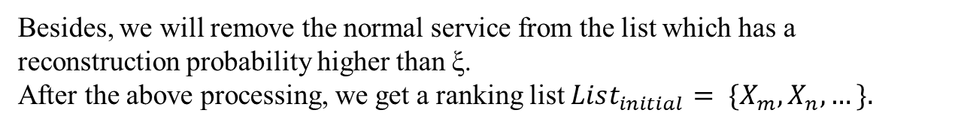
Anomaly Detection
The next step is to obtain the reconstruction probabilities of different services, the abnormal services can be ranked.
The lower the reconstruction probability, the higher the anomaly score.
Meanwhile, we can incorporate an attention mechanism to enhance the specific pattern recognition ability of the VAE model.
Besides, we will remove the normal service from the list which has a reconstruction probability higher than ξ.
After the above processing, we get a ranking list $List_{initial}= \{X_{m},X_{n}, …\}.$
Notes:
下一步是获取不同服务的重建概率，可以对异常服务进行排名。重建概率越低，异常分数越高
同时，我们可以引入注意力机制，增强VAE模型的特异模式识别能力。
例如，当异常发生时，模型可以特别关注那些在正常模式下从未出现过的日志模板，或者那些在正常模式下通常频繁出现但突然显著减少的日志模板。
此外，我们将从列表中移除重建概率高于ξ的正常服务

Slide 7
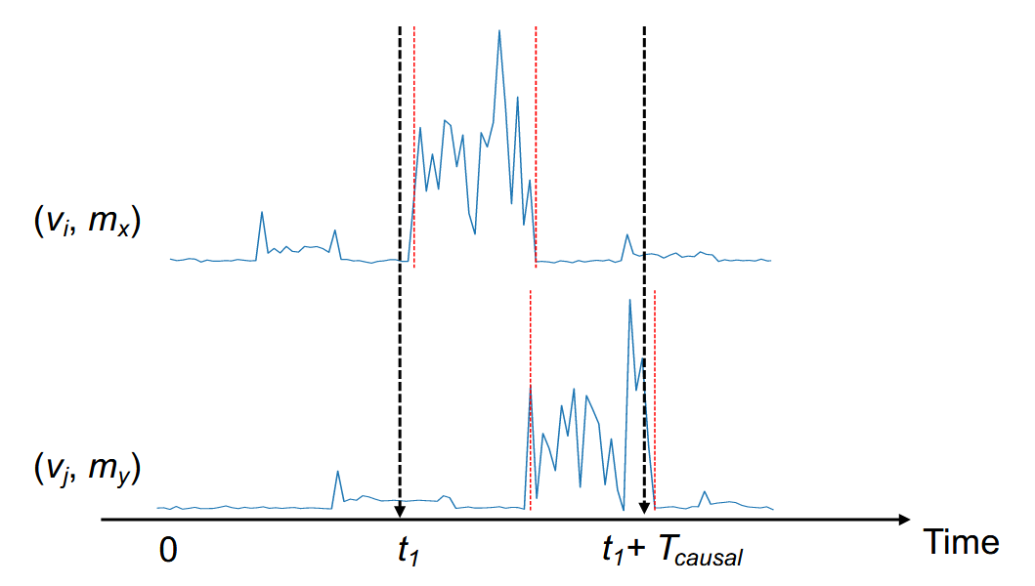
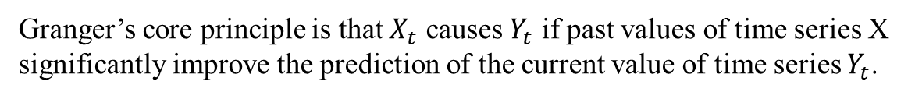
Causal Graphs Construction via Granger Algorithm
Granger’s core principle is that $X_{t}$ causes $Y_{t}$ if past values of time series X significantly improve the prediction of the current value of time series $Y_{t}$.
("用户服务", "CPU使用率")
("订单服务", "响应延迟")
Notes:
通过数据分析揭示因果关系
本文采用Granger算法进行因果分析，因为它能通过统计检验准确确定时间序列间的因果关系。
格兰杰的核心原则是，如果过去的时间序列X值显著提升了当前时间序列Yt值的预测，则Xt会导致Yt。

Slide 8
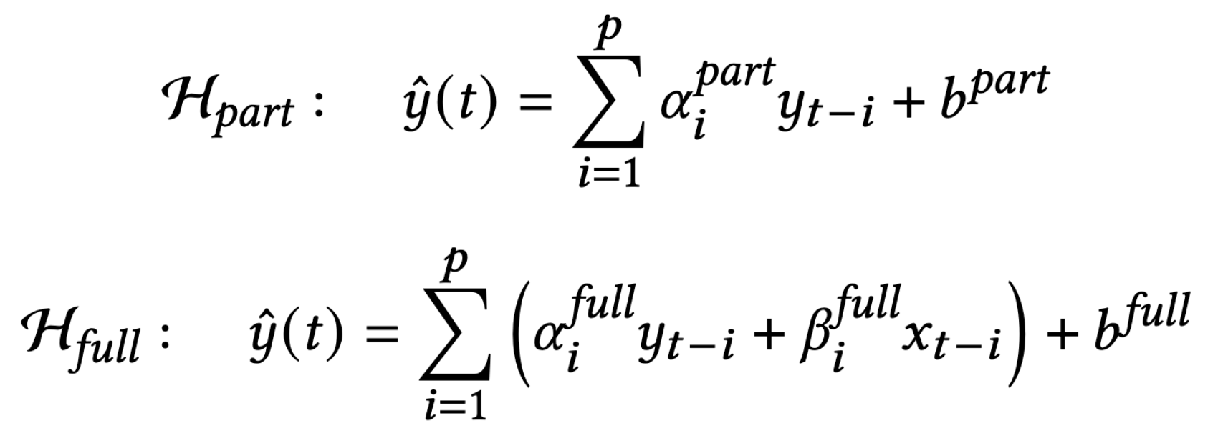
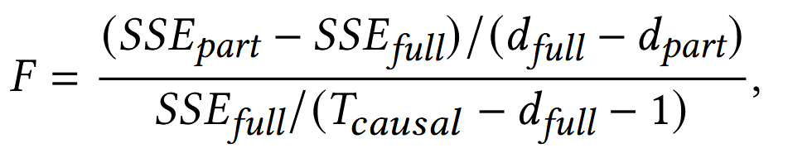
Causal Graphs Construction via Granger Algorithm
Notes:
我们可以从F分布估计原假设的概率，如果概率低于显著水平γ，则表明从xt到yt存在Granger因果关系。

Slide 9
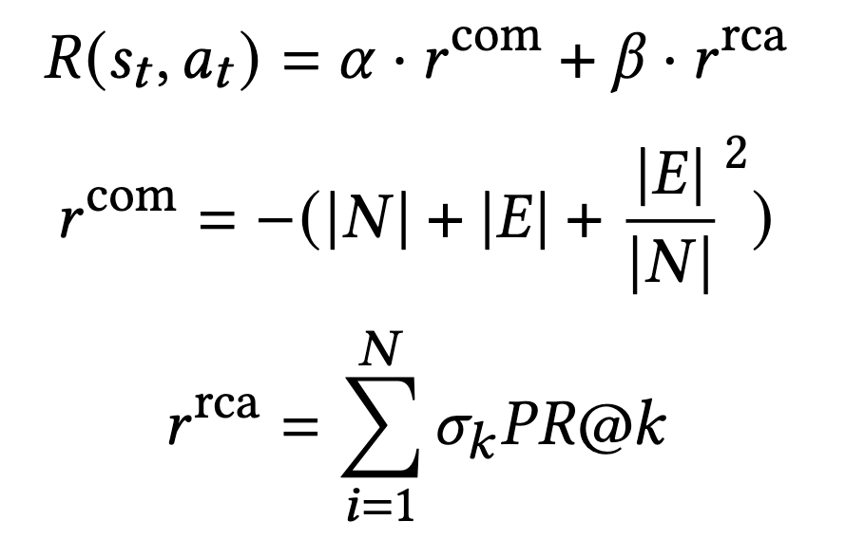
Learning Termination Strategy via Q-learning
Markov Decision Process (MDP): When expanding causal graphs, at any given moment, the impact of actions on the environment is only related to the current state and is independent of previous states.
Notes:
马尔可夫决策过程（MDP）[17]：在展开因果图时，在任何给定时刻，行为对环境的影响仅与当前状态相关，且与之前状态无关。
包含当前因果图的节点数、边、层数和服务数。
行为，前 m 个动作 ai 表示当前节点作时第 i 个节点的扩展。最后一个是停止扩展
奖励机制：一个是图的复杂度，另一个是RCA的准确性

Slide 10
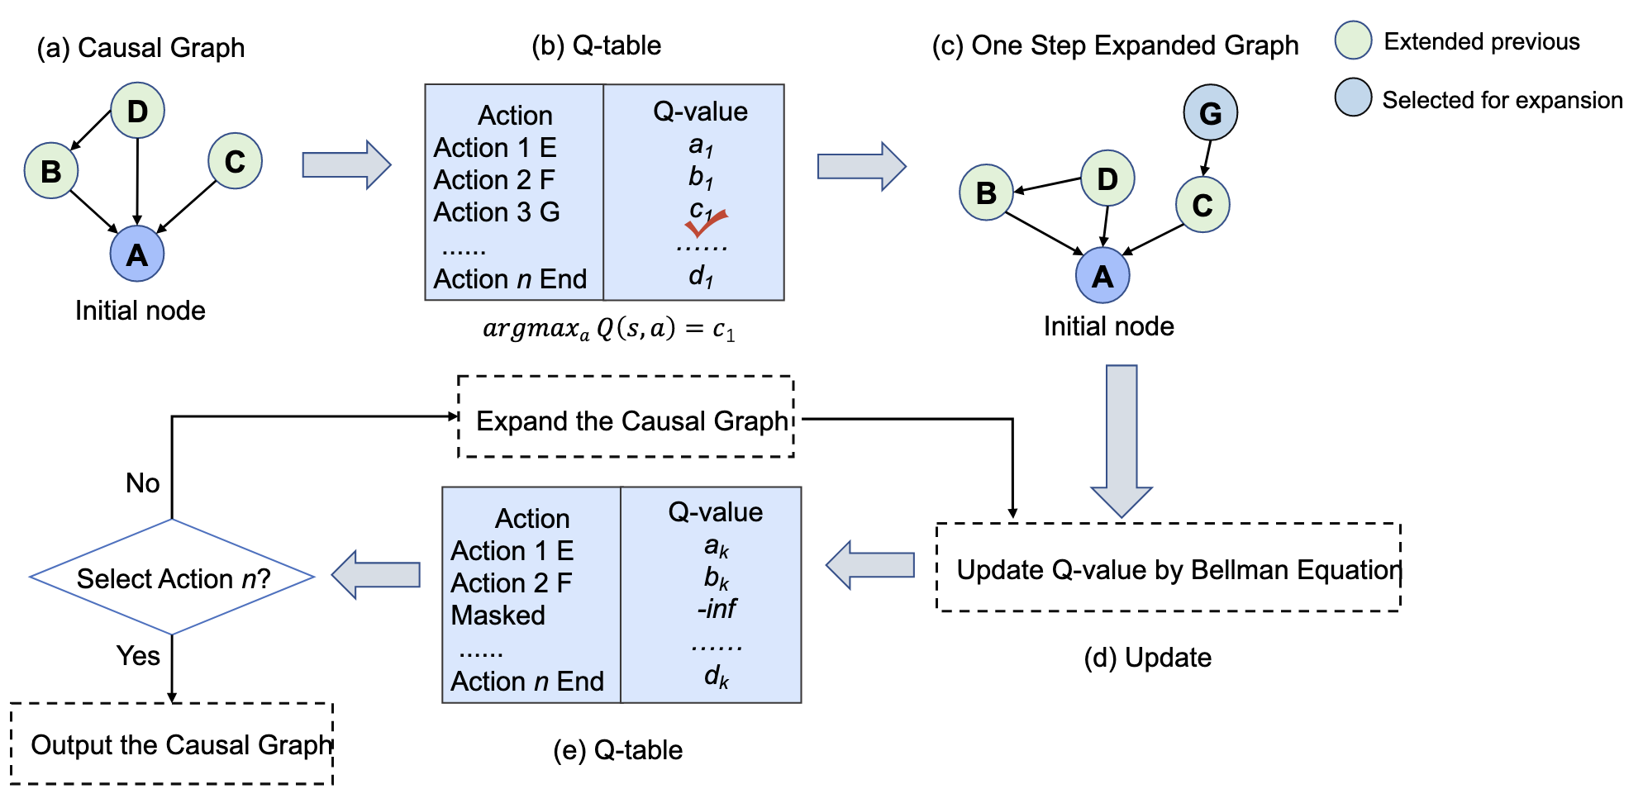
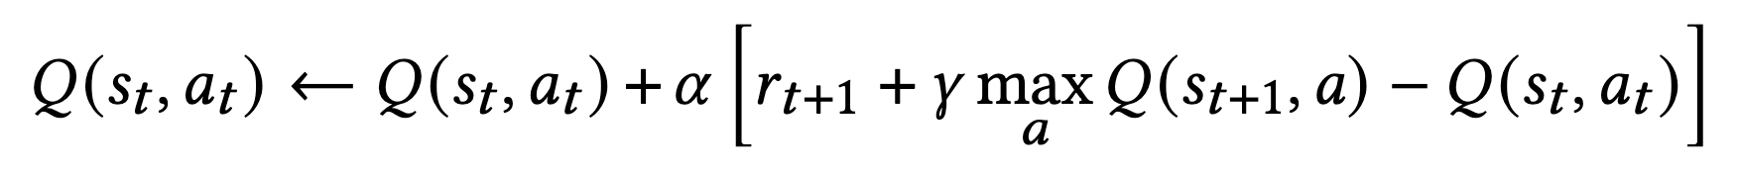
Learning Termination Strategy via Q-learning

Slide 11
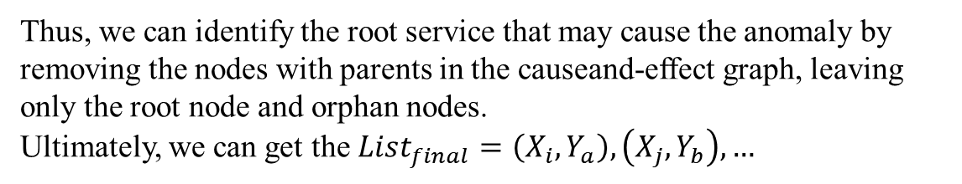
Prune Strategy
After obtaining the causal graph, we can perform pruning by analyzing the relationships between nodes.
In a causal graph involving time relationships, the cause event must occur before the effect event.
Thus, we can identify the root service that may cause the anomaly by removing the nodes with parents in the causeand-effect graph, leaving only the root node and orphan nodes.
Ultimately, we can get the $List_{final}=\left(X_{i},Y_{a}\right),\left(X_{j},Y_{b}\right),…$
Notes:
获得因果图后，我们可以通过分析节点间的关系来进行剪枝。在涉及时间关系的因果图中，因果事件必须发生在结果事件之前。
因此，我们可以通过移除因果图中父节点，只留下根节点和孤立节点，来识别可能导致异常的根服务。

Slide 12
Research Questions
• RQ1: How much does anomaly detection benefit from multi-modal data?
• RQ2: How does MRCA perform at the metric-level and service-level?
• RQ3: How much do the different data sources and pruning module contribute to RCA?
• RQ4: Can the pruning module of MRCA reduce the time cost of RCA?
Notes:
RQ1：多模态数据对异常检测有多大益处？
RQ2：MRCA在指标级和服务级表现如何？
RQ3：不同的数据源和剪枝模块对RCA贡献有多大？
RQ4：MRCA的剪枝模块能否降低RCA的时间成本？

Slide 13
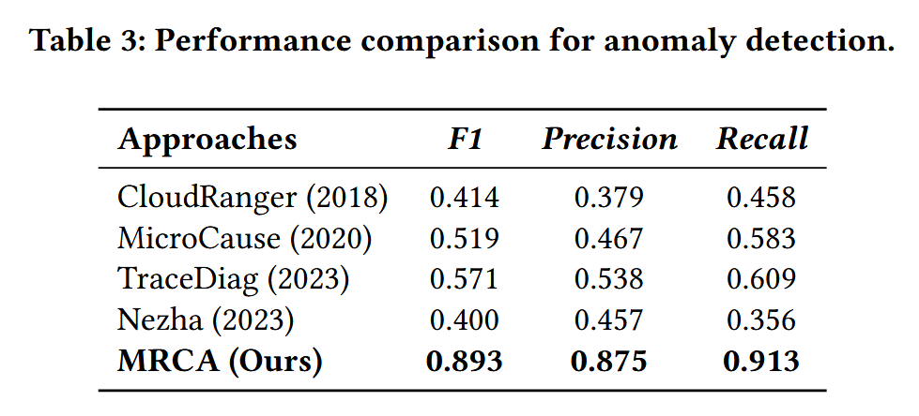
RQ1
Notes:
RQ1：多模态数据对异常检测有多大益处？
它提出了一种动态因果分析方法，不依赖预设拓扑，能够快速识别云服务中的问题服务。
它结合了路径条件时间序列算法和时间因果导向随机漫步方法
它利用强化学习制定服务依赖图的剪枝策略
它通过分析事件模式并对比正常与故障作阶段，应用多模态数据以精准定位根本原因。

Slide 14
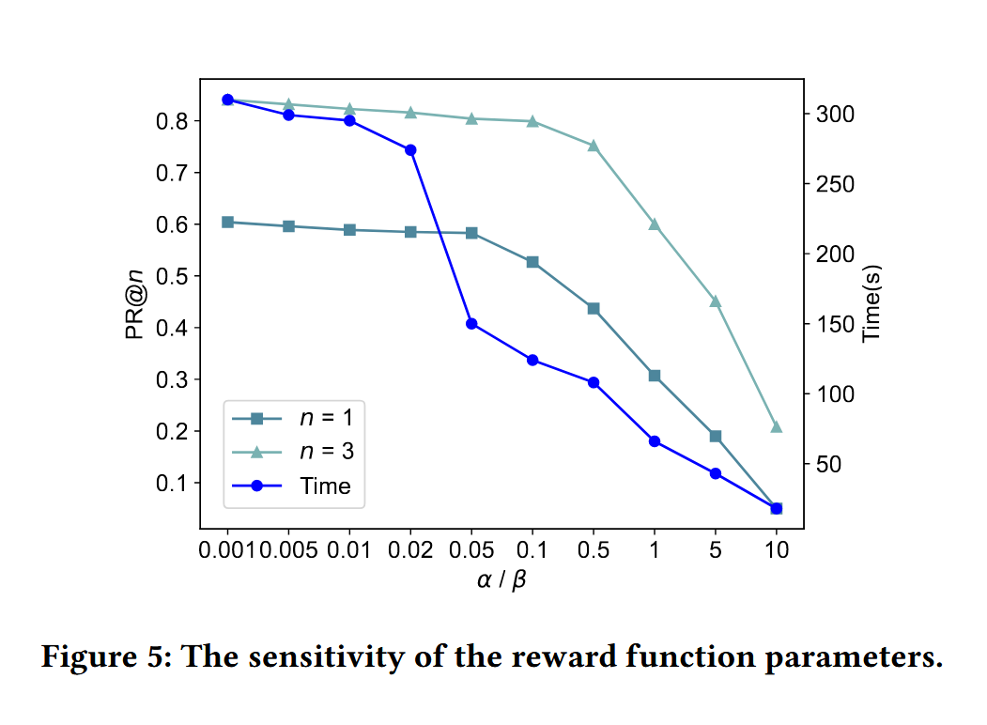
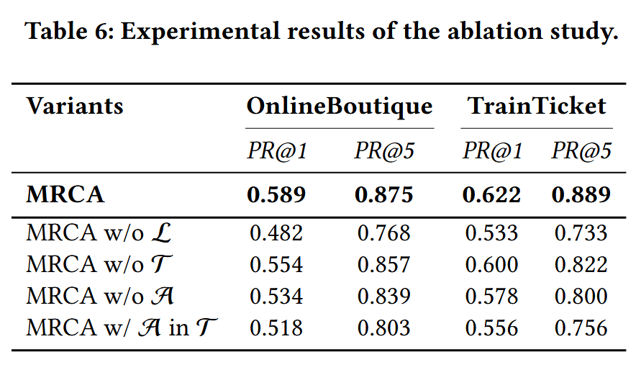
RQ2
Notes:
RQ2：MRCA在指标级和服务级表现如何？
移除日志建模模块
移除链路建模
移除注意力机制
把注意力从日志转移到链路

Slide 15
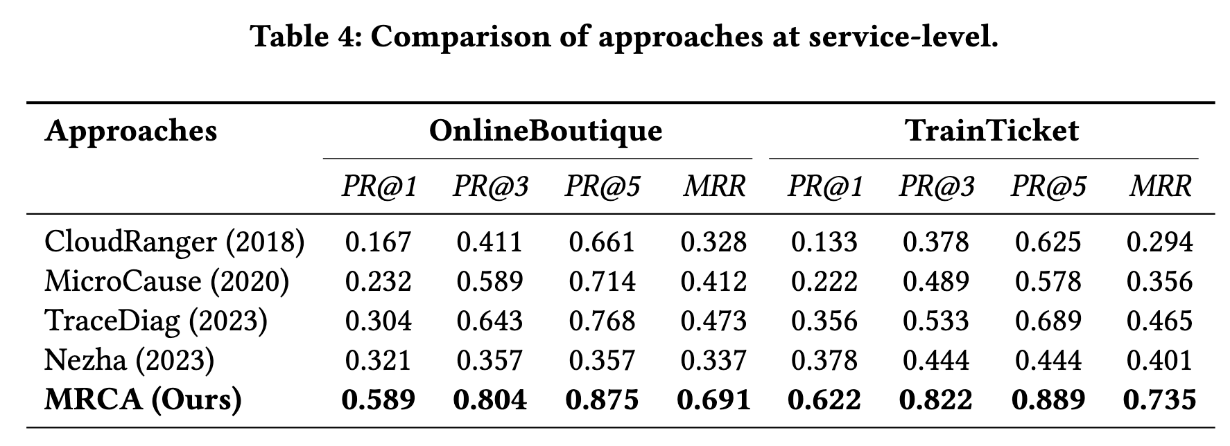
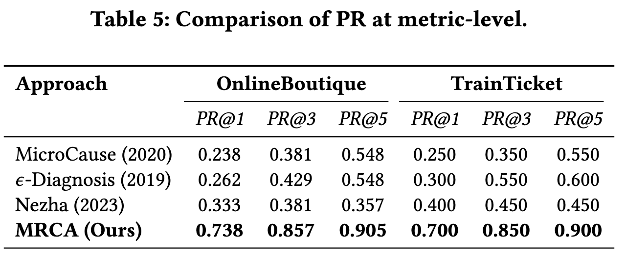
RQ3
Notes:
RQ3：不同的数据源和剪枝模块对RCA贡献有多大？
它引入了一个小窗口长尾延迟的网络服务延迟问题，并提出了一种成本效益高的无监督算法，通过统计检验比较跨多个指标的时间序列数据来检测根本原因。

Slide 16
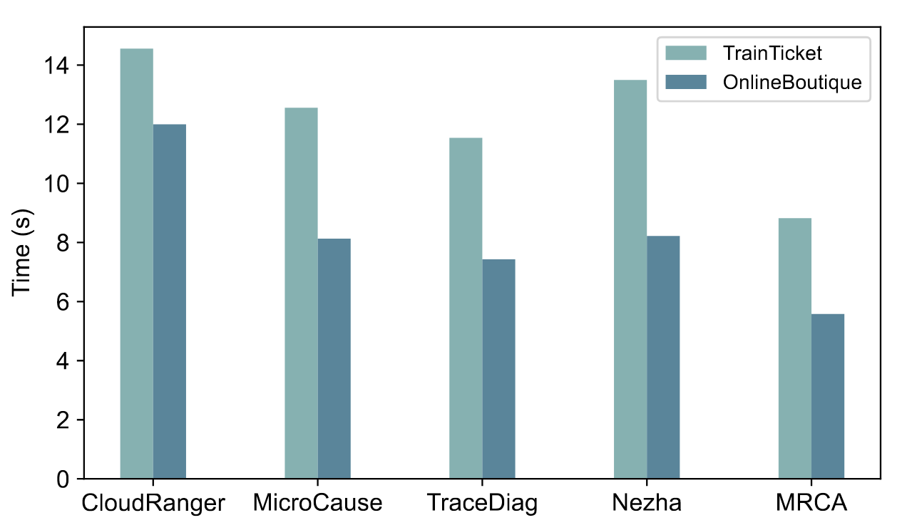
RQ4
Notes:
RQ4：MRCA的剪枝模块能否降低RCA的时间成本？

Slide 17

THANK YOU FOR LISTENING

