Slide 1
Graph-of-Agents: A Graph-Based Framework for Multi-Agent LLM Collaboration
Sukwon Yun Jie Peng Pingzhi Li Wendong Fan Jie Chen James Zou
Guohao Li Tianlong Chen Jun Jiang, and Yi Luo
ICLR
26 Jan 2026

Slide 2
Outline
Research Background
Driven by a rapidly diversifying ecosystem of Large Language Models (LLMs) and benchmarks, researchers are increasingly tasked with orchestrating multiple models at test time to solve complex tasks and leverage collective intelligence.
Early collaborative frameworks, such as Mixture-of-Agents (MoA), demonstrated that integrating multiple LLMs via a layered architecture can significantly enhance task performance compared to a single standalone model.
Existing multi-agent collaborative paradigms typically operate purely through prompt interfaces during test-time inference, ensuring seamless compatibility with black-box LLM APIs without requiring additional model fine-tuning or training.

Slide 3
Outline
Current Limitations
Pioneering frameworks like MoA lack an adaptive selection mechanism and routinely query all available agents simultaneously, which introduces excessive computational costs, computational explosion risks, and performance-degrading noise from irrelevant domains.
Current collaborative networks rely on simplistic protocols (e.g., symmetric debate, sequential refinement, or many-to-one aggregation chunks) that fail to capture fine-grained, relevance-weighted, one-to-one interactions between individual agent pairs.
Most existing graph-based multi-agent setups rely on predefined, static Directed Acyclic Graphs (DAGs), which severely limits structural flexibility and expressiveness across diverse domains.

Slide 4
Outline
Contributions
We identify key challenges in current multi-agent LLM systems: selecting which agents to sample, facilitating effective communication, and integrating responses efficiently.
We formulate multi-agent collaboration as a graph-based framework and introduce GoA, incorporating node sampling, edge sampling, message passing, and graph pooling. This enables construction of a scalable multi-agent LLM ecosystem, while enhancing inter-agent communication.
We demonstrate the effectiveness of GoA across diverse benchmarks, including MMLU, MMLU-Pro, GPQA, MATH, HumanEval, and MedMCQA. Notably, using only 3 agents, GoA outper forms recent multi-agent baselines that rely on pools of 6 agents, highlighting how graph-based structures improve both the scalability and effectiveness of multi-agent collaboration.

Slide 5
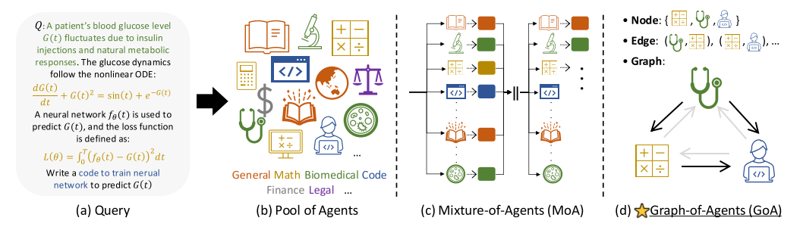
Outline
Overall framework
Figure 1: Current multi-agent LLM pipeline and our proposed approach.

Slide 6
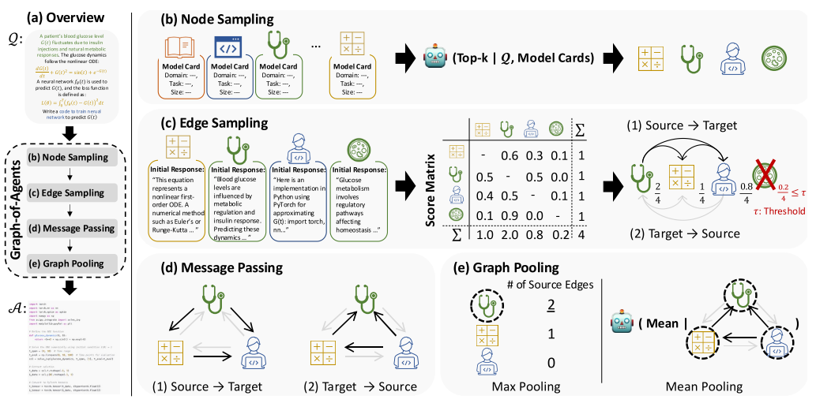
Outline
Overall pipeline of GoA
Figure 2: Overall pipeline of GoA.

Slide 7
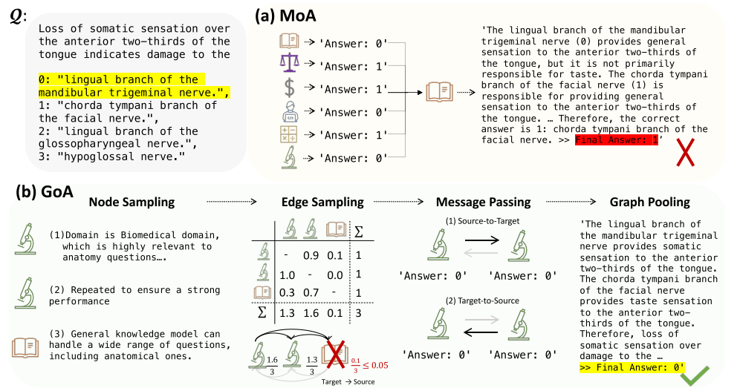
Outline
Reasoning process
Figure 3: Reasoning process of (a) Mixture-of-Agents (MoA) and (b) Graph-of-Agents (GoA).

Slide 8
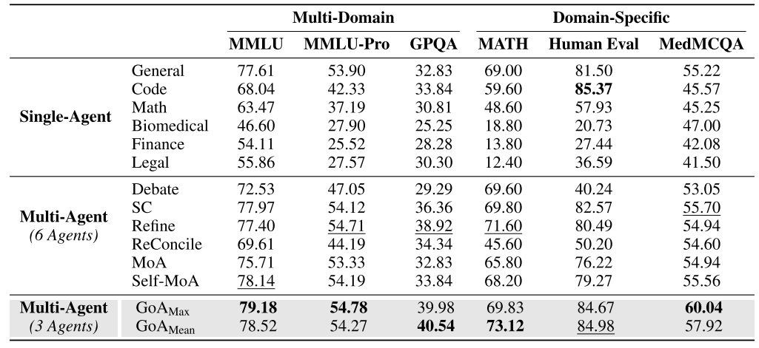
Outline
Experiments
Table 1: Benchmark performance across multi-domain and domain-specific benchmarks.

Slide 9
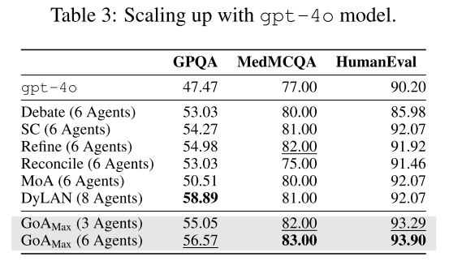
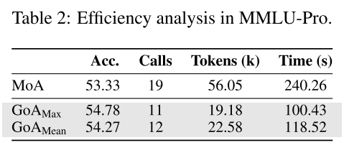
Outline
Experiments

Slide 10
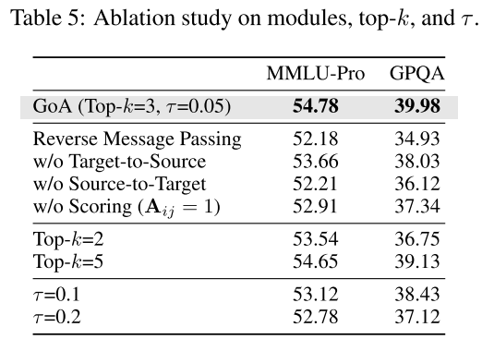
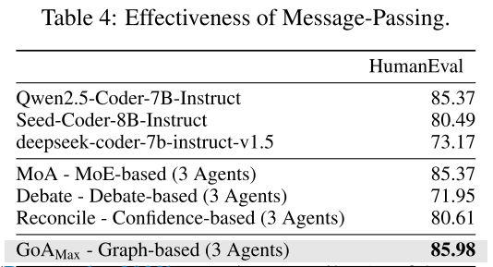
Outline
Experiments

