Slide 1
ADAMAS : Adaptive Domain-Aware Performance Anomaly Detection in Cloud Service Systems
Wenwei Gu, Jiazhen Gu, Jinyang Liu, Zhuangbin Chen, Jianping Zhang, Jinxi Kuang, Cong Feng, Yongqiang Yang, Michael R. Lyu
ICSE 2025
November 23，2025

Slide 2
CONTENTS
1. Introduction
2. Background
3. Methodology
4. Experiments
5. Conclusion

Slide 3
Introduction
Cloud services generate massive monitoring data. Detecting anomalies early is crucial for reliability.
Existing methods often fall short of detecting diverse and evolving anomalies across different services.
We propose ADAMAS, an adaptive AutoML-based anomaly detection framework.
We design a novel unsupervised evaluation function and ADAMAS also contains a lightweight human-in-the-loop design.

Slide 4
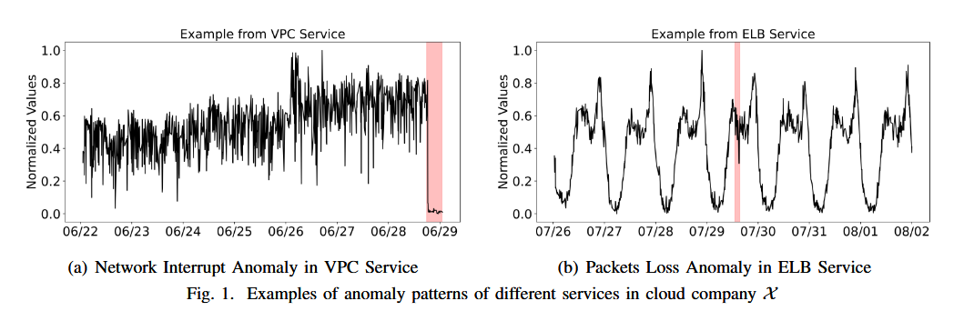
Challenges
Cloud services tend to exhibit great diversity and dynamism not only in functionalities but also in anomaly patterns.

Slide 5
Challenges
A technical anomaly do not always translate to a performance issue that impacts the overall business performance or customer experience .
Due to the frequent service updates and user behavior changes, the anomaly patterns of services may evolve accordingly.
Existing AutoML methods often require labeled data, which can mislead model search and heavily rely on human expertise to provide high-quality feedback.

Slide 6
Contributions
A label-free automated configuration search for anomaly detection models.
A feedback-based adaptive learning mechanism that reduces human workload.
Comprehensive evaluation on both public and industrial datasets.Real-world deployment demonstrating significant reduction in false positives

Slide 7
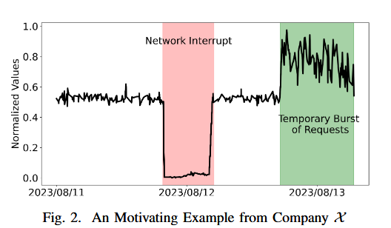
Background
Performance Anomaly Detection in Cloud Service Systems
A particular type of performance anomaly can be characterized as an anomaly pattern.
Not all anomaly patterns manifest in monitoring metrics are true performance anomalies

Slide 8
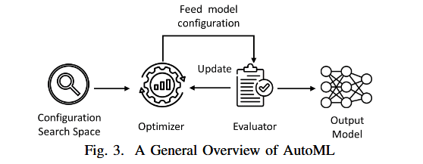
Background
AutoML
AutoML simplifies machine learning by eliminating manual hyperparameter tuning.
AutoML can be formulated as a Combined Algorithm Selection and Hyper-parameter problem.

Slide 9
Background
AutoML
None of the existing AutoML methods possess the merit of domain knowledge
Existing AutoML frameworks lack the adaptability to new anomaly patterns in online services

Slide 10
Methodology
We present ADAMAS, which is a Bayesian Optimization-based approach for identifying performance issues based on monitoring metrics in cloud systems.
First, we will give a formal definition of the problem
Then, we give the overview of ADAMAS.
We illustrate the core design of ADAMAS in detail in the remaining sub-sections.

Slide 11

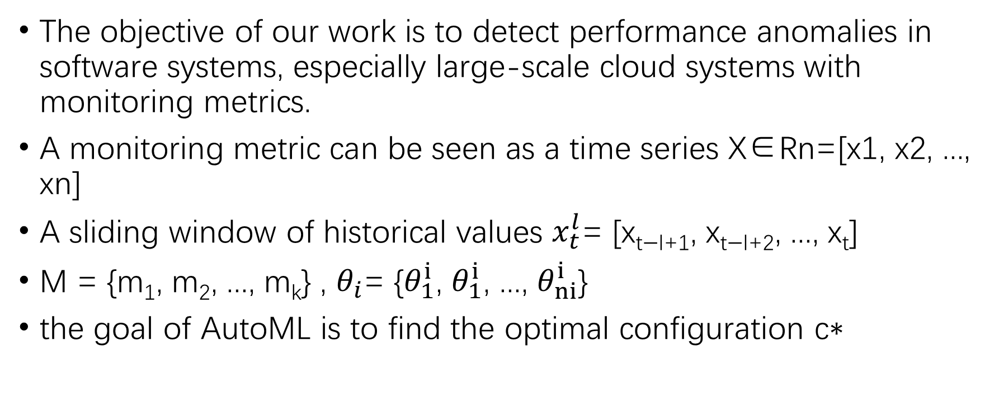
Problem Formulation
The objective of our work is to detect performance anomalies in software systems, especially large-scale cloud systems with monitoring metrics.
A monitoring metric can be seen as a time series X∈Rn=[x1, x2, ..., xn]
A sliding window of historical values $x_{t}^{l}$= [x_{t−l+1}, x_{t−l+2}, ..., x_{t}]
M = {m₁, m₂, ..., m_{k}} , $θ_{i}$= {$θ_{1}^{i}$, $θ_{1}^{i}$, ..., $θ_{ni}^{i}$}
the goal of AutoML is to find the optimal configuration c∗

Slide 12
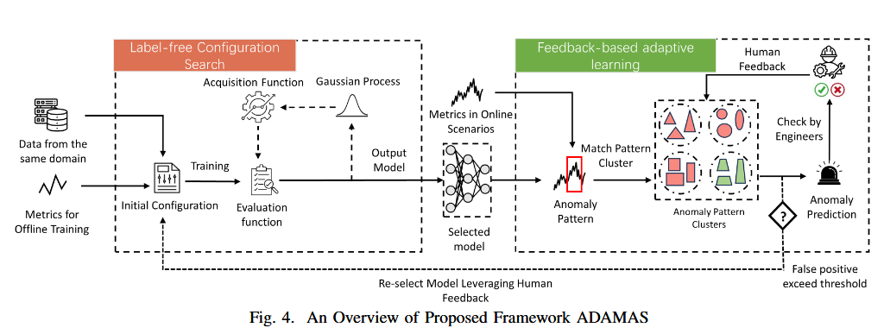
ADAMAS Framework Overview
ADAMAS consists of two phases, namely, label-free configuration search and feedback-based adaptive learning

Slide 13

Label-free Configuration Search
Cold start and warm start
The objective function evaluates each configuration, and the GP surrogate updates the search-space belief accordingly.
Noise-Free Mean squared error with Kurtosis (NFMK) serves as an excellent approximation to evaluation functions like the F1 score without labels.

Slide 14

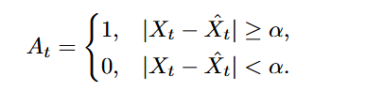
Label-free Configuration Search
Objective Function
By using Mean Squared Error (MSE), we can evaluate the reconstruction ability of a model.
Noise detection : Given an anomaly ratio r estimated by engineers according to historical observation, a threshold α is the r quantile of reconstruction error in each point.
e.g:0.1、0.2、0.2、0.3、0.4、...、1.8、1.9、2.8、2.9、3.1、3.3、3.5

Slide 15

Label-free Configuration Search
Objective Function
To ensure the model can differentiate potential anomalies from normal patterns, we use the difference in kurtosis before and after noise removal.
A higher kurtosis corresponds to greater fluctuation, indicating the presence of anomalies.

Slide 16
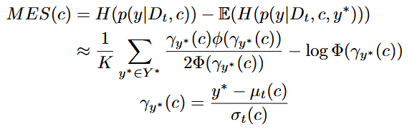
Label-free Configuration Search
Acquisition Function: Max-value Entropy Search (MES)
The acquisition function guides the choice of the next configuration to explore.
Entropy search-based acquisition functions are proven to achieve a fast convergence rate.
In our framework, we apply the Max-value Entropy Search (MES) as the acquisition function.

Slide 17
Feedback-based Adaptive Learning
We propose to incorporate the knowledge of experts through human-in-the-loop to facilitate the anomaly detection process.
We observe that similar types of performance anomalies tend to trigger similar patterns on the monitoring metric.
Because monitoring metrics arrive as a stream, storing all data is infeasible, making full-data clustering unsuitable.
We propose a streaming metrics clustering method, Metric Stream Clustering (MSC), that continuously clusters all incoming anomalous metric segments.

Slide 18
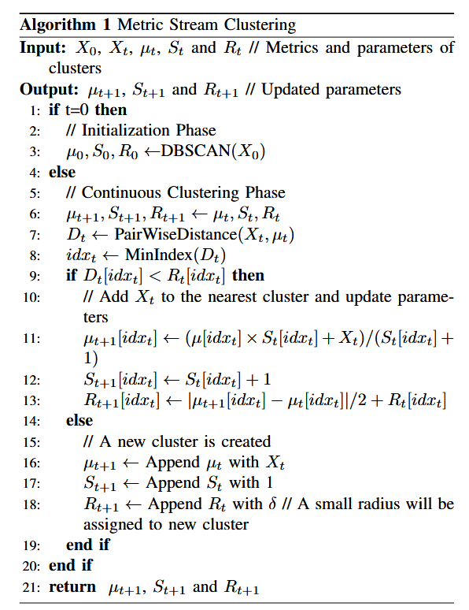
Feedback-based Adaptive Learning
Initialization Phase
Initialized clusters is denoted as X0
We apply DBSCAN to construct the initialized clusters.
The mean vectors, cluster sizes, and radii are denoted as μ0, S0, R0.
Continuous Clustering Phase
When a new anomaly pattern is absorbed, the cluster’s attributes should be updated.
Search for the index of the closest cluster idx_{t.}
check the distance between the mean vector of the cluster and the metric pattern.
Update attributes

Slide 19
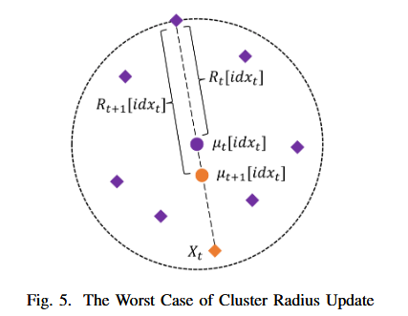
Feedback-based Adaptive Learning
the radius cannot be directly calculated as only the attributes of clusters are retained.
We estimate it by analyzing the best and worst case of the radius update.
the best case can be trivially derived in that the radius remained unchanged at Rt[idxt].
the worst case is shown in Fig. 5, where the new radius reaches its maximum value.

Slide 20
Feedback-based Adaptive Learning
With the proposed clustering method MSC, we can seamlessly integrate valuable feedback from on-site engineers to ADAMAS.
When the offline model identifies an unseen suspicious anomaly pattern, it issues a query to cloud experts for confirmation.
Experts only need to label a cluster once; if any segment is labeled anomalous, the entire cluster is treated as anomalous.
We address this by using an engineer-defined threshold: if false-positive clusters exceed it, the model is retrained.

Slide 21
Experiments
We evaluate ADAMAS using both a public dataset and real-world monitoring data from large-scale cloud systems in Company X.
We aim to answer the following research questions (RQs).
RQ1: What is the effectiveness of ADAMAS compared with other baselines?
RQ2: What is the effectiveness of each component in ADAMAS?
RQ3: What is the sensitivity of ADAMAS to each hyperparameter?

Slide 22
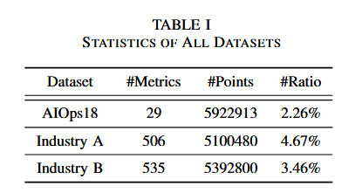
Experiment Settings
Datasets: one public benchmark (AIOps18) and two industrial datasets (A and B) collected from Huawei Cloud’s services.

Slide 23
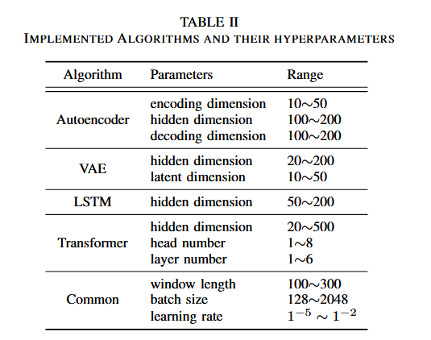
Experiment Settings
Implementation：We implement four widely used metric performance anomaly detection methods by cloud system operators in our ADAMAS framework.

Slide 24
Experiment Settings
Evaluation Metrics：The anomaly detection problem is modeled as a binary classification problem, so the widely used binary classification measurements can be applied to evaluate the models.
We employ Precision: PC = TP/(TP+FP), Recall: RC = TP/(TP +FN), F1 score: F1 = 2·PC·RC /(PC+RC).

Slide 25
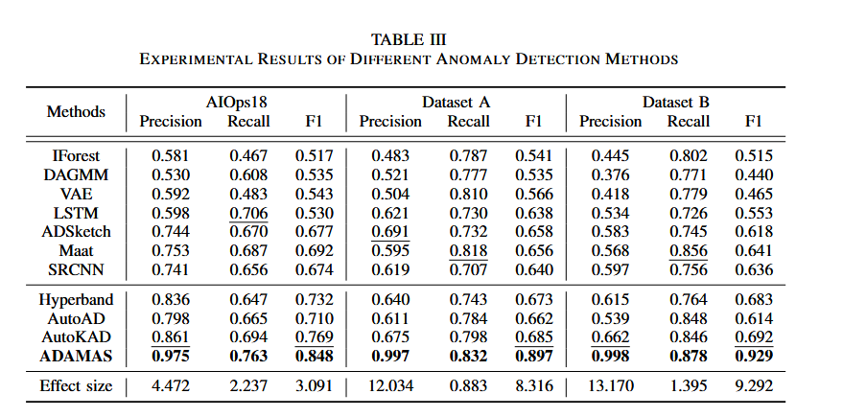
RQ1: The Effectiveness of ADAMAS

Slide 26
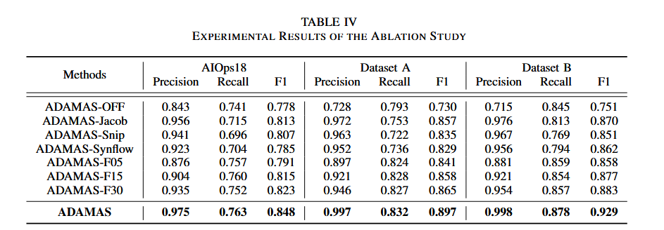
RQ2: The Effectiveness of Each Components of ADAMAS
ADAMAS-OFF：Remove human feedback or retraining.
ADAMAS-Jacob/Snip/Synflow：Replace NFMK with common proxy metrics.
ADAMAS-F05/F15/F30：Randomly sample 5%, 15%, or 30% of the metric stream and use feedback only on these sampled segments.

Slide 27
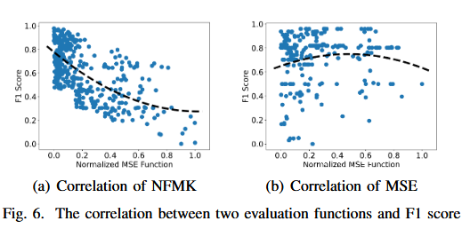
RQ2: The Effectiveness of Each Components of ADAMAS

Slide 28
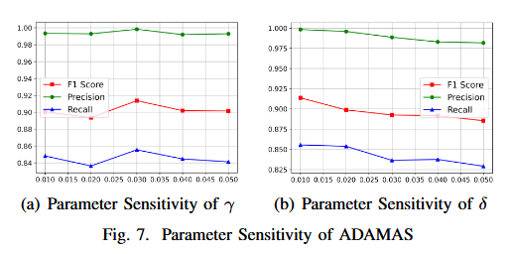
RQ3: Parameter Sensitivity of ADAMAS

Slide 29
Case Study
ADAMAS can be seamlessly integrated into the existing cloud monitoring data analytics pipeline
We focus on the deployment of ADAMAS in the Object Storage Service (OBS).

Slide 30
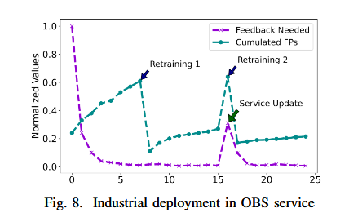
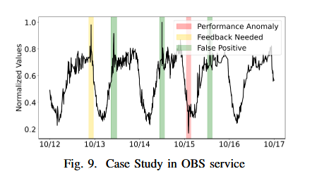
Case Study

Slide 31
Conclusion
We propose ADAMAS, an adaptive AutoMLbased performance anomaly detection framework incorporated with domain knowledge.
A novel unsupervised evaluation function, NFMK, is proposed to guide the configuration search.
MSC uses historical engineer feedback to reduce manual effort.
ADAMAS achieves high F1-score on public and industrial datasets, outperforming all baselines.

