Slide 1
AutoML-Agent: A Multi-Agent LLM Framework for Full-Pipeline AutoML
Patara Trirat, Wonyong Jeong, Sung Ju Hwang
ICML 2025

Slide 2
Background
Automated machine learning (AutoML) has significantly reduced the need for technical expertise and human labors in developing effective data-driven solutions by automating each process in the AI development pipeline, such as feature engineering, model selection, and hyperparameter optimization (HPO).
For an AutoML framework to be truly practical, it should perform end-to-end AutoML, considering both the data aspects (retrieval, preprocessing, and feature engineering) and model aspects (selection, HPO, and deployment).

Slide 3
Challenges
High Complexity of Planning Tasks: the planning of the entire AutoML pipeline introduces extra complexities compared to task- or problem-specific planning, primarily due to the inter-dependencies among the steps in the pipeline.
Challenges in Accurate Implementations: using LLMs to autonomously generate complete ML pipelines may lead to hallucination issues, including code incompletion, incorrect or missing dependencies, and potential undiscovered bugs.

Slide 4
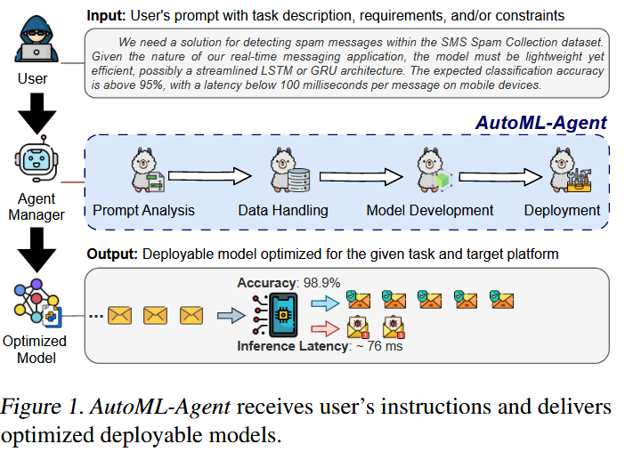
Contributions
To resolve this issue, we leverage the power of LLMs, which can understand tasks expressed in natural language and generate plans and code to solve them.
This approach reduces the barrier to entry, enabling users to build data-driven solutions through conversational interactions.

Slide 5
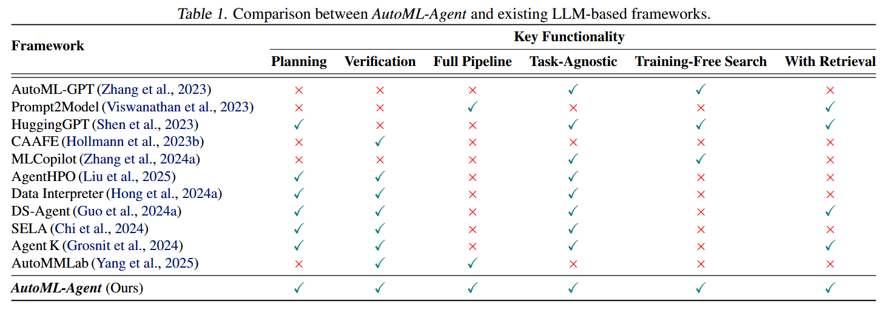
Related work

Slide 6
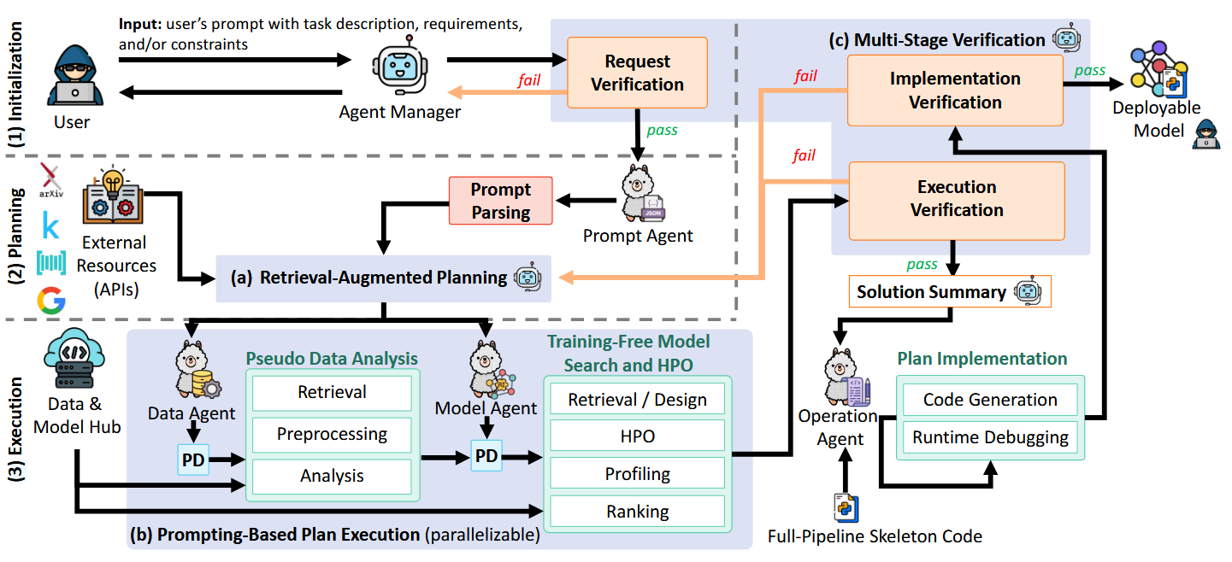
Overview
To ensure the efficient and accurate automation of the entire ML pipeline, we introduce a multi-agent framework in which specialized LLM agents handle distinct tasks.

Slide 7
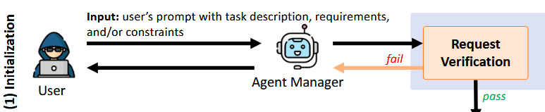
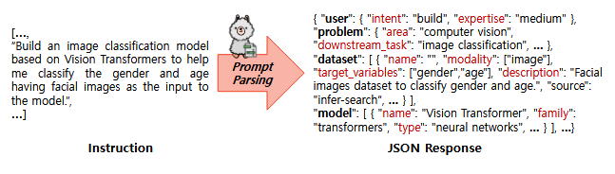
Initialization
The Agent Manager first checks the user instruction: if valid, it forwards it to the Prompt Agent, and otherwise, it asks the user for clarification.
The Prompt Agent parses the instruction into structured JSON, which the Agent Manager uses to retrieve relevant knowledge and generate global plans.

Slide 8
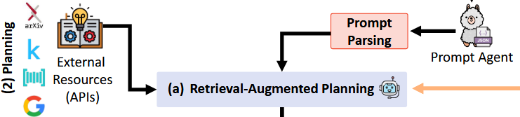
Planning
We present a retrieval-augmented planning strategy that generates multiple plans to solutions by accessing external knowledge sources.
Each global plan is then decomposed into smaller sub-tasks (e.g., data loading, model search, HPO) and assigned to the Data and Model Agents, which simulate execution through prompting.

Slide 9
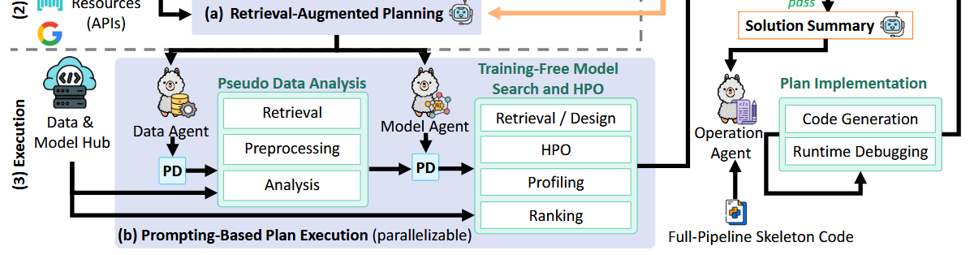
Execution
Data Agent performs dataset retrieval, preprocessing, and analysis Model Agent searches for suitable models, performs HPO, model profiling and ranking.
The best plan selected by the Agent Manager during the simulation is then executed by the Operation Agent, which writes the actual code and performs runtime debugging.

Slide 10
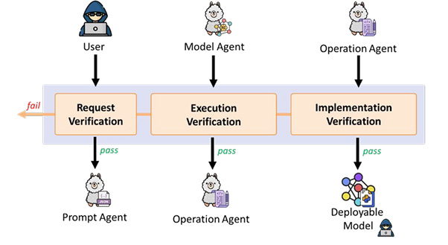
Multi-Stage Verification for Reliable Code
To ensure the reliability of generated code, we also incorporate a multi-stage verification process.
This process includes intermediate checks and validations, guiding agents to adhere to user requirements.

Slide 11
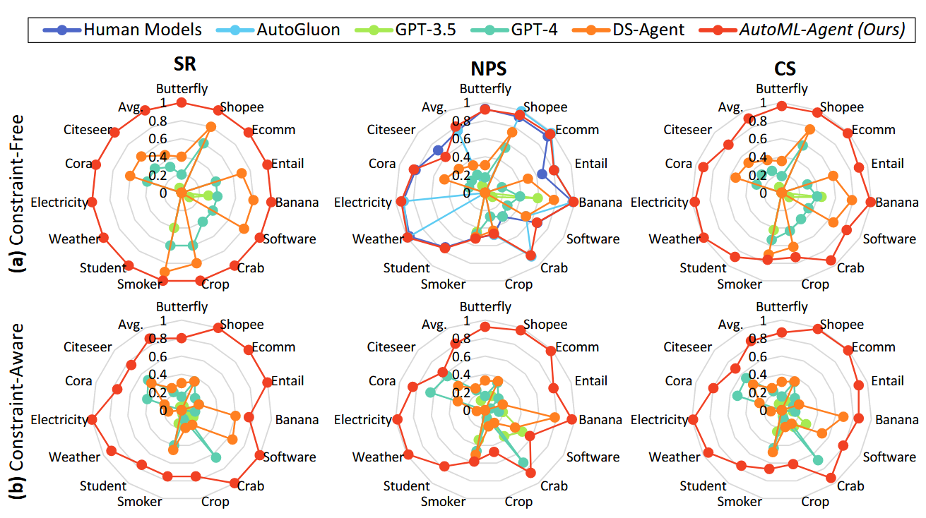
Results on Diverse Tasks and Settings
Evaluations on seven downstream tasks using fourteen datasets demonstrate that AutoML-Agent successfully writes executable code and produces models that outperform human-built ones.

Slide 12
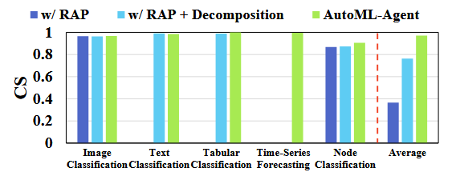
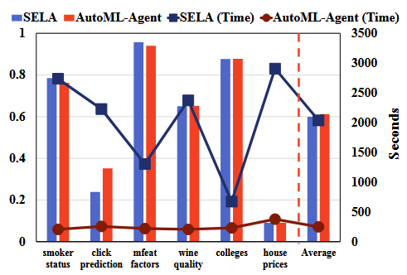
Effectiveness and Efficiency of AutoML-Agent
The ablation study (left) shows that the plan decomposition and verification stages are indeed effective, surpassing the performance of naïve retrieval-based planning RAP.
Compared to training-based methods like SELA (right), our framework is 8× faster while achieving similar or better results, with reduced computational resources and time.

Slide 13
Limitations
While training-free, AutoML-Agent could incur non-trivial time and inference cost for planning, multi-agent coordination, iterative plan refinement, and multi-step verification.
LLMs can hallucinate or generate incomplete / incorrect code, which may incur a large number of the revise and retry steps.
Although we evaluate AutoML-Agent across multiple machine learning tasks, specialized tasks (e.g., reinforcement learning and recommendation systems) may require further modifications to the framework.

Slide 14
Thank you for listening!

