Slide 1
Agentracer: Who is Inducing Failure in the LLM Agentic Systems?
Guibin Zhang , Junhao Wang , Junjie Chen , Wangchunshu Zhou ,
Kun Wang , Shuicheng Yan
ICLR
26 Jan 2026

Slide 2
Outline
Research Background
LLM-powered multi-agent frameworks have emerged to handle increasingly intricate challenges that single models struggle with, demonstrating superior performance in complex domains such as data science and software engineering.
The integration of multiple autonomous agents alongside diverse auxiliary modules (like external databases and tools) inevitably exacerbates the structural fragility of the system.
Recent empirical studies reveal that popular multi-agent frameworks, such as OpenHands and MetaGPT, suffer from alarmingly high failure rates (reaching up to 86.7%), which casts a long shadow over their real-world reliability.

Slide 3
Outline
Current Limitations
Identifying the precise faulty component upon task failure (failure attribution) is predominantly left as a manual endeavor, requiring considerable human effort to analyze trajectory logs.
Preliminary attempts to automate failure attribution using state-of-the-art reasoning models remain strikingly inadequate, with accuracy generally falling below 10%.
Current datasets for evaluating agentic failure attribution (like MAST and Who&When) are manually annotated and highly limited in scale, containing only 200 and 127 multi-agent failure trajectories, respectively.

Slide 4
Outline
Contributions
Automated Pipeline. We propose AgenTracer, the first automated pipeline for annotating multi-agent system failures, curating over 2,000 high-fidelity failure trajectories across seven datasets through counterfactual replay and programmatic fault injection.
Failure Tracer. We develop AgenTracer-8B, a lightweight failure tracer dedicated for LLM agentic systems, trained via a multi-granular reinforcement learning to ensure accurate attribution at both the step and agent levels, facilitating automatic agentic system debugging.
Empirical Evaluation. Experiments show that AgenTracer-8B facilitates (I) accurate attribution, outperforming giant LLMs like DEEPSEEK-R1 by ∼ 12.21% and GEMINI-2.5-PRO by ∼ 18.18% on Who&When benchmark; and (II) self-evolution, enabling off-the-shelf agentic systems to improve performance by 4.8 ∼ 14.2%.

Slide 5
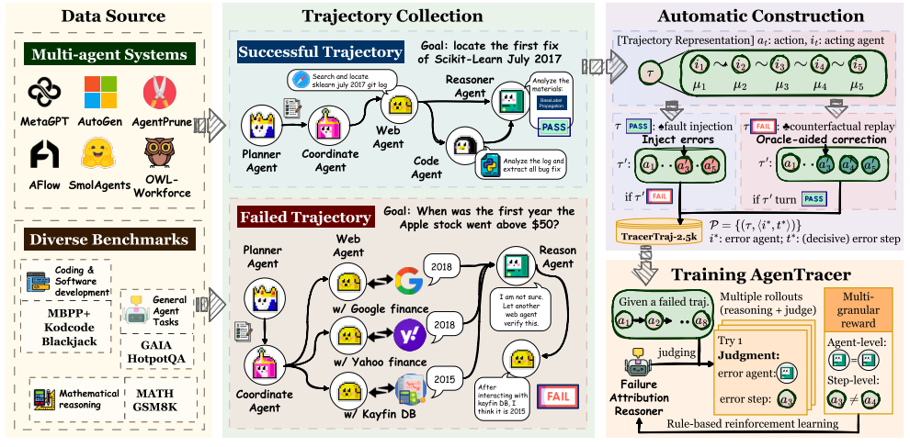
Outline
AgenTracer
Figure 2: The overview of our proposed AgenTracer.

Slide 6
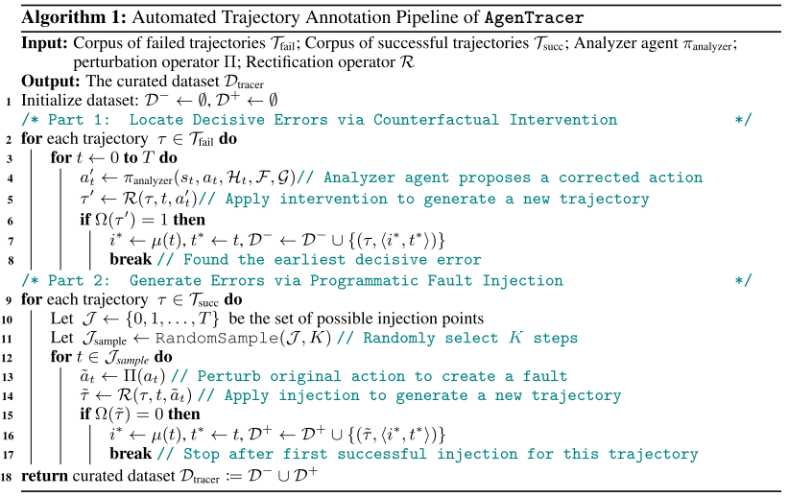
Outline
Algorithm

Slide 7
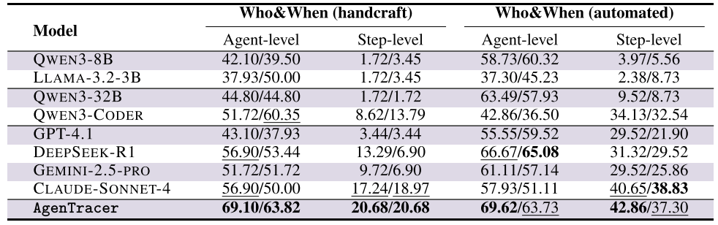
Outline
Experiment
Table 1: Performance comparison on the Who&When benchmark. For each subset, evaluation is conducted at both the agent and step levels. Each cell reports two values: the left corresponds to the setting w/ G (the failure tracer has access to ground truth trajectory), and the right corresponds to w/o G. The best and second-best results are bolded and underlined, respectively.

Slide 8
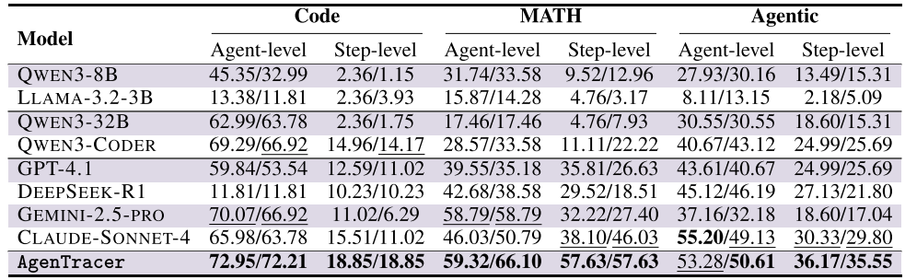
Outline
Experiment
Table 2: Performance comparison on different subsets of TracerTraj. For each subset, accuracy is reported at the agent/step levels. Each cell reports two values: the left corresponds to the setting w/G, and the right w/o G. The best and second-best results are bolded and underlined, respectively.

Slide 9
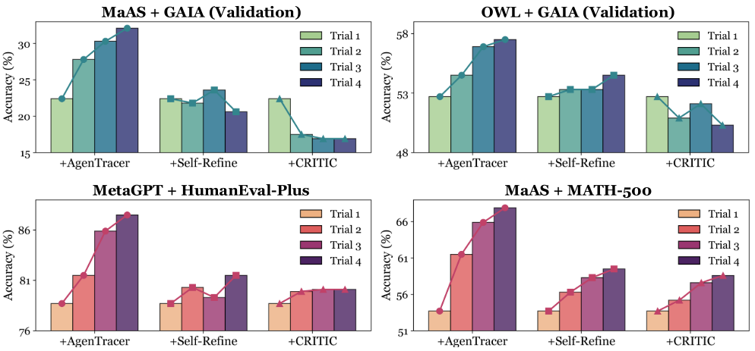
Outline
Experiment
Figure 3: The multi-turn improvement performance brought by AgenTracer-8B compared with classical agent reflection baselines, Self-Refine, and CRITIC.

Slide 10
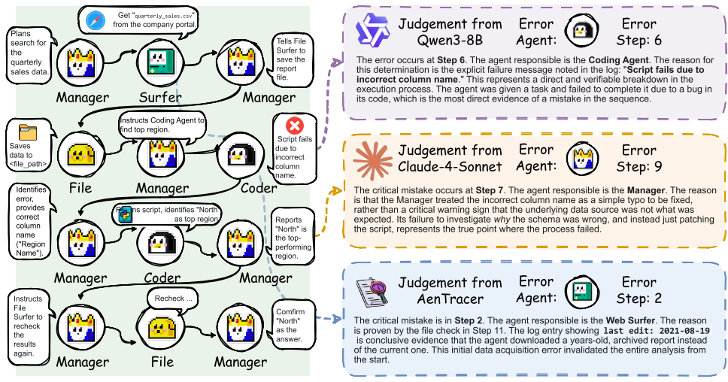
Outline
Experiment
Figure 4: Case study of failure attribution in a long-chain document analysis task, comparing three models (QWEN3-8B, CLAUDE-4-SONNET, and AgenTracer-8B).

