Slide 1
LLM-Enhanced Failure Localization in Microservices: Integrating Multi-Modal Data and Expert Interpretation
IEEE TSC 2026
刘军辉
2026/6/1

Slide 2
Modern Microservice Failure Localization
Identifying root causes and failure-indicating metrics in large-scale, interdependent systems
Challenge of Failure Propagation in Microservices
Core Questions for Failure Localization
Heterogeneous Observability Data Sources
Modern microservice systems are large-scale and highly interdependent. A single failure may propagate through service call chains and trigger multiple symptoms.
Failure localization needs to answer two questions: Which service or instance is the root cause? Which metric reflects the underlying failure?
Logs, metrics, and traces are widely used, but they have different data formats.

Slide 3
Existing LLM-based RCA Methods
Classification of current approaches to root cause analysis using large language models
1
2
3
4
Fine-tuning-based methods
In-context learning methods
LLM with diagnostic handlers
Tool-augmented local LLM
Ahmed et al. fine-tuned GPT-X for root cause identification.
Zhang et al. used historical incidents as contextual examples.
RCACopilot collected multi-modal diagnostic data using predefined handlers.
RCAgent enhanced a locally deployed LLM with external tool

Slide 4
Limitations of Previous Methods in Observability AI
Key challenges hindering effective root cause analysis and operational intelligence
1
3
5
Weak handling of structured data
Insufficient multi-modal integration
Privacy concerns
LLMs are mainly designed for text. Metrics are time series, and traces are call trees, which are hard to process directly.
Logs, metrics, and traces are not systematically fused.
Some methods rely on external API models, which may expose sensitive operational data.
2
4
High fine-tuning cost
Limited interpretability
Fine-tuning large models requires significant GPU resources. Continuous fine-tuning may be needed when new data arrives.
Many methods directly output root causes. They lack clear observations, reasoning, and evidence chains.

Slide 5
LocaleXpert: A Multi-Agent Framework for Interpretable Microservice Failure Localization
Improving failure localization through multi-modal analysis, dynamic prompting, tool integration, and collaborative reasoning
1
Multi-modal data transformation
3
Multi-agent collaboration
It converts metrics and traces into natural language descriptions. Logs are filtered and directly processed by LLM agents.
Trace Expert, Metric Expert, and Log Expert analyze different data modalities. Failure Localization Expert synthesizes the final conclusion.
2
Integration with traditional failure localization tools
4
Interpretable output
LLMs do not infer root causes alone. External modules such as MEPFL and MicroCause provide root cause candidates.
The system outputs Observation, Reasoning, and Final Answer. It provides evidence chains to improve trustworthiness.

Slide 6
LocaleXpert System Architecture

Slide 7
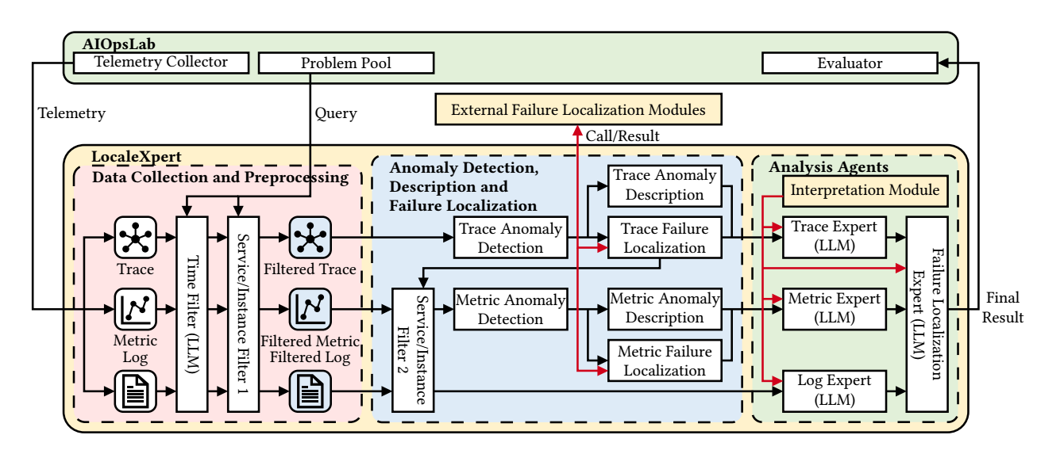

Slide 8
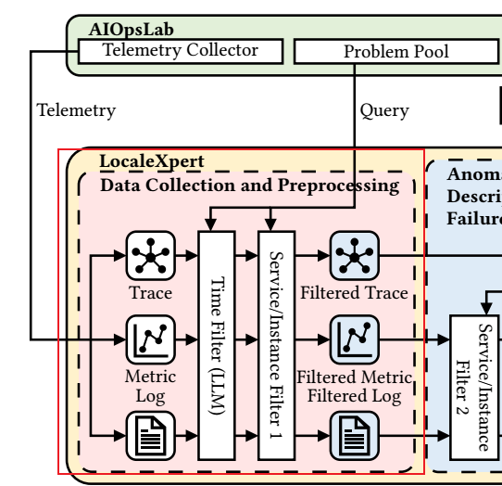
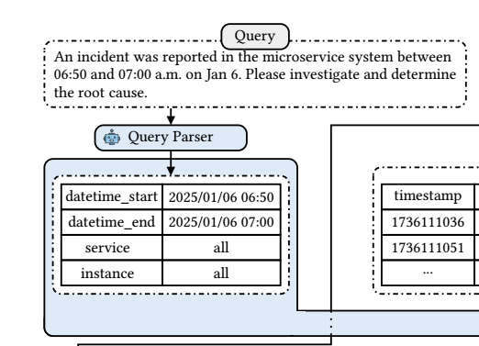

Slide 9
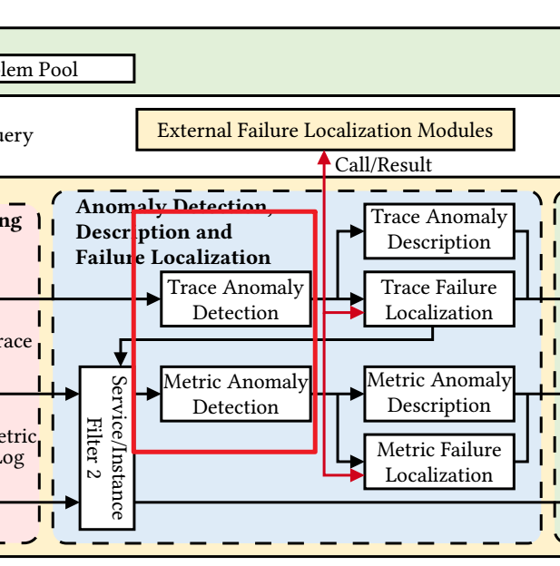
Metric Anomaly Detection
Statistical and machine learning approaches for identifying deviations in time-series metrics and distributed traces
Default Method: 3-Sigma Rule
Alternative Methods for Metrics
Trace Anomaly Detection
Why No Log Anomaly Detection?
Based on statistical outlier detection. Normal distribution assumption: ~99.7% of points fall within ±3σ. Points outside the range are treated as anomalies. Used for detecting: spikes, level shifts, sudden changes.
For non-Gaussian metrics: DBSCAN, density-based anomaly detection, Percentile-based methods, quantile-based thresholds, Deep learning methods, OmniAnomaly, USAD.
Default Method: TraceAnomaly. Detects: long latency, abnormal request paths, unusual service dependencies, deviations from normal trace patterns. Based on: unsupervised learning, offline training on normal traces.
Logs around incidents provide important context. Full logs from the event window outperform only anomalous logs. Therefore: logs are filtered, directly sent to Log Expert.

Slide 10
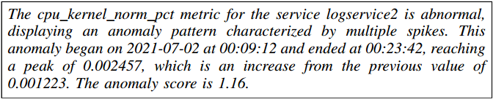
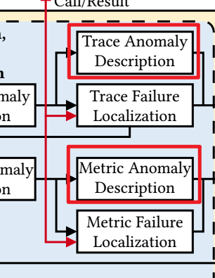
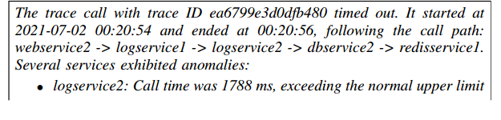
Metric and Trace Anomaly Description Generation
Metric Anomaly Description Components
Metric Pattern Recognition via PatternMatcher
Trace Description Generation Overview
Trace Anomaly Description Components
Generated information includes: affected metric, anomaly pattern, start time / end time, duration, peak value, relative magnitude change, anomaly score
Two types:
Structural anomaly (abnormal call path, missing / unexpected services) and
Timeout anomaly (normal path, abnormal latency on one or more nodes)
Generated information includes: trace ID, start/end time, call path sequence, abnormal services, slow nodes, exceeded latency threshold
PatternMatcher supports: spike, dip, increase, decrease, level shift, fluctuation

Slide 11
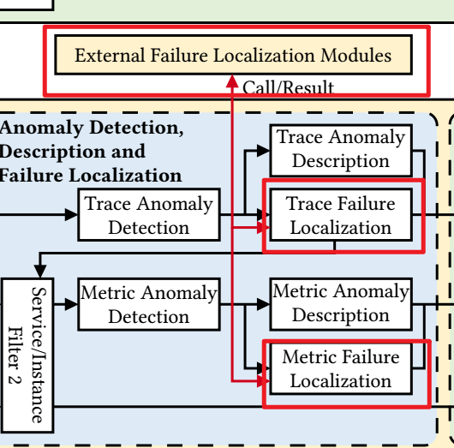
Trace-based and Metric-based Failure Localization Methods
Comparative overview of MEPFL and MicroCause for microservice failure diagnosis
1
Trace-based Failure Localization (MEPFL)
Input: trace logs, service interactions. Feature extraction: configuration features, resource features, instance features, interaction features. ML models: Random Forest, KNN, MLP. Output: suspicious faulty services, root cause service ranking.
2
Metric-based Failure Localization (MicroCause)
Uses: Path Condition Time Series (PCTS), Temporal Cause-Oriented Random Walk. Captures: time-lag propagation, causal dependency, temporal order, priority information. Output: ranked root cause metrics, suspicious components.

Slide 12
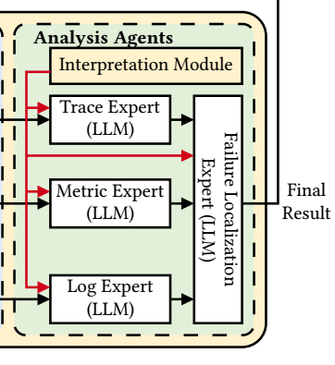
LocaleXpert Analysis Agents
Four specialized LLM experts for comprehensive system observability analysis
1
Trace Expert
2
Metric Expert
analyzes trace anomalies focuses on call paths, latency, and service dependencies
analyzes metric anomalies focuses on abnormal metrics and root cause metrics
3
Log Expert
4
Failure Localization Expert
analyzes logs focuses on errors, warnings, and semantic clues
integrates outputs from all experts generates final diagnosis

Slide 13
EXPERIMENT Components

Slide 14
Experimental Evaluation Objectives
Systematic Evaluation of LocaleXpert
1
Failure Localization Performance
Evaluate whether LocaleXpert can accurately identify: root cause services, root cause instances, root cause metrics.
2
Reasoning Interpretability
Evaluate the quality of explanations generated by: Log Expert, Metric Expert, Trace Expert. Focus on: clarity, reasoning quality, interpretability, usefulness for operators.

Slide 15
Ablation and Deployment Trade-off Analysis
Systematic evaluation of component contributions and practical deployment constraints
3
Ablation Study
Analyze the contribution of key components by removing them individually: Anomaly Description Module, External Failure Localization Module, Interpretation Module. Measure how each module affects overall performance.
4
Deployment Trade-off Analysis
Evaluate the trade-off between: model size, inference latency, diagnostic performance. Compare different LLM scales to support practical deployment decisions.

Slide 16
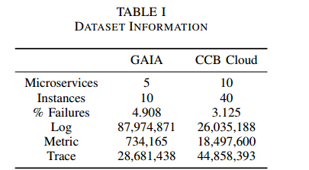
Evaluation Datasets
LocaleXpert is evaluated on two large-scale multi-modal AIOps datasets
GAIA Dataset
CCB Cloud Dataset
Generic AIOps Atlas Dataset (GAIA) Collected from CloudWise based on the MicroSS business simulation system. Dataset Statistics Microservices: 5 Instances: 10 Logs: 87.9M+ Metrics: 0.73M+ Traces: 28.6M+ Failure Types Includes five representative failure categories: system stuck process crash login failure file missing access denied
Collected from a real-world e-commerce microservice system deployed on CCB Cloud. Traffic patterns follow real production business workloads. Dataset Statistics Microservices: 10 Instances: 40 Logs: 26.0M+ Metrics: 18.5M+ Traces: 44.8M+ Failure Types Includes 15 real-world failures, such as: Resource Failures CPU failure memory failure disk failure Network Failures packet loss network latency Application Failures process termination service interruption

Slide 17
Failure Localization Methods in Distributed Systems
Comparative overview of traditional and LLM-based approaches for root cause identification
Traditional Failure Localization Methods
LLM-based Baseline: ReAct
Eadro: Uses logs, metrics, and traces together for failure localization. Combines anomaly detection with root cause localization. Applies multi-modal fusion strategies. Uses Graph Attention Network (GAT) to model dependencies across monitoring data.
DiagFusion: Incorporates CMDB information, traces, and deployment data. Builds dependency graphs between services. Encodes events into vector representations. Uses Graph Neural Network (GNN) for failure localization.
PDiagnose: Performs anomaly detection separately on each data modality. Builds an anomaly microservice queue. Uses a voting mechanism to identify the final root cause.
ReAct: Combines reasoning + action. Allows LLM to: reason step-by-step; call tools; interact with external analyzers or data sources. Supports dynamic information gathering during diagnosis.
RCACopilot
RCAgent

Slide 18
Two Evaluation Goals
Failure localization accuracy and reasoning quality assessment metrics
1
Localization Metric: Top-k Accuracy (A@k)
A@1: true root cause ranked 1st. A@3: true root cause in top 3. A@5: true root cause in top 5.
2
Reasoning Metrics
BLEU-4: Measures word-level precision by checking 4-word phrase overlap with expert-written explanations.
ROUGE-L: Measures content coverage based on the longest common subsequence between generated and reference reasoning.
G-sim: Uses GPT-4 to score semantic similarity, clarity, and coherence on a scale from 0 to 1.
W-rate: Uses human expert voting to judge which method gives the most reasonable and correct explanation.

Slide 19
Experimental Results

Slide 20
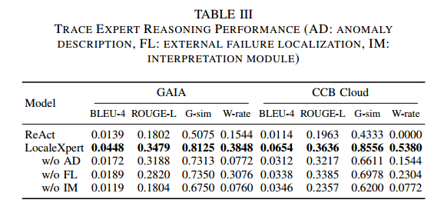
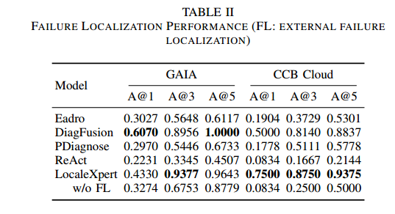
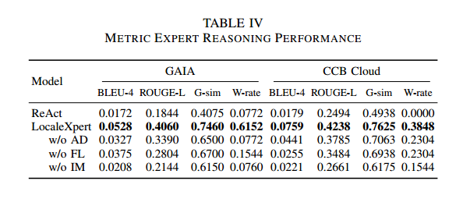
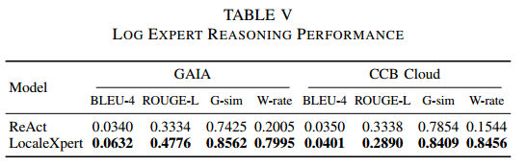
Effectiveness

Slide 21
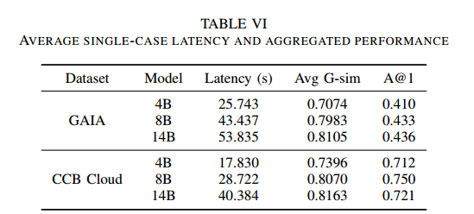

Slide 22
Thank You
2026/6/1

