Slide 1
Mixture-of-Experts Knowledge Graph Retrieval-Augmented Generation for Multi-Agent LLM-based Recommendation
KDD 2026
2026-06-01

Slide 2
Background
Existing LLM-based recommender systems still suffer from critical limitations, including hallucinations and insufficient up-to-date, domain-specific knowledge.
Recent Retrieval-Augmented Generation (RAG) leveraging external Knowledge Graph (KG) has emerged as a promising solution to provide the latest and domain-specific structured knowledge without costly fine-tuning

Slide 3
Challenges
user queries require KG knowledge at different granularities, while existing KG-RAG recommender systems typically adopt a one-size-fits-all retrieval granularity.
The retrieved knowledge is naturally graph-structured, while the input to LLMs is plain text. Directly describing structured knowledge into text can introduce redundant noise and lose structural information, reducing the utility of retrieved knowledge.
the selection of retrieval granularity lacks direct supervision and can only be inferred from the final recommendation outcome after alignment and downstream utilization.

Slide 4
Contributions
We propose MixRAGRec, a multi-agent KG-RAG framework for LLM-based recommendation that performs query-aware retrieval with different granularities via a mixture of KG experts.
We introduce a Knowledge Preference Alignment agent that converts structured KG knowledge into concise, LLM-friendly natural language, mitigating the structure-semantics gap.
We propose MMAPO, a unified optimization framework that couples agents with a shared objective and a retrieval-utility reward for cost-aware retrieval.
We conduct comprehensive experiments on various real-world datasets to demonstrate the effectiveness of the proposed MixRAGRec framework.

Slide 5
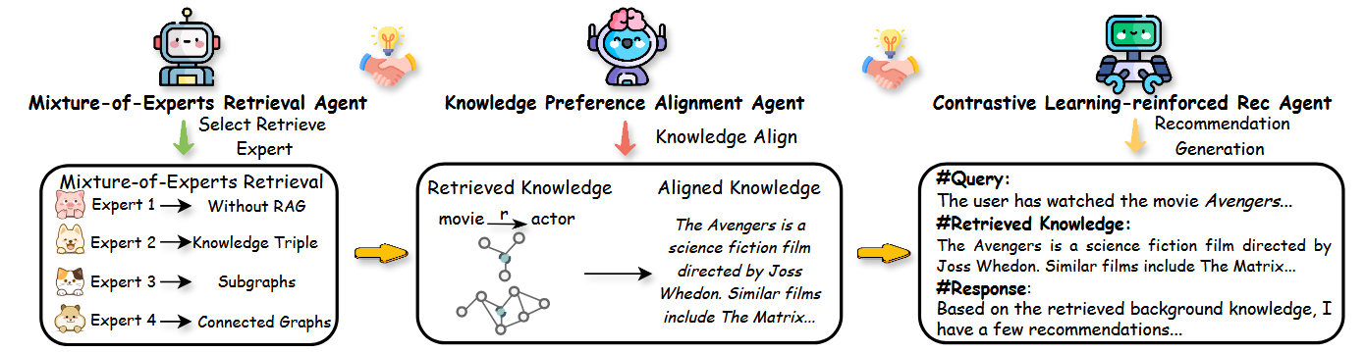
Overview
The overview of the MixRAGRec:

Slide 6
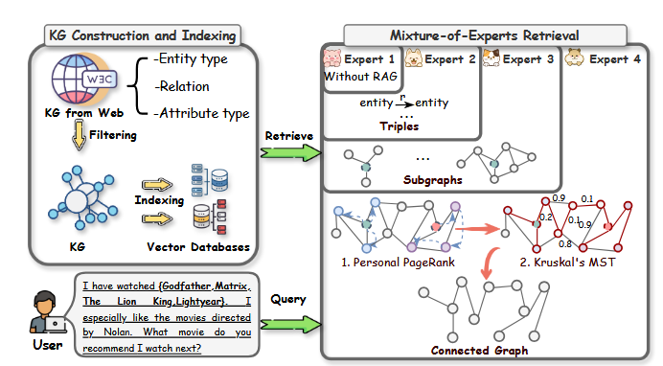
Mixture-of-Experts Retrieval agent
Step 1. KG Construction and Indexing
Step 2. Mixture-of-Experts KG Retrieval
Expert 1: DirectGenerator (no retrieval).
Expert 2: TripleRetriever (triple-level retrieval).
Expert 3: SubgraphRetriever (k-hop neighborhood subgraph).
Expert 4: ConnectedGraphRetriever (connected subgraph)

Slide 7
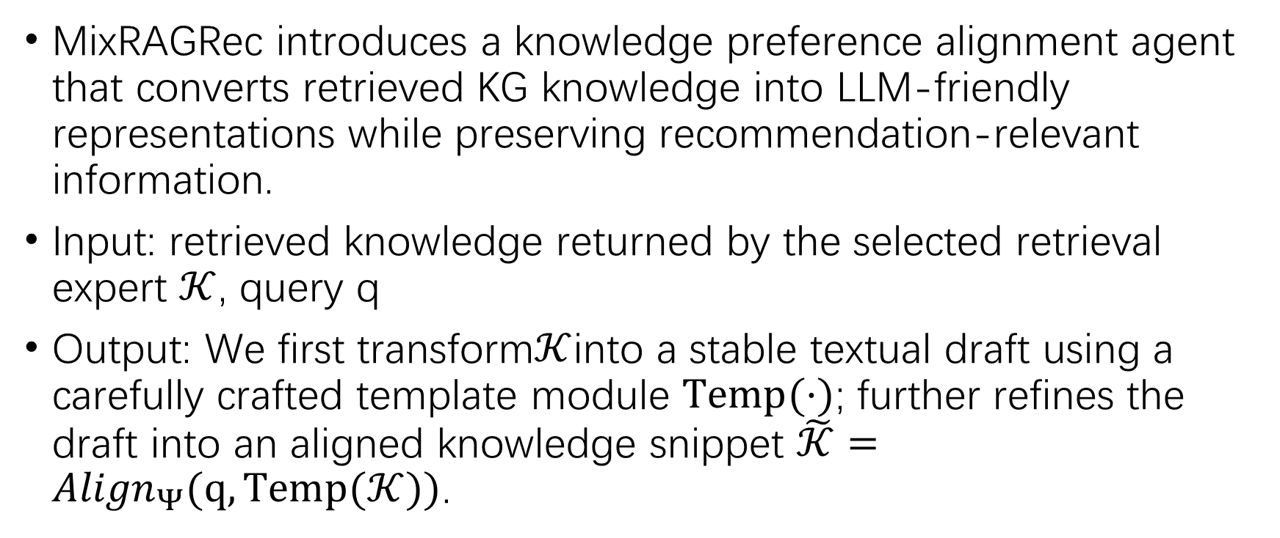
Knowledge Preference Alignment agent
MixRAGRec introduces a knowledge preference alignment agent that converts retrieved KG knowledge into LLM-friendly representations while preserving recommendation-relevant information.
Input: retrieved knowledge returned by the selected retrieval expert $𝒦$, query q
Output: We first transform$𝒦$into a stable textual draft using a carefully crafted template module $Temp(·)$; further refines the draft into an aligned knowledge snippet $\tilde{𝒦}={Align}_{Ψ}(q,Temp(𝒦))$.

Slide 8

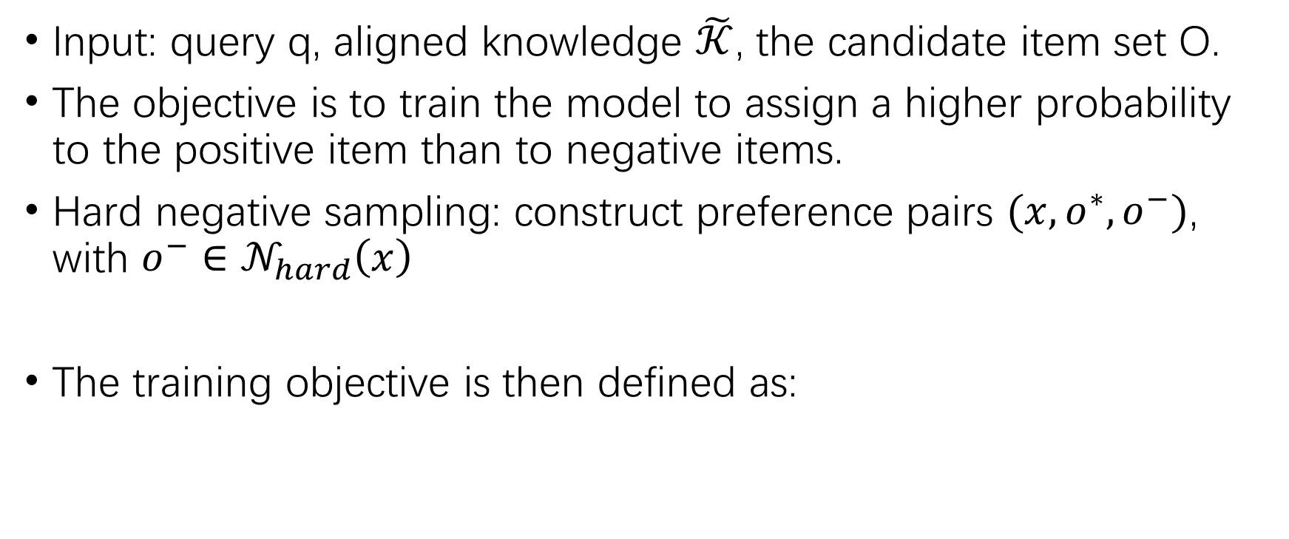
Contrastive learning-reinforced rec agent
Input: query q, aligned knowledge $\tilde{𝒦}$, the candidate item set O.
The objective is to train the model to assign a higher probability to the positive item than to negative items.
Hard negative sampling: construct preference pairs $(x,o^{∗},o^{−})$, with $o^{−}∈𝒩_{hard}\left(x\right)$
The training objective is then defined as:

Slide 9

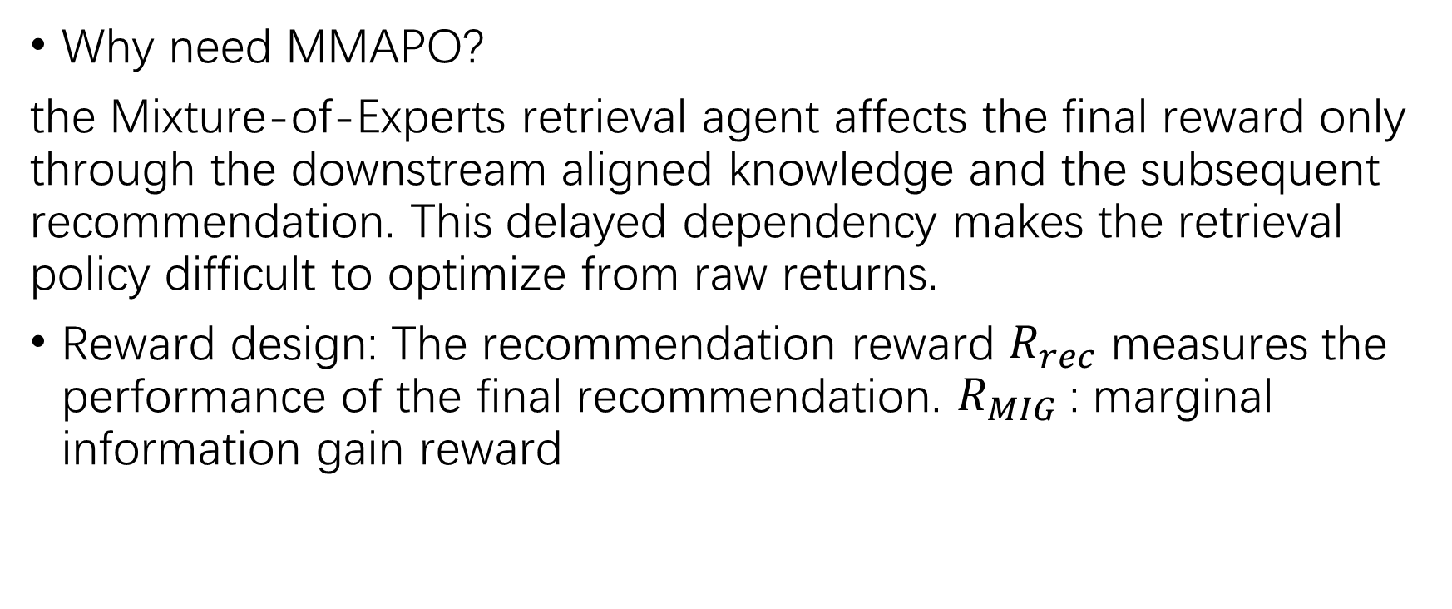
Mixture-of-Experts Multi-Agent Policy Optimization (MMAPO)
Why need MMAPO?
the Mixture-of-Experts retrieval agent affects the final reward only through the downstream aligned knowledge and the subsequent recommendation. This delayed dependency makes the retrieval policy difficult to optimize from raw returns.
Reward design: The recommendation reward $R_{rec}$ measures the performance of the final recommendation. $R_{MIG}$: marginal information gain reward

Slide 10
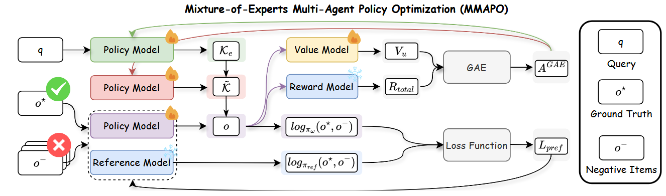
Mixture-of-Experts Multi-Agent Policy Optimization (MMAPO)
Using GAE for Advantage Estimation ;
Retrieval & Alignment Agent: PPO-style clipped update;
Recommender Agent: Contrastive Preference Optimization.

Slide 11
Experiment setup
Dataset: MovieLens-1M/20M; LastFM-1K
Baselines: Zero-shot inference; LLM-based Recommendation Models; KG-RAG for LLM-based Recommendation Models.
Evaluation Metrics: Recall@K (K = 3, 5), Accuracy

Slide 12
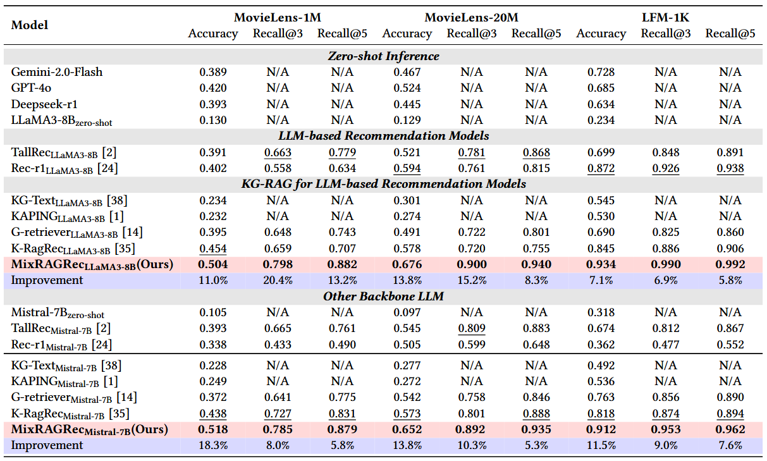
Experiment result
Zero-shot prompting is insufficient for recommendation.
Retrieving external knowledge from the KG can substantially improve recommendation performance.
MixRAGRec outperforms the strongest baselines on all three datasets under both backbones.

Slide 13
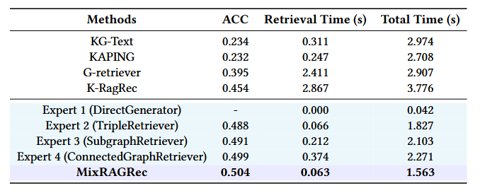
Efficiency Study
Efficiency comparison on MovieLens-1M with the LLaMA3-8B backbone.

Slide 14
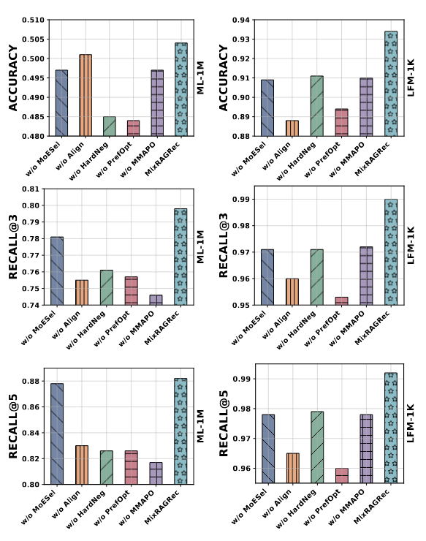
Ablation Study
(i) w/o MoESel: replaces the Mixture-of-Experts selector policy with random expert selection;
(ii) w/o Align: removes the Knowledge Preference Alignment agent;
(iii) w/o HardNeg: replaces hard negative sampling with random negatives;
(iv) w/o PrefOpt: removes contrastive preference feedback;
(v) w/o MMAPO: removes the shared objective and coordinated updates.

Slide 15
Thank you for listening!

