Slide 1
DoVer: Intervention-Driven auto Debugging for LLM Multi-Agent Systems
Ming Ma , Jue Zhang, Fangkai Yang3,
Yu Kang, Qingwei Lin, Saravan Rajmohan, Dongmei Zhang
ICLR
26 Jan 2026

Slide 2
Outline
Research Background
The rapid advancement of Large Language Models (LLMs) has led to the widespread development and deployment of multi-agent architectures, where agents of different roles work collaboratively to solve complex, real-world tasks.
As these systems transition into production, debugging their failures becomes inevitable; however, unlike conventional software crashes, these failures represent "silent errors" where the system executes without interruption but produces incorrect or unsatisfactory results.
Multi-agent sessions often involve many rounds of LLM calls, generating long and highly complicated interaction logs that track inter-agent information flow, making manual inspection extremely labor-intensive.

Slide 3
Outline
Current Limitations
The prevailing practice relies on using LLMs to perform log-based analysis to attribute failures to a specific agent and step, but this log-only paradigm lacks execution-based validation.
Enforcing a single-step or single-agent attribution is often ill-posed because multi-agent systems employ trial-and-error loops (like ReAct) with multiple potential failure points.
Failures frequently stem from coordination issues or misalignment between agents, making it ambiguous and inappropriate to assign fault to just one step or agent.

Slide 4
Outline
Contributions
(i) We propose DoVer, an intervention-driven framework for automatically debugging failures in LLM-based multi-agent systems;
(ii) We identify and analyze the challenges posed by uncertain ground-truth annotations in log-based failure attribution;
(iii) We demonstrate experimentally that DoVer not only recovers a significant portion of failure cases but also enables explicit validation and refutation of failure attribution hypotheses.

Slide 5
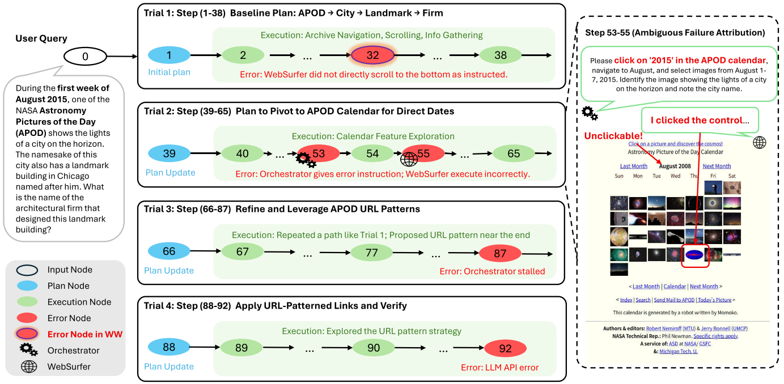
Outline
Failure trace of Case 3 inWW-HC
Figure 1: Failure trace of Case 3 inWW-HC, illustrating ambiguity in failure attribution.

Slide 6
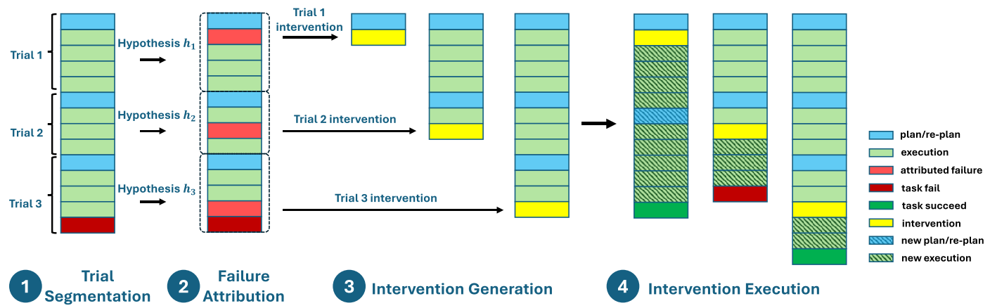
Outline
DoVer Debugging Pipeline.
Figure 2: DoVer (Do–then–Verify) Debugging Pipeline.

Slide 7
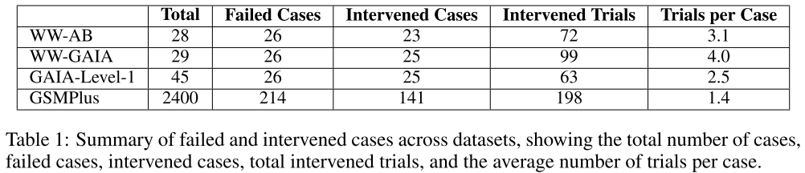
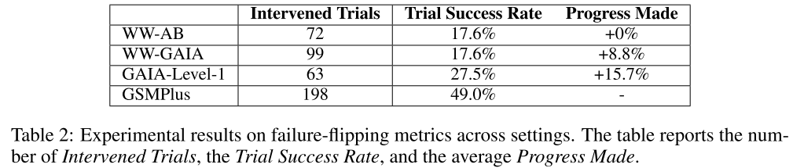
Outline
Experiment

Slide 8
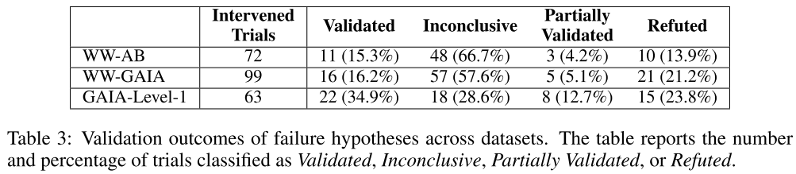
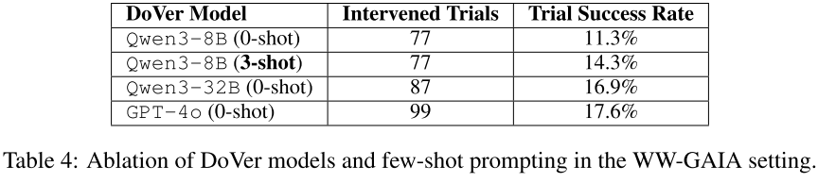
Outline
Experiment

