Slide 1
AgentCDM: Enhancing Multi-Agent Collaborative Decision-Making via ACH-Inspired Structured Reasoning
Xuyang Zhao, Shiwan Zhao, Hualong Yu, Liting Zhang, Qicheng Li
AAAI 2026

Slide 2
Background
The Potential of MAS：Multi-Agent Systems driven by LLMs enable collaboration to solve complex tasks beyond the reach of single agents, such as code generation and scientific discovery.
The Core: CDM：Collaborative Decision-Making (CDM) is the critical component that determines the final output quality and robustness of the entire system.
The Evolution：The field is moving from static, hand-designed frameworks toward more dynamic, adaptive, and context-aware architectures for higher automation.

Slide 3


Challenges
Mechanism Bottlenecks
Cognitive Threats
Dictatorial Mechanisms
Inherent Biases
Over-reliance on a single decision agent makes the system vulnerable to individual hallucinations and biases.
Anchoring, confirmation, and subjective validation biases degrade the objectivity of multi-agent interactions.
Voting-based Mechanisms
Negative Feedback Loops
Simple majority rules fail to resolve deep reasoning conflicts or synthesize local truths effectively.
Unaddressed biases are amplified during agent collaboration, leading to fragile and unrobust conclusions.

Slide 4
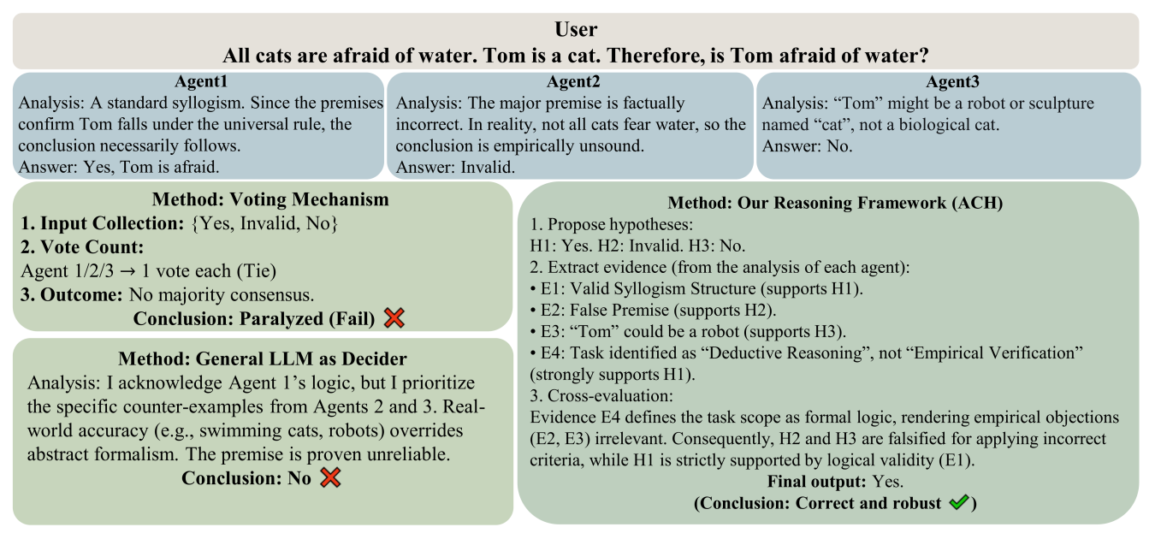
Contributions
Structured Reasoning Strategy
Introduces a cognitive science-inspired Analysis of Competing Hypotheses (ACH) framework to systematically mitigate cognitive biases in decision aggregation.
Two-Stage Training Paradigm
Proposes an evolution from explicit scaffolding to autonomous exploration, enabling models to internalize complex reasoning logic rather than just mimicking it.
Superior Performance & Generalization
Achieves SOTA results across MMLU, MMLU-Pro, and ARC-Challenge, demonstrating robust cross-domain generalization and stability in heterogeneous agent pools.

Slide 5
Related Work
LLM-based MAS
CDM in MAS
Rule-Based RL
Focuses on expanding task capabilities through communication and role-playing protocols.
Existing methods rely on simple dictatorial or voting mechanisms, lacking deep reasoning optimization.
Leverages rule-based rewards to enhance reasoning, but application in multi-agent CDM is still nascent.
CAMEL, MetaGPT, AutoGen
Dictatorial vs. Voting
DeepSeek-R1, GRPO

Slide 6


Problem Definition and Formulation
We formalize the process of an MAS handling a user query s. The system comprises n Execution Agents {π1, π2, . . . , πn} and a single Decision Agent π_{D}. The overall workflow is divided into two core phases:
Execution Phase, each agent πi (where i ∈ {1, 2, . . . , n}) independently receives the user query s and generates a candidate answer ai according to its own policy πi(· | s). Formally, this process can be represented as:
Decision Phase The Decision Agent πD receives the full context, including the original query s and all candidate answers {a1, a2, . . . , an} from the execution agents. We define this context as the history H = {s, a1, a2, . . . , an}. Based on H, π_{D} performs reasoning and produces the final, unified answer a_{D} for the system:

Slide 7
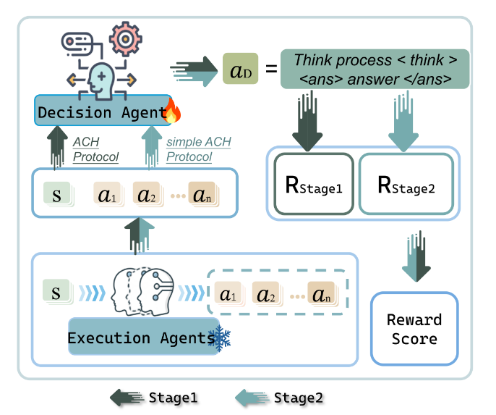
Method
STAGE 1
Scaffolding-guided Training
STAGE 2
De-scaffolding for Internalization

Slide 8
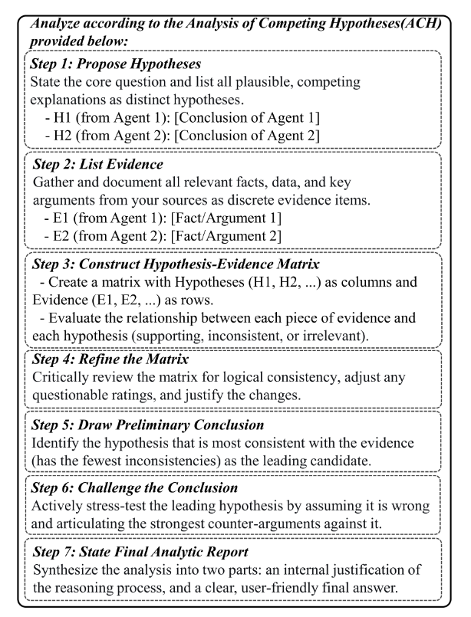
Stage One: Structured Reasoning Protocol based on ACH
To train the decision-maker agent, we have designed a composite, rule-based reward function consisting of three parts:Format rewards、Accuracy rewards、Accuracy rewards
Thus, the final score is computed as:

Slide 9
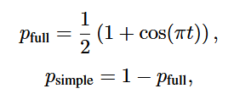
Stage Two: Scaffolding Removal and Autonomous Exploration
Soft ACH rewards：We introduce a soft structural reward, denoted as R_{soft ACH} , which is defined by the semantic similarity between the agent’s thought process and the ACH Protocol.
Curriculum Annealing Guidance：Simultaneously, to enable the model to explore more possibilities, we created two additional prompt types: a “Full ACH Protocol” and a “Simplified ACH Protocol”. During training, we use a cosine annealing schedule to dynamically adjust the probability of sampling these two prompt types:
where t = i /T , with i denoting the current training step and T the total number of training steps.
Thus, the stage two score is computed as:

Slide 10
Experiments
Benchmarks
Baselines
Models
MMLU
Single & Dictatorial
Open-source models
Massive Multitask Language Understanding across 57 subjects.
Single agent baseline and Informed Dictatorial aggregation.
GLM-4-9B, Mistral-7B, Llama-3-8B, Qwen-2-72B,
MMLU-Pro
Voting Methods
Closed-source models
A more challenging version requiring complex reasoning with 10 options.
Plurality, Borda, Bucklin, Instant-Runoff, Minimax, and Ranked Pairs.
GPT-4.1
ARC-Challenge
ACH Variants
Science questions requiring multi-step reasoning and common sense.
Qwen-7B-Instruct and Qwen-7B-R1 guided by ACH protocols.

Slide 11
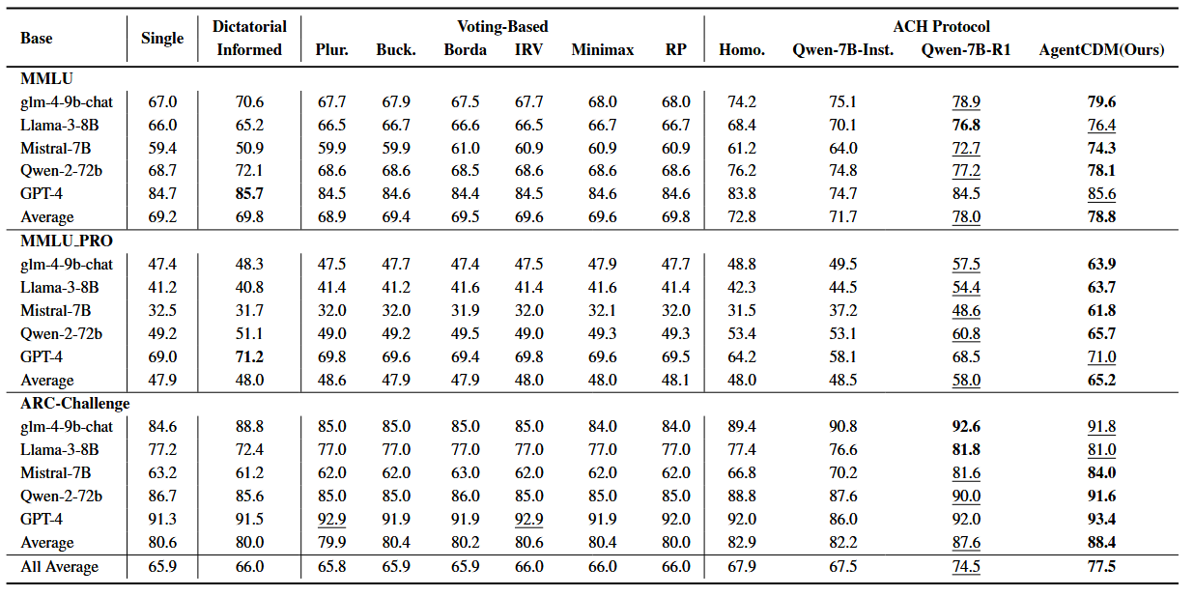
Main Results

Slide 12

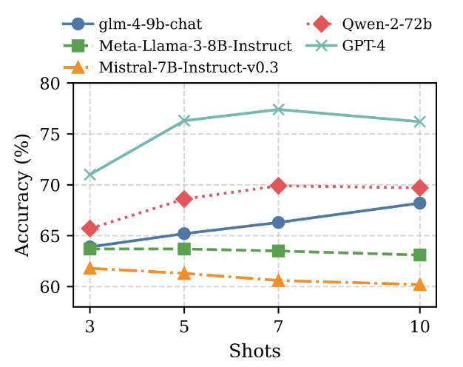
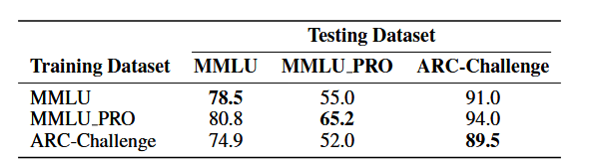
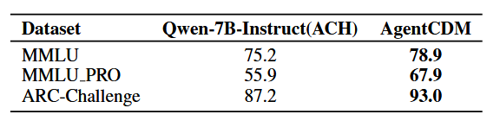
Deep Analysis: Generalization and Robustness
Cross-Dataset Generalization
Robustness and Scalability Analysis
Training on complex tasks (MMLU-Pro) significantly boosts performance on simpler ones, proving the transferability of structured reasoning.

Slide 13
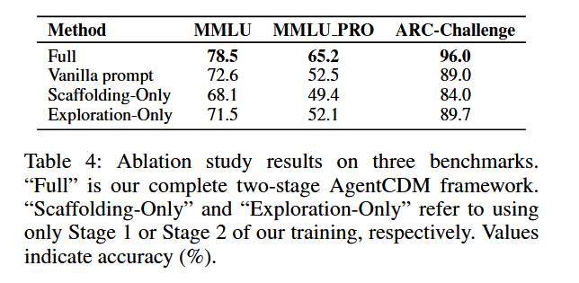
Ablation Study

Slide 14
Conclusion and Limitations
Conclusions
We presented AgentCDM, an ACH-inspired framework that enhances multi-agent decision-making through structured scaffolding and autonomous exploration.
Empirical results demonstrate that AgentCDM significantly outperforms voting-based and dictatorial baselines in accuracy and robustness.
Limitations
Limitations include reliance on the quality of initial hypotheses and the assumption of cooperative agents.

