Slide 1
MetaRCA: A Generalizable Root Cause Analysis Framework
for Cloud-Native Systems Powered by Meta Causal
Knowledge
FSE 2026
刘军辉
2026/07/05

Slide 2
Background: RCA in Cloud-Native Systems
Fast and accurate Root Cause Analysis is critical for ensuring the reliability of cloud-native systems
Architecture Characteristics and Challenges
Cloud-native systems are now widely adopted in modern production environments.
They are typically built upon: Microservices Containers Dynamic orchestration Large-scale service interactions While this architecture improves scalability and flexibility
it also makes failure propagation more complex. A single root cause may trigger cascading anomalies across multiple services, metrics, logs, and traces.
Example:
Database latency increases → Order service slows down → Payment service times out → Users experience service unavailability

Slide 3
Evolution of Causal RCA Methods
From early data-driven approaches to knowledge-enhanced causal analysis
2015-01
2018-01
Early data-driven methods
Dependency-aware methods
Examples: CloudRanger, AutoMap Use causal discovery algorithms such as PC Construct causal graphs from system metrics Apply graph-ranking algorithms such as PageRank
Examples: CauseInfer, CIRCA Incorporate service dependency graphs Use call dependencies to prune the causal search space
Main limitation
Knowledge-enhanced methods
Large-scale systems contain many services and metrics The causal search space grows rapidly Pure data-driven discovery becomes noisy and expensive
Use historical incidents, expert knowledge, or LLMs Extract causal relations from external knowledge Examples: RCACopilot, OpenRCA
2016-01
2023-01

Slide 4
Three Key Challenges of Existing RCA Methods
Addressing scalability, generalization, and knowledge integration issues in real-world deployment
1
Scalability
3
Knowledge Integration
Modern cloud-native systems contain a large number of services and metrics. Constructing causal graphs over all components is computationally expensive. The overhead grows rapidly as the system scale increases. This makes real-time incident response difficult.
Rule-based knowledge is often rigid and system-specific. LLM-based RCA can leverage richer knowledge, but may suffer from: Hallucination Slow inference High cost Unstable online behavior
2
Generalization
Many causal graphs are learned for a specific system, topology, or historical dataset. When the system changes, the learned causal relations may no longer hold. Existing methods often need to be retrained or rebuilt for each new system.

Slide 5
MetaRCA: Decoupling Offline Knowledge and Online Inference
Separating offline knowledge construction from online inference to enable fast root cause analysis
Key Idea
2
Do not start RCA from scratch for every failure. Instead, reuse general causal knowledge and adapt it to the current incident.
Online Stage: Perform Fast RCA
1
Instantiate the knowledge base according to the current system context. Weight and prune causal relations based on runtime evidence. Rank suspicious components for root cause localization.
Offline Stage: Build Reusable Knowledge
Construct a reusable causal knowledge base before failures occur. Integrate causal evidence from multiple sources. Avoid rebuilding causal graphs from scratch for every incident.
Meta Causal Graph，MCG

Slide 6
How Is the Meta Causal Graph Constructed?
Fusing LLM knowledge, historical experience, and monitoring evidence to build a reliable causal knowledge base
LLM-based Knowledge
Historical Incident Reports
Monitoring / Observability Data
Extracts general causal patterns from component types and metric semantics
Example: MySQL.query_latency ↑ → Microservice.api_latency ↑
Provide real-world SRE experience Capture failure patterns observed in past incidents
Example: Redis connection pool exhaustion → Service API timeout
Provides statistical evidence from historical runtime data Verifies whether two metrics show temporal or causal correlation in real failures

Slide 7
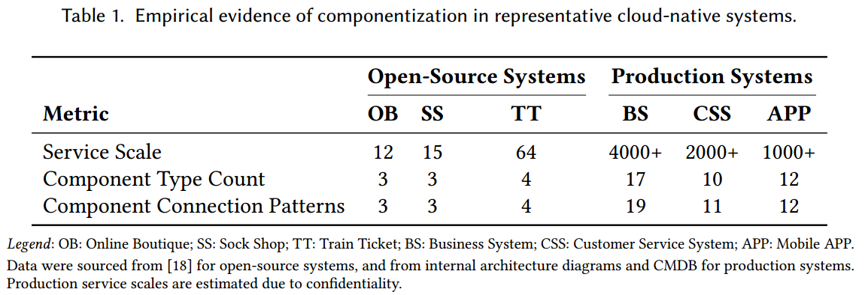
Motivation: Why Is Generalizable RCA Possible?
Exploring the feasibility of generalizable Root Cause Analysis through component abstraction, standardized stacks, and transferable experience
Limited Component Types in Cloud-Native Systems
Standardized Tech Stacks and Recurring Failure Patterns
Transferable SRE Experience Based on Causal Abstraction
Cloud-native systems may have thousands of service instances, but they can be abstracted into a few component types: Microservice, Database, Cache, Message Queue, Host, Gateway / Proxy.
Enterprises often use similar infrastructure across systems, such as Kubernetes, MySQL, Redis, Kafka, and Prometheus. This leads to recurring failure patterns: Redis slowdown → Microservice latency increases;MySQL query latency → Upstream service latency increases;High CPU usage → Service error rate increases.
SRE engineers rely on general causal experience rather than memorizing service names. Example: ProductDB.db_time ↑ → OrderService.api_latency ↑;UserProfileDB.db_time ↑ → NotificationService.api_latency ↑. Both can be abstracted as: Database.db_time ↑ → Microservice.api_latency ↑.

Slide 8
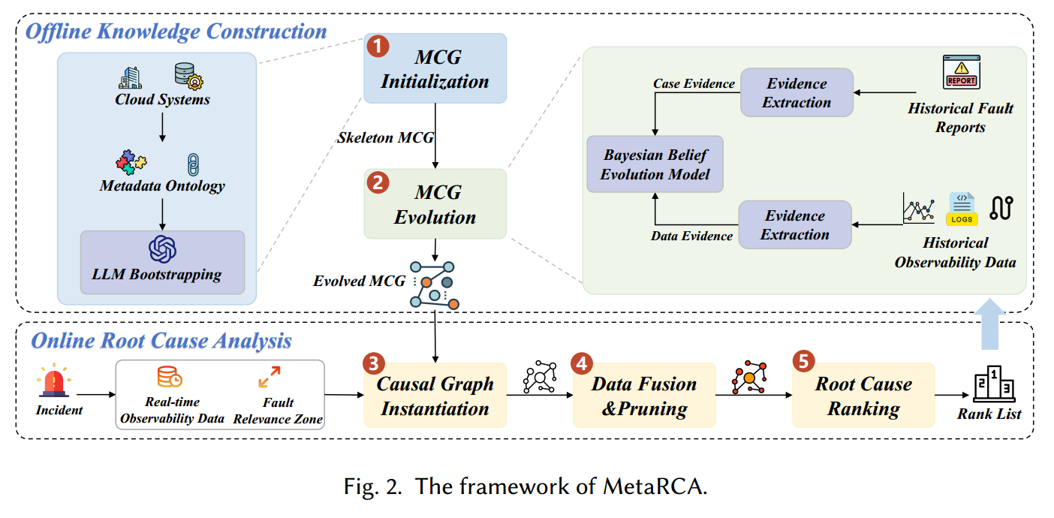
Detailed Design

Slide 9
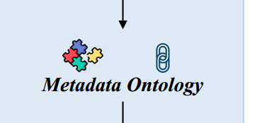
Metadata Ontology: Three Types of Metadata
MetaRCA defines three types of metadata to standardize system-level information
1
2
3
Component Types
Metrics
Connection Patterns
Map concrete service instances to abstract component types.
* order-service → Microservice
* product-db → MySQL *
cache-redis → Redis
* node-01 → Host
Define standard metrics and their semantic meanings for each component type. * Microservice: api_latency, error_rate, request_count
* MySQL: db_time, query_latency, slow_query_count Metric semantics help determine whether causal relations may exist between indicators.
Define allowed relationships between component types.
* Microservice → MySQL: Invoke
* Microservice → Host: On These patterns capture two common failure propagation paths:
* Invocation propagation
* Resource propagation

Slide 10
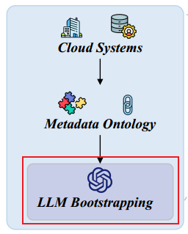
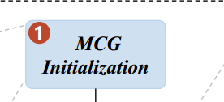
LLM-based Causal Knowledge Bootstrapping
MetaRCA uses LLMs offline to extract causal knowledge and build the initial skeleton MCG.
Output
Metric Classification
4
A skeleton Meta Causal Graph composed of candidate causal edges: cause metric → effect metric. Example: MySQL.query_latency ↑ → Microservice.api_latency ↑.
Service Level Indicators (SLIs): Measure service quality;Examples: latency, error rate;Propagate along service dependencies.
Resource Metrics: Measure internal resource saturation;Examples: CPU usage, memory usage;Influence SLIs within the service boundary.
Key Point
2
3
LLMs bootstrap causal knowledge offline, rather than directly performing online RCA.
1
LLM-guided Causal Extraction
For each connection pattern: (c_src, c_dst, conn_type). A structured prompt guides the LLM to infer: Candidate causal relations between metrics;Causal directions;Interactions between SLIs and resource metrics.

Slide 11
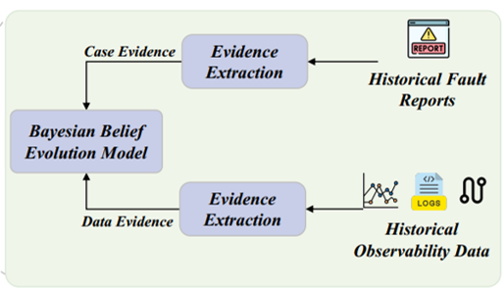
Meta Causal Graph Evolution
Continuously evolving the static MCG using real-world evidence from historical data to ensure reliability
1
2
The Limitation of Static Models and the Need for Evolution
Overall Workflow of Evidence-Based Evolution
The skeleton MCG generated by LLMs is only a static and unverified theoretical model. To make it reliable, MetaRCA continuously evolves the MCG using real-world evidence from historical data.
Raw Historical Data ↓
Evidence Extraction ↓
Evidence Alignment ↓
Structured Evidence Units ↓
Bayesian Belief Evolution ↓
Evolved MCG

Slide 12
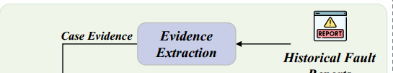
Case Evidence from Failure Reports
Extracting structured case evidence from historical failure reports using a two-stage LLM prompting strategy
Stage 1: Causal Entity Extraction
Output Format
The LLM identifies: Component entities, Metric entities, Causal relationships from the failure symptom and root cause analysis sections.
Each case evidence unit is represented as: {cause component, cause metric} → {effect component, effect metric} * report timestamp
1
3
2
Stage 2: Metric Semantic Alignment
A constrained prompt aligns extracted entities with the Metadata Ontology: Standard component types, Standard metric names.

Slide 13
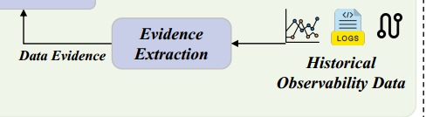
Statistical Evidence from Observability Data
Extracting objective statistical evidence from historical monitoring data via MetaRCA
Output
Each statistical evidence unit is represented as: {cause component, cause metric} → {effect component, effect metric} * fault timestamp
Stage 1: Causal Discovery
For each failure incident, MetaRCA: Extracts relevant multivariate metric time series Applies causal discovery algorithms, such as PC or PCMCI Identifies statistically significant instance-level causal links Example: service_A.latency → service_B.latency
3
2
1
Stage 2: Connection Pattern Alignment
The raw causal links are further refined by: Pruning links inconsistent with service dependencies Keeping links aligned with known upstream / downstream relations Abstracting instance-level links into meta-level relations Example: service_A.latency → service_B.latency ↓ Microservice.latency → Microservice.latency

Slide 14
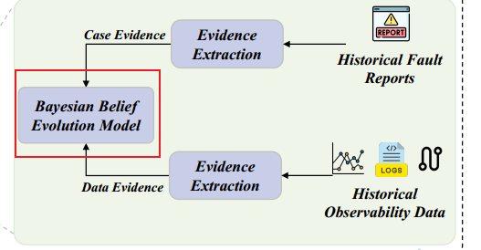
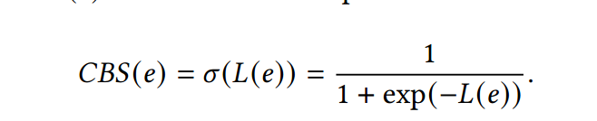
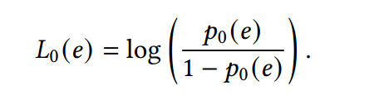
Bayesian Belief Evolution Model
Updating causal edge confidence in MCG through standardized evidence and Bayesian methods
Log-Odds Representation and Updating Mechanism
For numerical stability and efficient Bayesian updating, MetaRCA updates beliefs in the log-odds space. Initial belief comes from the LLM prior: p₀(e). It is converted into an initial log-odds score: L₀(e) = log(p₀(e) / (1 − p₀(e))). The final belief score is obtained through the sigmoid function: CBS(e) = σ(L(e)).
1
3
{cause component, cause metric} → {effect component, effect metric}
2
Causal Belief Score Definition
Key Point of Belief Evolution
For each causal edge `e`, MetaRCA maintains a belief score: CBS(e) = posterior probability that edge `e` represents a true causal relation. In other words: Higher CBS(e) → Stronger confidence in this causal edge.
LLM provides the initial prior belief, while historical evidence continuously updates the causal confidence of each edge.

Slide 15


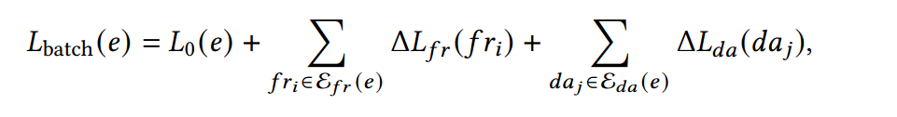
Offline Batch Weighting
Updating causal edge beliefs using historical evidence during deployment or recalibration

Slide 16
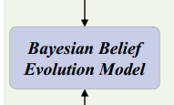

Online Streaming Update
Enable lightweight and real-time belief evolution for continuous MCG adaptation
1
2
Goal and Belief Decay Mechanism
Belief Augmentation Process
New evidence is then incorporated into the decayed prior. L_new(e) = L′_prior(e) + ΔL_new The contribution ΔL_new depends on the evidence type.
Enable lightweight and real-time belief evolution. Older beliefs become less certain over time. The current belief score is decayed based on the time since the last update. L′_prior(e) = L_current(e) × exp(−k · Δt)

Slide 17
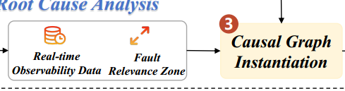
MCG-based Online Root Cause Analysis
MetaRCA performs online RCA in three steps using offline MCG as prior knowledge
1
Causal Graph Instantiation
Goal: Construct an instance-level causal graph for the current fault. Fault Relevance Zone, FRZ: MetaRCA first detects anomalous metric instances using time-series anomaly detection. Components with at least one anomalous metric are included in the Fault Relevance Zone (FRZ). Localized Instance Causal Graph, LICG: MetaRCA projects meta-causal relations from the MCG onto component connections within the FRZ. Each instantiated edge inherits its Causal Belief Score (CBS) from the MCG as prior knowledge. Key Point: Online RCA starts from a localized causal graph instead of analyzing the entire system.

Slide 18
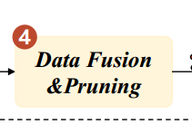

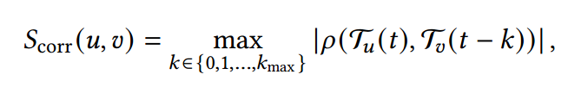
Data Fusion and Pruning
Refine the instantiated LICG using real-time observability data to fuse causal knowledge and remove unlikely edges
Goal
Causal Weight Fusion
Fuse offline causal knowledge with current fault context, then remove unlikely causal edges.
MetaRCA combines prior belief from MCG with real-time contextual evidence:
W_LICG(e) = W_MCG(e) × S_context(e)
1
3
2
4
Contextual Plausibility Score
Graph Pruning
Edges with low fused weights are removed. Default pruning threshold: θ_p = 0.3

Slide 19
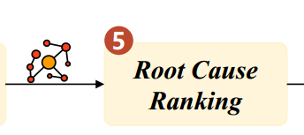

Root Cause Ranking
MetaRCA performs root cause ranking on the refined LICG using Causal Contribution Back-propagation
1
Method: Causal Contribution Back-propagation, CCB
CCB ranks nodes by aggregating fault contributions from their downstream effects.
If a node can explain many downstream anomalies through high-confidence causal edges, it is more likely to be the root cause. For each node `u`, its score is updated by collecting weighted contributions from its children:
Score(u) ← Σ Score(v) × W_LICG(u, v)
where `v` is a downstream child node of `u`. Initialize all node scores Iteratively back-propagate downstream fault contributions Stop when scores converge Rank nodes by final scores Output Top-K candidate root causes Root causes are ranked by how strongly they can causally explain downstream abnormal effects.

Slide 20
Experimental Evaluation of MetaRCA
Evaluation on diverse datasets addressing four key research questions
1
2
3
4
Datasets and Research Questions Overview
RQ1: Effectiveness
RQ2: Generalizability and Scalability
RQ3: Causal Graph Quality
RQ4: Ablation Study
MetaRCA is evaluated on diverse datasets, including: Three public microservice benchmarks One real-world production dataset The experiments are designed to answer four research questions.
How accurate and efficient is MetaRCA compared with baseline RCA methods?
Can MetaRCA generalize across different systems and scale to complex cloud-native environments?
Does the MCG-based approach generate higher-quality causal graphs than existing methods?
How much does each key component contribute to the final root cause localization performance?

Slide 21
Implementation of MCG
Four-step process for building the final Meta Causal Graph in MetaRCA
Metadata Ontology
Evidence Extraction
Covers 17 cloud-native component types Derived from 36 systems: * 32 production systems * 4 open-source systems Extracted from CMDBs and deployment diagrams Refined by expert interviews
1
3
Case evidence * 563 fault reports from 100+ production systems * Time span: Jan. 2020 – Mar. 2025 * Uses DeepSeek R1-70B for extraction and semantic alignment Statistical evidence * 375 cases from RCAEval-RE1 * 239 cases from AIOPS2022 * Uses PCMCI with α = 0.05
LLM-based Skeleton MCG
2
4
Evidence Fusion
Uses Google Gemini 2.5 Flash to bootstrap the initial MCG Initial CBS of each bootstrapped edge is set to 0.5
Incident report weight: λ_fr = 0.5 Data-driven evidence weight: λ_da = 0.05 Temporal decay constant: k = 0.005

Slide 22
Evaluation Datasets
MetaRCA is evaluated on two categories of datasets: Real-world production dataset and Public RCA benchmark dataset Evaluation Datasets
1
Production Dataset
Collected from large-scale production systems at China Unicom. Source systems: cBSS and customer service system User scale: 400M+ users Evaluation cases: 59 real fault incidents System scale: 9–112 services Time span: June–August 2025 Fault types: Microservice CPU overload Third-party service latency Database congestion Traffic surges Ground truth root causes were annotated by SREs and technical experts. Important: These cases do not overlap with the reports used for offline MCG construction.
2
Public Benchmark Dataset
Uses RCAEval-RE2, covering three open-source microservice systems. Dataset System Cases Services RE2-OB Online Boutique 90 12 RE2-SS Sock Shop 90 15 RE2-TT Train Ticket 72 64 The benchmark contains injected faults with ground truth injection points.

Slide 23
Baseline Methods
Comparison of MetaRCA with five representative causality-based RCA baselines
1
2
3
4
5
Knowledge-driven RCA: CIRCA
Data-driven Causal RCA: CausalRCA
Data-driven Causal RCA: PC_PR
Data-driven Causal RCA: PCMCI_RW
LLM-based RCA: OpenRCA
Constructs a causal architectural graph using predefined causal assumptions Uses regression-based hypothesis testing for root cause inference
Learns a weighted causal graph from data using a gradient-based method Applies PageRank for root cause ranking
Uses the PC algorithm to construct a causal graph from metrics Applies PageRank for root cause scoring
Uses PCMCI to discover causal relations from time-series metrics Applies random walk for root cause scoring
Uses an LLM as the knowledge brain Drives a Python executor for iterative data analysis Guides root cause identification through multi-step reasoning

Slide 24
Evaluation Metrics for MetaRCA
Assessing performance through accuracy and efficiency across service and metric levels
1
Accuracy: AC@k
AC@k measures whether the true root cause appears in the Top-k ranked results. Reported values: AC@1 AC@3 AC@5 MetaRCA reports AC@k for both: Root cause service: AC@k_service Root cause metric: AC@k_metric Higher AC@k means better localization accuracy.
2
Efficiency: Average RCA Time
Average RCA Time measures the end-to-end time from anomaly detection to final root cause ranking. It evaluates whether a method can support timely incident response.

Slide 25
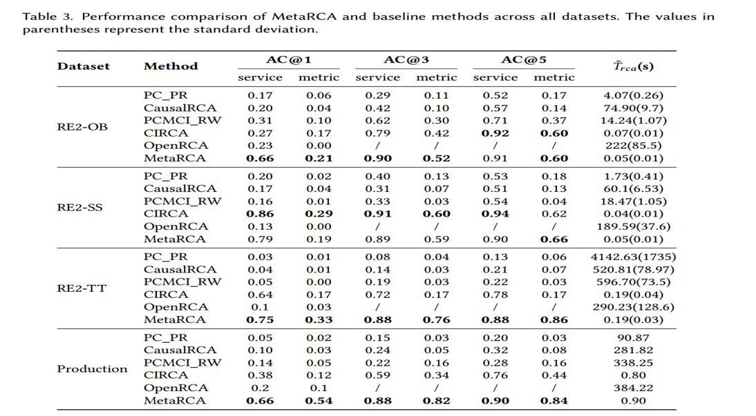
RQ1: Performance of MetaRCA

Slide 26
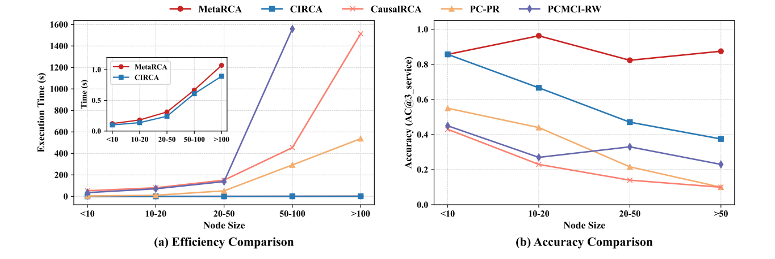
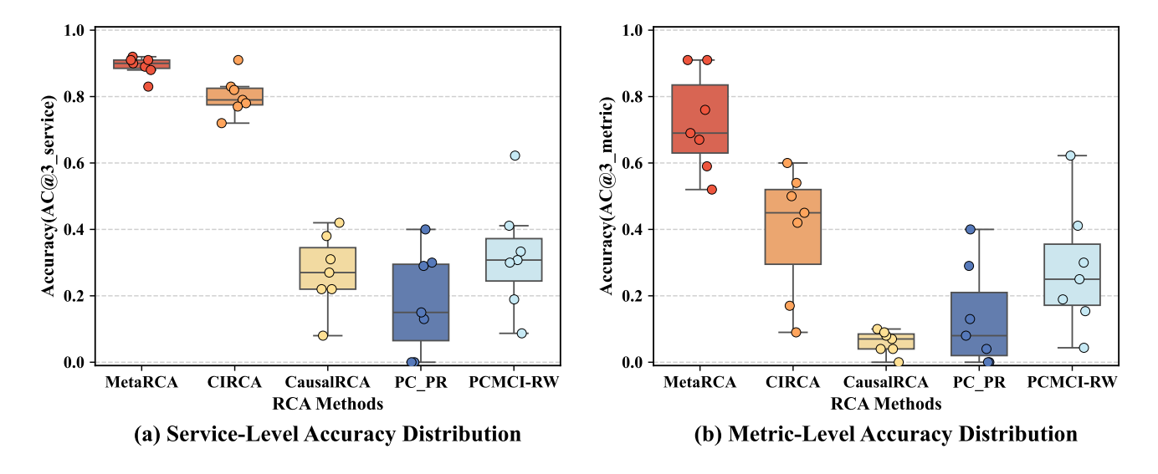
RQ2: Generalizability and Scalability of MetaRCA

Slide 27
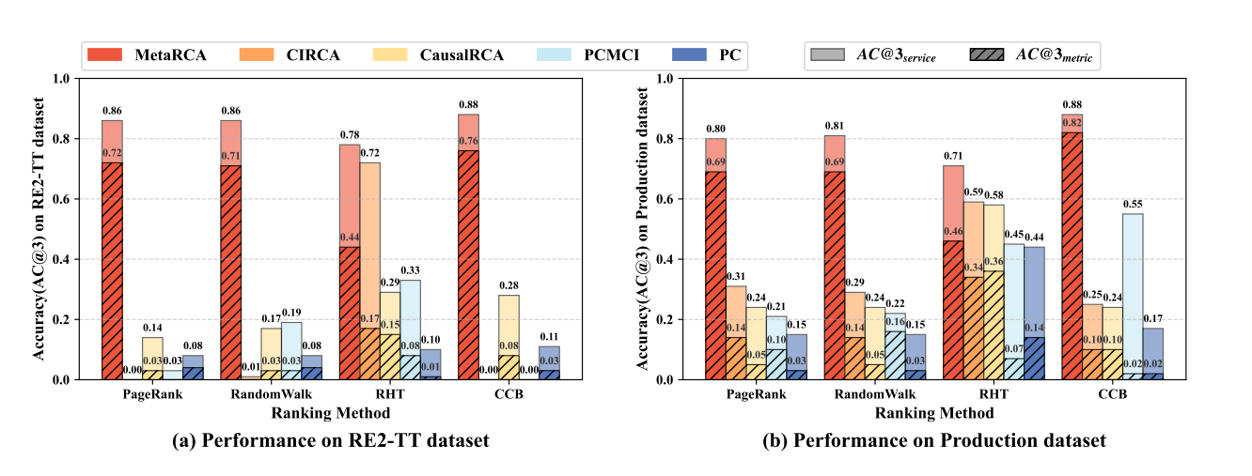
RQ3: Quality of Causal Graphs Constructed by MetaRCA

Slide 28
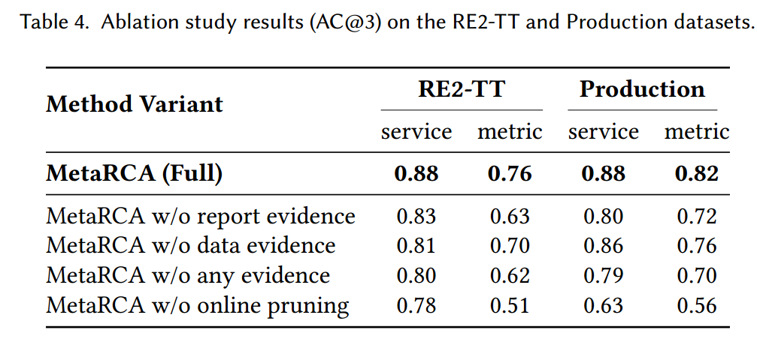
RQ4: Ablation Study of Key Designs

Slide 29
谢谢观看
刘军辉
2026/07/05

