Slide 1
Towards In-Depth Root Cause Localization
for Microservices with Multi-Agent
Recursion-of-Thought
2026 IEEE TDSC
刘军辉
2026/08/29

Slide 2
Background: Root Cause Localization in Microservices
An overview of system complexity, failure observation challenges, and the definition of Root Cause Localization
1
2
3
Increasing System Complexity
Failures Are Difficult to Observe Directly
Root Cause Localization (RCL)
Modern microservice systems consist of hundreds or even thousands of fine-grained, interdependent components. A single user request may propagate through a deep and branching invocation chain.
Failures usually manifest as observable anomalies rather than explicit root causes. Typical signals include abnormal latency, error logs, resource spikes, and irregular traces. Traces, metrics, and logs provide complementary but partial evidence.
RCL aims to identify the minimal system component that directly triggers the observed failure. The root cause may occur at different levels: Service / Pod / Node. The key challenge is to distinguish the true fault origin from propagated symptoms.

Slide 3
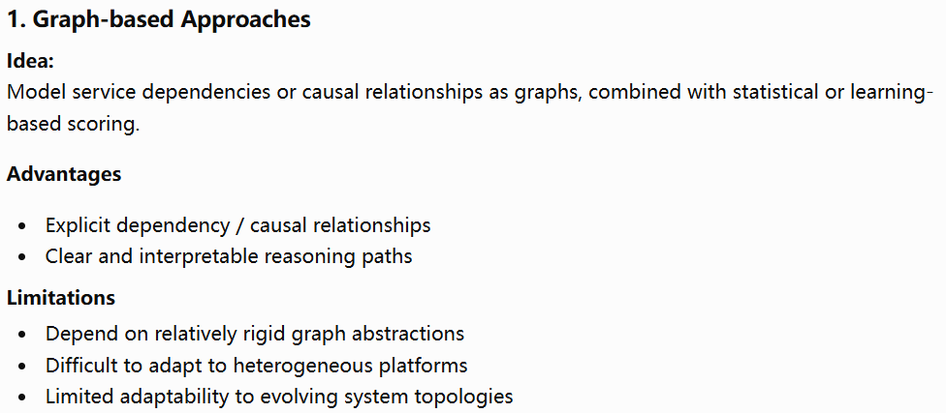
Mainstream Approaches for Root Cause Localization

Slide 4
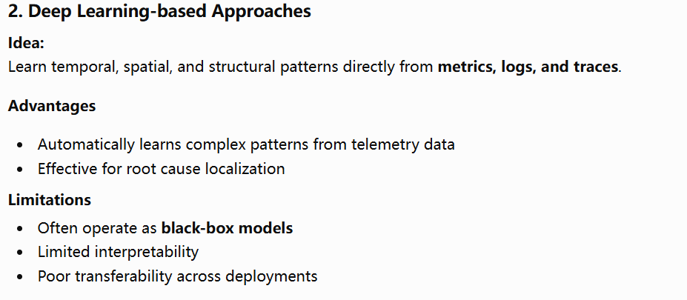
Mainstream Approaches for Root Cause Localization

Slide 5
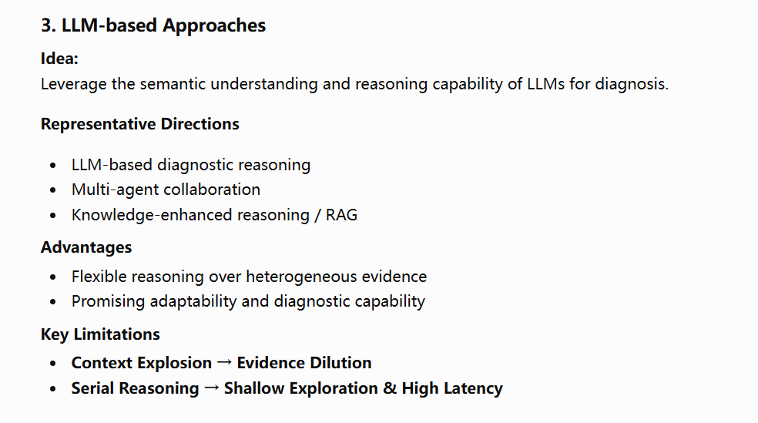
Mainstream Approaches for Root Cause Localization

Slide 6
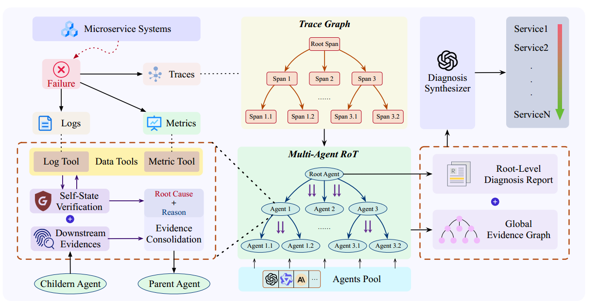
RCLAgent

Slide 7
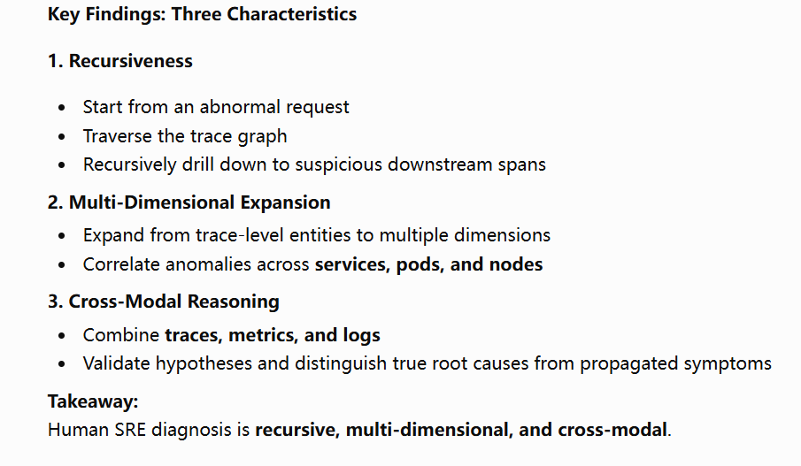
Empirical Study: How Do SREs Localize Root Causes?

Slide 8
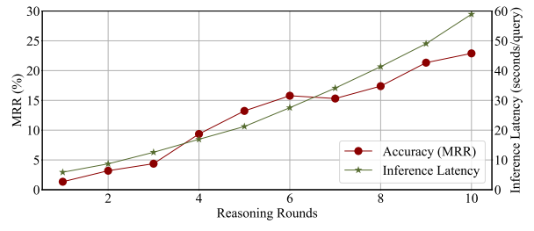
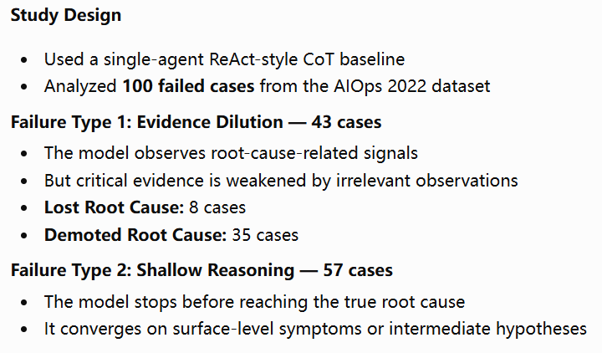
Empirical Study: Why Do LLM-based Methods Fail?

Slide 9
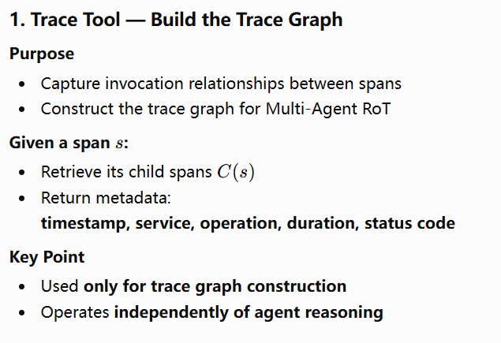
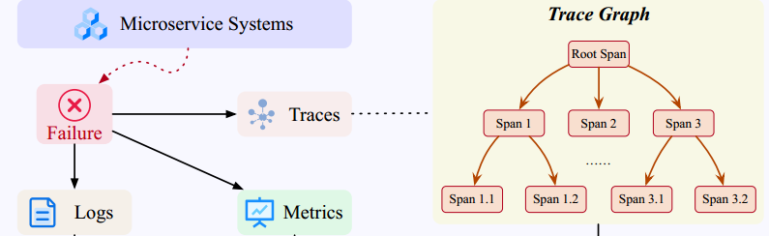
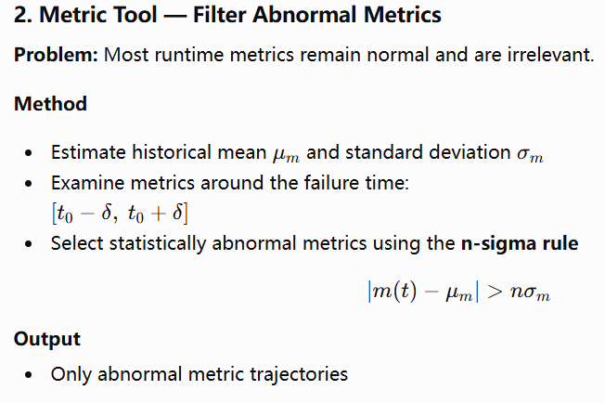
Data Tools: On-Demand Evidence Retrieval

Slide 10
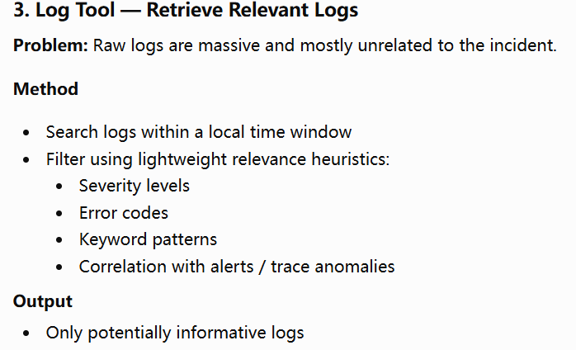
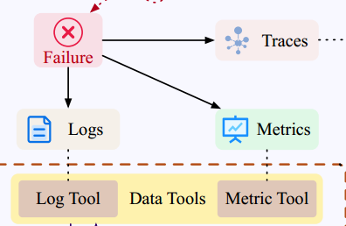
Data Tools: On-Demand Evidence Retrieval

Slide 11
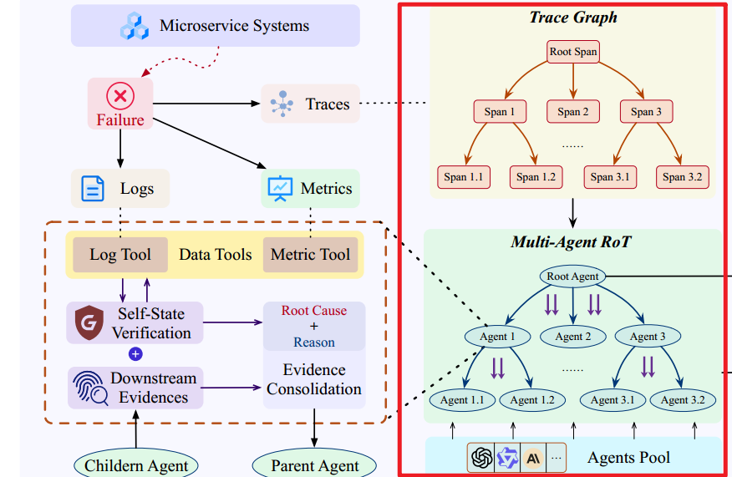
Multi-Agent RoT

Slide 12
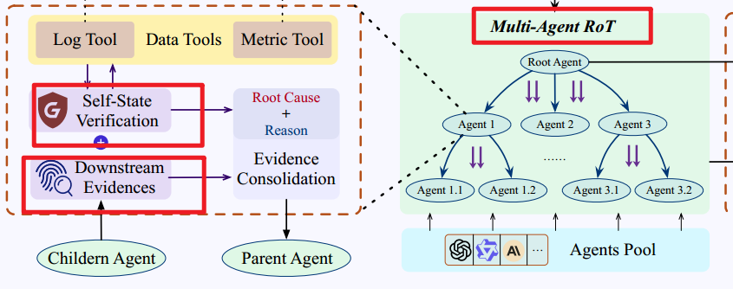
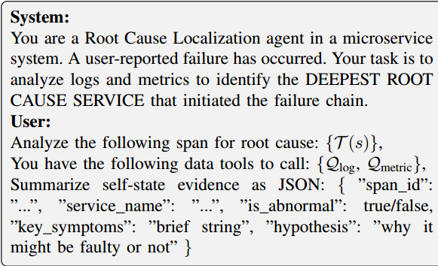
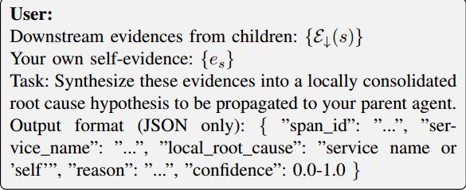
Multi-Agent RoT

Slide 13
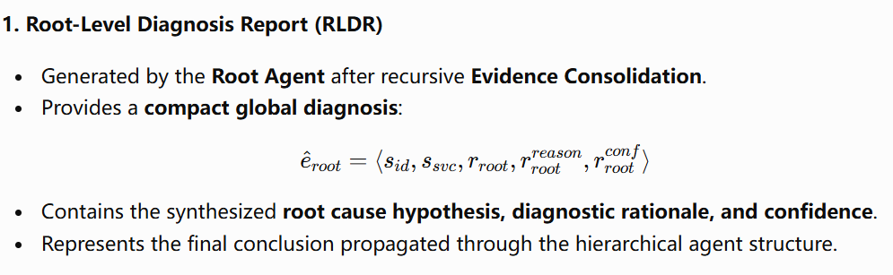
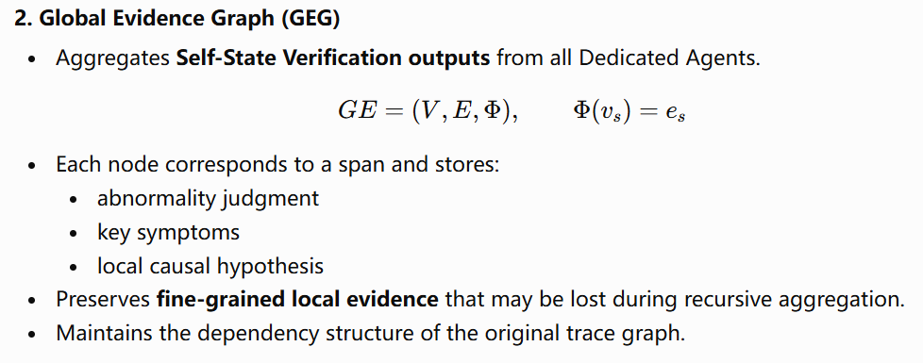
Diagnosis Synthesizer
Goal: Produce the final ranked list of root cause candidates by jointly reasoning over two complementary representations.

Slide 14
Diagnosis Synthesizer
Goal: Produce the final ranked list of root cause candidates by jointly reasoning over two complementary representations.

Slide 15
EVALUATION

Slide 16
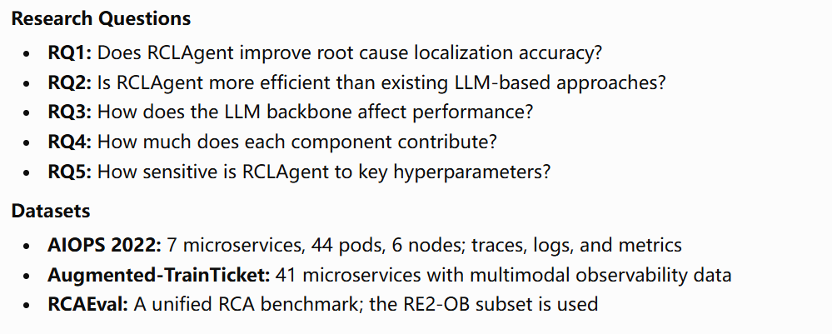
Experimental Setup

Slide 17
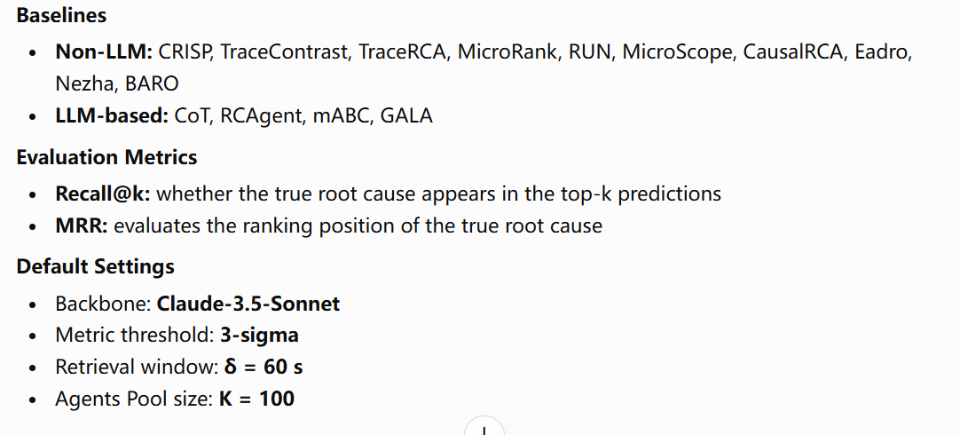
Experimental Setup

Slide 18
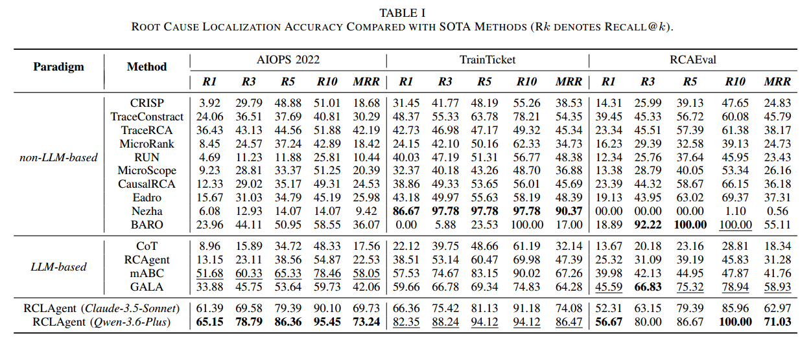
Root Cause Localization Accuracy

Slide 19
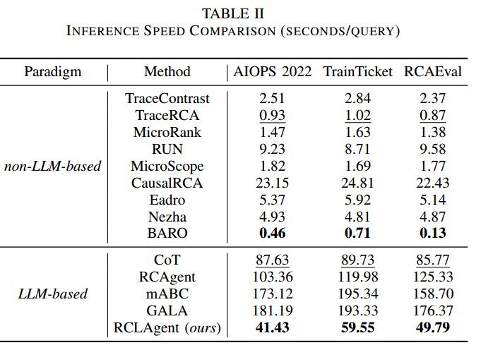
Inference Efficiency

Slide 20
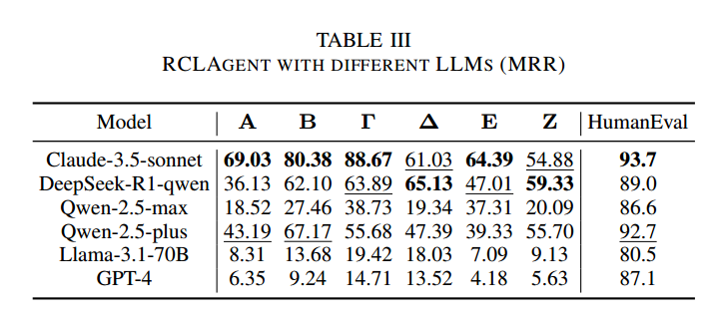
Impact of LLM Backbone

Slide 21
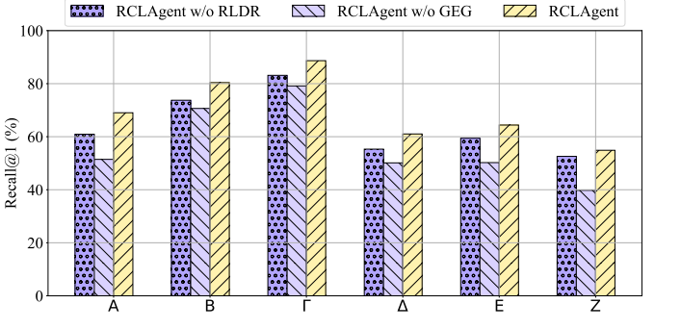
Ablation Study

Slide 22
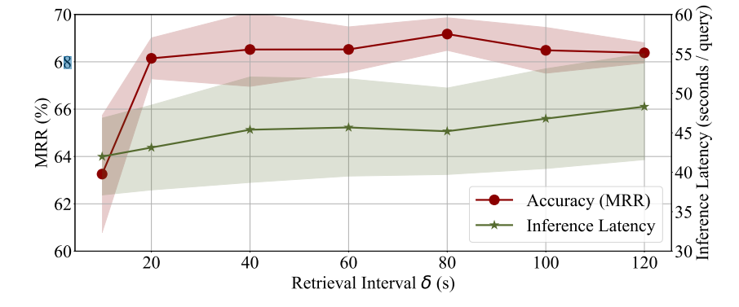
Hyperparameter Analysis & Experimental Takeaways

Slide 23
Thanks
刘军辉
2026/08/29

