Slide 1
RCAFlow: A Workflow-Informed Hierarchical Planning Multi-Agent System for Root Cause Analysis
Yufei Gao, Zhengong Cai*, Bowei Yang
AAAI 2026

Slide 2
Introduction
In microservice architectures, the complex inter-service dependencies make Root Cause Analysis (RCA) the most critical and challenging part of the incident response process.
Traditional Methods: Researchers have proposed various learning-based methods to mitigate the complexity of manual diagnosis. However, they often rely on predefined workflows, causal graphs, static fault-symptom models, resulting in one-off analyses.
LLMs: Some studies have introduced multi-agent systems. Others leverage semantic retrieval to incorporate historical incidents, troubleshooting guides (TSGs), or standard operating procedures (SOPs) as domain knowledge for LLMs. However, these methods rely on static flows, where agents follow predefined action sequences without adapting to intermediate feedback.
Notes:
在微服务架构中，复杂的跨服务依赖关系使得根本原因分析（RCA）成为事件响应流程中最关键且最具挑战性的环节。
传统方法：研究人员提出了多种基于学习的方法，以减轻人工诊断的复杂性。然而，这些方法往往依赖于预定义的工作流、因果图以及静态故障-症状模型，导致分析结果仅适用于特定情况。
大型语言模型（LLMs）：部分研究引入了多智能体系统。另一些研究则利用语义检索技术，将历史事件、故障排除指南（TSGs）或标准操作规程（SOPs）作为领域知识融入大型语言模型。然而，这些方法依赖于静态流程，智能体仅遵循预定义的操作序列，而无法根据中间反馈进行调整。

Slide 3
Framework
Transform structured knowledge such as Troubleshooting Guides (TSGs) and Standard Operating Procedures (SOPs) into three types of workflow to construct a knowledge base that supports task planning.
The hierarchical planning process is jointly driven by Planner and the Workflow Knowledge Base (WKB), and is organized and controlled through a Git-inspired branch management mechanism. Brancher creates and merges branches, while Coordinator manages global task scheduling.
Based on the output of Planner, tasks are either delegated to the next-level branch or directly executed by Executor following the planned steps.
In addition, the system records the complete reasoning trajectory and execution results in the current branch’s workspace, enabling data access and process traceability for other branches.
Notes:
将结构化知识（如故障排除指南（TSG）和标准操作程序（SOP））转化为三种工作流，从而构建一个支持任务规划的知识库。
分层规划流程由Planner和工作流知识库（WKB）共同驱动，并通过受Git启发的分支管理机制进行组织和控制。Brancher负责创建和合并分支，而Coordinator则负责管理全局任务调度。
根据规划器的输出结果，任务要么被分配给下一级分支，要么由执行器按照计划的步骤直接执行。
此外，系统会在当前分支的工作区中记录完整的推理轨迹和执行结果，从而为其他分支提供数据访问和流程可追溯性。

Slide 4
Contributions
Propose RCAFlow, a multi-agent framework that integrates structured knowledge guidance, hierarchical task planning, modular execution, and self-reflection and is tailored for RCA in complex, heterogeneous cloud systems.
Construct a structured workflow knowledge base by converting troubleshooting documents into behavior-treestyle processes.
Design a Git-inspired branching mechanism and hierarchical coordination to decouple reasoning paths, support modular execution.
RCAFlow achieves state-of-the-art performance on the challenging OpenRCA benchmark, demonstrating its effectiveness in complex root cause analysis.
Notes:
提出RCAFlow，这是一个多智能体框架，集成了结构化知识引导、分层任务规划、模块化执行以及自我反思功能，专为复杂、异构的云系统中的根本原因分析（RCA）而设计。
将故障排除文档转换为行为树风格的流程，构建结构化工作流知识库。
设计一种受Git启发的分支机制和分层协调机制，以解耦推理路径，支持模块化执行。
RCAFlow在具有挑战性的OpenRCA基准测试中取得了业界领先的性能，证明了其在复杂根本原因分析中的有效性。

Slide 5

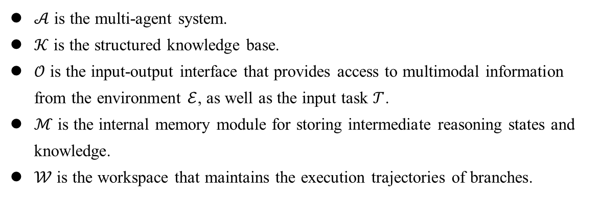
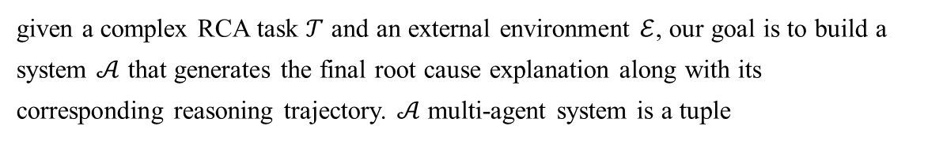
Problem Formulation
given a complex RCA task $𝒯$ and an external environment $ℰ$, our goal is to build a system $𝒜$ that generates the final root cause explanation along with its corresponding reasoning trajectory. $𝒜$ multi-agent system is a tuple
$$Σ_{𝒜}=\left(𝒜,𝒦,𝒪,ℳ,𝒲\right)$$
$𝒜$ is the multi-agent system.
$𝒦$ is the structured knowledge base.
$𝒪$ is the input-output interface that provides access to multimodal information from the environment $ℰ$, as well as the input task $𝒯$.
$ℳ$ is the internal memory module for storing intermediate reasoning states and knowledge.
$𝒲$ is the workspace that maintains the execution trajectories of branches.
Notes:
给定一个复杂的RCA任务 𝒯 和一个外部环境 ℰ，我们的目标是构建一个系统 𝒜，该系统能够生成最终的根本原因解释及其相应的推理轨迹。𝒜 多智能体系统是一个元组
𝒜 是多智能体系统。
𝒦 是结构化知识库。
𝒪 是输入输出接口，用于访问来自环境 ℰ 的多模态信息以及输入任务 𝒯。
ℳ 是用于存储中间推理状态和知识的内部存储模块。
𝒲 是工作区，用于维护分支的执行轨迹。

Slide 6
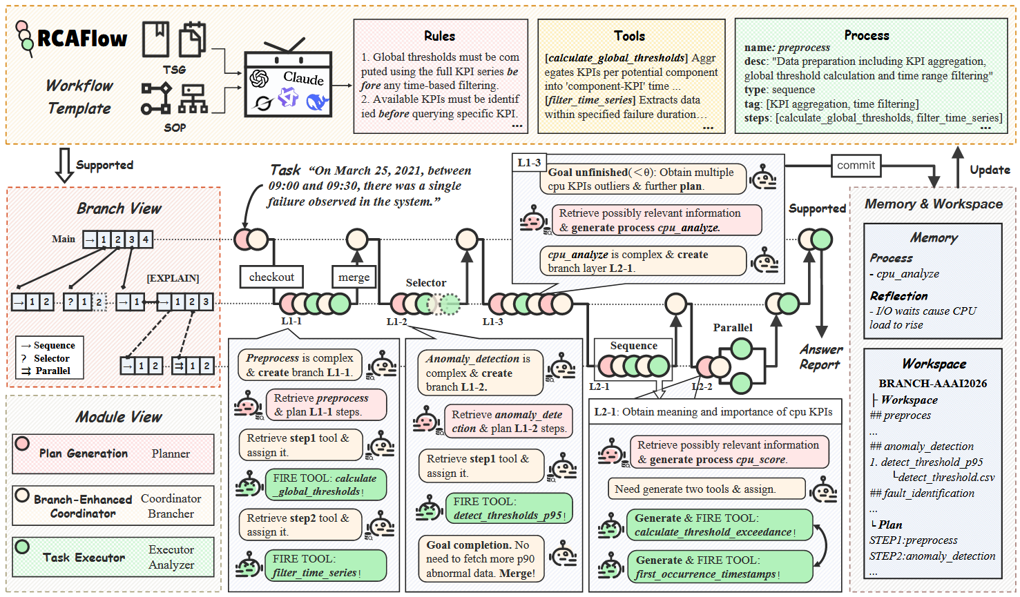
Overview

Slide 7
Overview of the RCAFlow Framework
Workflow-Informed Task Planning: This module leverages structured workflows to guide the generation of interpretable hierarchical reasoning plans.
Branch-Enhanced Hierarchical Coordinator: Designed for procedural control, this module incorporates Git-inspired branching mechanisms to enable hierarchical management and flexible scheduling of tasks.
State-Aware Task Execution: This module can generate or invoke existing tools for data processing and analysis, with the additional ability to assess the execution state and task completion status.
Notes:
基于工作流的任务规划：该模块利用结构化工作流来指导可解释的分层推理计划的生成。
分支增强型分层协调器：该模块专为流程控制设计，融合了受Git启发的分支机制，从而实现任务的分层管理和灵活调度。
状态感知型任务执行：该模块能够生成或调用现有工具进行数据处理与分析，并具备评估执行状态和任务完成情况的能力。

Slide 8
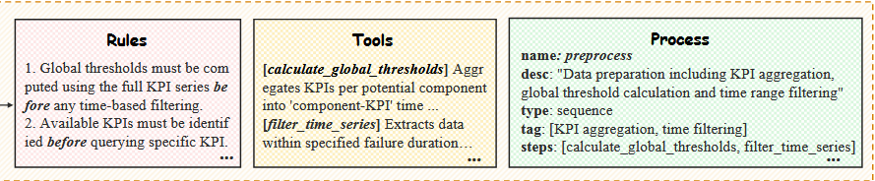
Structured Workflow Definition
Operation process related: Describe the necessary steps and their execution order for task completion. Given the RCA tasks’ inherent complexity and uncertainty, we adopt the Behavior Tree paradigm as the organizational framework for process control logic.
Condition/rule related: Define explicit preconditions and exception handling mechanisms for each workflow node to standardize valid state transitions.
Tool/data related: Encapsulate atomic operational capabilities as callable nodes with standardized APIs and data dependencies, enabling a decoupled design between reasoning logic and low-level execution.
Notes:
基于工作流的任务规划
操作流程相关：描述完成任务所需的步骤及其执行顺序。鉴于根本原因分析（RCA）任务固有的复杂性和不确定性，我们采用行为树范式作为流程控制逻辑的组织框架。
与条件/规则相关：为每个工作流节点明确定义先决条件和异常处理机制，以规范有效的状态转换。
工具/数据相关：将原子操作能力封装为可调用的节点，配备标准化的 API 和数据依赖关系，从而实现推理逻辑与底层执行之间的解耦设计。

Slide 9
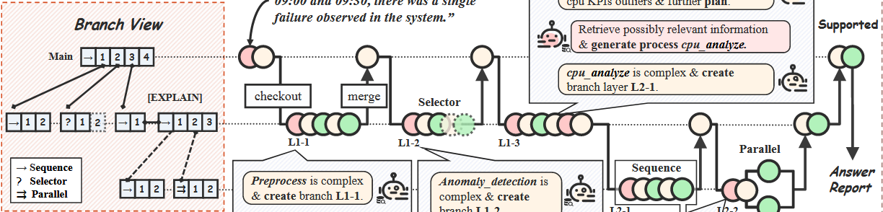
Operation process related
Sequence: Executes all child nodes sequentially; succeeds only if all succeed. Suitable for strongly dependent task chains.
Selector: Attempts child nodes in order; succeeds if any one succeeds. Suitable for multi-strategy exploration.
Parallel: Executes child nodes concurrently; completion is determined by an aggregation condition. Suitable for multi-source data fusion.
Notes:
顺序模式：依次执行所有子节点；仅当所有子节点均成功时才视为成功。适用于强依赖性的任务链。
选择器模式：按顺序尝试执行子节点；只要其中任意一个成功即视为成功。适用于多策略探索。
并行模式：并行执行子节点；是否完成由聚合条件决定。适用于多源数据融合。

Slide 10
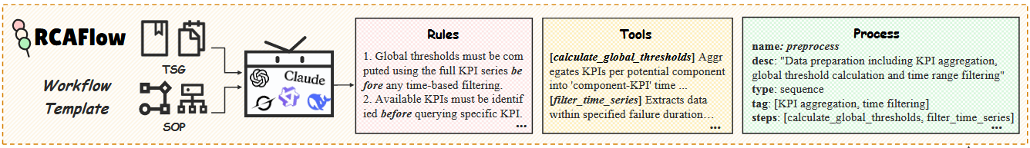
Automated Workflow Generation
RCAFlow leverages LLMs to automatically extract key task elements, control logic, and tool metadata from fault diagnosis rules, organizing them into JSON-based workflow graphs that conform to a predefined schema.
The system further extracts node-level preconditions, execution rules, and dependencies, and performs semantic validation to ensure logical consistency and executability.
It also supports automatic generation of names and descriptions for undocumented tools based on context, enabling dynamic code generation within RCAFlow and contributing to a high-quality, searchable knowledge base.
Notes:
RCAFlow 利用大型语言模型（LLMs）从故障诊断规则中自动提取关键任务元素、控制逻辑和工具元数据，并将它们组织成符合预定义模式的基于 JSON 的工作流图。
该系统进一步提取节点级先决条件、执行规则和依赖关系，并执行语义验证以确保逻辑一致性和可执行性。
它还支持根据上下文为未记录的工具自动生成名称和描述，从而在 RCAFlow 内实现动态代码生成，并有助于构建高质量且可搜索的知识库。

Slide 11
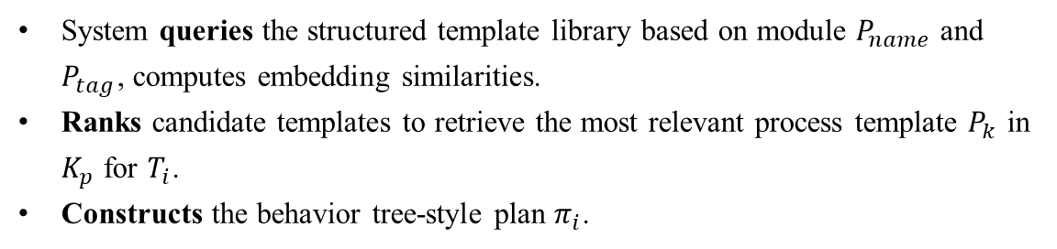
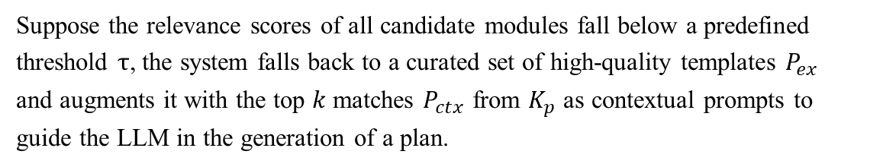
Reasoning Plan Generation
System queries the structured template library based on module $P_{name}$ and $P_{tag}$, computes embedding similarities.
Ranks candidate templates to retrieve the most relevant process template $P_{k}$ in $K_{p}$ for $T_{i}$.
Constructs the behavior tree-style plan $π_{i}$.
Suppose the relevance scores of all candidate modules fall below a predefined threshold $τ$, the system falls back to a curated set of high-quality templates $P_{ex}$ and augments it with the top $k$ matches $P_{ctx}$ from $K_{p}$ as contextual prompts to guide the LLM in the generation of a plan.
Notes:
系统根据模块 𝑃_𝑛𝑎𝑚𝑒 和 𝑃_𝑡𝑎𝑔 查询结构化模板库，并计算嵌入向量的相似度。
对候选模板进行排序，以从 𝐾_𝑝 中检索出与 𝑇_𝑖 最相关的流程模板 𝑃_𝑘。
构建行为树风格的计划 𝜋_𝑖。
假设所有候选模块的相关性得分均低于预定义的阈值 τ， 系统将回退到一组经过人工筛选的高质量模板 𝑃_𝑒𝑥，并将其与来自 𝐾_𝑝 的前 𝑘 个匹配项 𝑃_𝑐𝑡𝑥 结合，作为上下文提示来引导 LLM 生成计划。

Slide 12
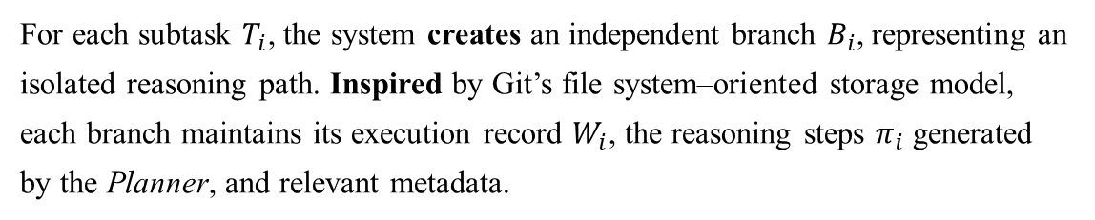
Git-Inspired Branch Manager
For each subtask $T_{i}$, the system creates an independent branch $B_{i}$, representing an isolated reasoning path. Inspired by Git’s file system–oriented storage model, each branch maintains its execution record $W_{i}$, the reasoning steps $π_{i}$ generated by the Planner, and relevant metadata.
The lifecycle of each branch is centrally managed by a global stack structure maintained.
When creating a new branch, Brancher module automatically pushes it onto the stack and switches the execution context.
During the merging phase,
(1) the system pops the current branch from the stack.
(2) The Coordinator aggregates the execution results into the workspace of its parent branch.
(3) Brancher then merges the completed branch into the main reasoning path.
Notes:
分支增强型分层协调器
对于每个子任务 𝑇_𝑖，系统会创建一个独立的分支 𝐵_𝑖，代表一条隔离的推理路径。受 Git 文件系统导向存储模型的启发，每个分支都维护其执行记录 𝑊_𝑖、规划器生成的推理步骤 𝜋_𝑖 以及相关元数据（例如时间戳、父分支标识符）。
每个分支的生命周期由一个全局栈结构集中管理。创建新分支时，Brancher 模块会自动将其压入栈中，并切换执行上下文。
在合并阶段，系统会将当前分支从栈中弹出。Coordinator 将执行结果聚合到其父分支的工作区中。Brancher 将已完成的分支合并到主推理路径中。

Slide 13
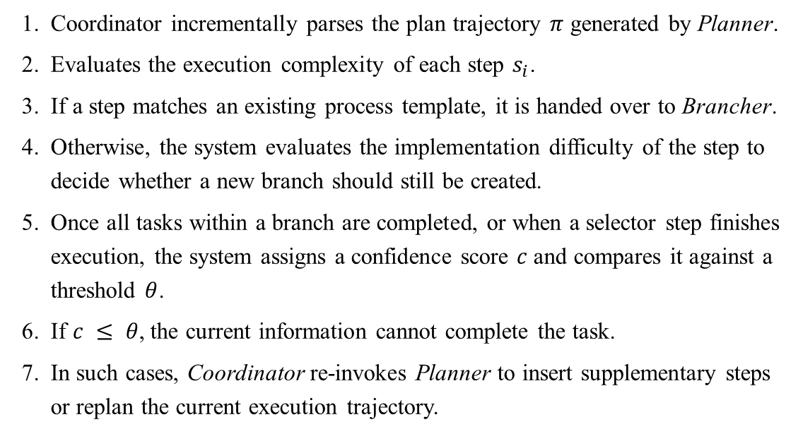
Adaptive Hierarchical Coordinator
Coordinator incrementally parses the plan trajectory $π$ generated by Planner.
Evaluates the execution complexity of each step $s_{i}$.
If a step matches an existing process template, it is handed over to Brancher.
Otherwise, the system evaluates the implementation difficulty of the step to decide whether a new branch should still be created.
Once all tasks within a branch are completed, or when a selector step finishes execution, the system assigns a confidence score $c$ and compares it against a threshold $θ$.
If $c ≤ θ$, the current information cannot complete the task.
In such cases, Coordinator re-invokes Planner to insert supplementary steps or replan the current execution trajectory.
Notes:
协调器逐步解析规划器生成的计划轨迹 𝜋。
评估每个步骤 𝑠_𝑖 的执行复杂度。
如果某个步骤与现有流程模板匹配，则将其移交给分支器。
否则，系统将评估该步骤的实现难度，以决定是否仍需创建新分支。
当分支内的所有任务完成，或选择器步骤执行完毕时，系统会分配一个置信度评分 𝑐 并将其与阈值 𝜃 进行比较。
若 𝑐 ≤ 𝜃，则当前信息无法完成该任务。
在此情况下，协调器将重新调用规划器，以插入补充步骤或重新规划当前的执行轨迹。

Slide 14
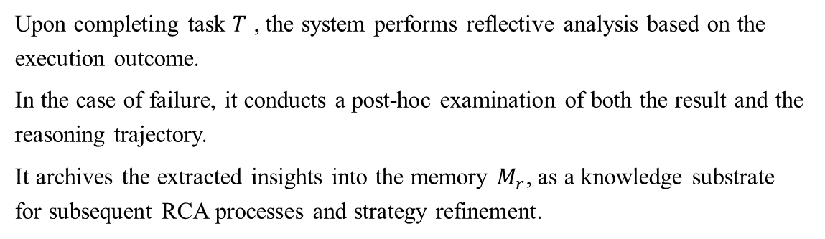
Reflection
Upon completing task $T$ , the system performs reflective analysis based on the execution outcome.
In the case of failure, it conducts a post-hoc examination of both the result and the reasoning trajectory.
It archives the extracted insights into the memory $M_{r}$, as a knowledge substrate for subsequent RCA processes and strategy refinement.
Notes:
完成任务 𝑇 后，系统会根据执行结果进行反思性分析。
若任务失败，系统将对结果和推理路径进行事后审查。
系统将提取的见解存档至记忆库 𝑀_𝑟，作为后续根本原因分析（RCA）流程及策略优化的知识基础。

Slide 15
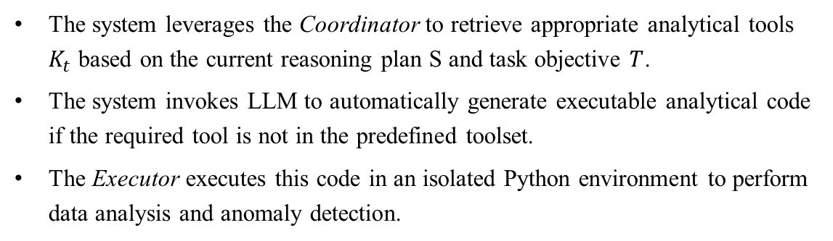
Dynamic Task Execution
In real-world scenarios such as the anomaly detection tasks in OpenRCA, the combined volume of logs, metrics, and traces can exceed 68GB, far beyond the context limits of current mainstream LLMs.
Therefore, RCAFlow is designed to orchestrate external analytical tools for dynamic data processing.
The system leverages the Coordinator to retrieve appropriate analytical tools $K_{t}$ based on the current reasoning plan S and task objective $T$.
The system invokes LLM to automatically generate executable analytical code if the required tool is not in the predefined toolset.
The Executor executes this code in an isolated Python environment to perform data analysis and anomaly detection.
Notes:
状态感知型任务执行
在现实场景中，例如 OpenRCA 中的异常检测任务，日志、指标和跟踪记录的总容量可能超过 68GB，这远超当前主流大型语言模型（LLMs）的上下文限制。
因此，RCAFlow 旨在协调外部分析工具，以实现动态数据处理。
系统利用协调器（Coordinator），根据当前推理计划 S 和任务目标 𝑇 检索合适的分析工具 𝐾_𝑡。
如果所需工具不在预定义工具集中，系统将调用大型语言模型（LLM）自动生成可执行的分析代码。
执行器（Executor）会在隔离的 Python 环境中执行该代码，以进行数据分析和异常检测。

Slide 16
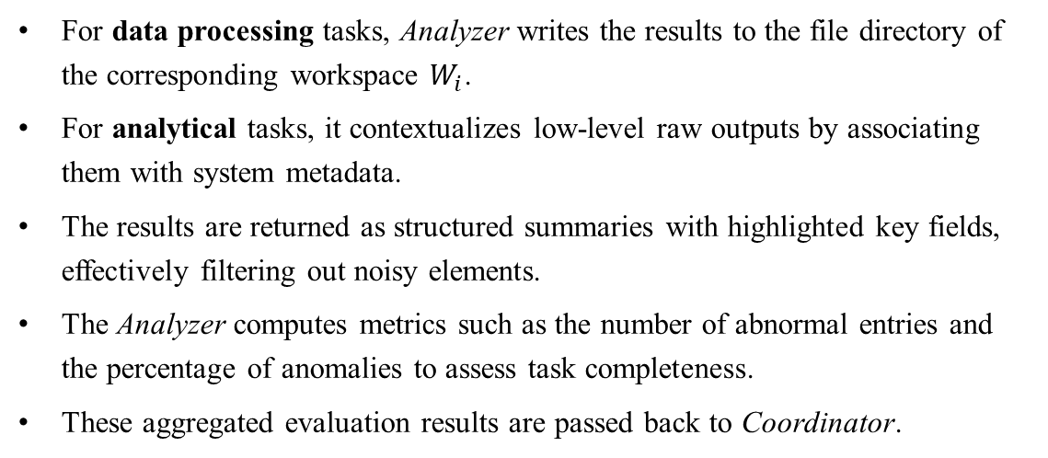
State-Aware Analyzer
Poorly designed reasoning chains may lead to premature termination (missing critical steps) or excessive expansion (introducing redundant information), which can disrupt LLM context retention and degrade diagnostic accuracy and stability.
For data processing tasks, Analyzer writes the results to the file directory of the corresponding workspace $W_{i}$.
For analytical tasks, it contextualizes low-level raw outputs by associating them with system metadata.
The results are returned as structured summaries with highlighted key fields, effectively filtering out noisy elements.
The Analyzer computes metrics such as the number of abnormal entries and the percentage of anomalies to assess task completeness.
These aggregated evaluation results are passed back to Coordinator.
Notes:
设计不佳的推理链可能会导致过早终止（遗漏关键步骤）或过度扩展（引入冗余信息），从而破坏大语言模型（LLM）的上下文保持能力，并降低诊断的准确性和稳定性。
对于数据处理任务，分析器将结果写入对应工作区 Wi 的文件目录。
在分析任务中，它通过将低级原始输出与系统元数据关联起来，从而为其提供上下文背景。
结果以结构化摘要的形式返回，高亮关键字段，从而有效地过滤掉噪声元素。
分析器还会计算异常条目数量和异常占比等指标，以评估任务完成度。
这些汇总评估结果将回传给协调器。

Slide 17
Experiment Setup
Dataset. Three challenging datasets from OpenRCA: Bank, Market, and Telecom, corresponding to a banking system, an online retail system, and a telecommunications database system, respectively.
Evaluation Metrics.
Correct accuracy: requires all predicted root cause elements—including the component, timestamp, and reason—to match their corresponding ground-truth labels exactly.
Partial Accuracy: measures whether the model successfully identifies at least one correct root cause element.
Notes:
数据集。OpenRCA 中的三个具有挑战性的数据集：Bank、Market 和 Telecom，分别对应银行系统、在线零售系统和电信数据库系统。
评估指标。
完全准确率：要求所有预测的根本原因要素（包括组件、时间戳和原因）与相应的真实标签完全一致。
部分准确率：衡量模型是否成功识别出至少一个正确的根本原因要素。

Slide 18
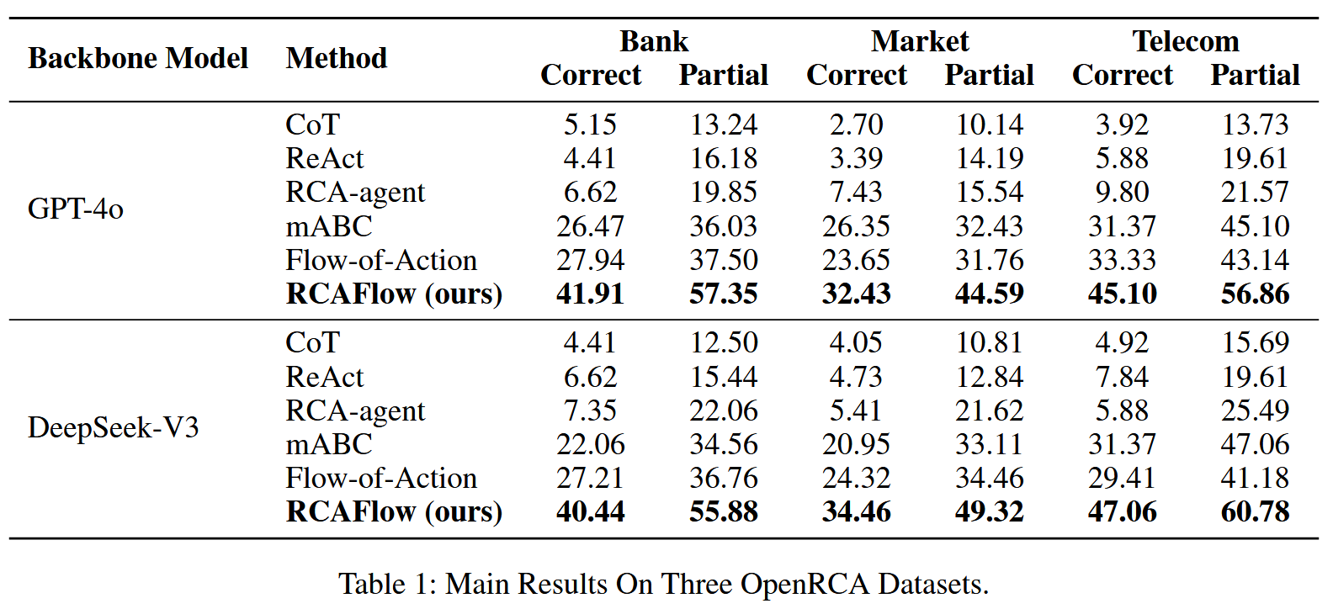
Main Results
RCAFlow consistently achieves the highest success rate across all datasets regardless of the backbone.
RCAFlow achieves leading performance across both evaluation metrics.
Notes:
无论采用何种骨干网络，RCAFlow 在所有数据集上均能保持最高的成功率。
RCAFlow 在两项评估指标上均表现优异。

Slide 19
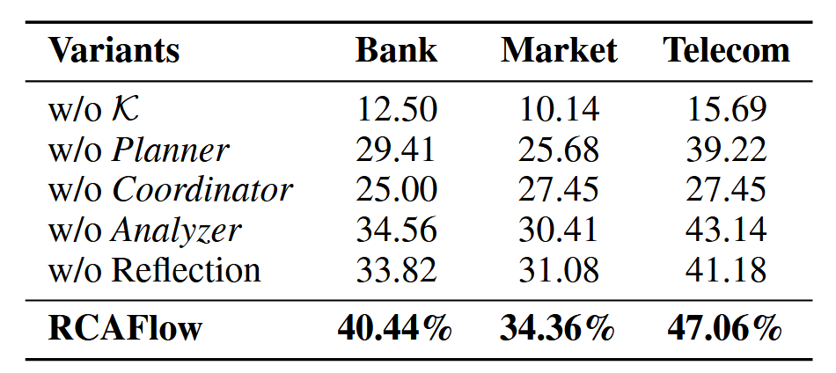
Ablation Study
All variants exhibit varying degrees of performance degradation, confirming the necessity and effectiveness of each module.
Notes:
所有变体都表现出不同程度的性能下降，这证实了每个模块的必要性和有效性。
RCAFlow w/o K 移除了 K，将所有领域知识视为未知，并完全依赖大语言模型（LLM）进行任务规划；
RCAFlow w/o Planner 省略了语义检索和结构化规划，直接将原始任务上下文输入语言模型进行决策；
RCAFlow w/o Coordinator 去除了分支管理器和自适应分层协调器，代之以线性思维链推理结构；
RCAFlow w/o Analyzer 移除了执行分析模块，使模型无法总结执行结果；
RCAFlow w/o Reflection 舍弃了反思模块，禁用了推理轨迹内省和经验保留功能。
这凸显了基于先验知识的任务分解以及具备分支感知适应性的可靠子任务执行的重要性。
这表明结构化规划在提高任务合规性和推理效率方面起着至关重要的作用

Slide 20
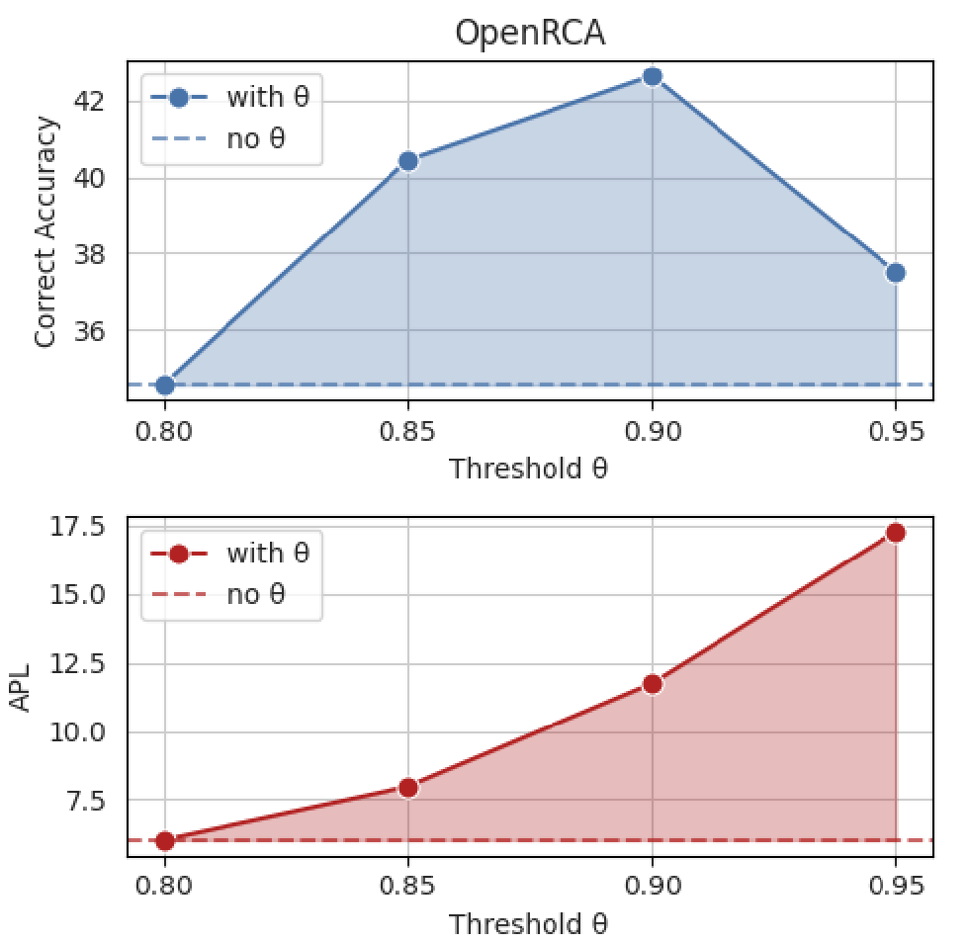
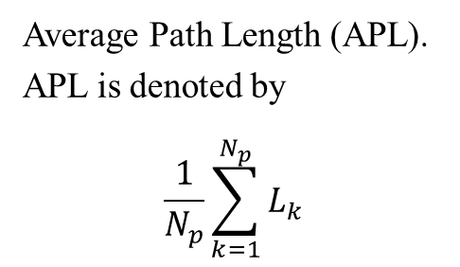
Impact of threshold $θ$
Average Path Length (APL).
APL is denoted by
$$\frac{1}{N_{p}}\sum_{k=1}^{N_{p}}{L_{k}}$$
Notes:
𝐿_𝑘 表示第 𝑘 个样本的诊断路径长度，𝑁_𝑝 表示在指定的最大路径长度内完成诊断的样本数。
APL 会随着阈值的增加而增加，因为系统往往会过度延长任务的执行时间--甚至在某些子任务完成后还在继续分析--从而导致多余的推理步骤。
随着阈值的增加，正确率呈现先升后降的模式：适度的阈值有助于更准确地完成推理路径，从而提高性能。
过高的阈值会引入噪声或不必要的步骤，导致路径臃肿、信息冗余和认知负荷增加，从而降低性能。
过低的阈值可能会导致系统过度简化复杂的子任务，跳过关键步骤，造成不完整的根本原因分析。

Slide 21
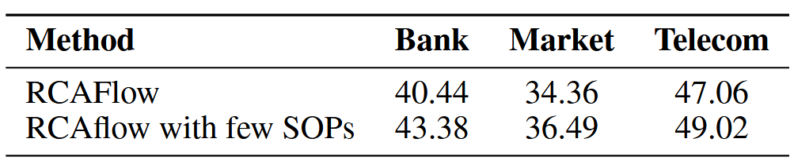
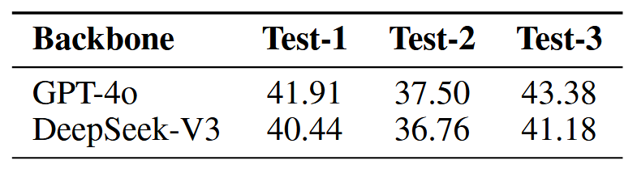
Sensitivity Analysis of Workflow
Initial Workflow
Workflow Generation
Notes:
通过额外的 SOP 和规则对原始工作流程进行改进，进一步提高了正确率，凸显了高质量工作流程设计的价值。
作者对结构相对简单的故障规则进行了实验。结果表明，该系统仍能显著提高故障定位效率，证明了其在典型场景中的实用性。
考虑到 LLM 的随机性，作者对每条规则进行了多次工作流生成试验。准确度指标显示出较低的方差，表明该系统具有鲁棒性。

Slide 22

THANK YOU FOR LISTENING

