Slide 1
KAIOPS：A Platform Solution of End-to-End Multi-Modal AIOps for AI Training at Scale
Zeying Wang、Junhong Liu、Penghao Zhang、Xiaoyang Sun、Xu Wang、Tianyu Wo、Chunming Hu、Chengru Song、Jin Ouyang、Renyu Yang*
ASE 2025
Notes:
KAIOPS：面向大规模人工智能训练的端到端多模态 AIOps 平台解决方案

Slide 2
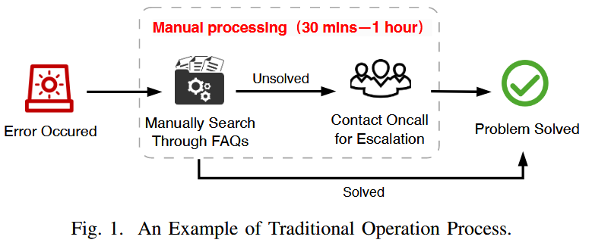
Introduction
Our empirical study on a production-grade cluster in Kuaishou – one of China’s largest short-video platforms – indicates that the task-level failure rate can reach as high as 19.3%. To ensure cluster stability and reliable task execution, timely detection, localization, and mitigation of these anomalies has therefore become a major operational challenge.
Notes:
我们针对快手（中国最大的短视频平台之一）上一个生产级集群进行的实证研究表明，任务级故障率最高可达19.3%。因此，为了确保集群的稳定性和任务执行的可靠性，及时检测、定位并缓解这些异常情况已成为运营方面的一大挑战。
图 1 描述了高度依赖人工干预的处理异常情况的实际解决方案。。
当一个错误出现，SRE 工程师必须手动搜索常见问题解答和文档，并在必要时将未解决的问题上报给值班人员。整个过程可能需要 30 分钟到 1 小时，在某些复杂的情况下甚至需要更长时间。毫无疑问，这样做非常耗费人力，而且会导致平均恢复时间（MTTR）恶化。

Slide 3
Challenges
i) Observability Data. A notable scarcity of standardized datasets hinders the implementation of effective detection approaches for training tasks. Domain-specific failure modes – such as GPU memory overflows, node disconnections, and configuration errors – require specialized feature extraction and modeling approaches.
ii) Subtle and Long-term Fault Patterns. Unlike the immediate performance fluctuations of traditional systems, anomalies in training tasks often stem from gradual resource depletion, performance bottlenecks, or configuration errors.
iii) Extreme Class Imbalance. The frequency of different anomaly types varies drastically in realworld systems, leading to severe scarcity of long-tail samples.
Beyond anomaly detection and classification, production-grade AIOps solutions must deliver end-to-end anomaly management.
Notes:
i) 可观测性数据。标准化数据集的严重匮乏阻碍了针对训练任务的有效检测方法的实施。特定领域的故障模式——例如 GPU 内存溢出、节点断开连接和配置错误——需要专门的特征提取和建模方法。
ii) 隐蔽且长期的故障模式。与传统系统中即时的性能波动不同，训练任务中的异常往往源于资源的逐渐耗尽、性能瓶颈或配置错误。
iii) 极端类不平衡。在实际系统中，不同异常类型的发生频率差异极大，导致长尾样本严重匮乏。
除了异常检测和分类之外，生产级 AIOps 解决方案必须提供端到端的异常管理

Slide 4
Contributions
The first multi-modal dataset, stemming from large-scale AI training tasks and encompassing a diverse range of typical fault types.
A new detection framework, with the aid of temporal context encoding and dynamic class-weighted loss, to handle complex data schema, subtle fault patterns and class imbalance that are widely manifested in AI training tasks.
An end-to-end AIOps solution for AI training tasks by leveraging the integration of knowledge graph and large language model, such that automated root cause analysis and solution recommendations can be fulfilled.
Notes:
第一个多模式数据集，源自大规模人工智能训练任务，包含多种典型故障类型。
借助时间上下文编码和动态类加权损失，建立一个新的检测框架，以处理人工智能训练任务中广泛存在的复杂数据模式、微妙故障模式和类不平衡问题。
通过整合知识图谱和大型语言模型，为人工智能训练任务提供端到端的 AIOps 解决方案，从而实现自动化的根本原因分析和解决方案建议。

Slide 5
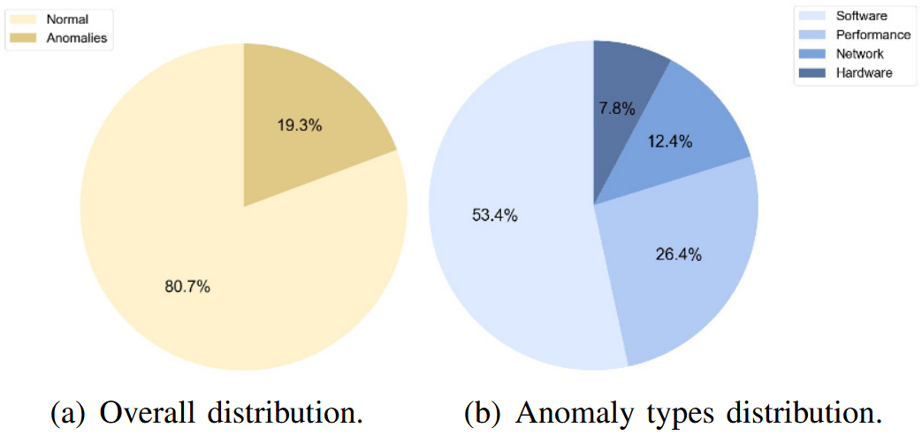
Anomaly Characteristics in Model Training Tasks
Software anomalies typically include code errors, misconfigurations, and dependency conflicts, commonly occurring during task initialization or execution.
Performance anomalies are primarily manifest as irregular GPU utilization, Out-Of-Memory (OOM), and computational performance degradation.
Network anomalies involve inter-node communication failures, bandwidth bottlenecks, and data transmission interruptions.
Hardware anomalies encompass GPU failures, storage device malfunctions, and node crashes.
Notes:
软件异常通常包括代码错误、配置错误和依赖冲突，这些情况通常发生在任务初始化或执行过程中。
性能异常主要表现为 GPU 利用率异常、内存不足（OOM）以及计算性能下降。
网络异常涉及节点间通信故障、带宽瓶颈和数据传输中断。
硬件异常包括 GPU 故障、存储设备故障和节点崩溃。
这些异常情况往往会引发连锁故障，给故障诊断和修复带来巨大挑战。

Slide 6
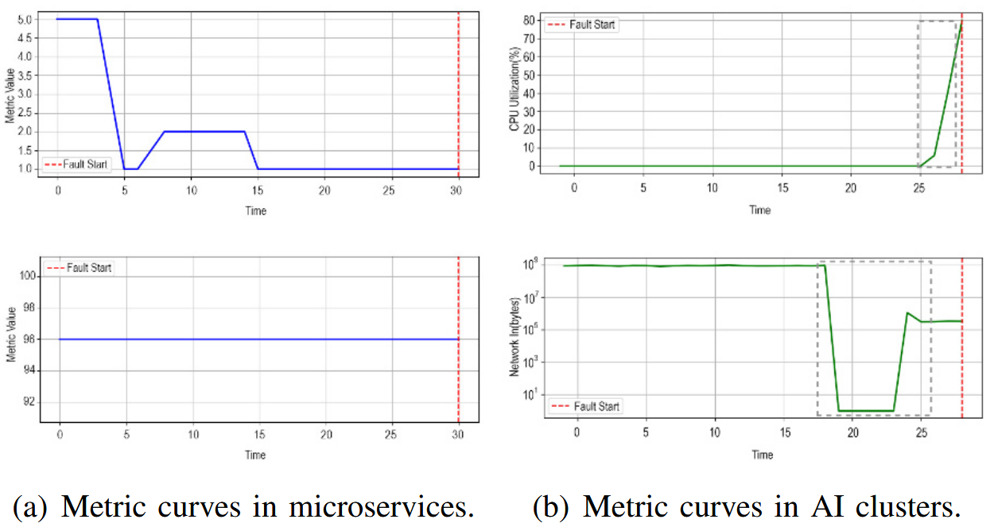
Anomaly Characteristics in Model Training Tasks
Anomalies in traditional microservice systems: lack persistent occurrence precursors
Anomalies in AI training tasks: follow subtle, long-term evolutionary trends.
Notes:
传统微服务系统中的异常现象往往缺乏持续发生的前兆，而人工智能训练任务中的异常现象则遵循微妙的长期演化趋势。
在 OOM 故障发生前，内存利用率曲线通常会出现尖峰增长。同样，通信故障发生前的网络吞吐量往往会出现波动或下降。这意味着与故障事件在时间上接近的数据点包含有洞察力的警告信号。

Slide 7
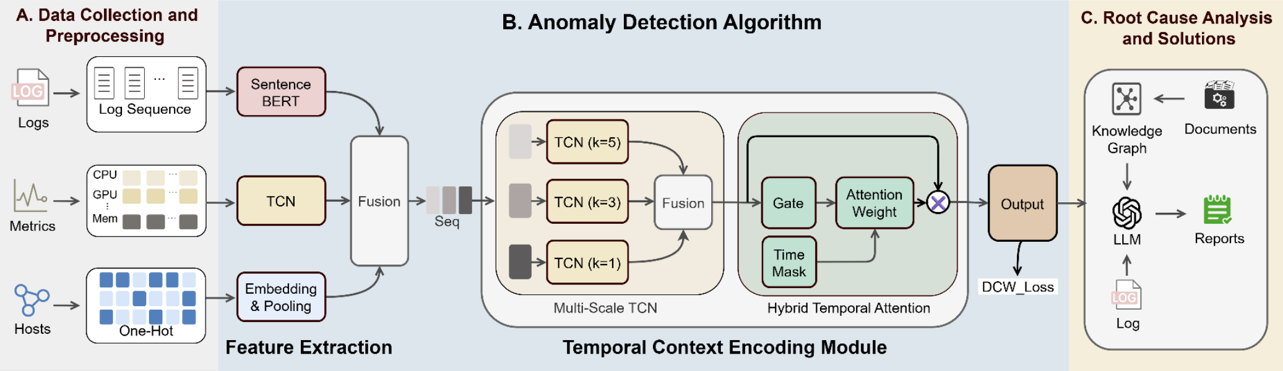
Approach
Logs: By aggregating logs from multiple machines and employing Log Parsing techniques, we convert unstructured logs into structured event sequences.
Metrics: We collected various critical performance metrics for each training task, specifically focusing on the 30minute window preceding an anomaly event.
Host Distribution Data: It captures the specific physical node allocation information for each training task.
Notes:
日志：通过聚合多台机器的日志并运用日志解析技术，我们将非结构化日志转换为结构化的事件序列。
指标：我们收集了每个训练任务的各种关键性能指标，特别关注异常事件发生前30分钟的时间窗口。
主机分布数据：该数据记录了每个训练任务的具体物理节点分配信息。

Slide 8
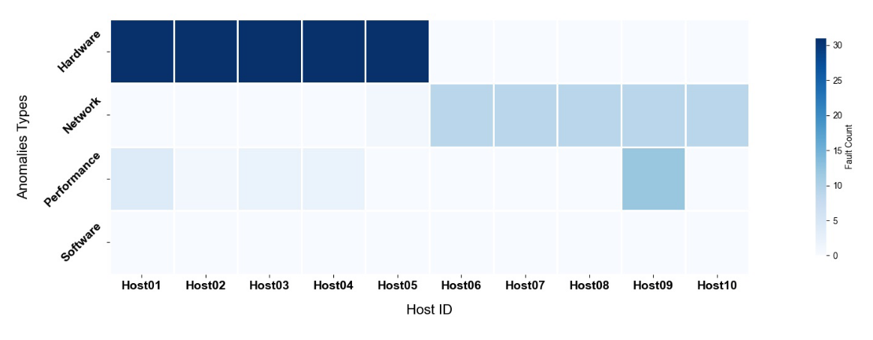
Approach
Our analysis revealed that distinct anomaly types exhibit clustering characteristics based on host distribution.
Hardware anomalies typically concentrate within a specific subset of nodes. We collected this data by recording the host lists assigned by the task scheduler, integrating it as a vital “spatial” feature into our system.
Notes:
我们的分析表明，不同的异常类型根据主机分布呈现出不同的聚类特征。
如图所示，硬件异常通常集中在特定的节点子集中。我们通过记录任务调度器分配的主机列表来收集这些数据，并将其作为重要的 "空间 "特征集成到我们的系统中。

Slide 9
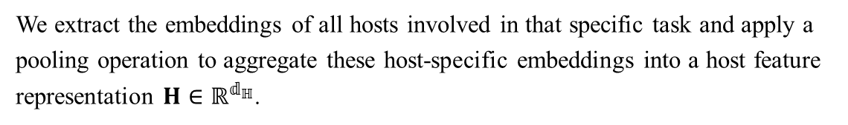
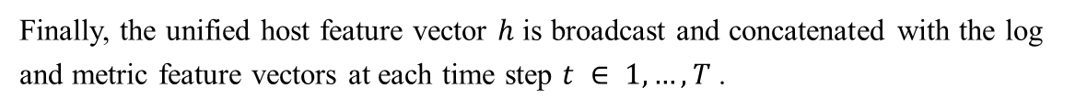
Multi-modal Feature Extraction and Fusion
We leverage a lightweight pre-trained Sentence-BERT model. Subsequently, a multi-head self-attention mechanism is applied to model long-range dependencies within the log data.
Log
Given their inherent time-series nature and the importance of local patterns, we employ a Temporal Convolutional Network (TCN) to encode the metric sequences.
Metric
We extract the embeddings of all hosts involved in that specific task and apply a pooling operation to aggregate these host-specific embeddings into a host feature representation $H∈ℝ^{𝕕_{ℍ}}$.
Host
Finally, the unified host feature vector $h$ is broadcast and concatenated with the log and metric feature vectors at each time step $t ∈ 1, …, T$ .
Notes:
为了在语义处理深度与计算效率之间取得平衡，我们采用了轻量级的预训练Sentence-BERT模型。随后，通过应用多头自注意力机制，对日志数据中的长程依赖关系进行建模。
鉴于其固有的时间序列特性以及局部模式的重要性，我们采用时序卷积网络（TCN）来对指标序列进行编码。
我们提取参与该特定任务的所有主机的嵌入向量，并应用池化操作，将这些主机特有的嵌入向量聚合为主机特征表示 𝐇∈ℝ^(𝕕_ℍ )。
最后，在每个时间步 𝑡 ∈ 1, …, 𝑇 上，将统一的主机特征向量 ℎ 进行广播，并与日志特征向量及度量特征向量进行拼接。

Slide 10
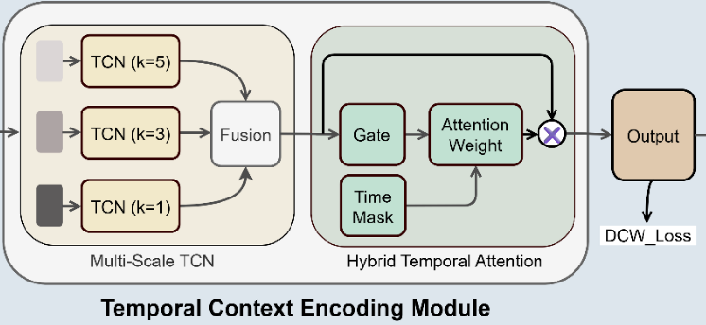
Temporal Context Encoding
Processing the fused feature sequences via a multiscale temporal convolution strategy.
The outputs from these segmented convolutions are then concatenated, forming a comprehensive feature representation that encapsulates diverse temporal granularities.
A Bidirectional Gated Recurrent Unit (Bi-GRU) is employed to process this concatenated representation. We introduce an adaptive hybrid temporal attention mechanism.
This mechanism dynamically modulates the model’s focus across different timesteps and features within the Bi-GRU’s output.
Notes:
通过一种新型的多尺度时域卷积策略处理融合后的特征序列。
随后，将这些分段卷积的输出结果进行拼接，从而形成一种涵盖多种时间粒度的综合特征表示。
采用双向门控循环单元（Bi-GRU）来处理该拼接表示。
我们引入了一种自适应混合时序注意力机制。该机制能够动态调节模型在Bi-GRU输出中不同时间步长和特征之间的关注点。
训练任务中的异常模式通常表现为多尺度的时间演变，且在接近故障点时往往呈现加速趋势。
关键在于，该机制倾向于将注意力集中在序列的后期时间步上，从而有效地优先处理潜在异常发生前紧邻时段的信息。

Slide 11



Dynamic Class-Weighted Loss Function
Traditional solutions can introduce biases or fail to adapt to the evolving data distribution during training.
We propose a Dynamic Class-Weighted(DCW) Loss function, which integrates label smoothing and a dynamic class weighting mechanism.
We employ Label Smoothing, converting rigid one-hot encoded targets into softer probability distributions:
To dynamically emphasize underperforming or underrepresented classes, we introduce a Dynamic Class Weighting strategy.
Notes:
传统的解决方案会带来偏差，或者在训练过程中无法适应不断变化的数据分布。
我们提出了一种动态类加权（DCW）损失函数，该函数融合了标签平滑和动态类加权机制，旨在有效处理类不平衡问题并提升模型鲁棒性。
我们采用标签平滑技术，将 “独热编码”目标转换为更柔和的概率分布：
为了动态强调表现不佳或代表性不足的类别，我们引入了动态类别加权策略。

Slide 12

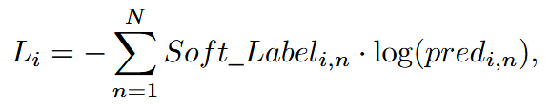
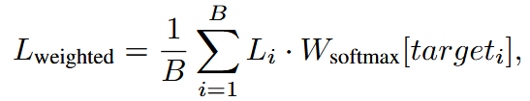
Dynamic Class-Weighted Loss Function
To modulate the sensitivity and distribution of these weights, we apply a temperature-scaled Softmax function:
Calculate the standard cross-entropy loss for every sample in batch:
Apply the class-specific dynamic weights to each sample based on its true class:
Notes:
为了调节这些权重的灵敏度和分布，我们应用了一个温度缩放的Softmax函数：
计算批次中每个样本的标准交叉熵损失：
根据每个样本的真实类别，对其应用相应的动态权重：

Slide 13
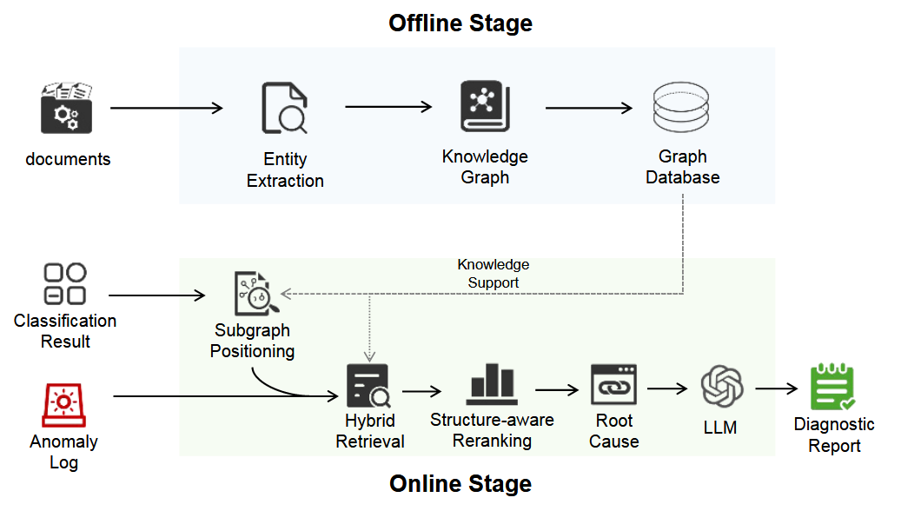
Root Cause Analysis and Solutions
Performs entity extraction on FAQ documents.
Converts them into semantic embedding vectors using Sentence-BERT models.
Constructs the knowledge graph and stores it in a graph database.
Notes:
对常见问题解答（FAQ）文档进行实体提取。
利用Sentence-BERT模型将其转换为语义嵌入向量。
构建知识图谱，并将其存储在图数据库中。

Slide 14
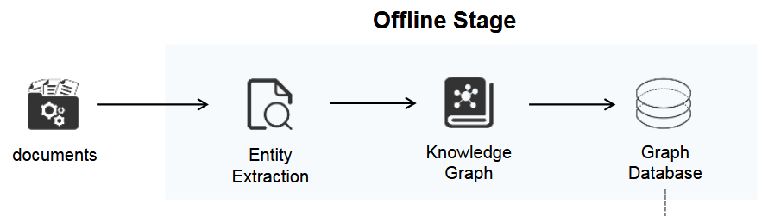
Root Cause Analysis and Solutions
i) Symptom Layer: stores specific fault phenomenon descriptions
ii) Root Cause Layer: contains fundamental causes leading to symptoms,
iii) Solution Layer: provides targeted remediation strategies and operational procedures.
Symptom -[:BELONGS_TO]-> FaultCategory
Symptom -[:CAUSED_BY]-> RootCause
RootCause -[:RESOLVED_BY]-> Solution
Notes:
i) 症状层：存储具体的故障现象描述
ii) 根本原因层：包含导致这些症状的根本原因
iii) 解决方案层：提供针对性的整改策略和操作流程。

Slide 15
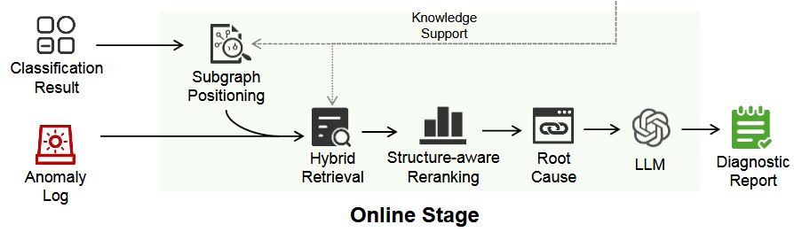
Root Cause Analysis and Solutions
i) Subgraph Positioning Stage: locates the target subgraph from the graph database based on classification results and anomaly logs.
ii) Hybrid Retrieval Stage: executes keyword matching and semantic vector retrieval in parallel within the determined subgraph, where keyword retrieval rapidly locates relevant nodes containing technical terms through Cypher queries, while semantic retrieval computes cosine similarity between anomaly descriptions and candidate node embedding vectors.
Notes:
i) 子图定位阶段：根据分类结果和异常日志，从图数据库中定位目标子图。
ii) 混合检索阶段：在确定的子图内并行执行关键词匹配和语义向量检索。
其中，关键词检索通过 Cypher 查询快速定位包含技术术语的相关节点；而语义检索则计算异常描述与候选节点嵌入向量之间的余弦相似度。

Slide 16
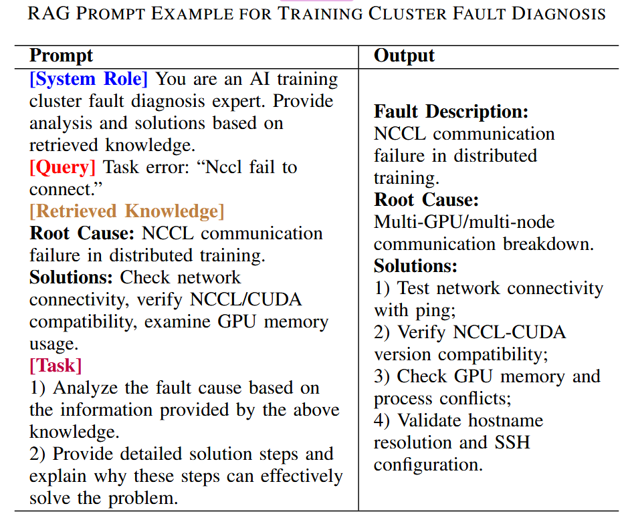
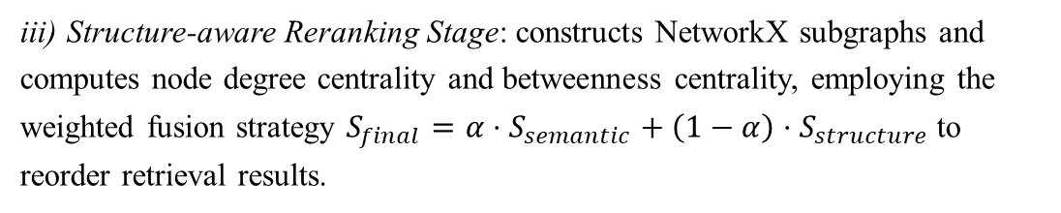
Root Cause Analysis and Solutions
iii) Structure-aware Reranking Stage: constructs NetworkX subgraphs and computes node degree centrality and betweenness centrality, employing the weighted fusion strategy $S_{final}=α⋅S_{semantic}+\left(1−α\right)⋅S_{structure}$ to reorder retrieval results.
iv) Retrieval-augmented Generation Stage: traverses knowledge graph relationships based on Top1 root cause nodes to extract corresponding solution nodes and related technical information.
Notes:
iii) 结构感知重新排序阶段： 构建 NetworkX 子图，并计算节点的度中心性与介数中心性，采用加权融合策略对检索结果进行重新排序。
iv) 检索增强生成阶段：基于Top1根本原因节点遍历知识图谱关系，提取相应的解决方案节点及相关技术信息。
通过模板化提示将结构化的根源分析结果和解决方案输入大型语言模型，如表 I 所示，生成包含故障描述、环境信息、问题原因和详细解决步骤的综合诊断报告。

Slide 17
Experiment
RQ1(Performance): What is the overall performance of KAIOPS in anomaly detection for industrial-scale AI training tasks?
RQ2(Robustness): How robust is KAIOPS in industrial scenarios characterized by extreme class imbalance?
RQ3(Data-wise Individual Contribution): What is the individual contribution of different data modalities within KAIOPS to the overall detection performance?
Notes:
RQ1（性能）：在工业级AI训练任务的异常检测中，KAIOPS的整体性能如何？
RQ2（鲁棒性）：在类不平衡极其严重的工业场景中，KAIOPS的鲁棒性如何？
RQ3（数据模态的个体贡献）：在KAIOPS中，不同数据模态对整体检测性能的个体贡献如何？

Slide 18
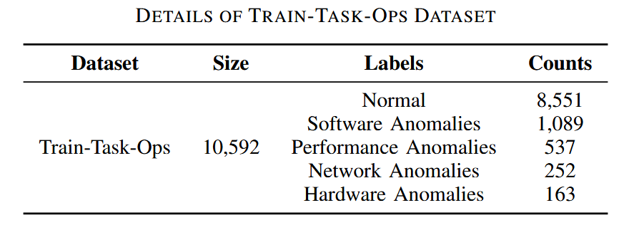
Experiment Setup
Dataset. Our study constructed and leveraged a unique, proprietary dataset collected from Kuaishou’s internal industrial-grade training platform.
Metrics. For RQ1 and RQ3, we use Precision, Recall, and F1-score as performance evaluation metrics. For RQ2, we use False Negative Rate (FNR) and False Positive Rate (FPR) to evaluate the model robustness.
Notes:
数据集。本研究构建并利用了一套独特的专有数据集，该数据集来源于快手内部的工业级训练平台。
评估指标。针对研究问题1和研究问题3，我们采用精确率、召回率和F1分数作为性能评估指标。针对研究问题2，我们采用假阴性率（FNR）和假阳性率（FPR）来评估模型的鲁棒性。

Slide 19
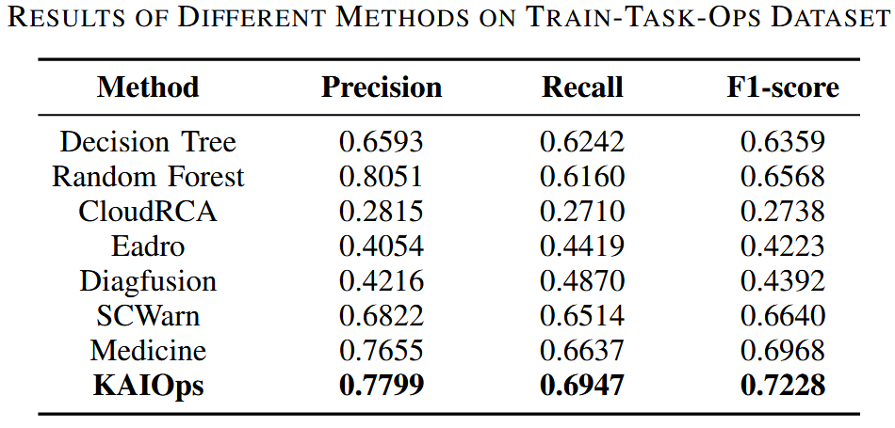
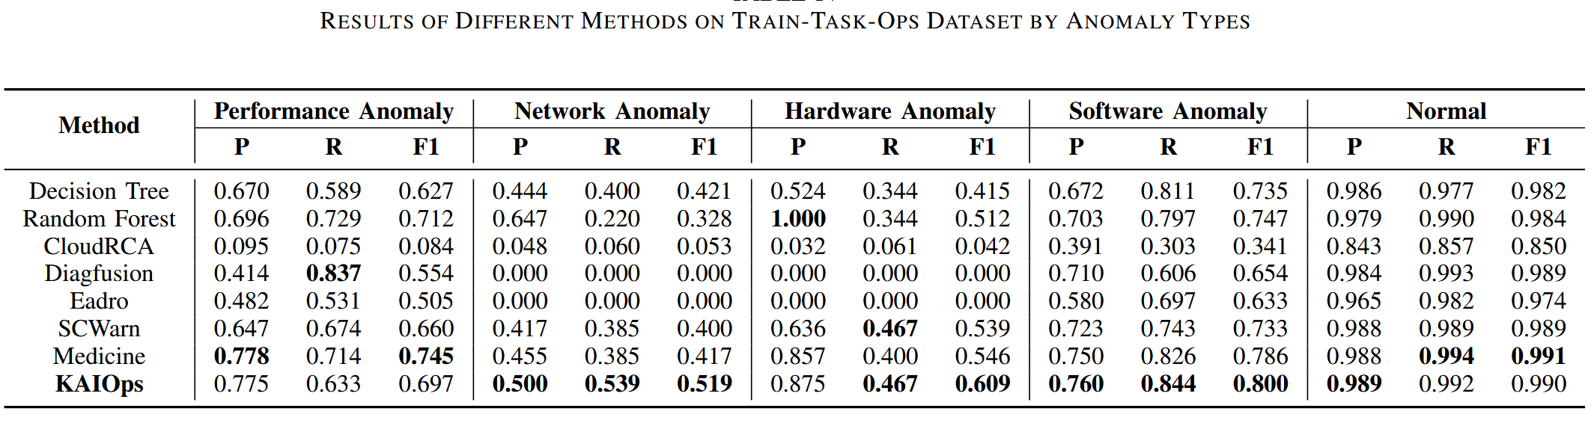
RQ1
Notes:
问题 1 的答案：KAIOPS 在 "训练-任务-行动 "数据集上的表现明显优于最先进的基线。这种优越性源于模式交互机制和针对训练任务场景独特特征的定制优化。

Slide 20
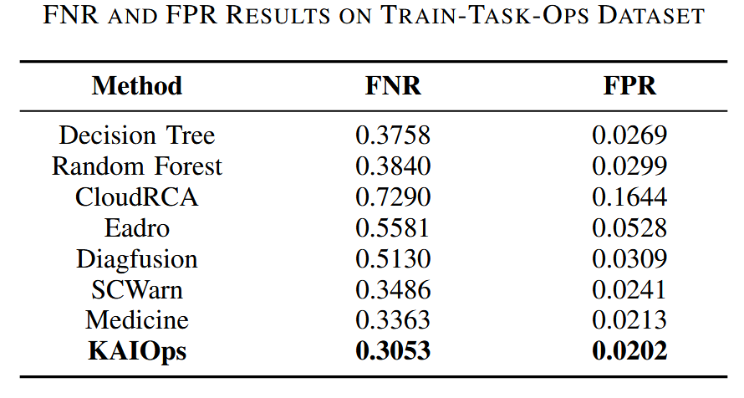
RQ2
A high FNR indicates the system’s failure to detect genuine anomalies.
A high FPR results in an excessive number of false alarms.
Notes:
较高的FNR值表明系统未能检测到真实的异常。较高的FPR值会导致过多的误报。
KAIOPS 在等级严重失衡的工业场景中表现出卓越的鲁棒性。它通过显著降低假阴性率（FNR）和假阳性率（FPR），有效地平衡了假阴性和假阳性，从而确保了检测结果的准确性和可靠性。

Slide 21
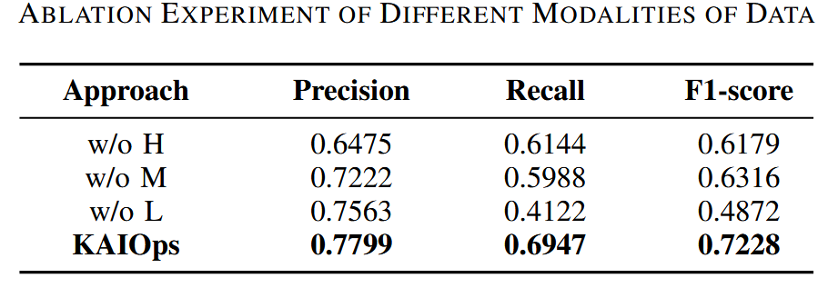
RQ3
The rich semantic information contained within logs for identifying fault root causes and complex anomaly patterns.
Performance metrics offer vital information regarding resource consumption and performance bottlenecks.
Host Distribution Data is more than merely providing additional features; it functions as a crucial calibration or discriminatory signal.
Notes:
日志中包含丰富的语义信息，可用于识别故障根本原因和复杂的异常模式。
性能指标提供了有关资源消耗和性能瓶颈的关键信息。
主机分布数据不仅提供了额外功能，还起到了关键的校准或判别信号的作用。
KAIOPS 中的所有数据模式对其整体检测性能都是不可或缺的，并显示出协同效应。这种多源异构数据的全面融合对于 KAIOPS 实现卓越的异常检测性能和准确的判别能力至关重要。

Slide 22
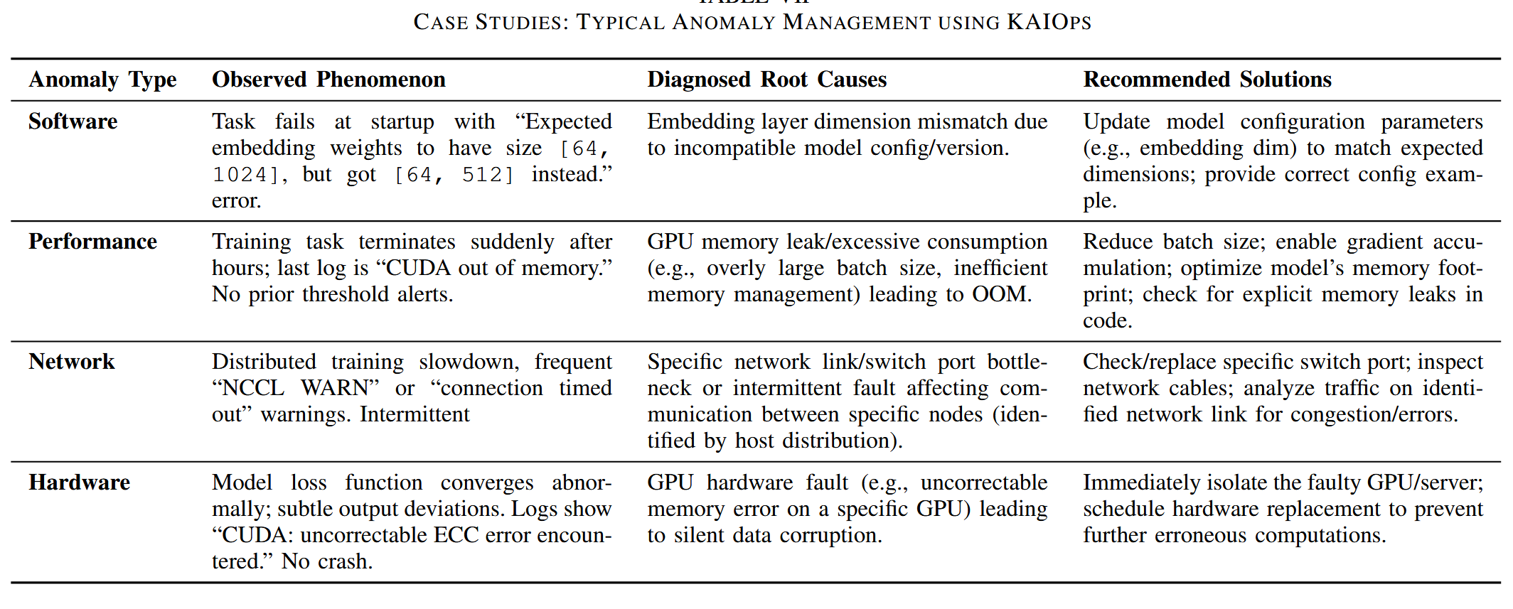
Case Studies
Notes:
我们通过具体案例研究验证了 KAIOPS 在各种异常情况下的卓越功效。
对于软件异常，如嵌入层维度不匹配导致的任务启动失败，KAIOPS 可利用其对日志语义的深刻理解以及与知识图谱的集成，迅速找出配置不一致的根本原因，并提供精确的修复建议。
在处理性能异常（如细微的 GPU 内存超出内存（OOM）问题）时，KAIOPS 的时间上下文编码模块可准确捕捉 OOM 事件发生前 GPU 内存利用率持续加速的细微趋势，从而实现早期预警并提出优化策略，有效防止任务崩溃和资源浪费。
对于普遍存在的网络异常现象（如 NCCL 连接问题），KAIOPS 会整合日志、度量指标及其独特的主机分布数据，以发现物理层网络链接瓶颈，精确定位根本原因，并提供有针对性的网络设备检查建议。
即使是细微的硬件异常，如 "CUDA: uncorrectable ECC error "等无声的 GPU 计算错误，KAIOPS 也能从最小的日志条目中检测到，即使没有明确的系统崩溃，也能及时定位故障 GPU，并建议隔离和更换。

Slide 23
Engineering Experience
Guaranteeing Model Training Stability. In large-scale AI training clusters – where jobs run for days/weeks across thousands of accelerators –runtime anomaly detection and diagnosis acts as a mission-critical safeguard.
Applicability and Generality. This can be simply achieved by adapting the multimodal data interfaces, i.e., using a unified observability stardard APIs, and by customizing their own representation learning and anomaly detection algorithm.
Notes:
确保模型训练的稳定性。在大规模 AI 训练集群中——任务会在数千个加速器上运行数天甚至数周——运行时异常检测与诊断是至关重要的保障措施。
适用性与通用性。这可以通过适配多模态数据接口（即采用统一的可观测性标准 API）并定制专属的表示学习与异常检测算法来轻松实现。

Slide 24

THANK YOU FOR LISTENING

